Slide 1
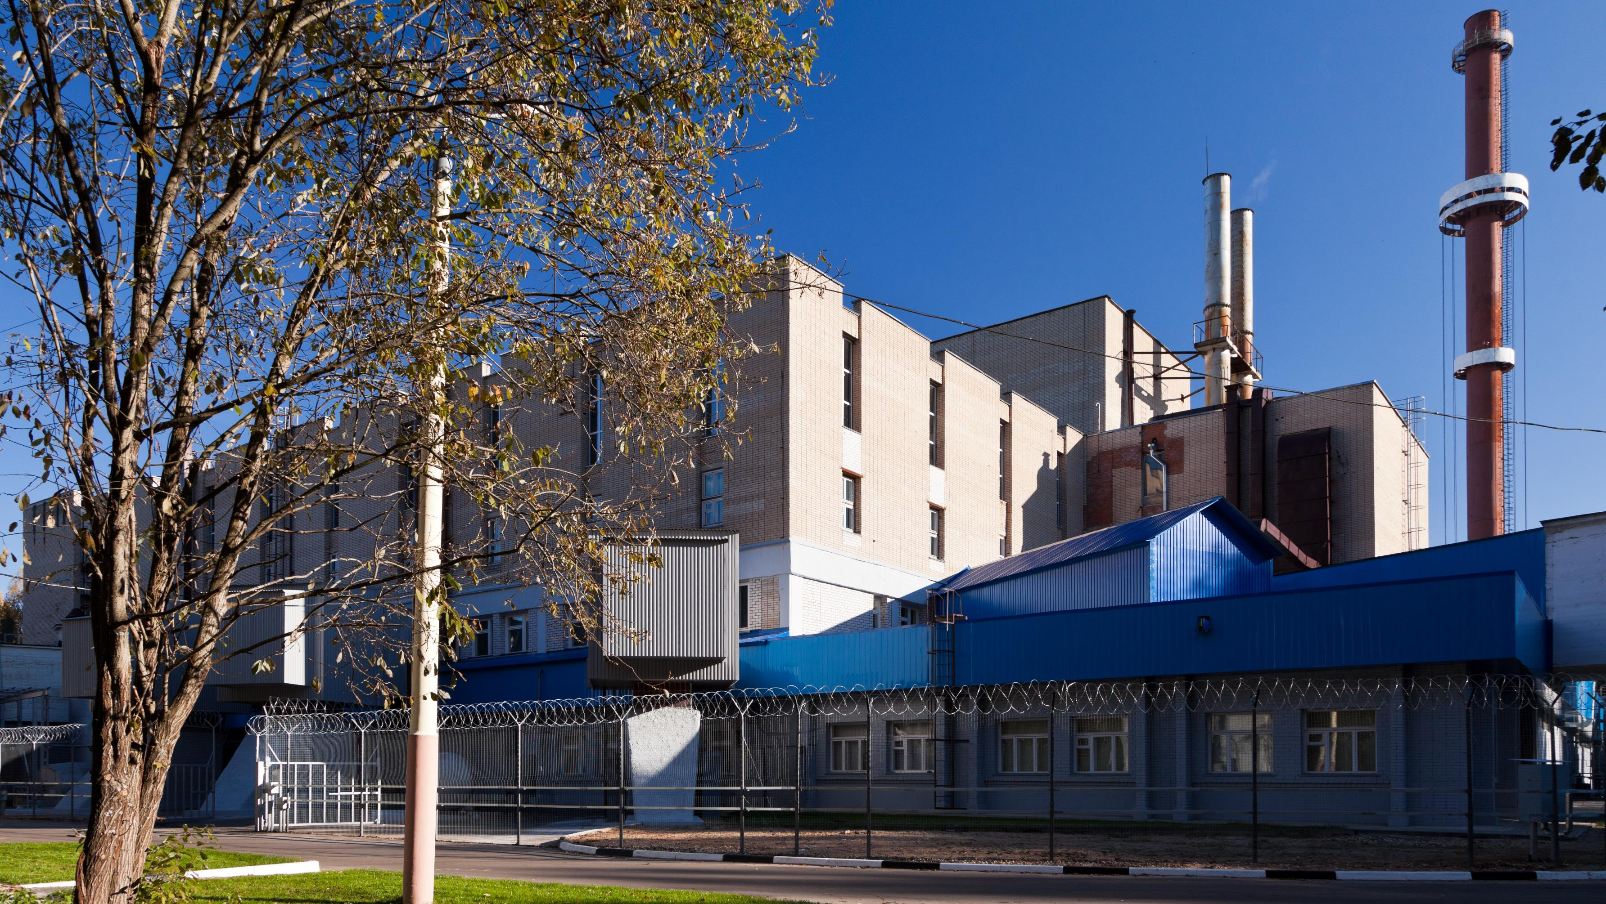
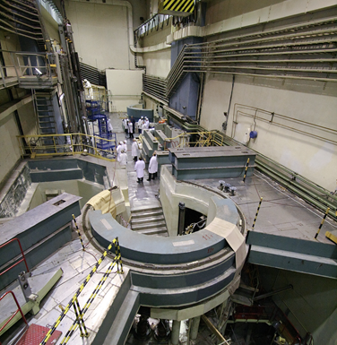
Frank Laboratory of Neutron Physics 2013-2018 results and perspectives for the future
V.Shvetsov

Slide 2
Frank Laboratory of Neutron Physics
536 staff personnel, 105 from non-Russia, average age 47 years;
21.22 M$ - 2018 annual budget, 45% - for the research;
Two scientific directions:
  Neutron nuclear physics;
  Condensed matter physics;
Methodic;
Basic facilities:
  IBR-2M;
  IREN;
About 250 papers published annually;

Slide 3
Staff personnel: hired

Slide 4
Staff personnel, age

Slide 5
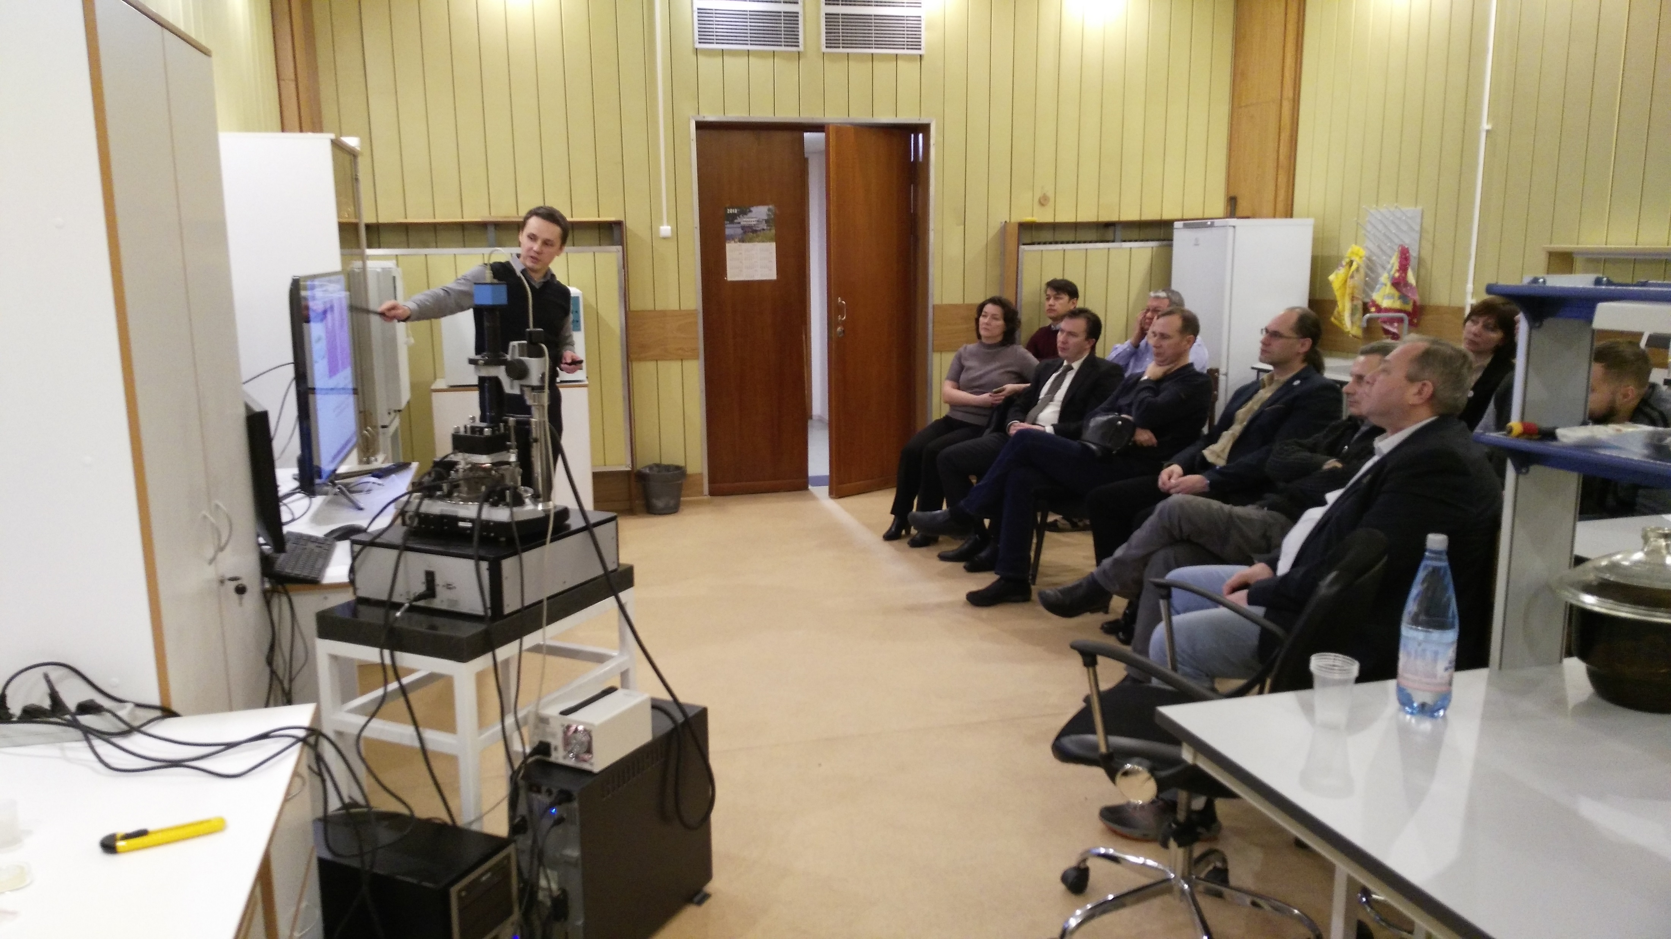
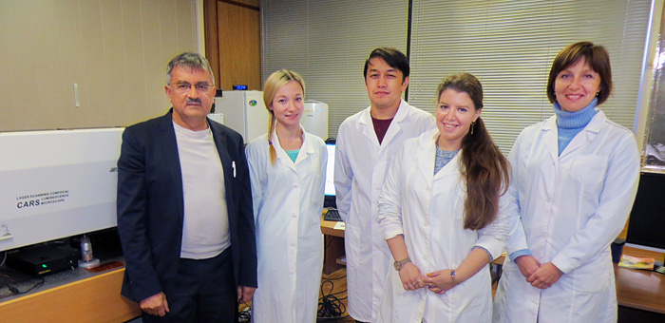
New sector: Raman Spectroscopy

Slide 6
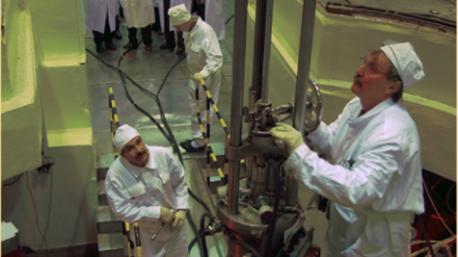
IBR-2 modernization
Any reactor has a limited lifetime because of the development of radiation fatigue of structural materials. In the middle 90s the program of modernization of the IBR-2 was initiated to replace the most part of its units. In 2007, the reactor reached the service life limit on fuel burn up and fluence on the reactor vessel and was shut down for modernization and replacement of the primary reactor equipment. The main objectives of the modernization were to increase safety, reliability and experimental possibilities of the reactor for the next 25 years of operation. By 2010 the installation of new equipment was completed and followed by a successful power startup. Now we have reactor lifetime extended to mid of 2030th.

Slide 7
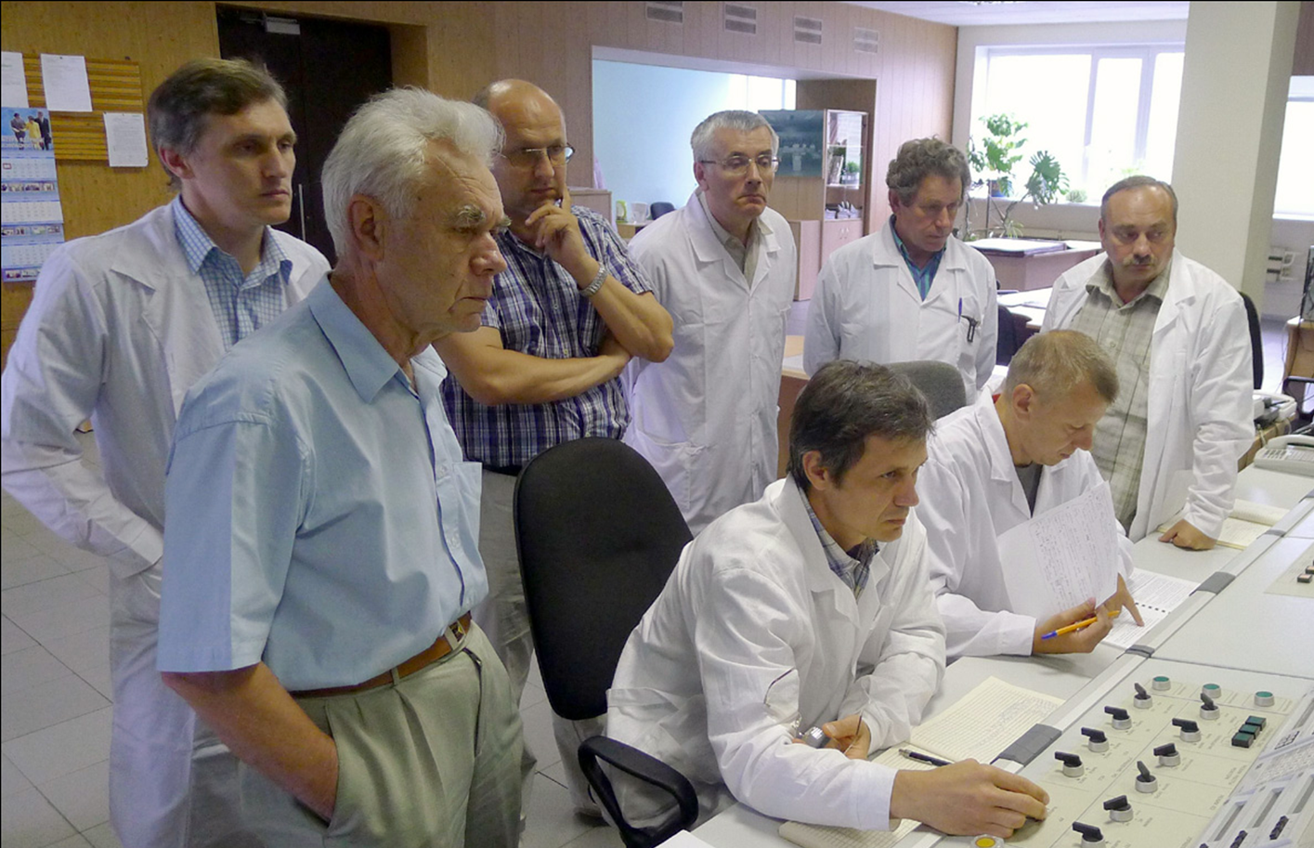
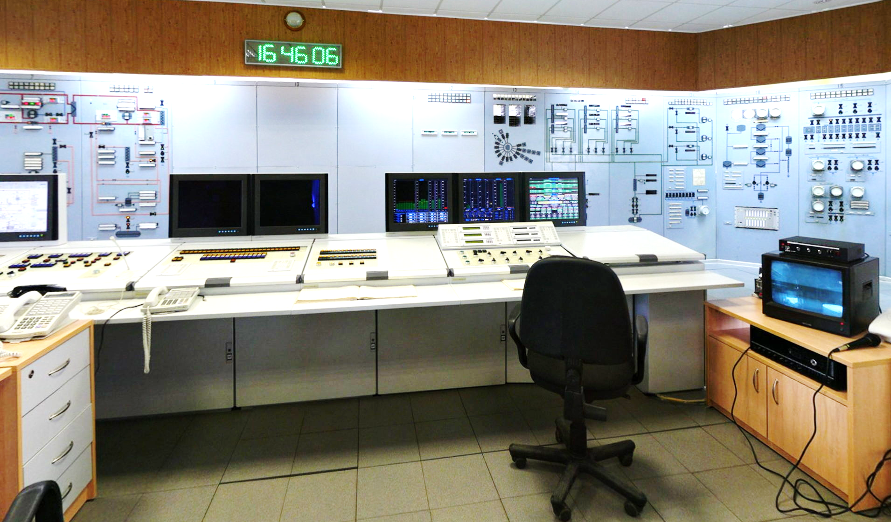
IBR-2 First Power June 2011
IBR-2 New Control Room

Slide 8
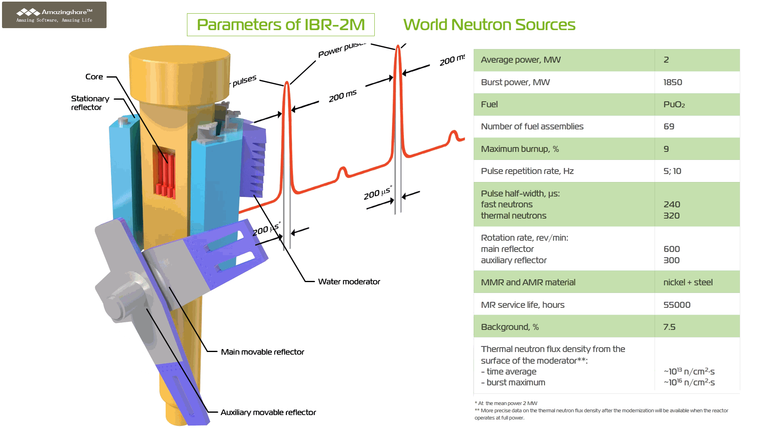

Slide 9
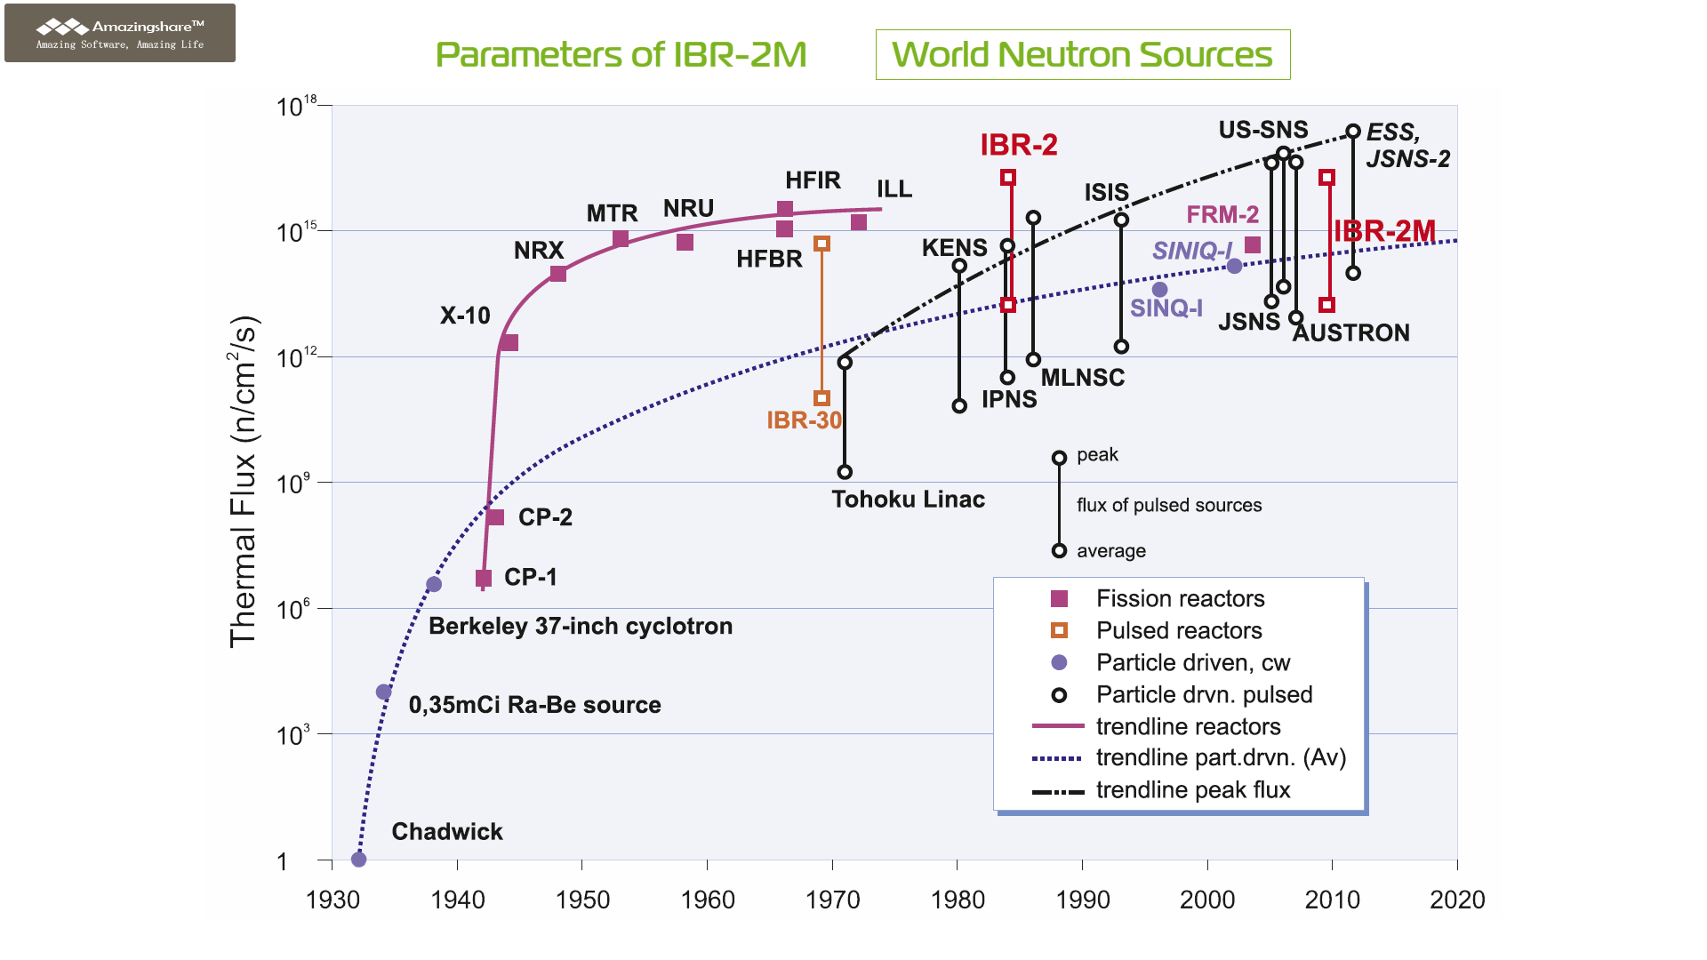

Slide 10
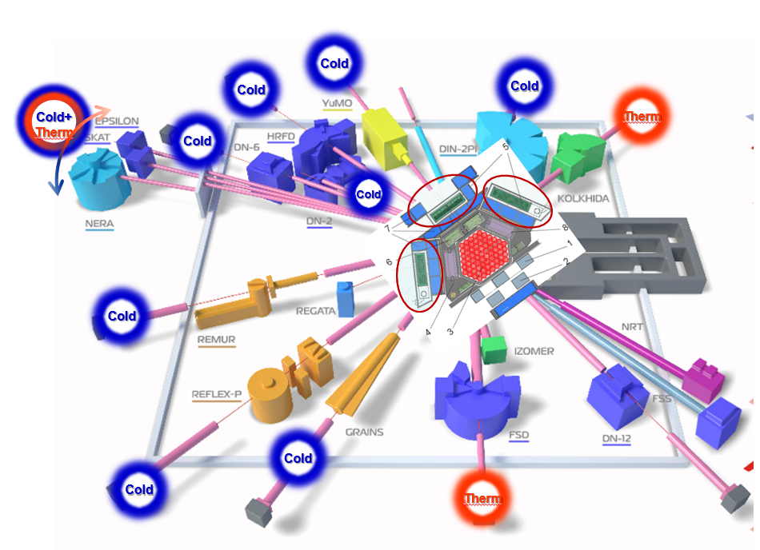
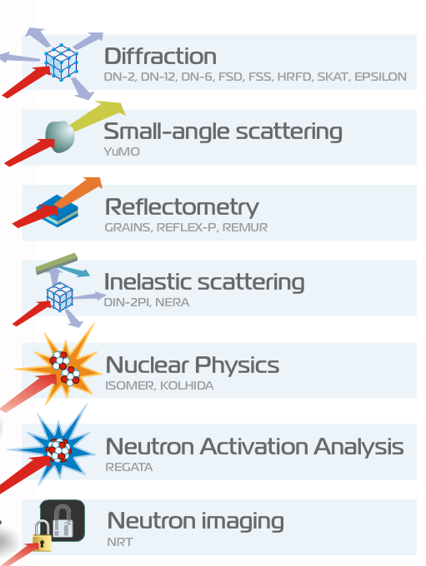
Complex of moderators of the IBR-2 reactor
(cold moderators and ambient temperature water moderators)

Slide 11
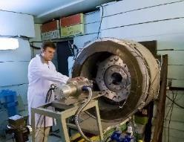
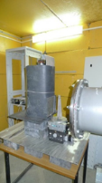
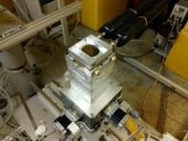
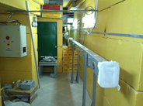
DN-6
diffractometer
NRT
spectrometer
New
New
GRAINS
reflectometer
FSS
spectrometer
New
New
microsamples under extreme conditions (P ≤ 0.5 Mbar)
radiography tomography
soft and liquid interfaces
bulk industrial components
new advanced materials
2016 – 15 instruments
+ 2 new
instruments for users
+ 64% more
applications for experiments
2016 user distribution by countries
2011 – 11 instruments
Notes:
After completion of the IBR-2 modernization, the development of the IBR-2 spectrometers’ complex became the first priority. Four new spectrometers were installed and two of them were included in the user program. A number of other spectrometers were upgraded. The number of instruments in open access system increased by 2, number of applications for experiments increased by 64% since 2011 up today.
После завершения модернизации реактора ИБР-2 первым приоритетом стало развитие комплекса спектрометров ИБР-2. В частности, начали свою работу четыре новых спектрометра, два из которых были включены в программу пользователей. Также модернизирован ряд других спектрометров. На сегодняшний день количество спектрометров доступных для пользователей увеличилось на 2, а число заявок на эксперименты увеличилось на 64% по сравнению с 2011 г..

Slide 12

FLNP User Program
 | 2015 | 2016 | 2017
Submited proposals | 197 | 238 | 221
Accepted proposals | 174 | 208 | 203
Countries | 15 | 11 | 11
Visitors | 84 | 107 | 115
 | 2015 | 2016 | 2017
Materials science | 26% | 2% | 36%
Physics | 40% | 37% | 32%
Chemistry | 12% | 31% | 12%
Applied science | 4% | 10% | 3%
Geosciences | 10% | 14% | 8%
Biosciences | 8% | 6% | 9%
Notes:
In 2017, within the framework of the User Program 221 proposals for conducting experiments were received from 11 different countries. 203 proposals were accepted for performance experiment.
Received proposals covered the broad spectrum of neutron research in: physics (32%), materials science (36%), chemistry, geosciences, biology and applied sciences. An decrease in the range of physics was observed.
It was also observed an increase in the number of publications resulting from experiments carried out on instruments working in our User Programme.

Slide 13
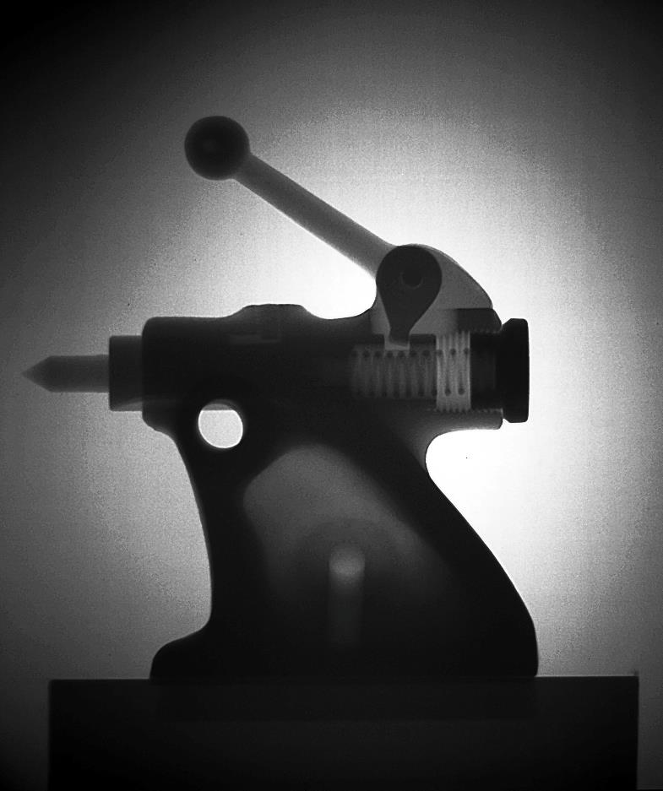
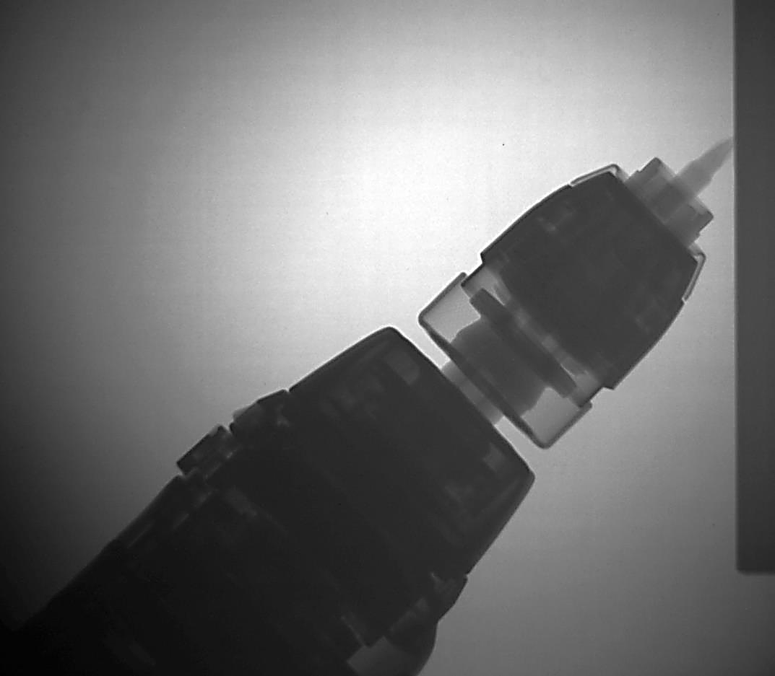
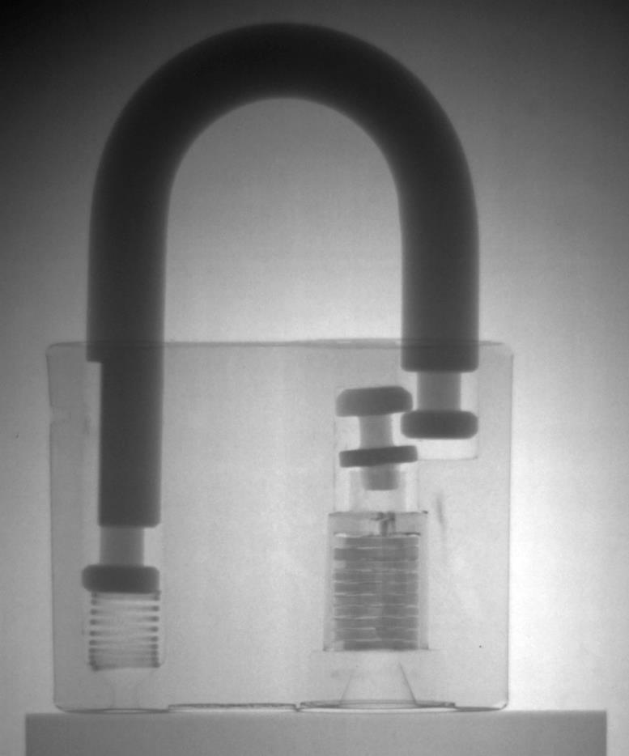
Введен в эксплуатацию канал №14

Slide 14
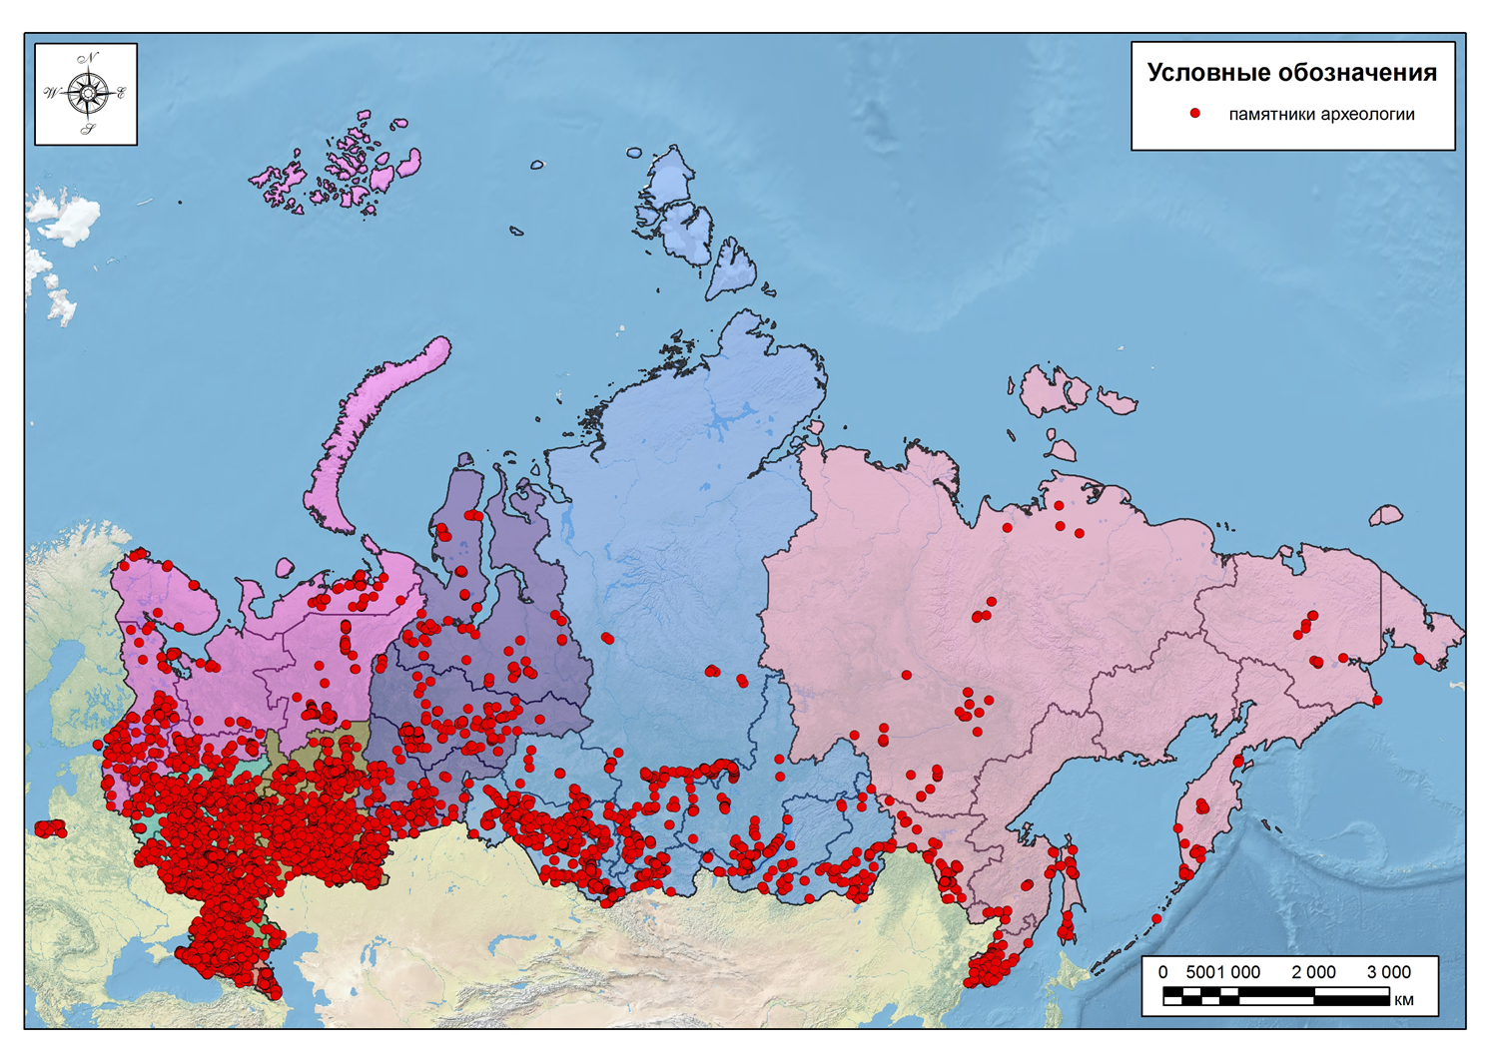
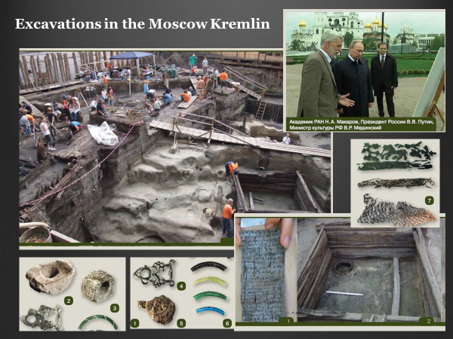
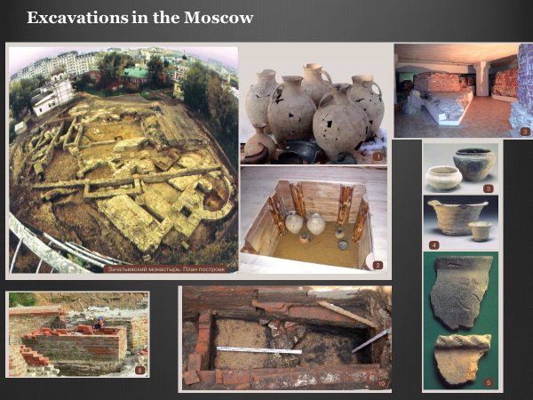
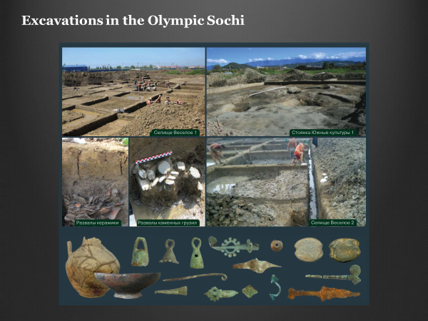
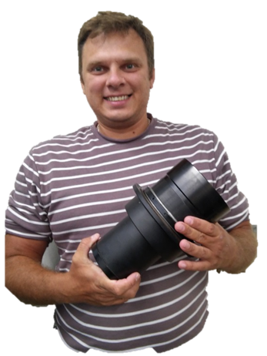
Neutron radiography and tomography at the Beam #14 are used to study archeological objects, especially metallic artifacts
S. Kichanov

Slide 15
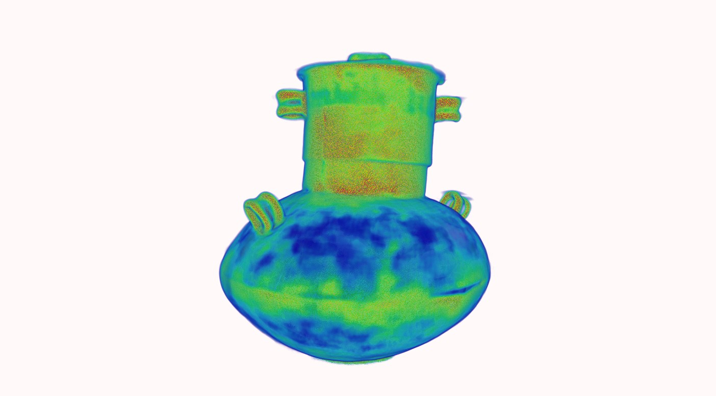
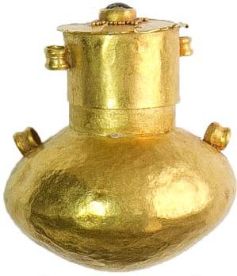
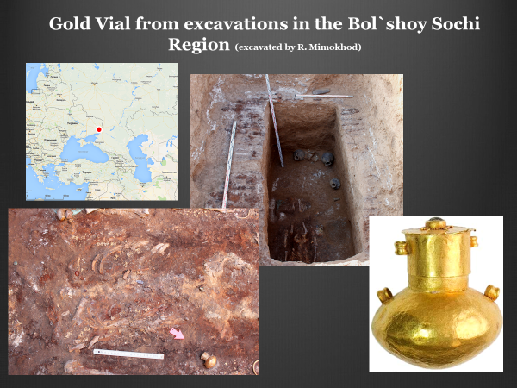
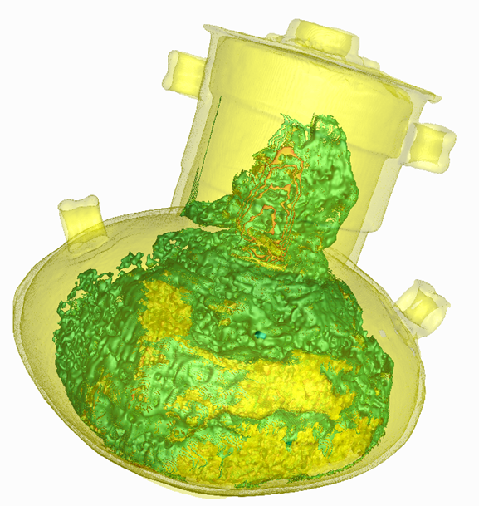
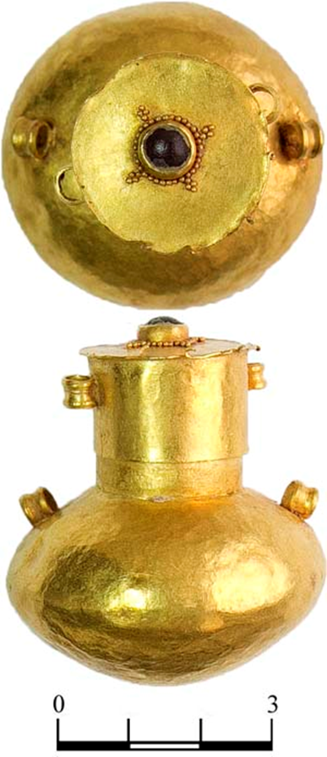
Areas with other composition of gold
traces of concealment
of a joint
Site of dispersed
joint
Site of dispersed
joint

Slide 16
Development of New Wide Aperture Back Scattering Detector ZnS(Ag)/⁶LiF, project within the theme 1122 (NEO KS)
Ω = 1.5 Sr
S = 13.5 m²
≈190 elements
R_{g}: from 0.0004
to 0.0009
Ring
W, str
0
0.050
∅
1
0.202
2
0.208
3
0.216
Geometrical contribution to the resolution function for sample of 5x5x5 mm³
4
0.225
5
0.237
1 | 2 | 3 | 4 | 5 | 6 | 7 | 8
3.7E-4 | 5.4E-4 | 6.1E-4 | 6.7E-4 | 7.3E-4 | 7.8E-4 | 8.3E-4 | 8.8E-4
6
0.252
7
0.202
8
0.221
Expected increase in the neutron counting rate is ~ 10 times
Σ
1.813

Slide 17
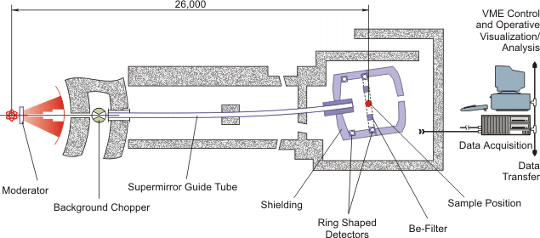
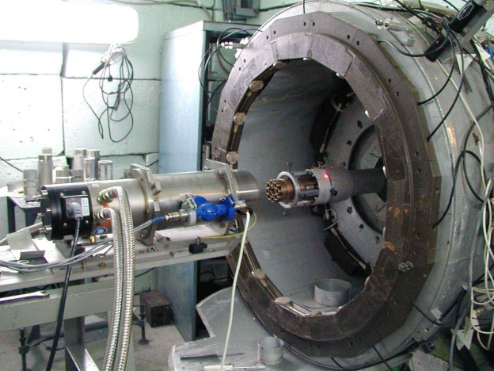
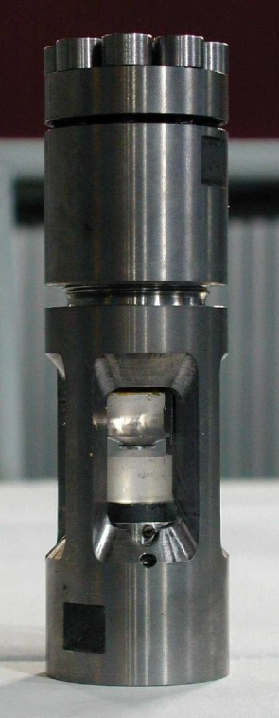
DN-12 Spectrometer for Studies of Microsamples
Neutron flux at sample position: 2⋅10⁶ n/cm²/s
Resolution at d = 2 Å, 2θ =90⁰: Δd/d = 0.02
D-spacing range: 0.8 - 13 Å
Pressure range: 0 – 7 GPa
Temperature range: 10 – 300 K
Simultaneous study of crystal and magnetic structure of materials
Pressure cell with sapphire anvils

Slide 18
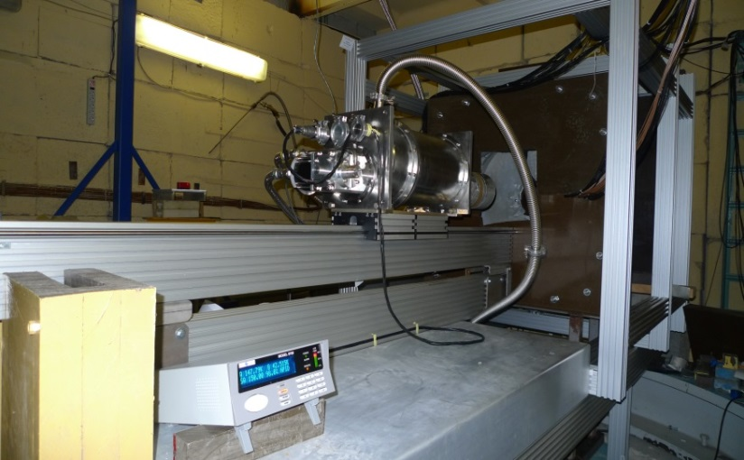
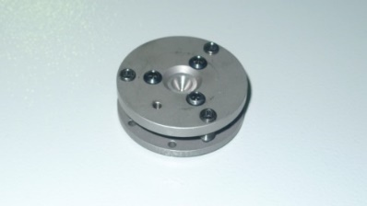
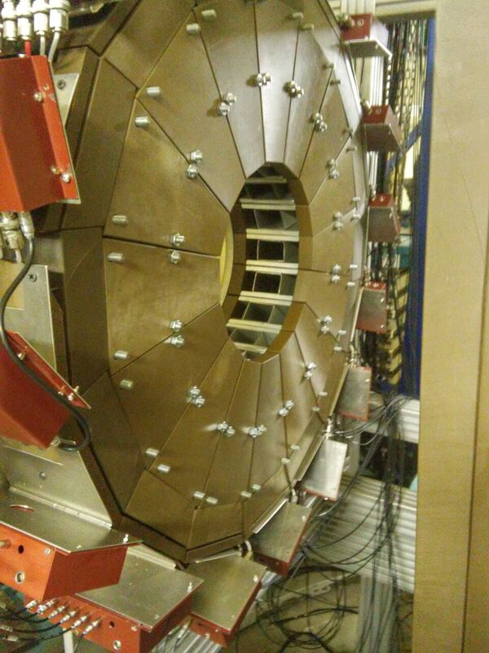
Diffractometer DN-6 for studies of microsamples under extreme conditions
DAC
Intensity gain: 12 times (compared to DN-12)
Pressure range: 30-50 GPa
Temperature range: 4– 300 K
Sample volume: 0.01-0.05 mm³
DN-6 diffractometer (operational from 2012
Second circular detector of DN-6, consisting of 96 separate ³Не counters
Neutron diffraction patterns of Cr₂O₃ sample measured in sapphire anvil cell up to 4.6 GPa
Neutron diffraction patterns of Cr₂O₃ sample measured in DAC up to 35 GPa

Slide 19
Further Development of DN-6: Installation of Neutron Parabolic Focusing Device (7 m length)
Neutron flux at sample position: 3⋅10⁷ n/cm²/s (with focusing device)
Resolution at d = 2 Å, 2θ =90⁰: Δd/d = 0.025
D-spacing range: 0.8 - 12 Å
Pressure range: 0 – 50 GPa
Temperature range: 4 – 300 K
Top level among relevant class of instruments, achievable pressure range comparable with SNAP (SNS)
The replacement of the remaining tail part of the mirror neutron guide (17 m) from m = 1 to m = 2 is planned. The expected additional intensity gain is ~ 2 times
The averaged incident neutron flux gain is ~ 6 times.
Multiplication factor compared to DN-12: 35 times

Slide 20
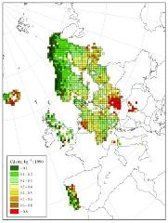
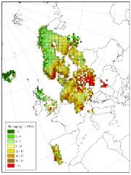
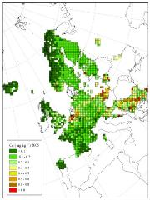
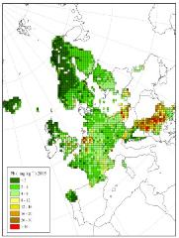

Cadmium
Lead
Mosses provide a complementary method to assess spatial patterns and temporal trends of atmospheric heavy metal deposition:
Carpet forming mosses receive
trace elements and nutrients mainly
from the atmosphere.
In recent years, the lowest
concentrations of heavy metals in
mosses were found generally in
northern Europe and the highest
concentrations in Belgium and
eastern Europe .
Europe-wide the concentration in
mosses of arsenic, cadmium,
lead and vanadium has declined
the most between 1990 and 2010,
with hardly any reduction being
observed for chromium and
mercury.
Temporal trends were country-
specific.
Spatial patterns and temporal trends
for cadmium and lead agree quite
well with those modelled by the
European Monitoring and
Evaluation Programme (EMEP).
-72%
-12%
-2%
1990
1990
-20%
Cadmium
Lead
-20%
-62%
2005
2005
-45%
-29%
-52%
-72%
ICP Vegetation Programme Coordination Centre
Notes:
Comparison of the Cd and Pb pollution in Northern Europe in 1990 and 2005. More than 50% decreased concentrations.
20

Slide 21
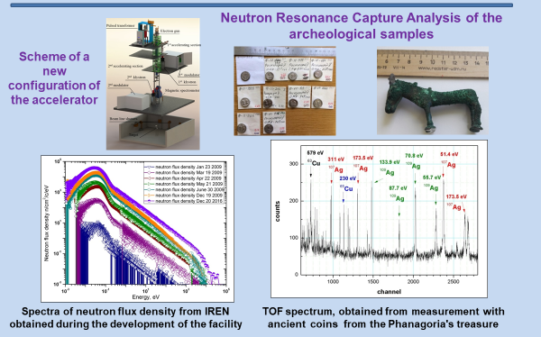
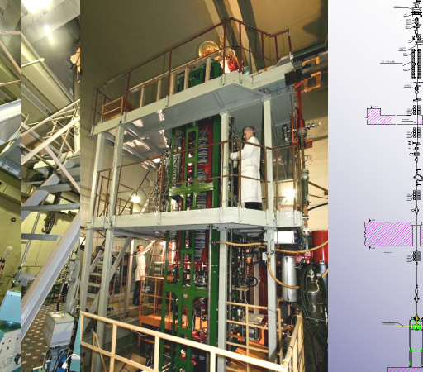
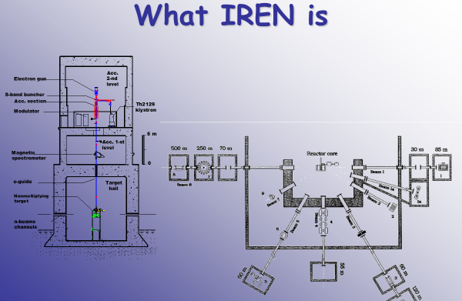
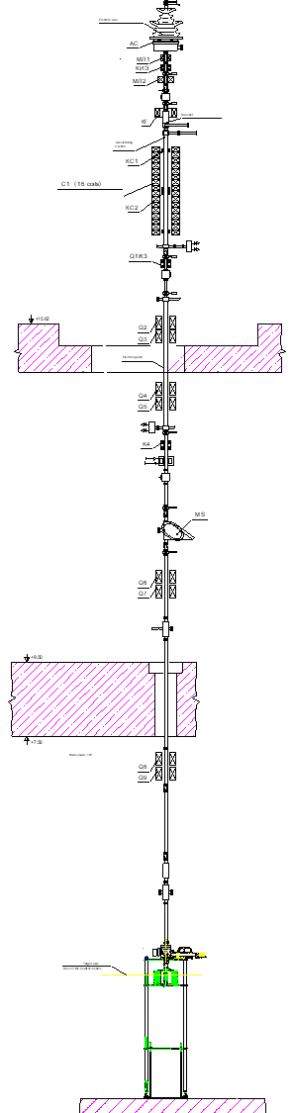
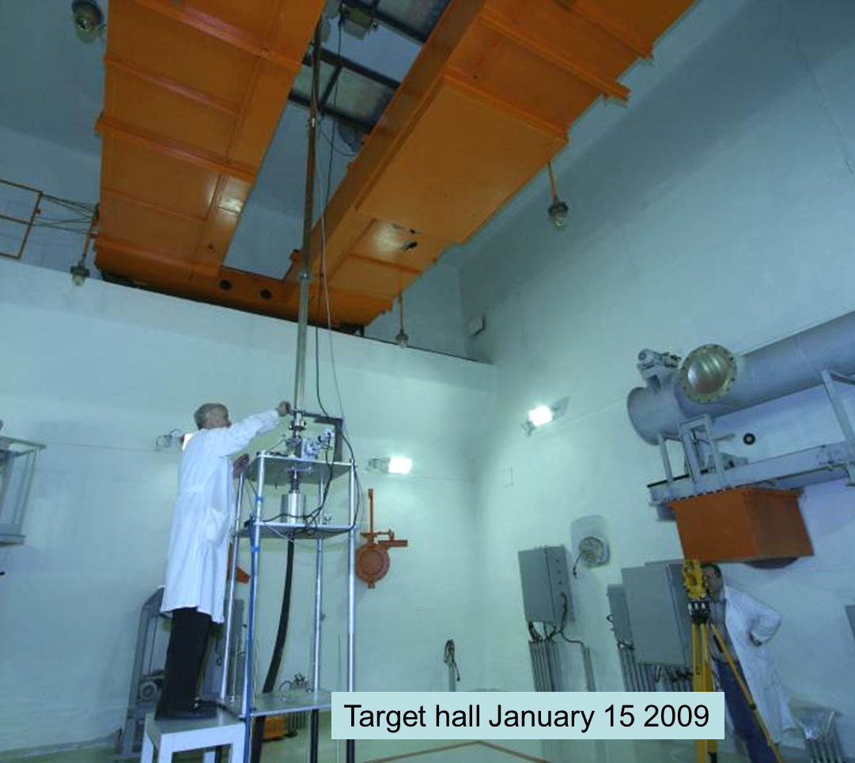

Slide 22
Preparation of the Conceptual Design Review of the New
Neutron Pulsed Source at JINR
IBR-2 lifetime is scheduled to 2032-2037 (depending on the operating mode);
Condensed matter studies by neutron scattering is one of three main scientific directions of the JINR;
Within next 20-30 years neutron beamtime in Europe and all around the world will decrease twice (Neutron scattering facilities in Europe. Present status and future perspectives, ESFRI PSE Strategy Working Group, Neutron Landscape Group, ESFRI Scripta Vol. I, 2016);

Slide 23
Basic Reference Data for the New Source
Technical idea: subcritical assembly driven by superconducting proton accelerator with 100 kW beam power;
Pulse duration: two options: short (20-30 μs) and long (200-300 μs);
Kick-off document is scheduled to be published by mid of 2019;

Slide 24
Conclusion
FLNP is well developing Lab with balanced budget and manpower resources;
IBR-2 will provide the possibility for research during at least 20 years from now;
During the last years Laboratory become more attractive for yong people from member-countries;
The main short-term goal is an upgrade of the IBR-2 instruments;
The main long-term perspective is the design and construction of the new JINR neutron source;

Slide 25
Thank you for your attention

