Slide 1
V.V. Korenkov
The 123rd Session of the JINR Scientific Council
22 – 23 February 2018

Slide 2
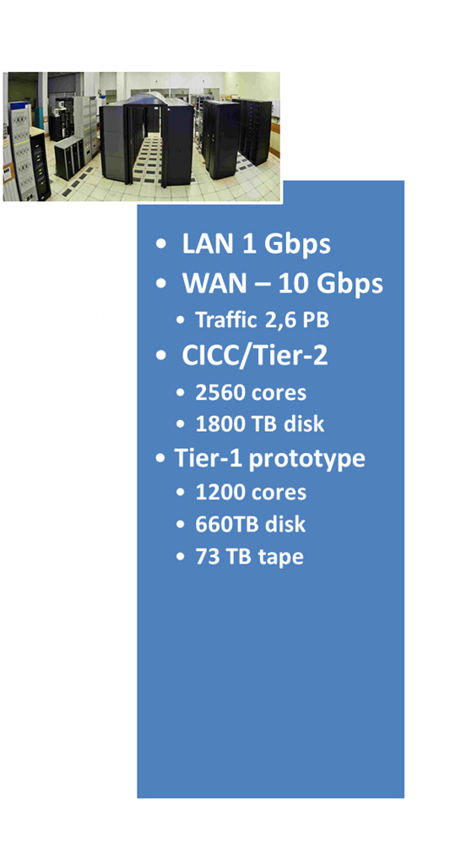
LIT resources from 2013 to 2017
During the last 5 years three new components have been put into operation:
2013
2017
Tier-1 center – JINR Basic Facility. One of 7 world centers for the CMS experiment.
JINR cloud infrastructure.
Heterogeneous computation cluster HybriLIT.
Increase of
LAN and WAN by 10 times
Traffic by ~10 times
computational nodes of CICC/Tier-2 and Tier-1 by 2 times
storage system by 3.5 times
Tape robot for 9 PByte was put into operation.
New engineering infrastructure.
Modernization of LIT building.

Slide 3
LIT personnel
Total | Scientists | Engineers | Workers
327 | 100 | 177 | 50
 | Total | From Russia | Outside Russia
Doctor of science | 26 | 21 | 5
PhD | 62 | 47 | 15
Scientists | 100 | 78 | 22
Students | 14
LIT publications
 | 2013 | 2014 | 2015 | 2016 | 2017
Journal publications | 194/96 | 213/79 | 192/84 | 221/103 | 214/119
Conference proceedings | 102 | 52 | 53 | 65 | 64

Slide 4
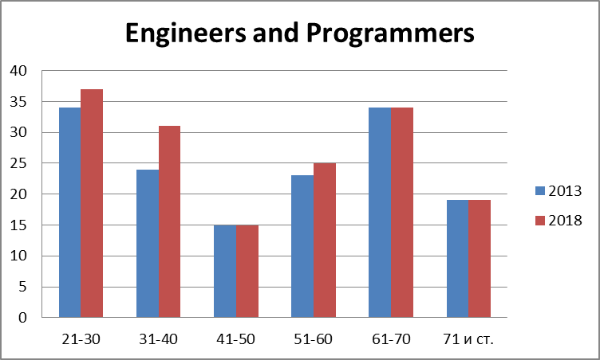
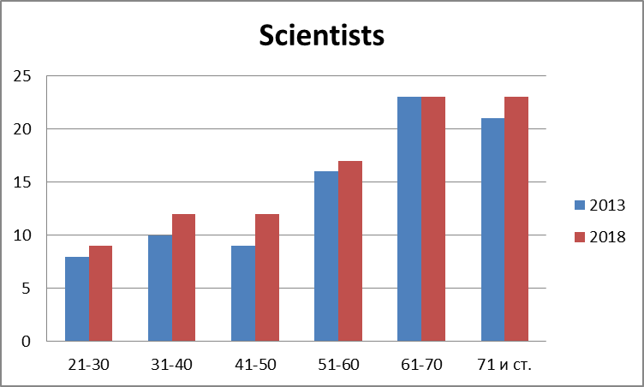
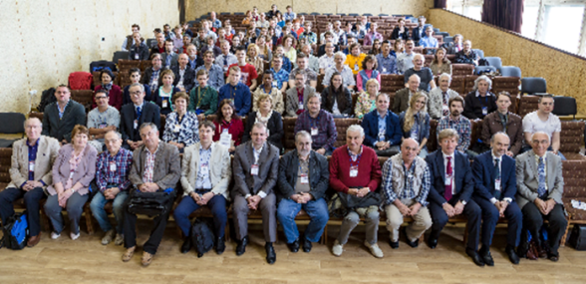
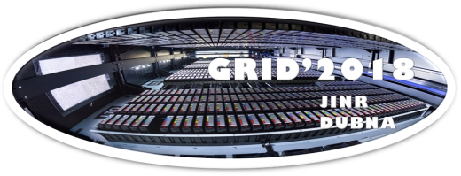
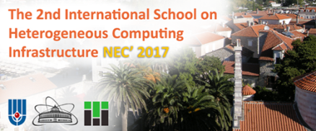
Problems, solutions, prospects
LIT structure, personnel, personnel certification
Information security
Licensing policy at JINR
Conferences, schools, courses, training
Dissertation Council

Slide 5
Problems, solutions, prospects
Concentration of efforts on the main directions of LIT development.
Effective use of budget resources, attraction of extra-budgetary funds (grants from RSF, RFBR, FСP, etc.).
Intensive international relations, especially with JINR Member States, by means of joint scientific programs, grants, scientific schools and conferences. Development of a system of training and advanced training of IT professionals for JINR and Member States.
Youth policy.
Attracting talented students from universities of Russia and JINR Member States for the preparation of master's theses on the subject of LIT. Activation at LIT of the basic chair “Distributed computing”. LIT will become an attractive center for talented and creative youth, where the young scientists will find good conditions for their professional growth.
Development of the system of improving of professional skills within the IT field.

Slide 6
Main goal for Seven-year plan for the development of LIT 2017–2023
Information Technology:
to carry out fundamental promising and advanced research in the field of distributed computing, computational mathematics and computational physics aimed at the creation and use of new computing platforms, the development of new mathematical methods, algorithms and software by addressing urgent problems arising in experimental and theoretical studies.
The solution of this task is closely related to a wide range of research conducted at JINR in high-energy physics, nuclear physics, condensed matter physics and nanotechnology as well as radiobiology and biophysics, and several other areas that require application and development of new approaches to modeling physical processes, processing and analysis of experimental data, including application in the studies within the NICA project, in the neutrino programme and in other strategic goals of the Institute.
Within the modern computerized world, the advancement of the development in this direction is fundamental for the progress in all the other areas of the JINR research.

Slide 7
Strategy of Information Technologies and Scientific Computing in JINR
Implementation of all tasks of the seven-year plan for the development of LIT 2017–2023
LIT IT-infrastructure is the one of JINR basic facilities
Multifunctional Information and Computing Complex
Strategy of Information Technologies and Scientific Computing in JINR is creating a scientific IT ecosystem that combines a variety of technological solutions, concepts and methodologies
New trends are Digital science, Digital Economics…

Slide 8
Promising directions of LIT development
Development of a computing model and a megaproject architecture (NICA, LHC, FAIR, PIC, ELI, SKA …).
Development of the architecture of distributed system of data storage, processing and analysis for experiments on the NICA complex.
CHALLENGE: distributed data storage evolution: DATALAKES.
CHALLENGE: R&D of software to acquire, manage, process, and analyze the big amounts of data to be recorded (HSF).
Parallel and hybrid computing, re-engineering of software packages for modern architectures.
Development of the PanDA platform as a universal environment for the large-scale projects.
Development of the systems of distributed monitoring and intelligent management.
Simulation of complex systems, quantum computing.
Development of modern data analysis methods (like Machine Learning, etc.). Development and implementation of Big Data methods and technologies.

Slide 9
THANK YOU FOR YOUR ATTENTION !

