Slide 1
46th meeting of the PAC for Nuclear Physics
Study of deep subcritical electronuclear systems and feasibility of their application for energy production and radioactive waste transmutation
S. Tyutyunnikov, A. A. Solnyskhin
Speaker: V. Wagner
Accelerator Driven Systems – still many challenges (nuclear data, models of spallation reactions, structural materials …)
Big steps in high-intensity accelerators, spallation targets (ESS project)
Important synergies with future spallation sources, fission and fusion systems

Slide 2
The Content
Introduction
Set up “Quinta” for research of deep subcritical system and it base tasks.
Main experimental methods producing by set up “Quinta” (only examples).
  Monitoring of input beam
  Activation techniques – high energy threshold reaction
  New type of detectors (track detectors, passive semiconductor detectors, breakdown structures diamond detectors)
  Thermomeasuring
The main results of experiments on setup "Quinta“ for 2013-2016 timeframe at the VBLHEP Nuclotron and LNP Phasotron
  increase hardness of the energy of the neutrons generated spectrum
  Significant discrepancy between experimental results and model calculations of the neutrons generated spectrum
  Spatial profile of neutron leakage
  Comparison of the energy characteristics of "Quinta" irradiation by deuterons and carbon
The main directions of the project "The quasi infinite target. Stage III. 2017-2019 ":
  Calculations of neutron leakage and energy efficiency
  Experimental investigations on LNP Phasotron, placement the assembly target “Big Uranium Target«
  Experimental research at the Nuclotron-M, power generation on setup "Quinta" on heavy ions.
  Work plan for 2017-2019 timeframe
Conclusion

Slide 3
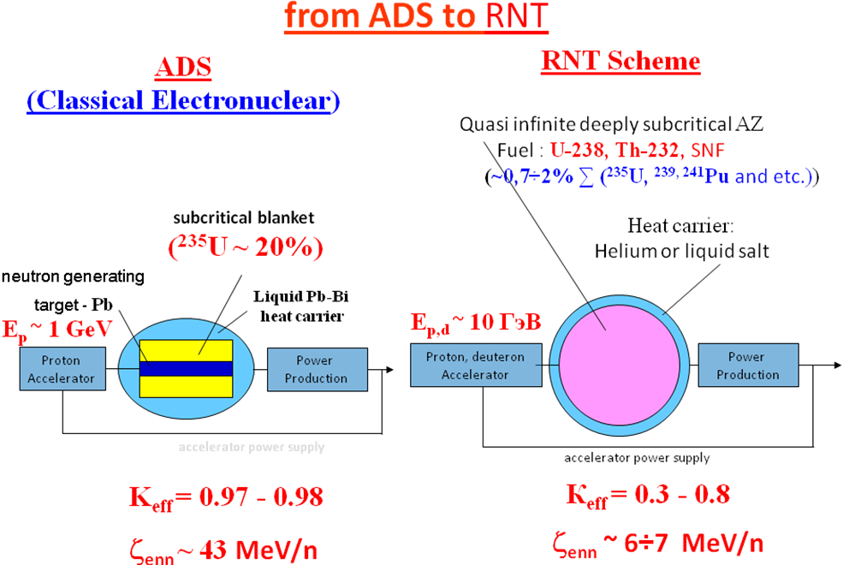
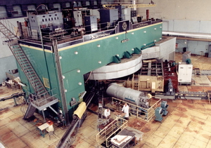
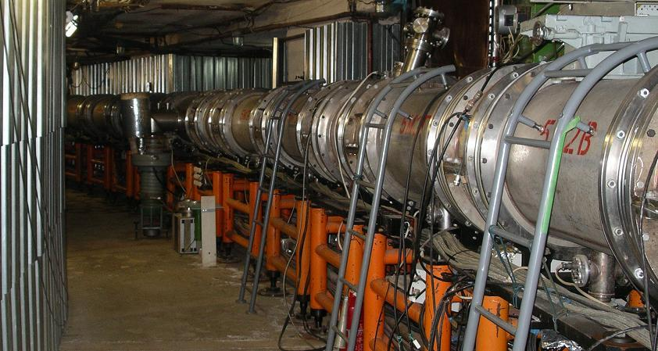
Introduction
JINR Dubna accelerators
ideal tools to test different schemes
Scheme of obtaining nuclear energy with the use of charged particles beams:
Classic electronuclear (ADS - Accelerator Driven Systems) scheme – proton accelerator (~ 1 GeV),
slightly subcritical reactor core (project MYRRHA)
RNT (relativistic nuclear technology) - extremely hard neutron spectrum formed by beams
of relativistic particles ~ 10 GeV inside deeply subcritical, quasi infinite reactor core.
Usage of heavier ions (~0,5 AGeV) – light element target core, relatively small target, compact system.

Slide 4
Basic experimental goals for setup "Quinta"
(Continuation of previous program with E+T set-up)
Determination of the energy spectrum of the neutrons generated in the uranium target with a beam of relativistic particles, a comparison of the experimental data with calculations based on different methods.
Determination of the spatial distribution of neutron leakage, their dependence on the energy of incident particles.
Measuring the energy yield from deeply subcritical assembly, its dependence on the energy of incident particles.
The study of transmutation of minor actinides by neutron spectrum generated in a deeply subcritical assembly.
Important methodical studies connected with beam monitoring
Main scientific goal: Accurate and reliable nuclear data – benchmark and
improvement of models and codes

Slide 5
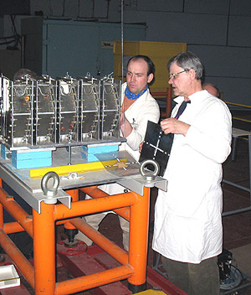
Not only scientific goals
International collaboration:
Russia, Czechia, Poland, Ukraine, Bulgaria, Belorussia, Armenia, Mongolia, Germany, India …
Nice possibility to obtain experience mainly for young people !
Diploma and PhD students education (Czechia):
Defended PhD (last ten years): A. Krása (2008), K. Katovský (2008), M. Majerle (2009), O. Svoboda (2011), L. Závorka (2015), J. Vrzalová (2016) and M. Suchopár (2017)
( + 3 PhD students from other countries)
Present PhD students: R. Vespalec, M. Zeman, P. Tichý, J. Svoboda + two more (September 2017)
More diploma thesis and also student practice
Our previous students (not only Czech):
V. Henzl, L. Závorka – Los Alamos (USA)
A. Krása – SCK-Mol (Belgium)
V. Pronskikh – Fermilab (USA)
Harpool Kumawat – BARC (India)
Lukáš Závorka – one of Czech PhD students and QUINTA

Slide 6
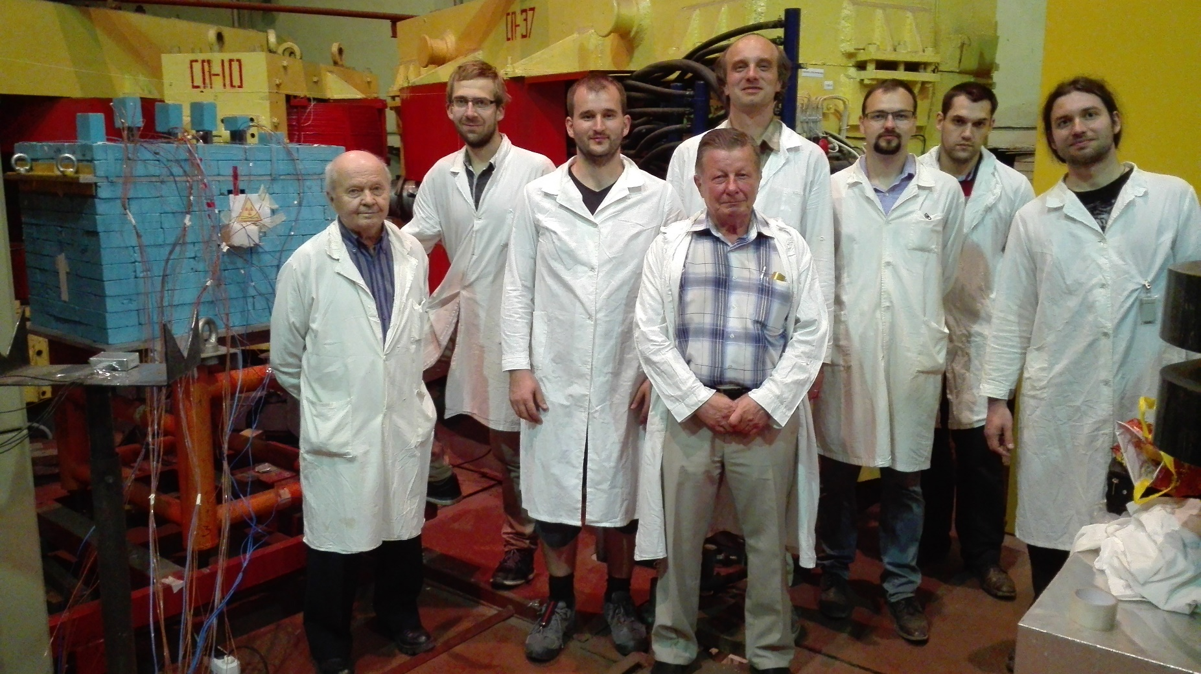
Set up QUINTA on LNP Phasotron and some of our students

Slide 7
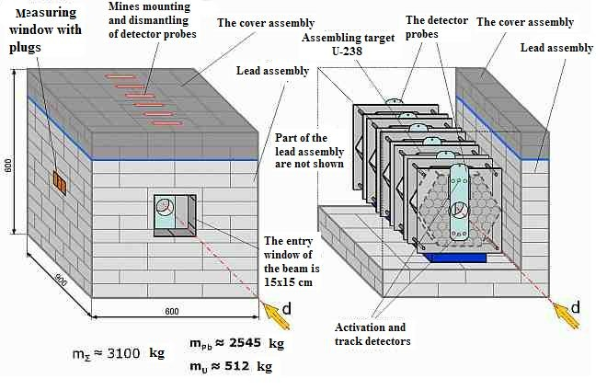
The “Quinta” target setup with the lead reflector

Slide 8
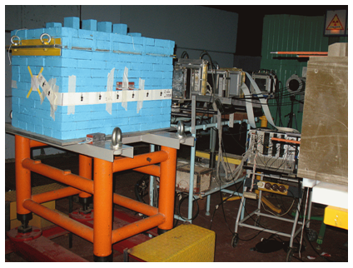
The “Quinta” target setup with the lead reflector on the irradiation position

Slide 9
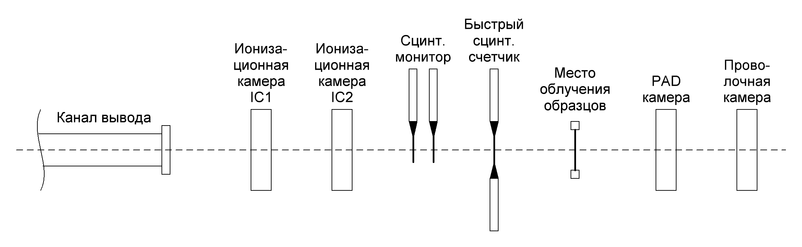
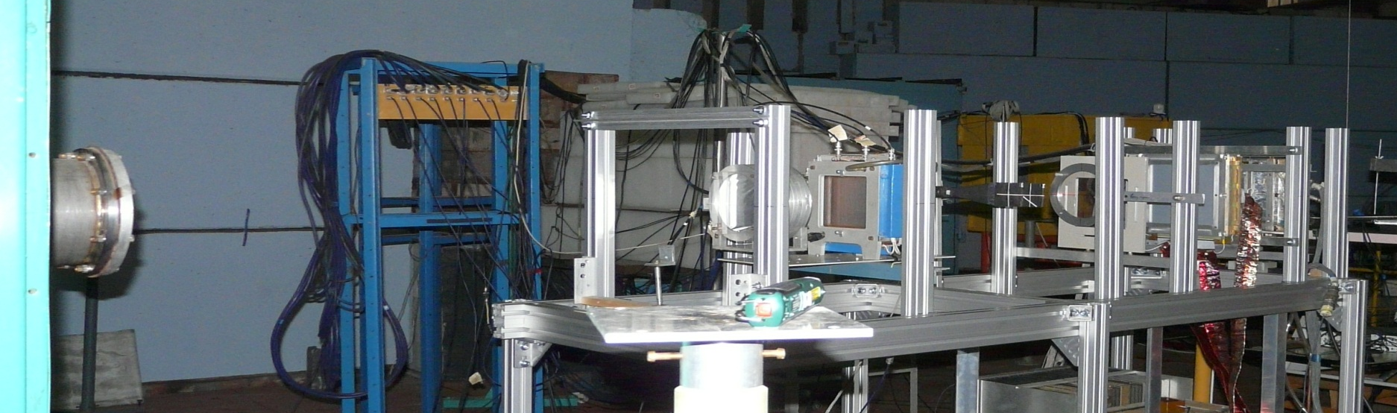
System of monitoring Nuclotron extracted beam for “Quinta” placement
fast scintillation counter
scintillation monitor
Ionization
chamber
Ionization
chamber
place of samples exposure
PAD chamber
Wire
chamber
Beam line
Al and Cu
monitors

Slide 10
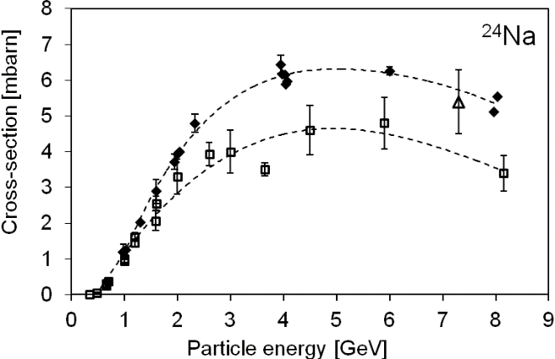
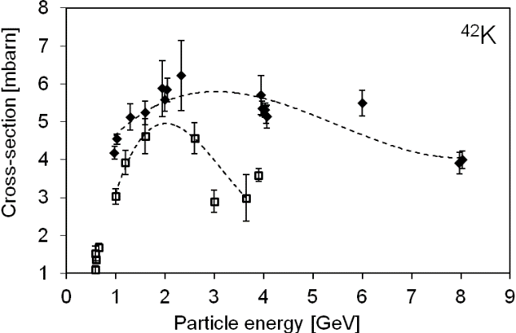
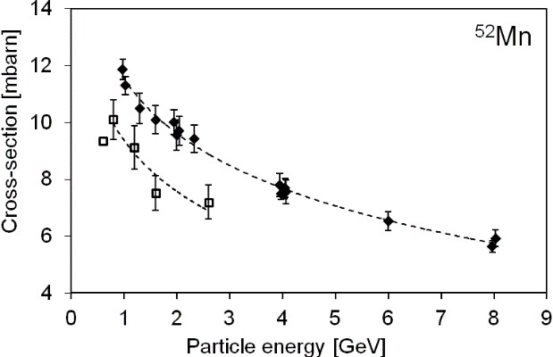
Monitoring of deuteron beam by copper activation detectors
Needed cross-sections were missing – we started to measure (only data for protons)
Overall 38 different radioisotopes were identified by their respective gamma lines (namely ⁷Be, ²²Na, ²⁴Na, ²⁸Mg, ²⁸Al, ³⁸S, ³⁸Cl, ³⁹Cl, ⁴²K, ⁴³K, ⁴⁷Ca, ⁴³Sc, ⁴⁴Sc, ^{44m}Sc, ⁴⁶Sc, ⁴⁷Sc, ⁴⁸Sc, ⁴⁸V, ⁴⁸Cr, ⁴⁹Cr, ⁵¹Cr, ⁵²Mn, ⁵⁴Mn, ⁵⁶Mn, ⁵²Fe, ⁵⁹Fe, ⁵⁵Co, ⁵⁶Co, ⁵⁷Co, ⁵⁸Co, ⁶⁰Co, ⁵⁶Ni, ⁵⁷Ni, ⁶⁵Ni, ⁶¹Cu, ⁶⁴Cu, ⁶²Zn, and ⁶⁵Zn)
Monitoring of deuteron beam by copper is possible
Nice data for nuclear models
M. Suchopár: NIM B344 (2015) 63

Slide 11
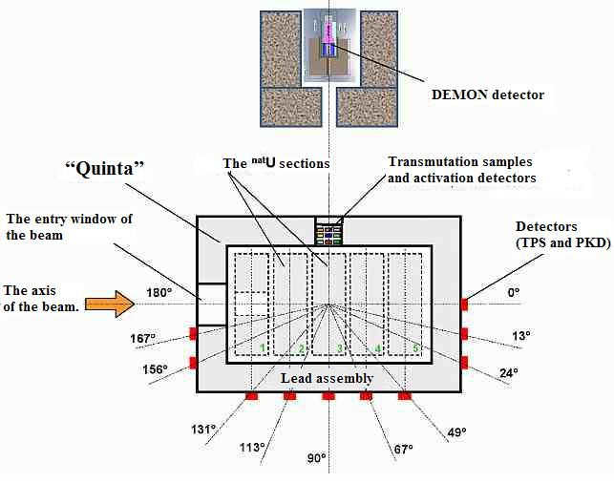
The scheme of leaking-neutron flow measuring with the TDC and PSD detectors and its energy spectra measuring with the DEMON detector. Top view. The detectors are located in the horizontal plane of the deuteron beam.

Slide 12
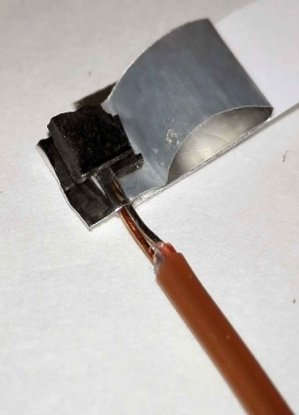
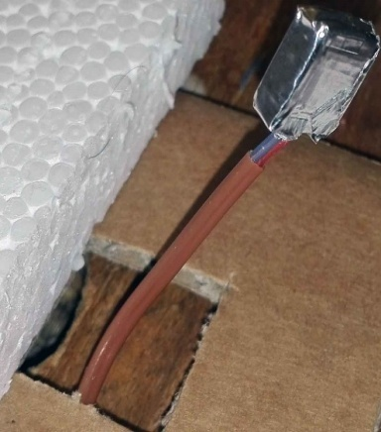
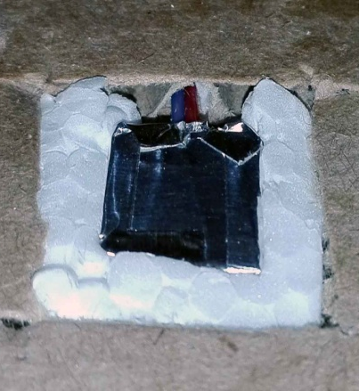
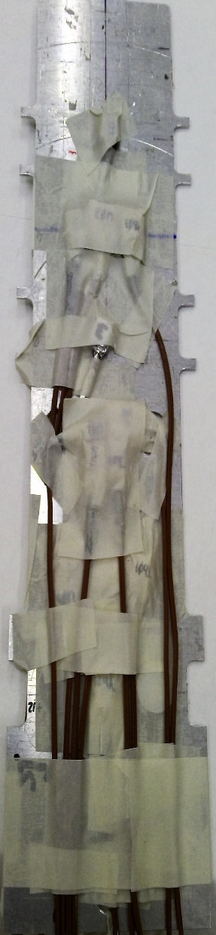
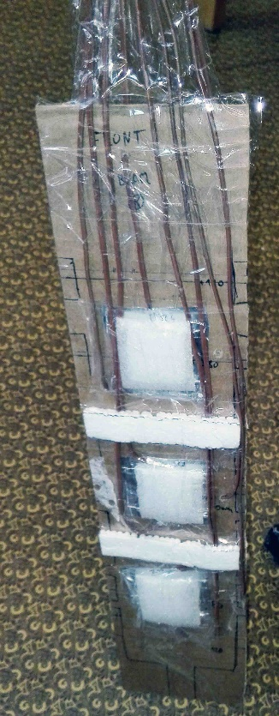
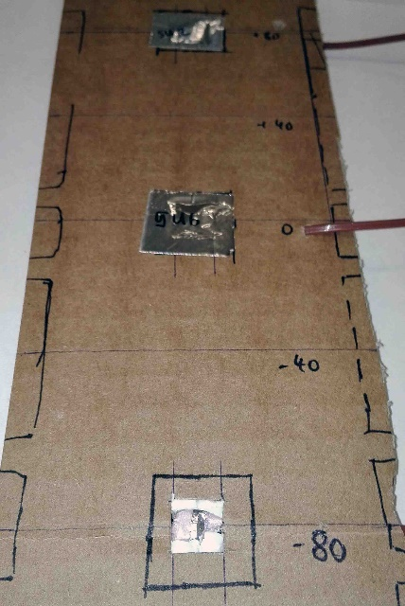
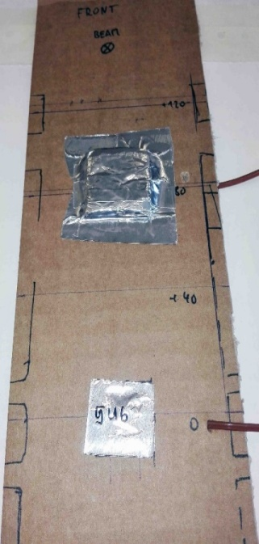
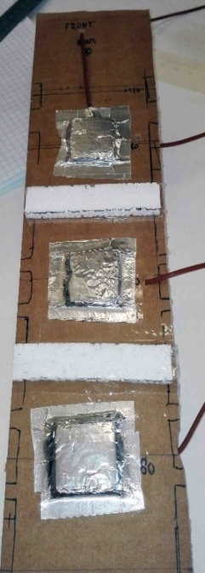
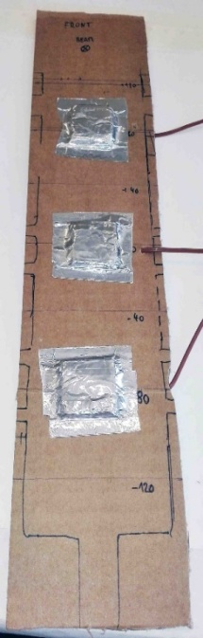
Thermocouples setup
December 2015
March 2016

Slide 13
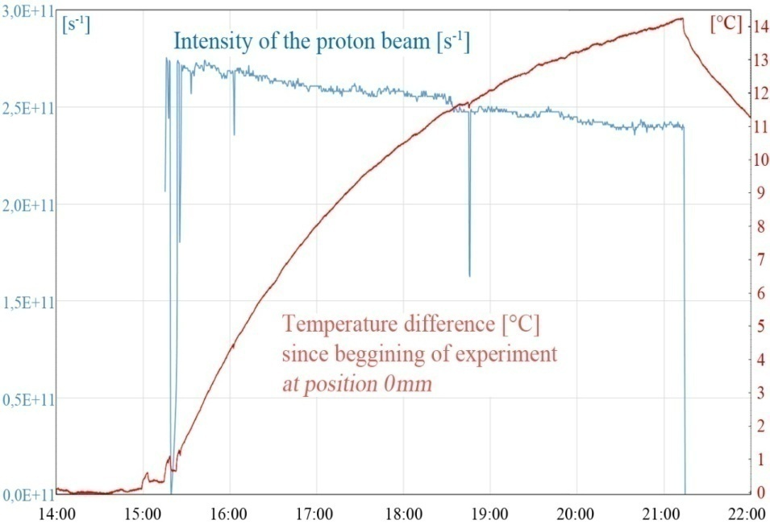
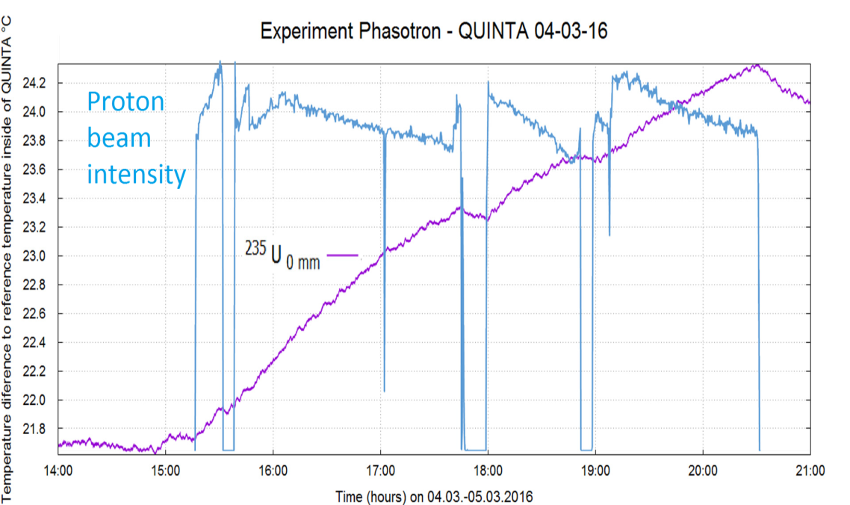
Drops of the proton beam intensity are well reflected by temperature
December 2015 March 2016

Slide 14
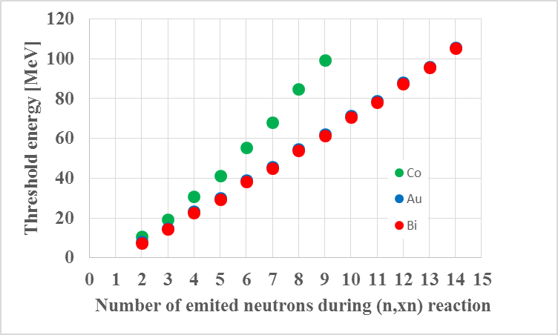
Spatial distribution of neutron field
Detailed methodology of activation detector usage – analysis, neutron spectra deconvolution
Very extensive set of activation detectors in many places
Threshold reactions up to 90 MeV threshold (Au, Bi)
Knowledge of excitation functions of (n,xn) is really needed
Important synergies with studies by means of NPI Řež and other European neutron sources
¹⁹⁷Au(n,8n) ¹⁹¹Au

Slide 15
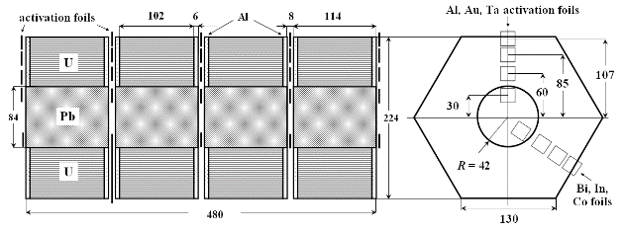
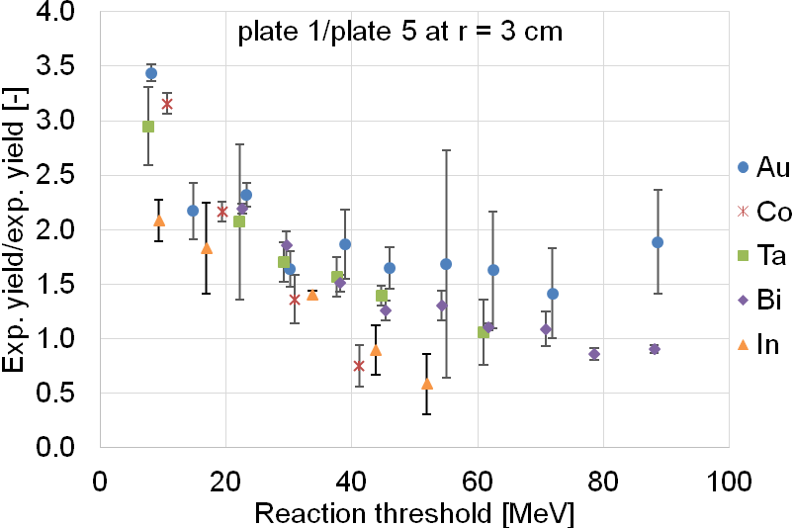
Hardening of neutron spectra derived by (n,xn) reactions
The E+T set-up, deuterons 4 GeV,
very extensive set of activation detectors
1
5
Ratios of yields in front of the target (at L = 0 cm) and behind the target (at L = 48 cm) 3 cm over the target axis as a function of threshold energy

Slide 16
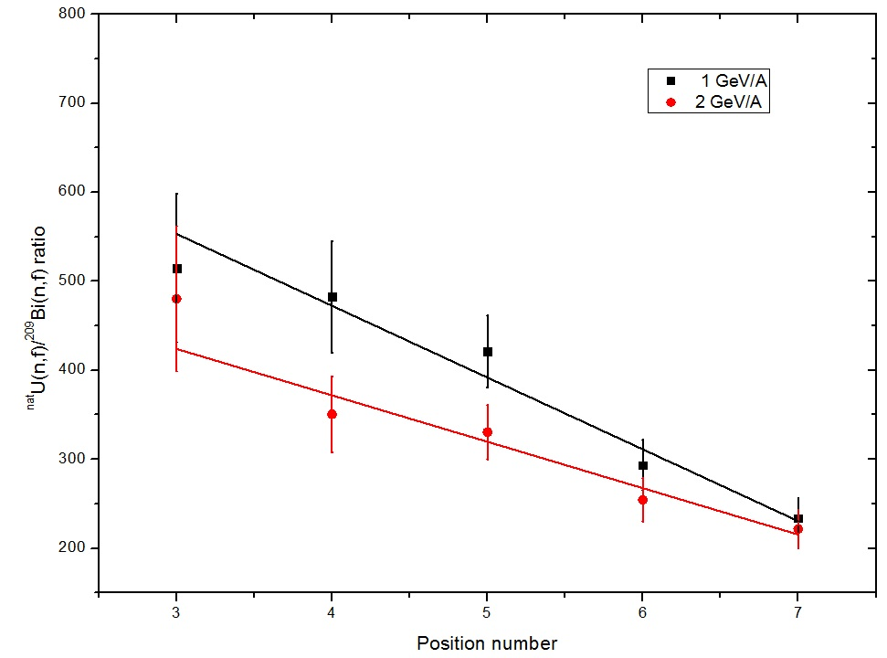
Hardening of neutron spectra from fission reactions
The ratio of number of fission ^{nat}U(n.f) / ²⁰⁹Bi(n,f) along the side of Quinta
(data for 0.66 GeV/A and 4 GeV/A is not displayed, but the trend - the same)
^{nat}U (n,f) / ²⁰⁹Bi (n,f)
Group A. Smirnov (Radium Institute)

Slide 17
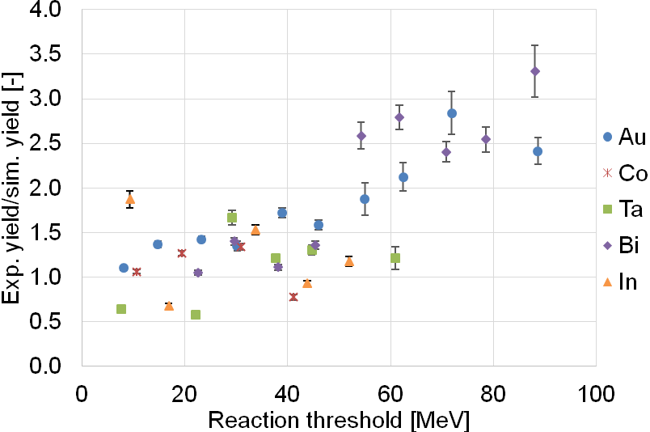
Benchmark of codes and models
MCNPX – up to 40 MeV nice description, higher energies discrepancies
E+T set-up, deuteron beam 4 GeV, extensive set of activation detectors
Average value of experimental to simulated yield ratios as a function of threshold energy (simulation - TALYS 1.6 and MCNPX v2.7 – INCL4.2 and ABLAv3)

Slide 18
Spectral characteristics of leakage neutrons on QUINTA surface
E_{d}, GeV | 1.32 | 2.0 | 4.0 | 8.0
Total numbers of leaked neutrons N, n/(d∙GeV)
N_{En>0,1 MeV} (exp), | 46.8 | 49.1 | 51.0 | 51.8
N_{En>20 MeV} (exp)) | 2.97 | 3.16 | 3.76 | 6.23
N_{total} (calc. MARS-5, FNAL) | 49.2 | 47.9 | 42.8 | 39.1
N_{En>20 MeV} (calc. MARS-5, FNAL) | 0.68 | 0.70 | 0.50 | 0.62
Ratios N_{En>20 MeV} / N_{total} , %
N_{En>20 MeV} (calc) / N_{total} (calc) | 1.38 | 1,46 | 1.17 | 1.60
N_{En>20 MeV} (exp) / N_{En>0,1 MeV} (exp) | 6.35 | 6.43 | 7.38 | 12.0

Slide 19
Experiments with carbon beam
The distributions of capture and fission reaction in natural U probes, placed inside Quinta under irradiation with deuteron and carbon beams at energies 2 and 4 GeV/A was measured with activation technique.
The integrated number of fission and capture reaction in target volume show an almost linear increase with the mass number for beams with the same energy per nucleon. The numbers presented in the table are normalized to the beam energy per nucleon.
The carbon beam produces 5 times more fissions than deuteron with the same energy per nucleon.
The ratio is the same for both studied energies.
Beam | Energy, GeV/A | Capture | Fission
Deuteron | 2 | 22.6 ± 1.2 | 19.2 ± 1.4
 | 4 | 21 ± 1.2 | 19 ± 1.4
Carbon | 2 | 126 ± 8.4 | 90 ± 9.6
 | 4 | 93.6 ± 8.4 | 92.4 ± 9.6

Slide 20
Eight fission products were identified in the ²³⁷Np sample. Reaction rates of all isotopes divided by the fission yield is presented in (a) and the averaged ratio as a function of deuteron beam energy and the same ratio related per GeV/A are presented in (b). Constant value of fission events per GeV/A can be seen within uncertainties.
a) b)

Slide 21
Programme for the 2017-2019 years.
Conditions:
Phasotron should work at least next two years
Nuclotron should be closed (works connected to NICA project)
Nuclotron will start work after 2 – 3 years
We have PhD students on theme and more possible
Very good spectroscopy laboratory and also other equipment (clover detector)
Good collaboration with Czech universities (Czech direct financial support)
Plans:
Setup Quinta – important additional measurements on Phasotron beam;
Simulation of hybrid nuclear reactor on the basis of a deep subcritical assembly of natural uranium, excited by a beam of high-energy ions. Research possibility of transmutation of radioactive waste under the influence of radiation.
Measurements of important cross-sections and systematic review analysis of up to date results;
Setup “Big uranium target - BURAN" - extracted beam from Phasotron (LNP);
Later: Setup Quinta and BURAN - Nuclotron extracted beam (205 VBLHEP building) – depends on start of Nuclotron work.

Slide 22
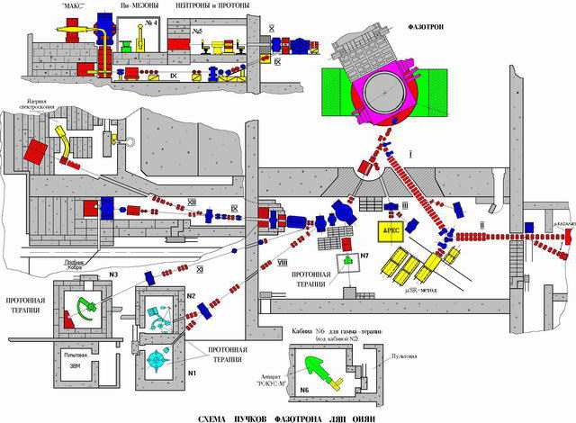
БУРАН
Scheme of LNP Phasotron beam

Slide 23
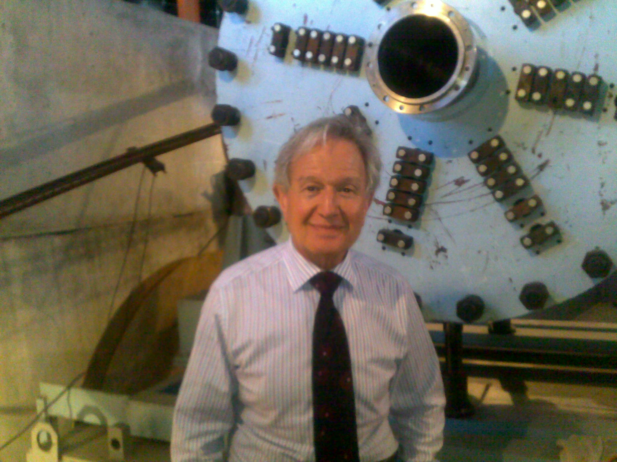
Pablo Adelfang (IAEA) near setup "Buran"

Slide 24
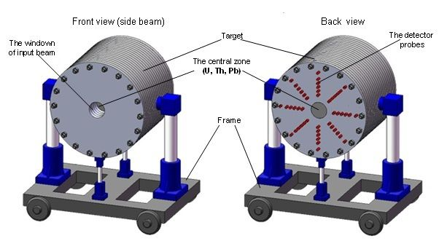
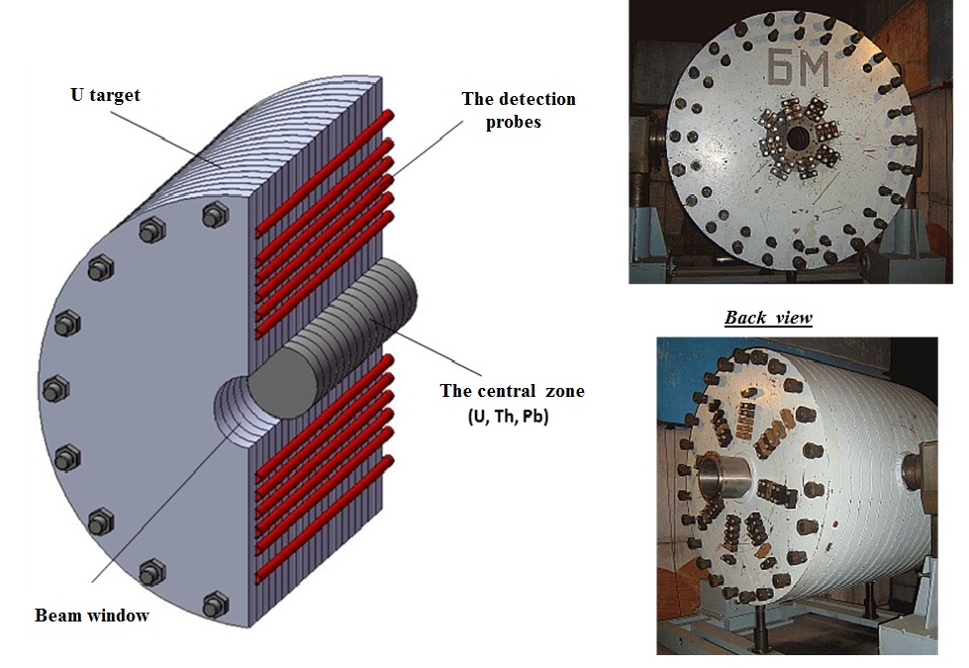
Mass of uranium – 19.5 т. Materials of central zone – U, Th, Pb.
Diameter – 1,2 м. Diameter of central zone – 0,2 м.
Length – 1 м.
General view of the target setup BURAN at the transport-fixing platform.
The scheme of longitudinal section of the TS BURAN with the mounted central zone (top-left) and general view photo (right).

Slide 25
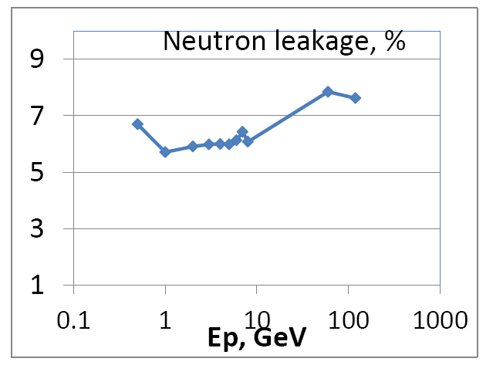
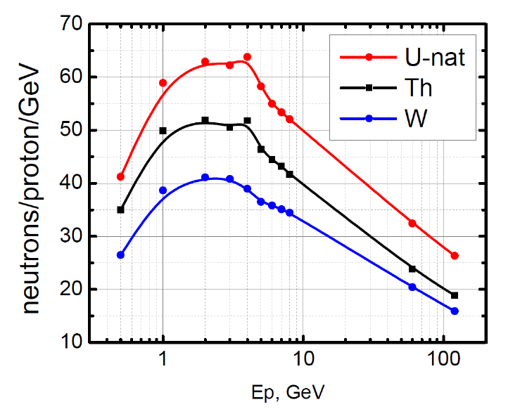
ENERGY PRODUCTION DEMONSTRATOR FOR MEGAWATT PROTON BEAMS
Leakage from the uranium target surface.
Number of neutrons released per one proton per GeV in the target.
Simulations of BURAN like targets used MARS15

Slide 26
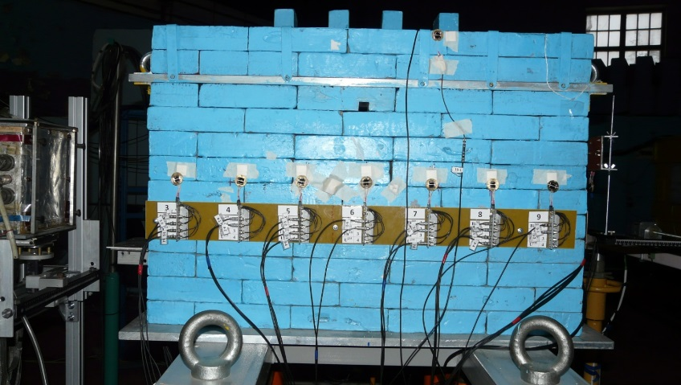
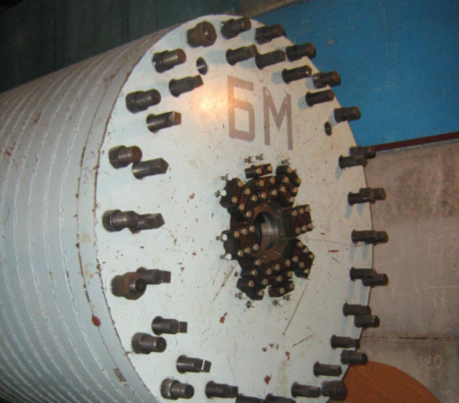
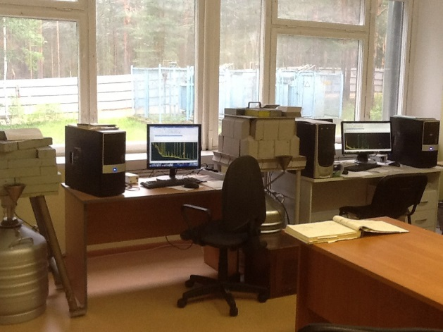
Conclusions
JINR Dubna accelerators are ideal tools for studies of different ADS concepts
Long range studies by means of ADS simple set-ups E+T, Quinta …
Very nice needed nuclear data were obtained (neutron spatial distributions, neutron leakage, transmutation). Benchmark of models and codes
Many PhD thesis were defended
Large contributions of different countries (finance, students, … - Czechia, Poland …)
New set-up – quasi infinite uranium target BURAN – first tests on Phasotron
Preparation of experiments with BURAN on Nuclotron
Synergies with other fields, spalletion targets, fusion, nuclear models, student studies, nuclear know-how …

Slide 27
Thank you for attention !
We would like to thank plenipotentiaries of Czech Republic, Poland, Bulgaria and Belarus for support

Slide 28
Estimated project cost
"Research of deep subcritical nuclear electric systems and possibilities of their use for energy production, transmutation of radioactive waste and Radiated Materials Science”
 |  | Expense item No. | Total costs | 1 year | 2 year | 3 year
Direct costs on the project
 | Accelerator, reactor (type) |  | hour | 150 | 300 | 400
 | Computer (type) |  | hour
 | Networking |  | USD thsnd
 | Design department |  | Standard hour | 2100 | 1800 | 600
 | Workshop |  | Standard hour | 750 | 1500 | 2250
 | Materials |  | USD thsnd | 50 | 50 | 50
 | Equipment |  | USD thsnd | 75 | 75 | 100
 | Costs of R&D activities, performed under the contracts |  | USD thsnd | 20 | 50 | 40
 | Business trip expenses, including: |  | USD thsnd | 20 | 10 | 20
 | trips to the non-rouble zone states
 | trips to rouble-zone states
 | trips within the protocol
 | Total direct costs: |  | USD thsnd | 165 | 185 | 160

Slide 29
Project Work Plan
"Research of deep subcritical nuclear electric systems and possibilities of their use for energy production, transmutation of radioactive waste and Radiated Materials Science "
Stages of the project | 2017 |  |  |  | 2018 |  |  |  | 2019
 | I | II | III | IV | I | II | III | IV | I | II | III | IV
Planning and design.
Development of the project to install a uranium target on DLNP Phasotron
Development of diagnostic system specifications for a big uranium target
Mounting of pilot setup of large uranium target at the DLNP Phasotron
Selection, preparation and testing of experimental systems and instrumentation modules
Development of schemes of experimental studies on the "Quinta" installations "Big uranium target"
II. Production, mounting and debugging of experimental equipment and measurement systems.
Production of experimental equipment and systems for installations on "Quinta" and "Big uranium target"
Installation and debugging of experimental equipment and systems to installations "Quinta" and "Large uranium target"
Installation and testing of experimental systems and measuring equipment
Debugging of methodologies and systems of experimental and measuring equipment.
III. Carrying out of physical experiments on "Nuclotron M" and Phasotron (according to the schedule of setups work)
“Quinta”
"Big uranium target"
IV. Design-theoretical activities aimed at prediction and improvement
V. Experimental data processing. Refinement and development of new algorithms, models and programs in order to achieve the project goals.

