Slide 1
46th PAC for Nuclear Physics
June, 14, 2017, JINR, Dubna
Targets, Separators, Detector Units for Superheavy Elements Factory
A.G. Popeko
Flerov Laboratory of Nuclear Reactions,
Joint Institute for Nuclear Research

Slide 2
Decay chains
2016
Og
Ts
Lv
Mc
Fl
114
Nh
184

Slide 3
Superheavy element factory – the goals
Synthesis and study of properties of superheavy isotopes
Chemistry of new elements
Fusion and multi-nucleon transfer reactions
Mass-spectrometry and nuclear spectroscopy of SH nuclei
Laser spectroscopy of heavy atoms.

Slide 4
Targets

Slide 5
Target isotopes
Isotope | Enrichment % | Isotope | Enrichment %
²³²Th | 100 | ²⁴⁴Pu | 98.6
²³³U | - | ²⁴³Am | 99.9
²³⁸U | 99.3 | ²⁴⁵Cm | 98.7
²³⁷Np | 99.3 | ²⁴⁸Cm | 97.4
²³⁹Pu | - | ²⁴⁹Bk | >95
²⁴⁰Pu | 99.8 | ²⁴⁹Cf | 97.3
²⁴²Pu | 99.98 | ²⁵¹Cf | 36
Isotope separators are necessary !

Slide 6
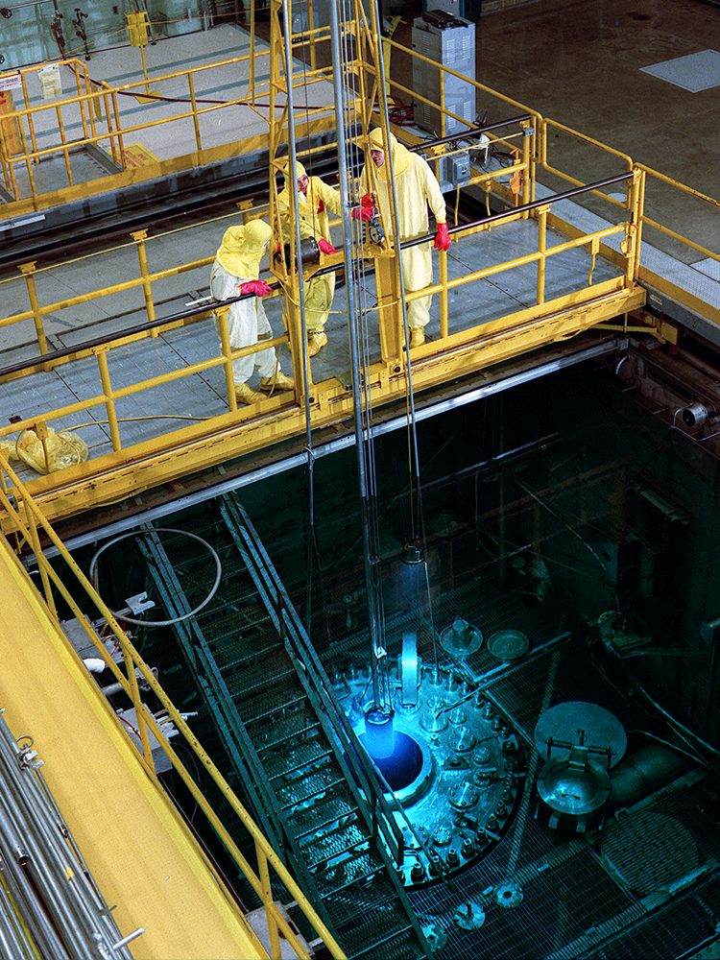
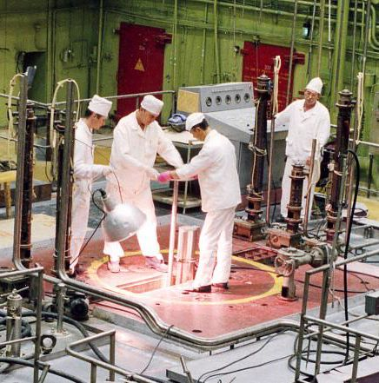
Isotope reactors
HFIR, ORNL, Oak Ridge, USA, 85 MW
CM-3, IAR, Dimitrovgrad, RF, 100 MW

Slide 7
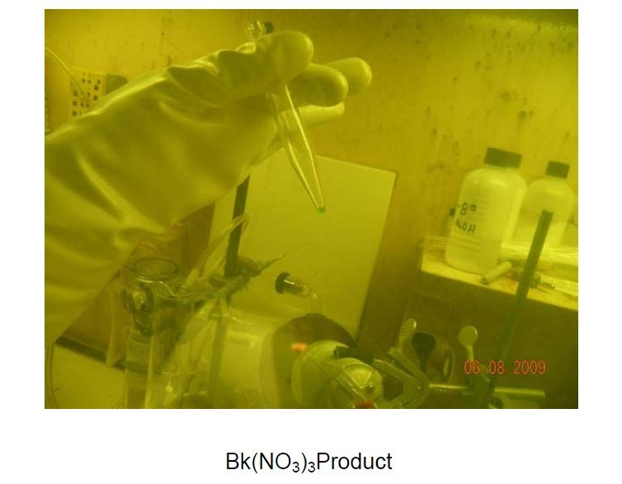
Targets I – material availability
22 mg of ²⁴⁹Bk, 1 year at HIFR ORNL

Slide 8
Transmission & yield of ²⁵⁴No
²⁰⁸Pb(⁴⁸Ca,2n)²⁵⁴No (FWHM=10.0 MeV→1.37 mg/cm², σ =0.583 mg/cm²)
Targets II – optimization for the highest production rate

Slide 9
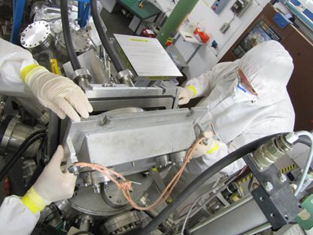
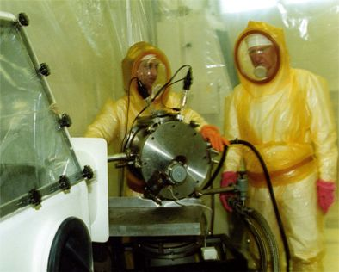
Targets III – radiation safety
²⁴⁸Cm @ SHIP
(S. Hofmann)
²⁴⁹Cf @ DGFRS

Slide 10
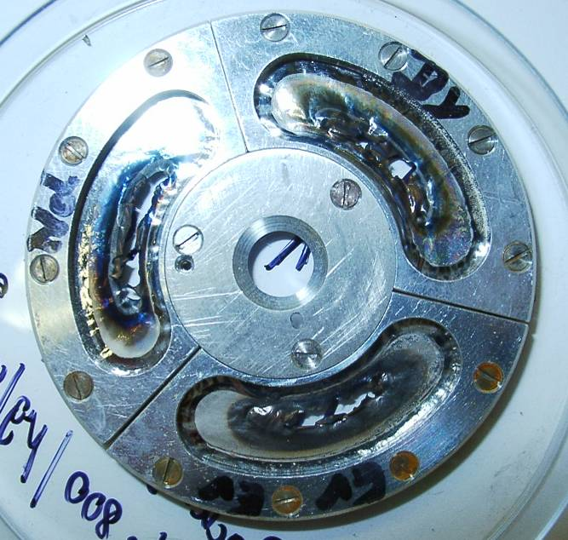
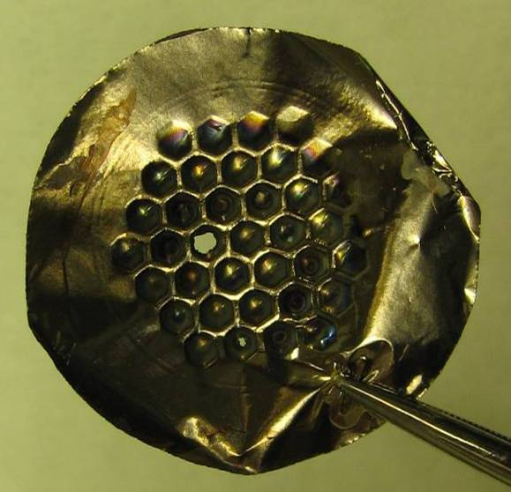
Targets IV – destruction
Heating and melting;
sputtering;
radiation damage.

Slide 11
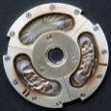
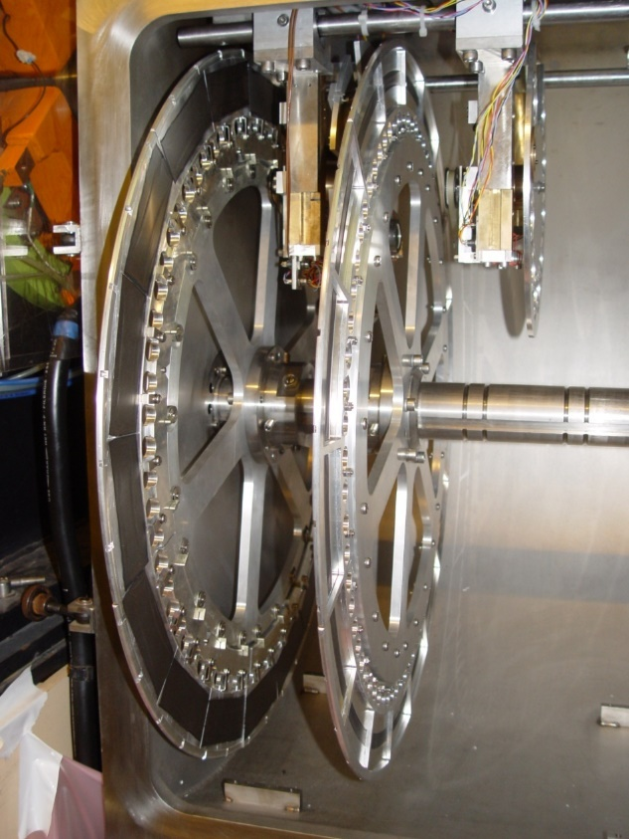
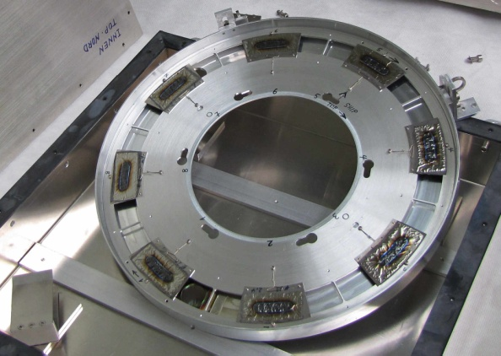
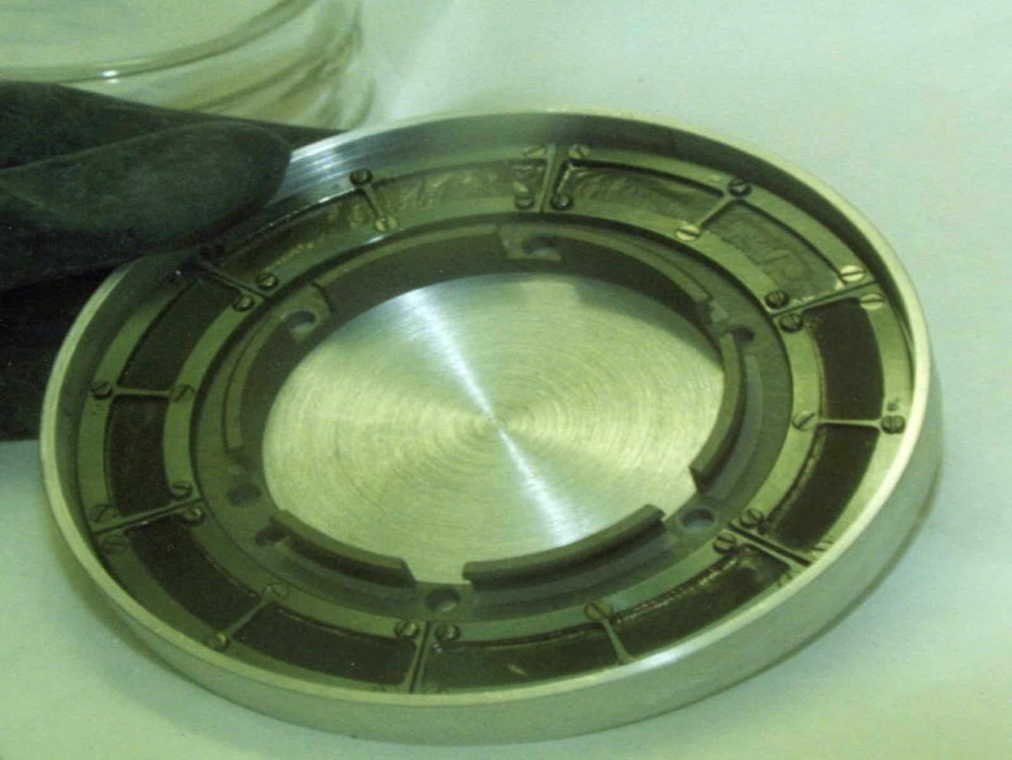
Targets V – reduction of heating
ø5 cm
Target: 2 μm Ti + 0.5 mg/cm² U₃O₈
Beam: ⁴⁸Ca, 1 pμA → 20 W/cm² → T = 1600K
ø10 cm
ø30 cm
ø60 cm →

Slide 12
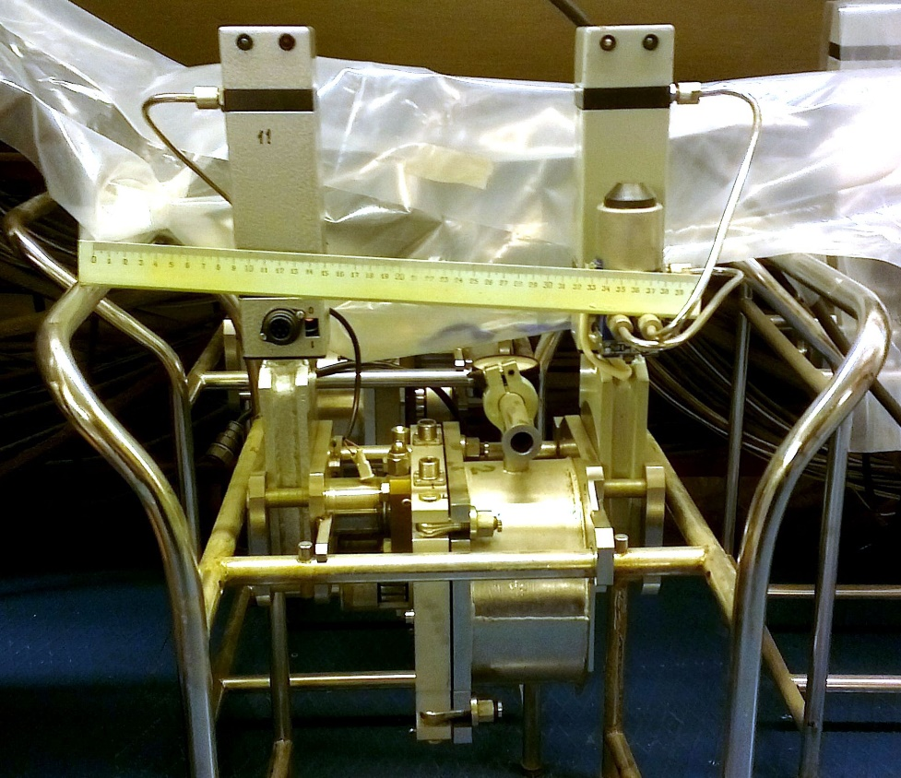
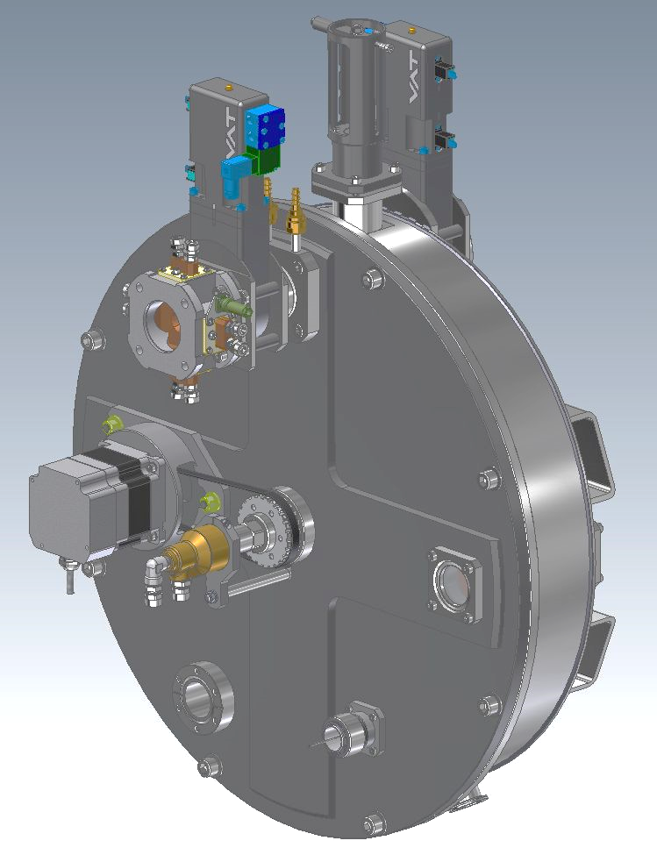
Target block design
(G.N. Ivanov)
old
new
Ø = 120, 1500 r.p.m. synchronous
Beam wobbler or scanner,
Segmented beam diafragm
Is in use at GFS, SHELS, MASHA
Ø = 480, 1500 r.p.m. synchronous,
e-beam & optical diagnostic,
water cooling

Slide 13
Separators

Slide 14
Analyzed reactions

Slide 15
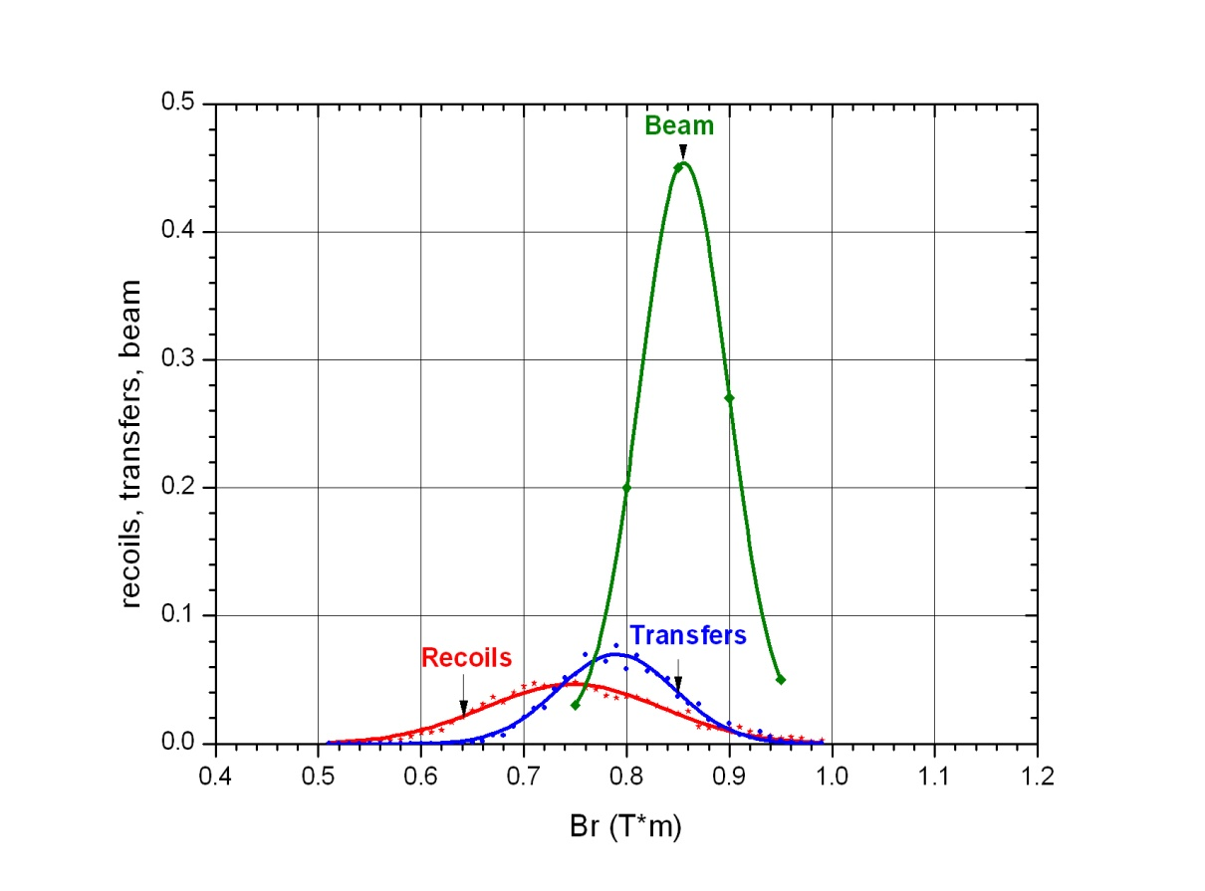
Conclusion I
Pure magnetic vacuum systems will not work
⁴⁸Ca(E_{1/2}= 236MeV) + ²⁴⁸Cm(300μg/cm², CmO₂) → ²⁹⁶116*

Slide 16
Conclusion II
Technical requirements
 | Air-free | Gas-filled
Electric rigidity | < 10 MV | ---
Magnetic rigidity | < 1.0 T×m | < 3.1 T×m
Field gradients in quadrupoles | < 5 T/m | < 15 T/m

Slide 17
Conclusion III:
Universal gas-filled separator QDQQD
performs focusing in impulse & charge spaces,
is manufacturing
Velocity selector SHELS performs focusing in charge space, in test operation
Gas-filled pre-separator
in project

Slide 18
Gas-filled separator:
Pros:
Can provide the highest efficiency
Provides additional cooling due to filling gas
Cons:
Is not applicable for symmetric reactions

Slide 19
Gas-filled separator, the tasks:
asymmetric complete fusion reactions
multi-nucleon transfer reactions
nuclear spectroscopy @ focal plane

Slide 20
GF-separators
Separator | DGFRS | GARIS | RITU | BGS | TASCA | SHANS
Configuration | DQ_{h}Q_{v} | DQ_{h}Q_{v}D | Q_{v}DQ_{h}Q_{v} | Q_{v}D_{h}D | DQ_{h}Q_{v} | Q_{v}D_{h}Q_{v}Q_{h}
Deflection angle | 23º | 45º+10º | 25º | 70º | 30º | 52º
Bρ (max/T∙m) | 3.1 | 2.15 | 2.2 | 2.5 | 2.4 | 2.9
Length (m) | 4.0 | 5.75 | 4.7 | 4.6 | 3.5 | 6.5
Dispersion (mm/% Bρ) | 7.5 | 9.7 | 10.0 | 20.0 | 9.0 | 7.3

Slide 21

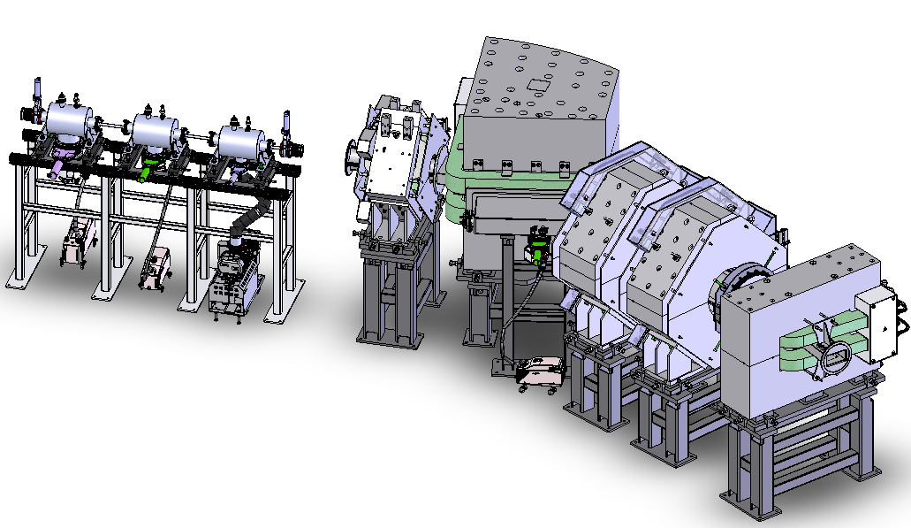
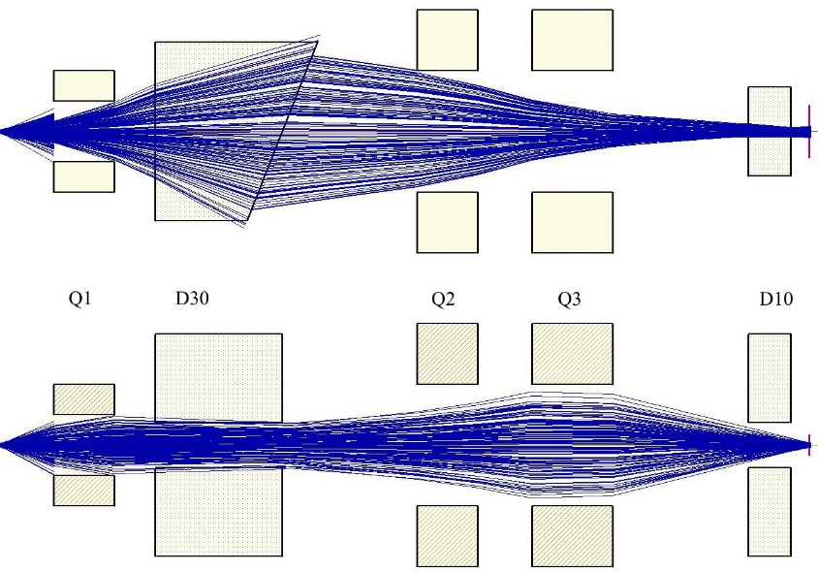
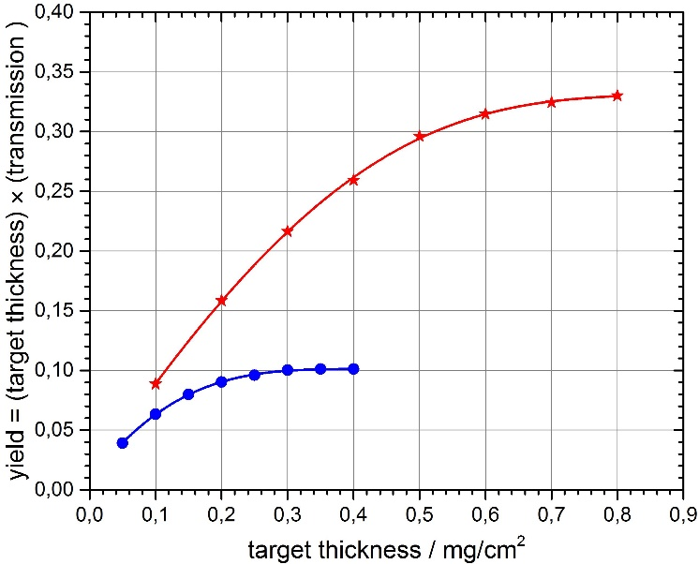
New gas-filled separator GFS-2

Slide 22
Optical elements of GFS-2
Magnetic quadrupole 1
Magnetic quadrupole 2 & 3
Effective length | 460 mm
Bore diameter | 150 mm
Maximum field gradient | 13.2 T/m
Effective length | 600
Bore diameter | 300 mm
Maximum field gradient | 5.5 T/m
Magnetic dipole 1
Magnetic dipole 2
Gap | 132 mm
Deflection angle | 30⁰
Radius of curvature | 1.8 m
Maximum field | 1.8 T
Face pole rotation angle | -7⁰
Rear pole rotation angle | 43.5⁰
Gap | 132 mm
Deflection angle | 10⁰
Radius of curvature | 1.8 m
Maximum field | 1.8 T
Face pole rotation angle | 0⁰
Rear pole rotation angle | 10⁰

Slide 23
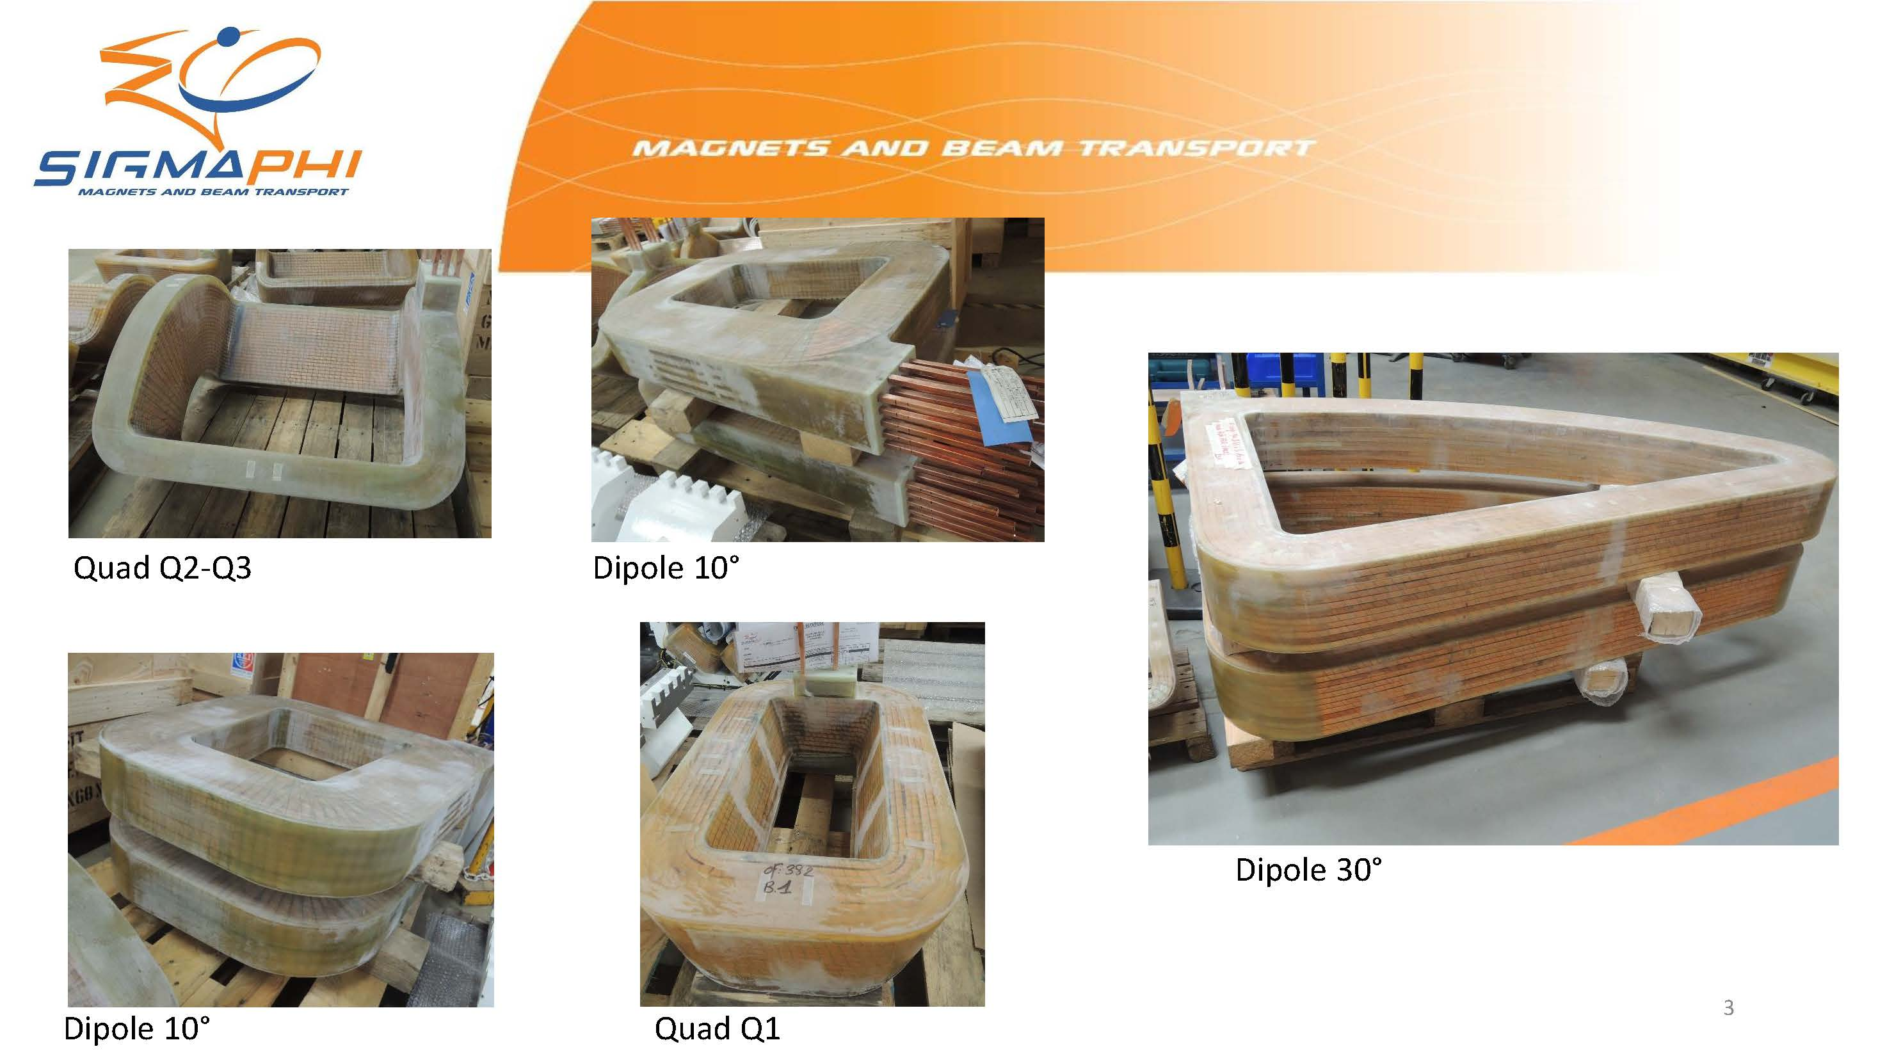
GFS-2, the coils

Slide 24
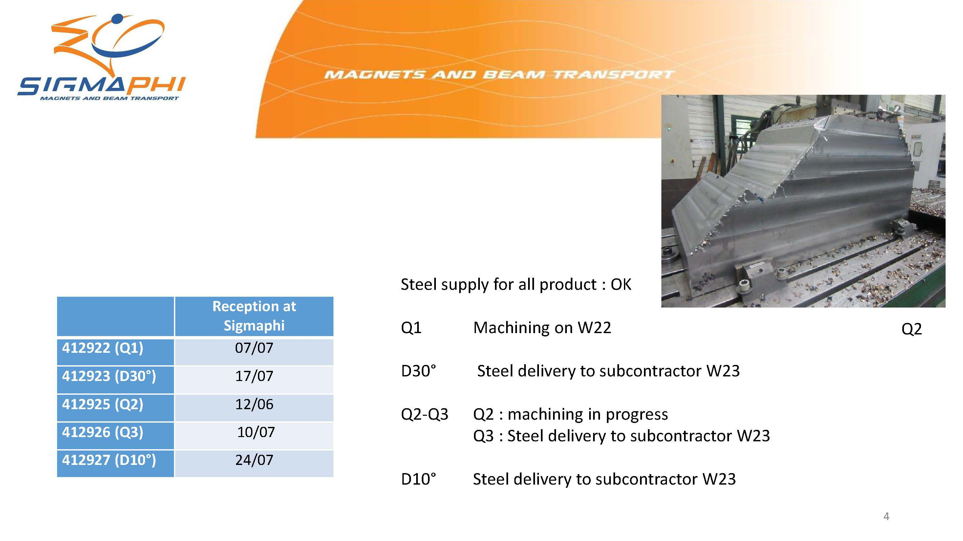
GFS-2, manufacturing progress

Slide 25
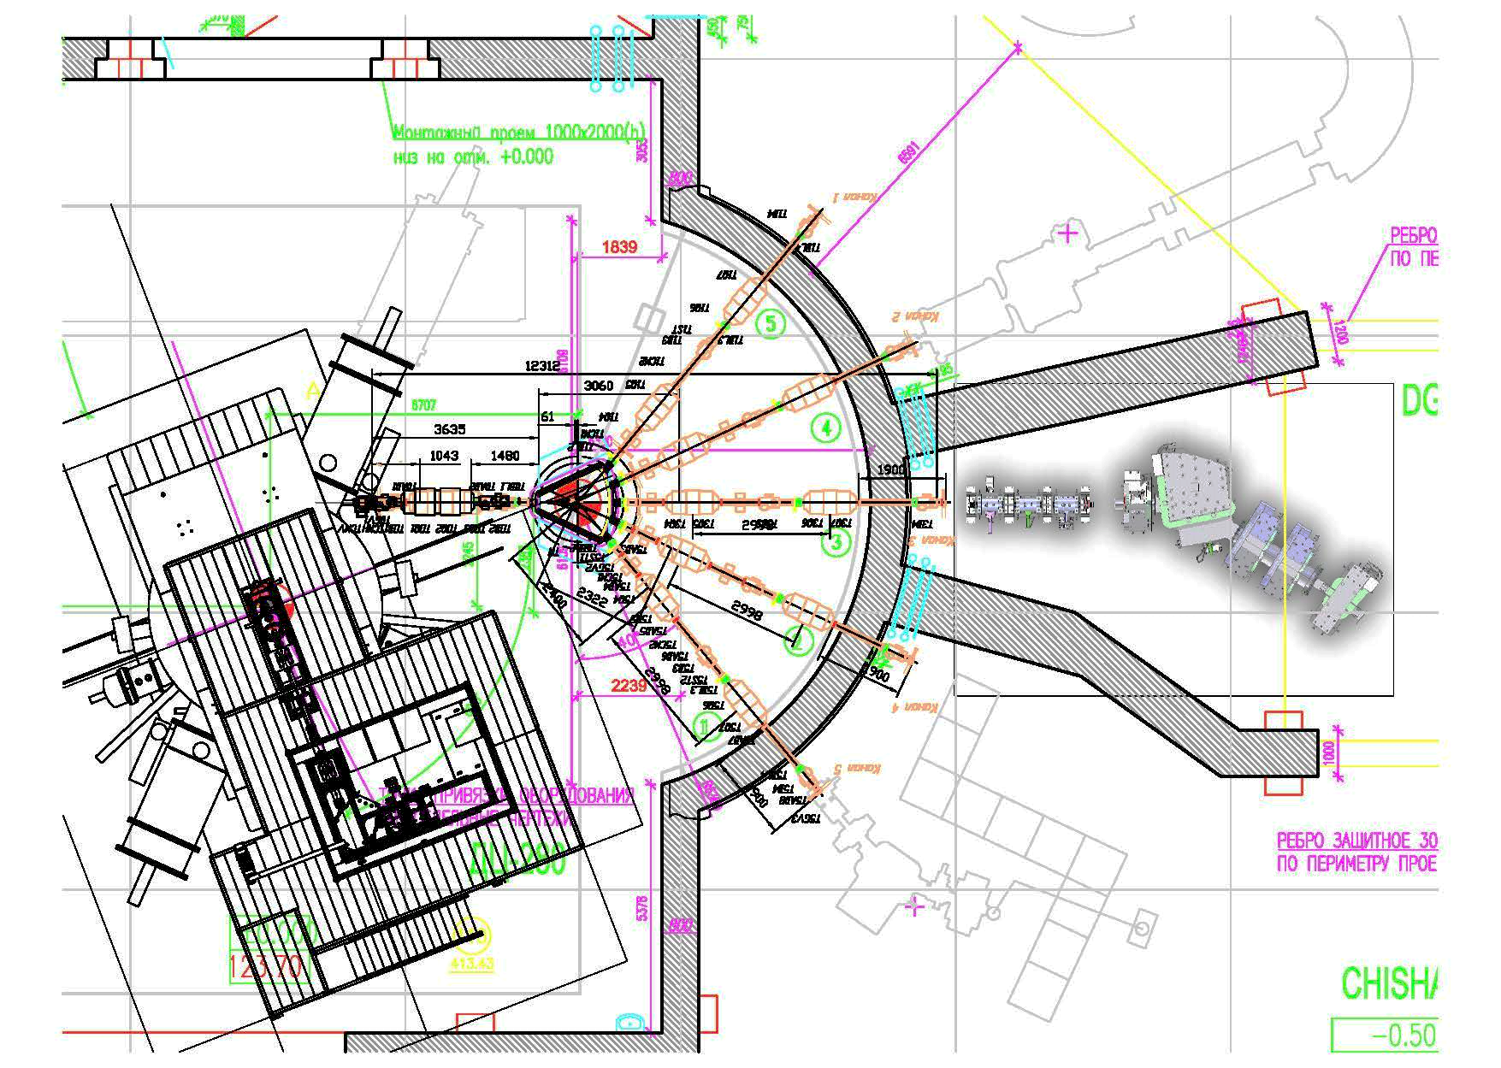
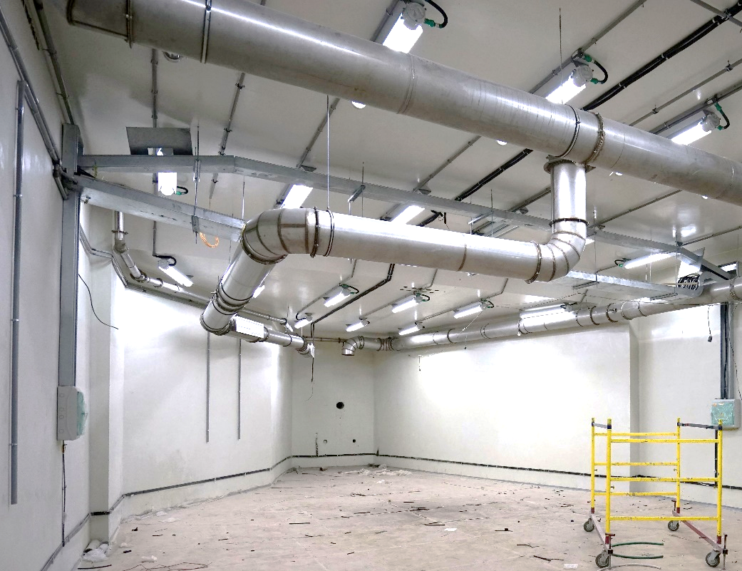
Arrangement of GFS-2 at the beam line No3

Slide 26
Velocity selector, the tasks:
symmetric & asymmetric complete fusion reactions;
multi-nucleon transfer reactions;
nuclear spectroscopy @ target & focal plane.

Slide 27
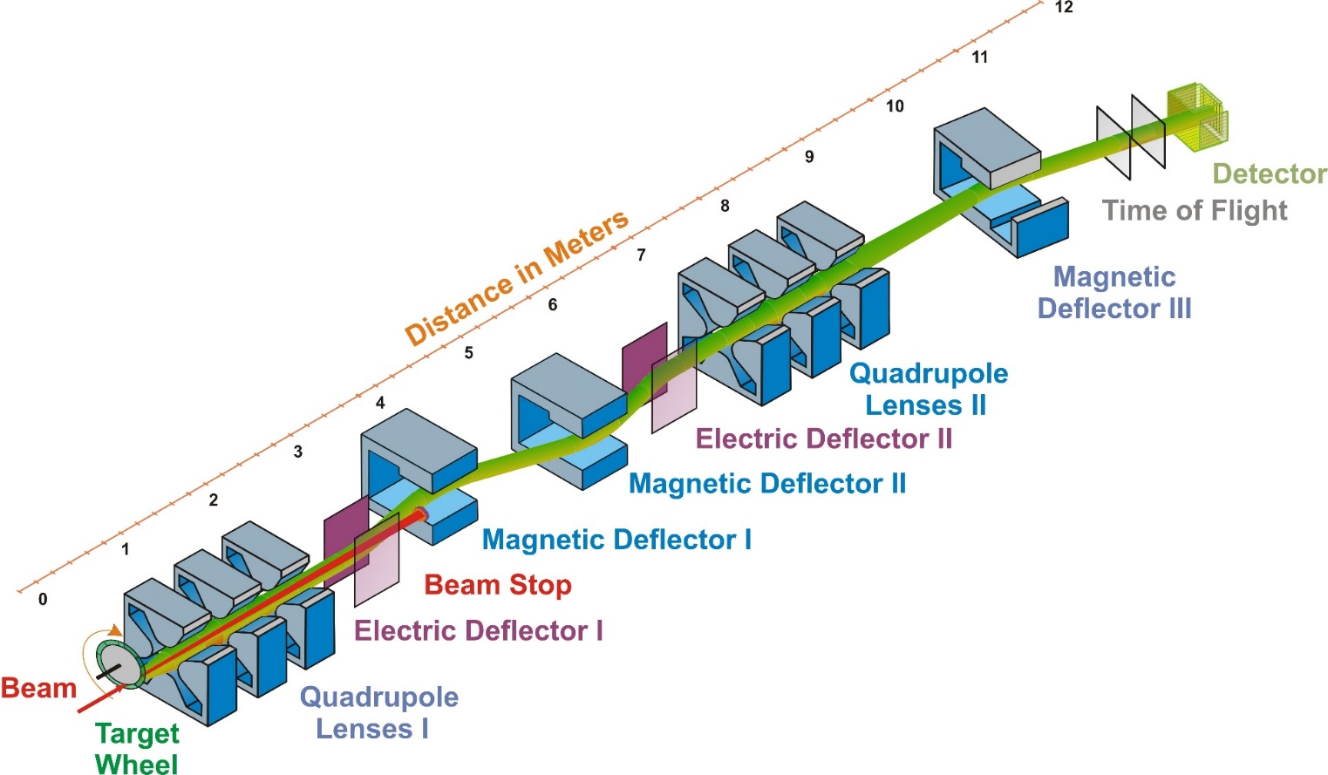
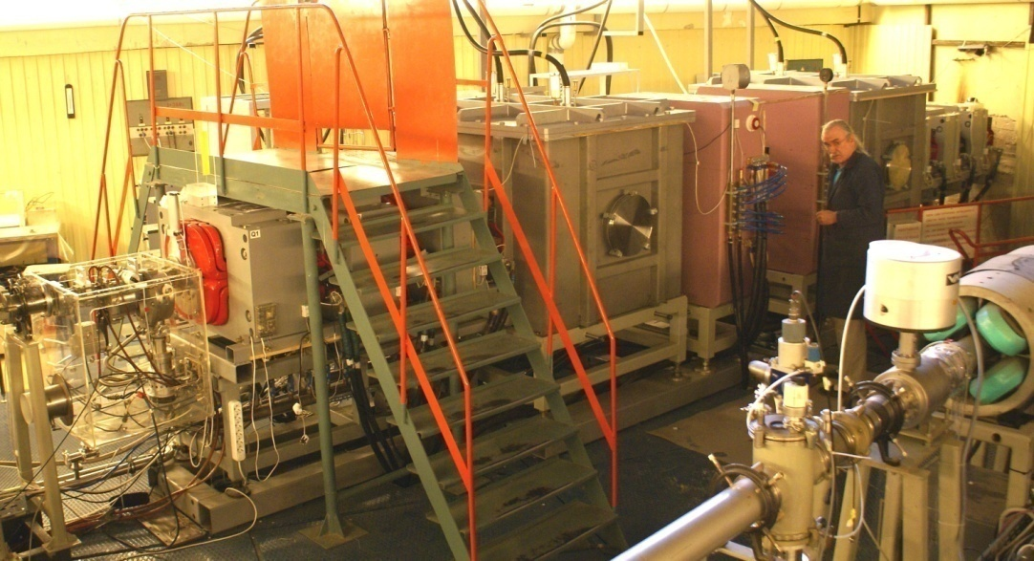
Separator for Heavy ELement Spectroscopy (SHELS)

Slide 28
Preseparator & gas-catcher, RSC-chamber:
chemistry
fusion and multi-nucleon transfer reactions
mass-spectrometry and nuclear spectroscopy
laser spectroscopy of heavy atoms

Slide 29
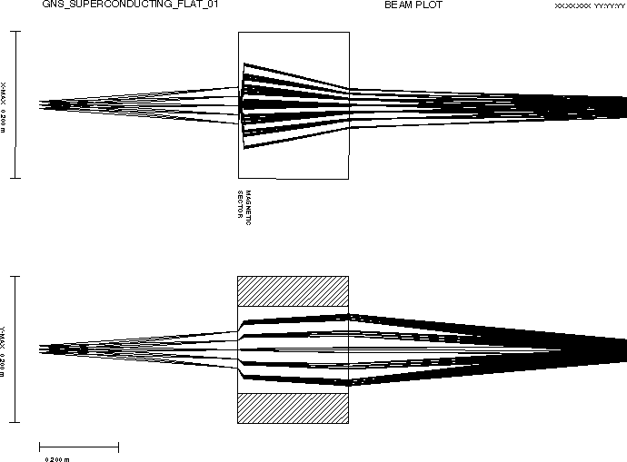
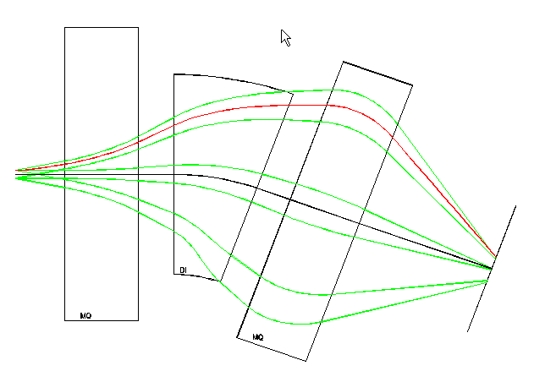
Gas-filled pre-separators
Q_{v}DQ_{h}
Superconducting

Slide 30
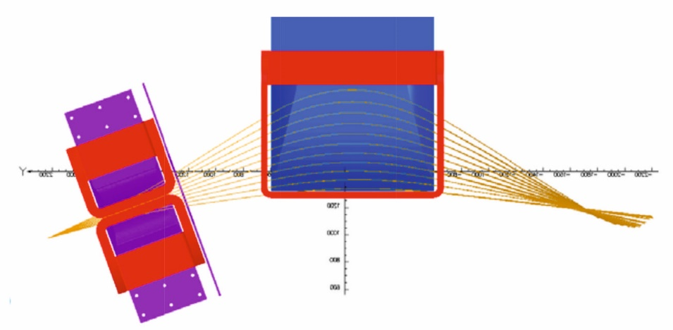
Gas-Filled Pre-separator Q_{V}D_{H}
Dipole D1
 | warm | super
Bending angle | 40º | 40º
Bending radius | 1.8 m | 1.0 m
Maximum field | 1.8 T | 3.3 T
Field inhomogeneity factor n₁ | -1.262 | -1.249
Front & rear pole face rotation angles | -35º | -20º
Quadrupole Q1 (vertical)
Effective length | 600 mm
Bore diameter | 200 mm
Maximum field gradient | 13.5 T/m

Slide 31
Detectors

Slide 32
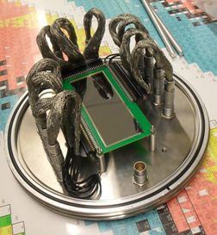
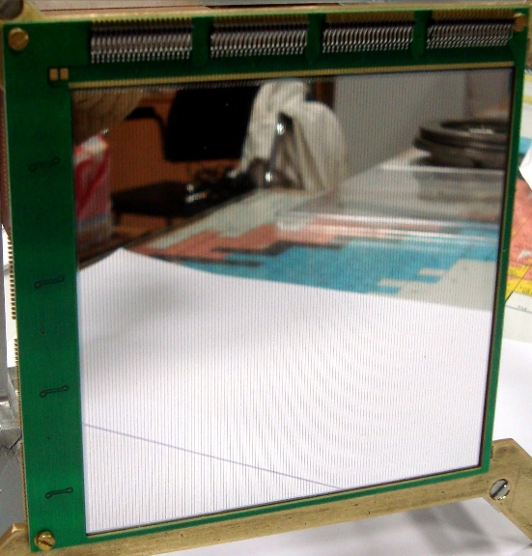
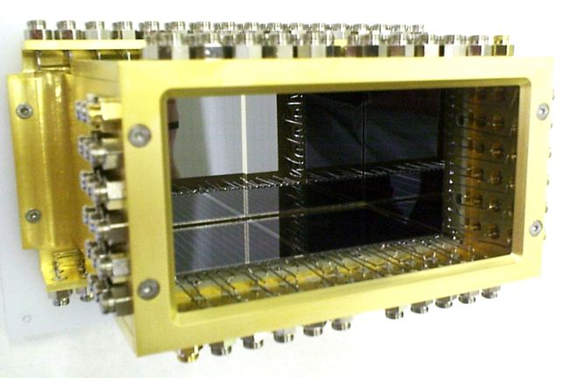
Focal plane DSS-Detectors
(Micron Semiconductors, UK)
48 × 128 strips
6144 pixels
128 × 128 strips
16384 pixels
Detector box

Slide 33
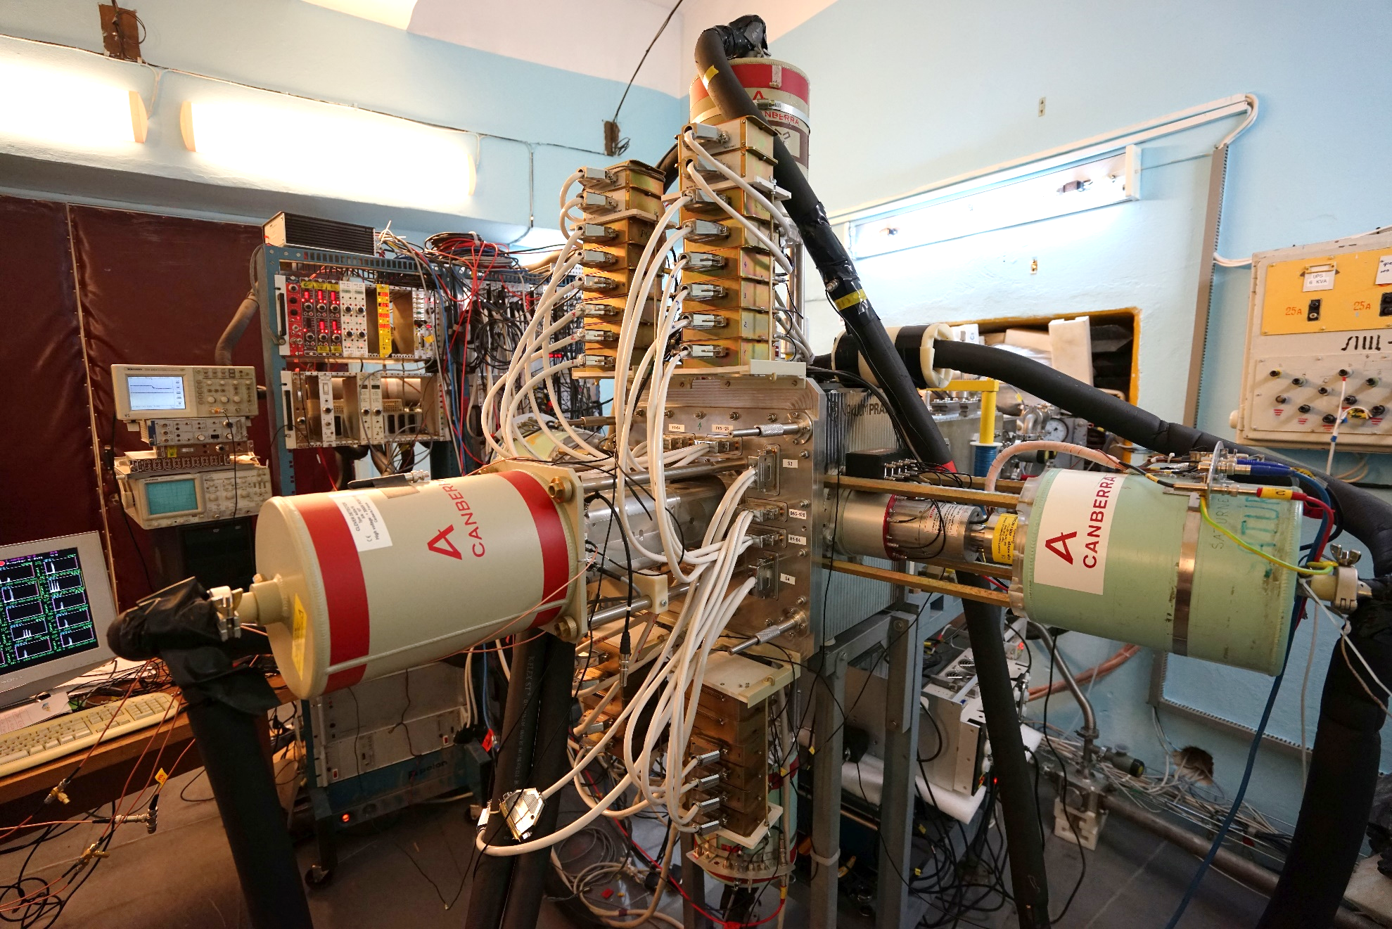
New focal plane detector GABRIELA
GABRIELA - Gamma Alpha Beta Recoil Investigation with the Electromagnetic Analyser

Slide 34
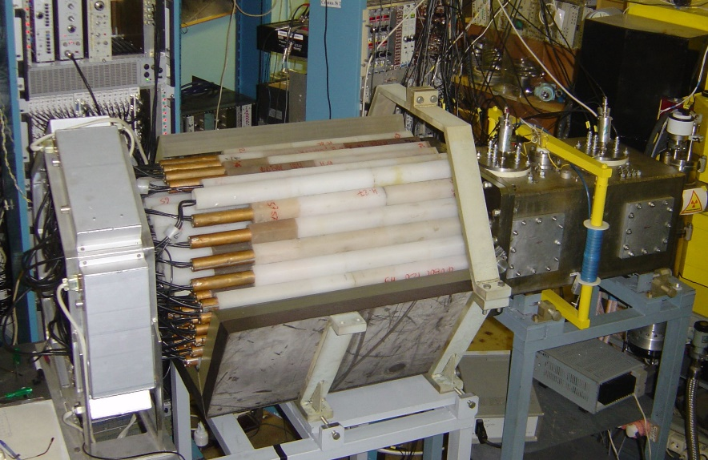
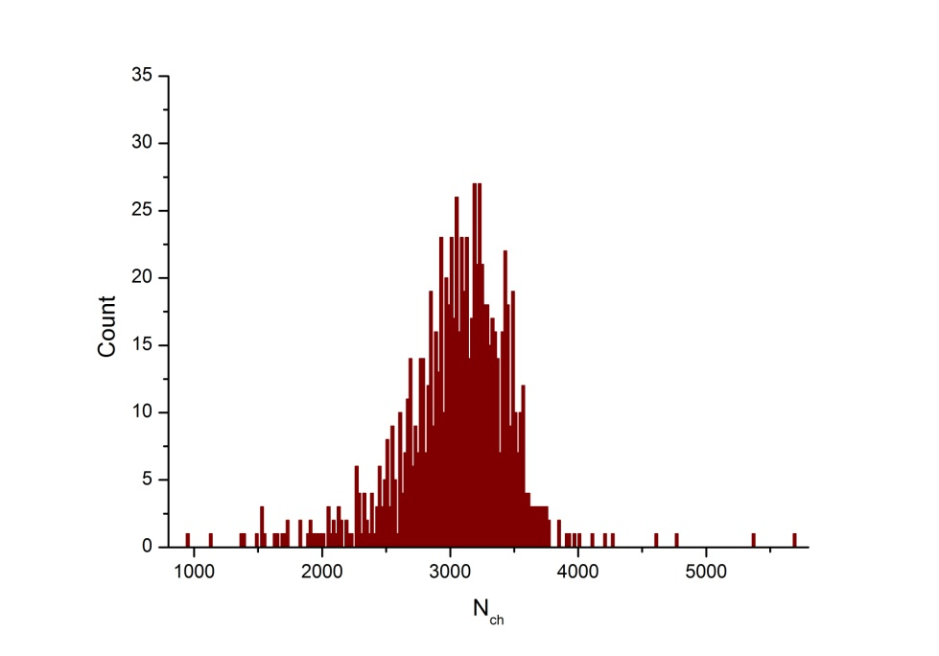
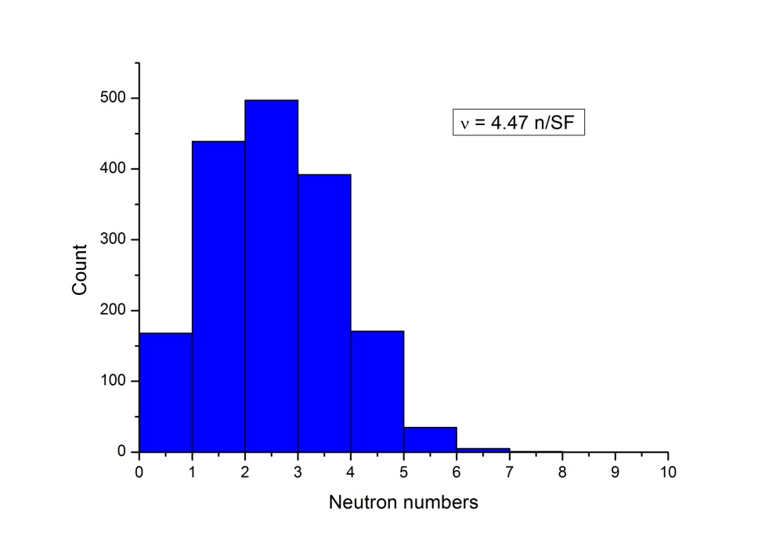
⁵⁰Ti beam intensity – 3×10¹² pps.
⁵⁰Ti + ²⁰⁸Pb = ²⁵⁶Rf + 2n
³He – neutron detector system
ε(²⁵²Cf) = 40%
TKE spectra for S.F. of ²⁵⁶Rf isotope
Neutron multiplicity measured for spontaneous fission of ²⁵⁶Rf
Notes:
For the synthesis of elements heavier than 118, the beams of ions heavier than Ca-48 are needed. In cooperation with our colleagues from France the Ti-50 ions were accelerated at the U400. First experiments were dedicated to the measurement of the average number of prompt neutrons from spontaneous fission of Rf, produced in 50Ti+208Pb reaction using the modernized VASSILISSA separator He-3 neutron detector. These set-ups were developed in accordance with the DRIBS-III project. The average number of neutrons was found to be 4.47 n/SF. These measurements are of special interest for understanding properties of SHE and for their search in nature.

Slide 35
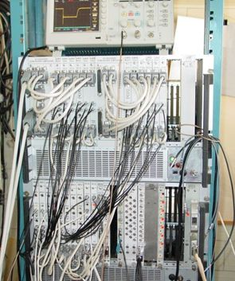
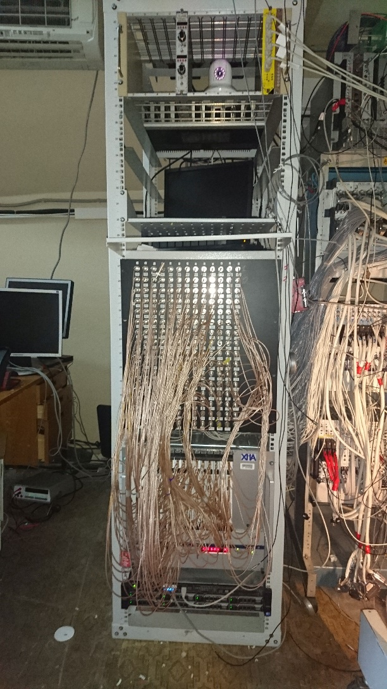
Data taking
Home made
ORNL

Slide 36
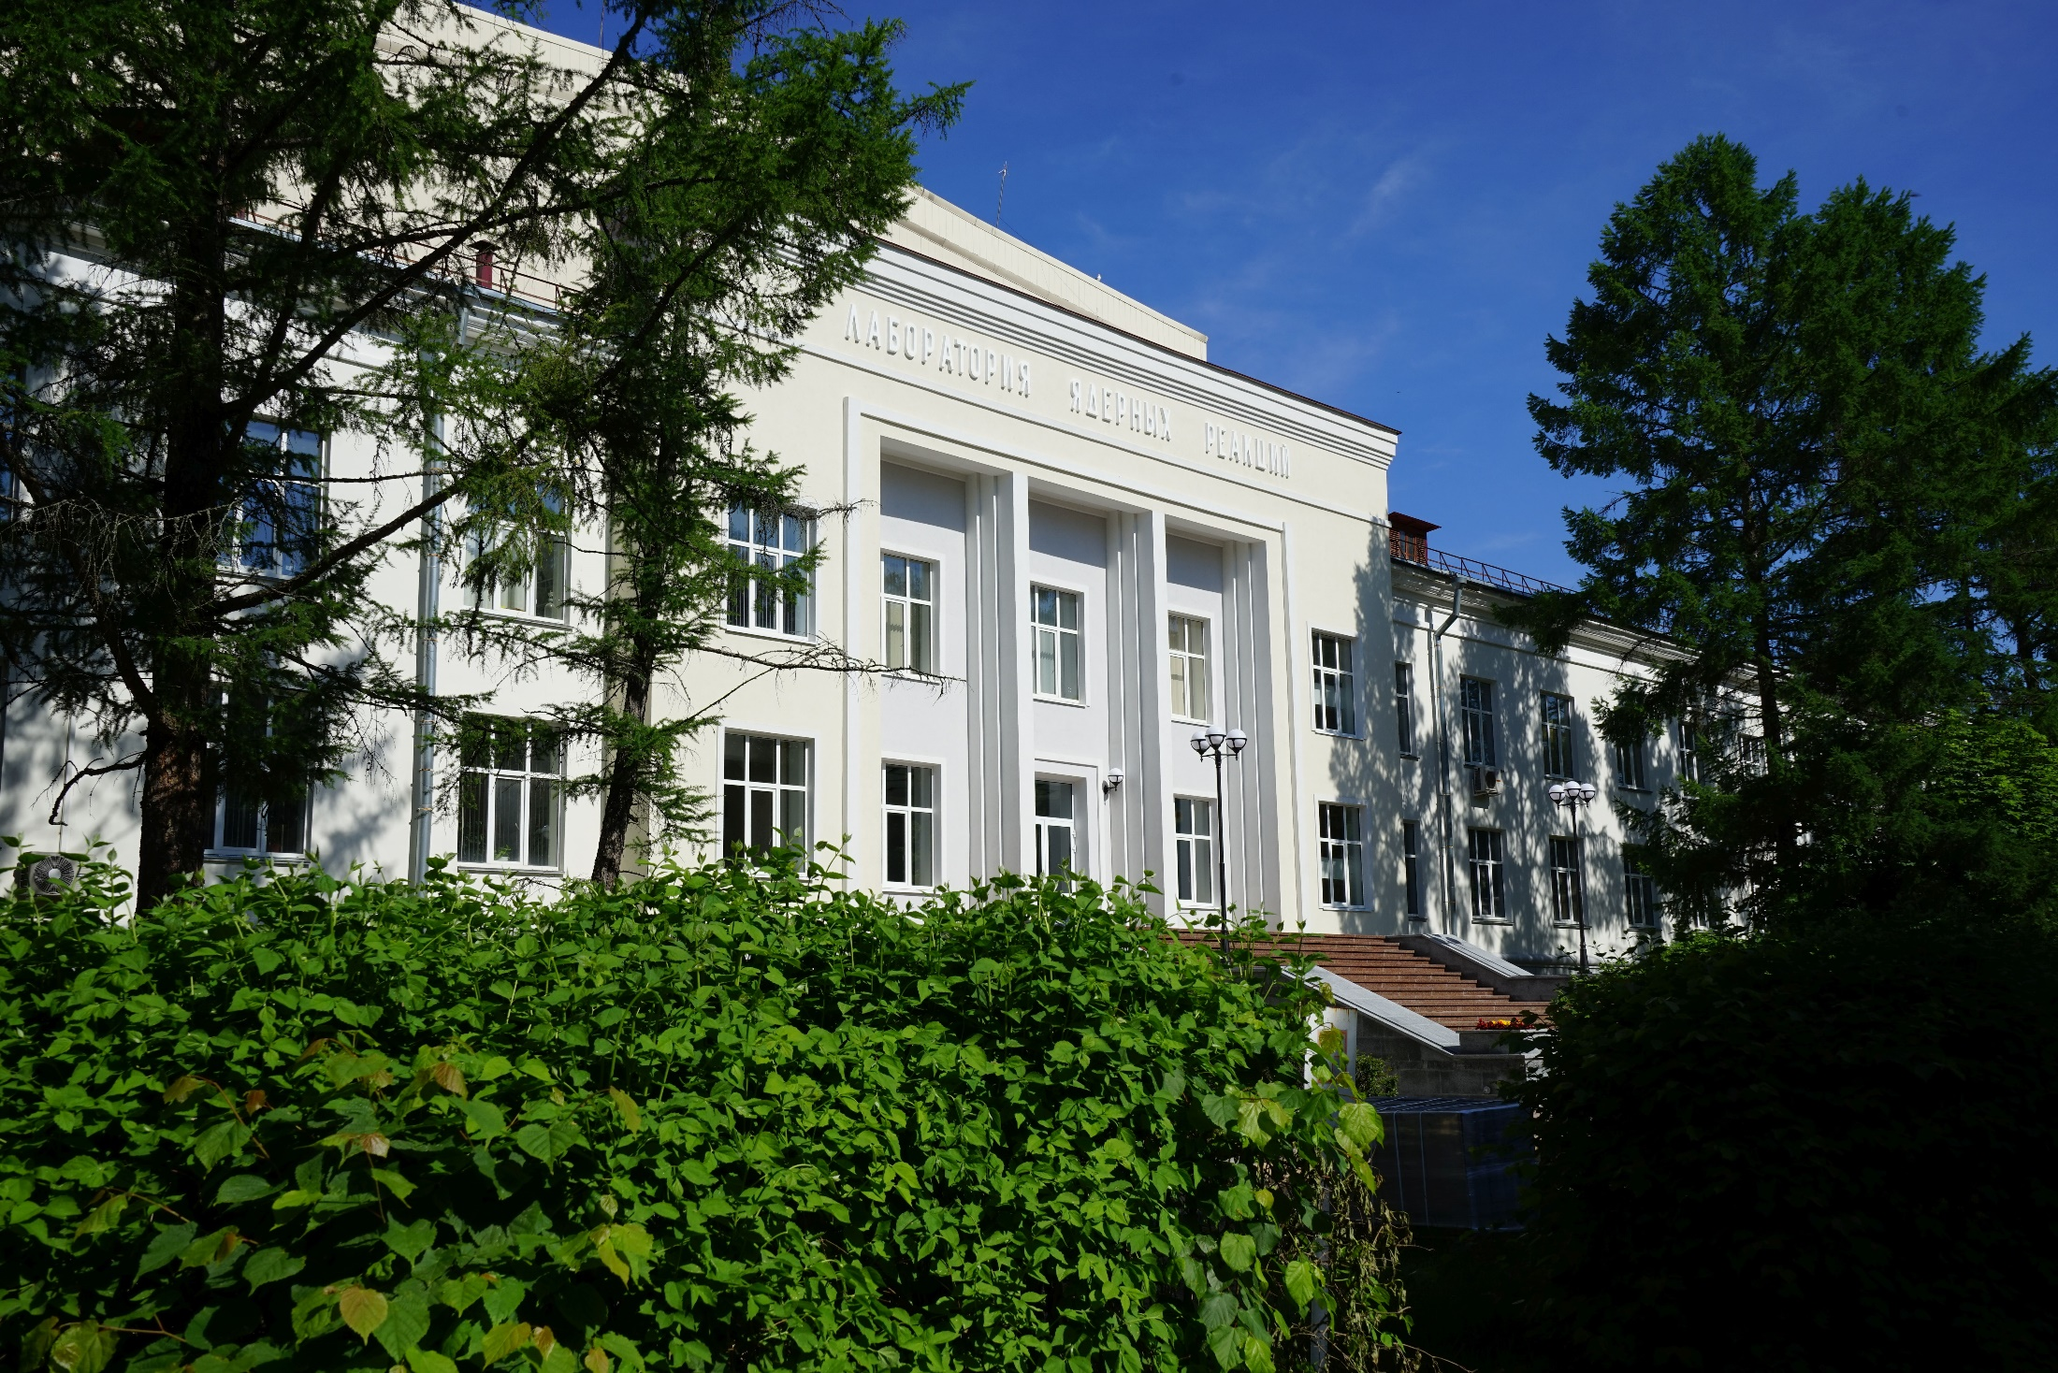
THANK YOU FOR YOUR ATTENTION !

