Slide 1


Commissioning of the ACCULINNA-2
fragment separator and
its first day experiments
Andrey Fomichevª
for ACCULINNA Collaboration
a – Flerov Laboratory of Nuclear Reactions, JINR, Dubna, Russia
b – Institute of Physics, Silesian University in Opava, Czech Republic
c – Bogolyubov Laboratory of Theoretical Physics, JINR, Dubna, Russia
d – GSI Helmholtzzentrum fur Schwerionenforschung, Darmstadt, Germany
e – National Research Center “Kurchatov Institute”, Moscow, Russia
f – Institute of Nuclear Physics PAN, Krakow, Poland
g – Skobel’tsyn Institute of Nuclear Physics, Moscow State University, Russia
h – Faculty of Physics, University of Warsaw, Warsaw, Poland
i – Fundamental Physics, Chalmers University of Technology, Goteborg, Sweden
j – All-Russian Research Institute of Experimental Physics, Sarov, Russia
k – Ioffe Physical Technical Institute, St. Petersburg, Russia
l – NSCL, Michigan State University, East Lansing, Michigan, USA
Dubna PAC meeting, June 14-15, 2017

Slide 2
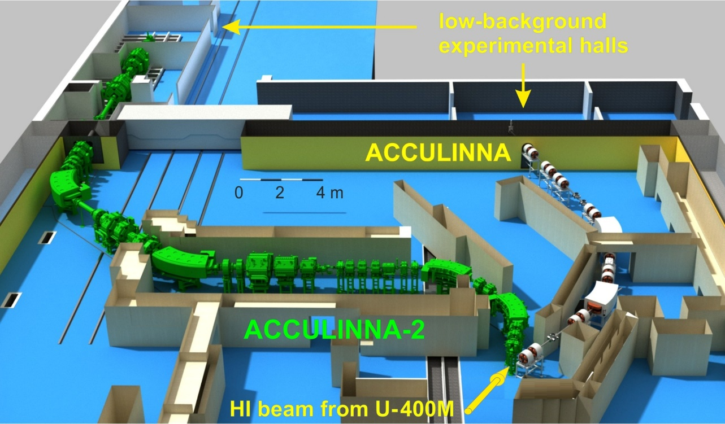
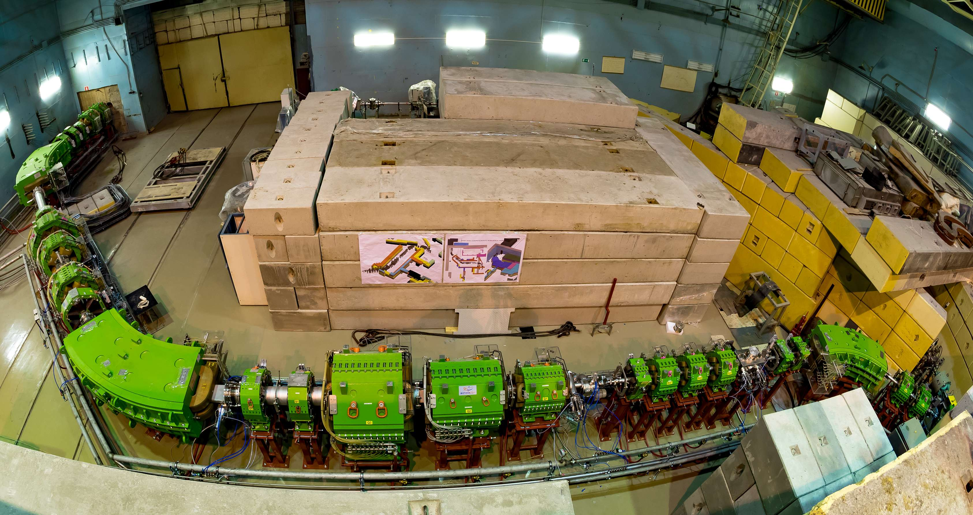
Setup layout
&
Today status
F5
F4
F3
total length F0-F5 ~53m
39 magnetic elements
F2
F1
F3
F0
6 m
F2
F1
F0

Slide 3
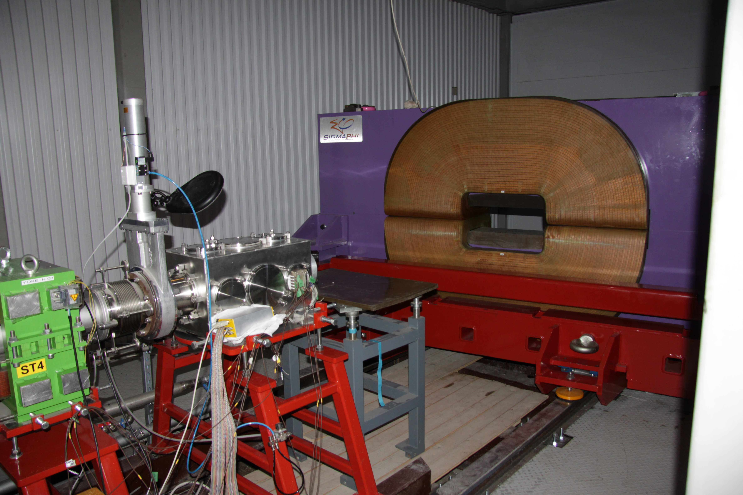
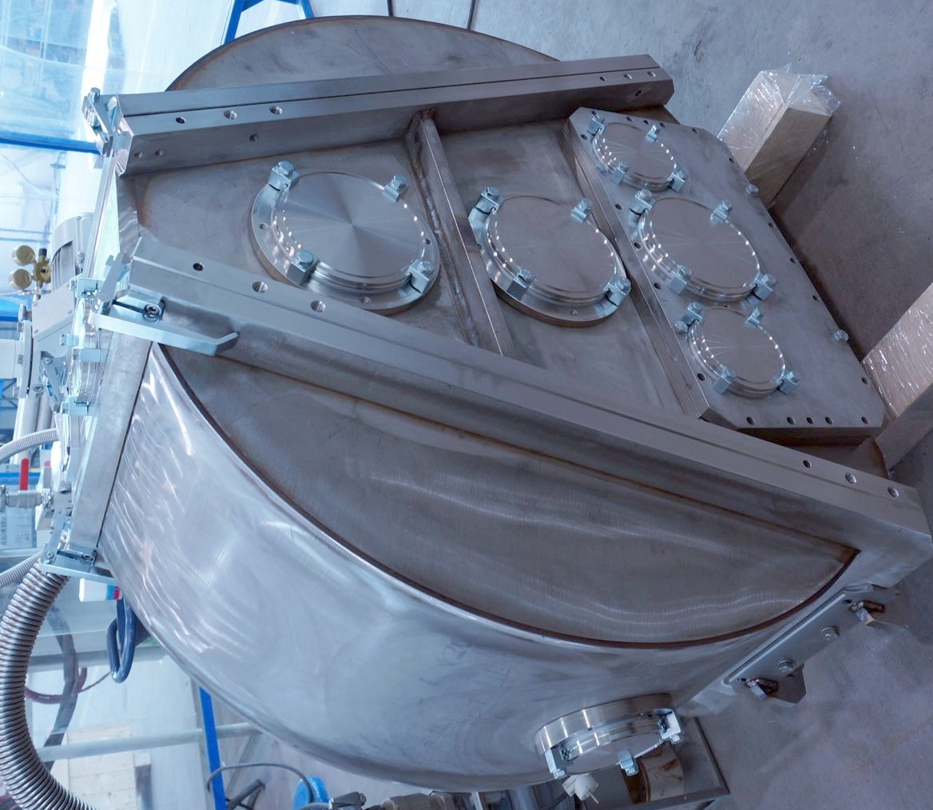
Setup layout in F3-F5
F5
F5: Dipole magnet – installed, detector system & electronics in a progress; new reaction chamber is recently delivered;
F3: RF-kicker – contracted in 2016, will be ready in the middle 2018
F3
Frequency range (MHz) | 15 – 22
Peak voltage (KV) | 120
Gap (mm) | 70
Width of electrode (mm) | 120 min
Length of electrodes (mm) | 700
Cylinder diameter (mm) | 1200 max
Stem diameter (mm) | 120 max
Length of coaxial line (mm) | 1830
gap

Slide 4
Goals of the test
in March 2017:
- ¹⁵N profile at F3 depending on F1 diaph. (∅ 25, 12, 7 mm)
-- main parameters (I, P, X_Y) of some RIBs at F3, F4, F5
X-MAX 0.25 m
2 см
F1 F2 F3 F4 F5
target wedge/slits slits
Y-MAX 0.25 m
2 см
5.0 m
RIB’s profile estimation in ¹⁵N (49.7 AMeV) + Be (2 mm) reaction
(X₁ _Y₁ = 2_8 mm, ε = 35 mrad, Δp/p = 2.5%, W = 1 mm)

Slide 5

Beam profile of ¹⁵N at F3 with ∅7 mm diaphragm at F1
4х4 мм
~ 7
F3: X_Y ~ 8_7 mm
* Ion optics working well !
** RIB production could be started
~ 8

Slide 6
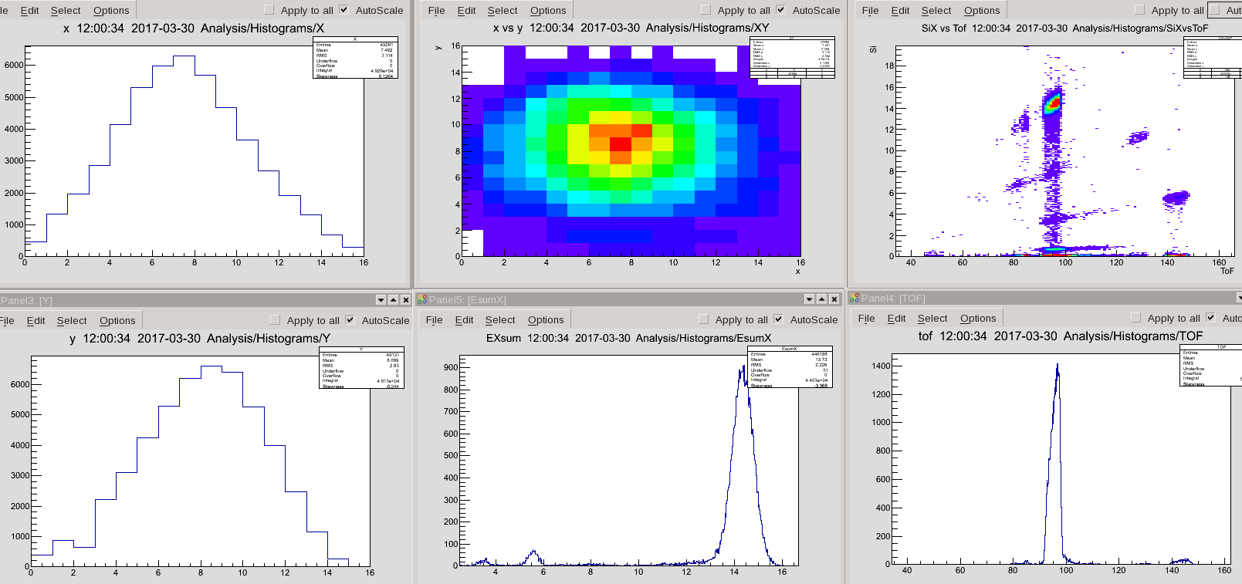
¹²Be from ¹⁵N(49.7 AMeV) + Be(2 mm):
I = 190 1/s @ 1 pnA; Δp/p = 4%; P ~ 92%; E = 39.4 AMeV; X₅ _Y₅ = 22_25 mm
Good agreement with calculation & Factor ~ 25 (I_Acc2 / I_Acc1)
¹²Be
¹¹Be
¹¹Li
22 mm
⁹Li
⁸Li
⁸He
⁶He
Multipoles OFF
25 mm
¹²Be
⁸He

Slide 7
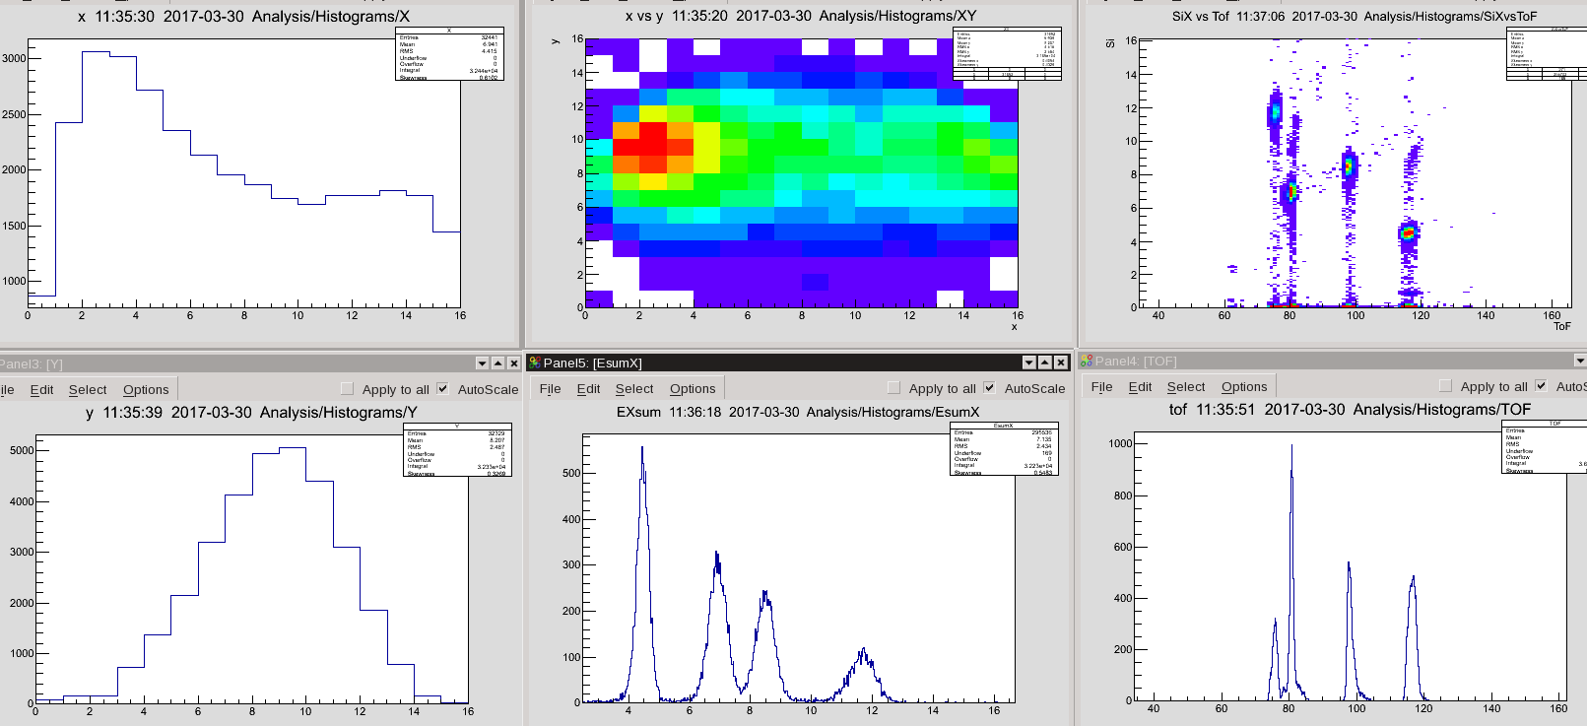
⁶Нe from ¹⁵N(49.7 AMeV) + Be(2 mm):
I = 2700 1/s @ 1 pnA; Δp/p = 2%; E = 31.5 AMeV;
X₅ _Y₅ = 20_20 mm; P ~ 53% @ F3: ±11 mm
⁶He
⁹Be
⁸Li
20 mm
⁷Li
⁶He
Multipoles ON
⁶He
⁷Li
⁶He
⁸Li
⁹Be
It good agrees with estimations

Slide 8
RIBs production rates in ¹⁵N(49.7 AMeV) + Be(2 mm) reaction
F1: I(¹⁵N) = 1 pnA @ 7 mm; F2: Δp/p = 2%, Wedge_Be = 1 mm
RIB | Energy, MeV/nucl. | Intensity, 1/s
¹⁴B | 37,7 | 120
¹²Be | 39,4 | 150
¹¹Li | 37,0 | 4
⁹Li | 33,1 | 1100
⁸He | 35,8 | 25
⁶Не | 31,5 | 2700
Experiments
in 2017
Main parameters (I, P, X_Y) are agree well with estimations
First experiments with RIBs could be started in 2017 (I < 0.1 pμA)
Experiments with intense primary beam (~ 1 pμA) will be able since 2018
¹²Be + d → ⁶Li + ⁸He (alpha transfer cross section)
⁶He + d → ³He + ⁵H (proton transfer cross section)
2017
Moving ahead to ⁷H via ¹¹Li or ⁸He
2018 - flagship exp.

Slide 9
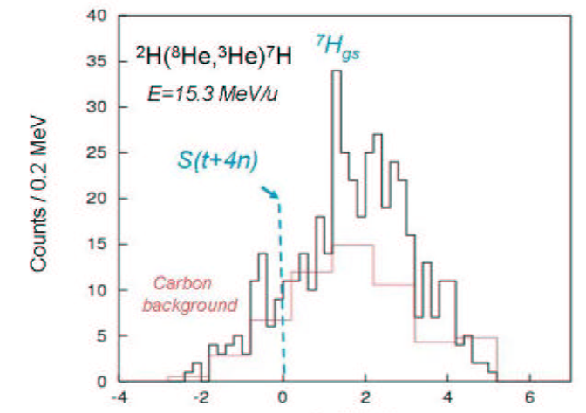
⁷H puzzle: each time only limits of σ were observed
p(⁸He,pp)⁷H
E=25 AMeV
Golovkov et al.,
EXON-2006 p.32
E=61 AMeV
coincidences
σ~15 μb/sr
Counts/1.5 MeV
Counts/0.6 MeV
Korsheninnikov et al.,
PRL 90(2003)
d(⁸He,³He)⁷H
d(⁸He,³Het)⁷H
E=15.3 AMeV
Fortier et al.,
EXON-2006 p.3
Nikolskii et al.,
PRC 81 (2010)
Counts/0.2 MeV
σ~30 μb/sr
σ~10 μb/sr
⁷H missing mass (MeV)
Caamaño et al. PRL 99(2007) ¹²C(⁸He,¹³N)⁷H ==>
E = 0.57
+0.42
MeV, Γ = 0.09
+0.94
MeV
-0.21
-0.06
 Drastically improvement of sensitivity in d(⁸He,³He)⁷H or p(⁸He,pp)⁷H
 ¹¹Li as a projectile and alpha transfer reaction d(¹¹Li,⁶Li)⁷H

Slide 10
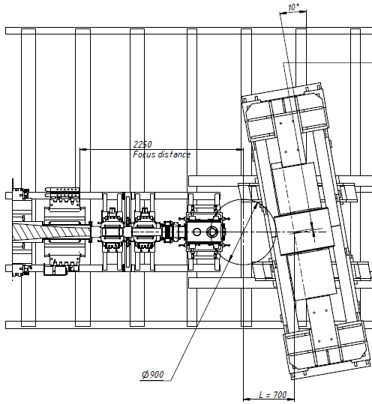
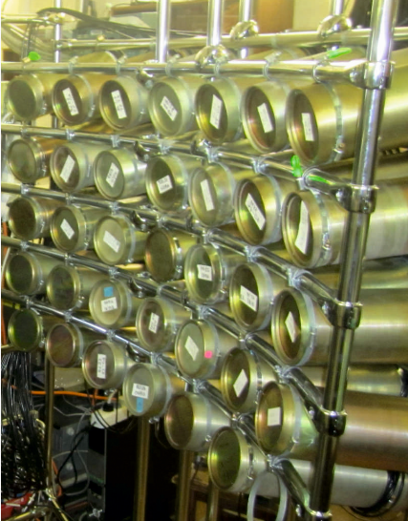
Hunt for ⁷H and search for the 4n radioactivity
in the d(¹¹Li,⁶Li)⁷H reaction
Plan on 2018
Hodoscope X_Y~20x80 cm
(it should be done)
Decay tritons & ¹¹Li,
Bρ = 0.4 ~ 1.0 Tm
Cone 0 ~ 14°
annular
Si –telescope for ⁶Li
Bρ=1.0
Bρ=0.4
¹¹Li
E~30 MeV/A
Neutrons,
Cone 0 ~ 14°
Stilbene modules
∅ 80x50 mm → 0.25° accuracy
7x6=42 → 64 units
D-target
3x10²¹ at/cm²
* I(¹¹Li @ 30 AMeV) ~ 2x10⁴ pps ==> ~ 100 ⁷H events/day (missing mass)
** Decay energy will be measured with around 100 keV resolution,
~ 3 events/day (⁶Li-t-n coincidences)
Notes:
SIGMAPHI PRESENTATION - JUNE 2001

Slide 11
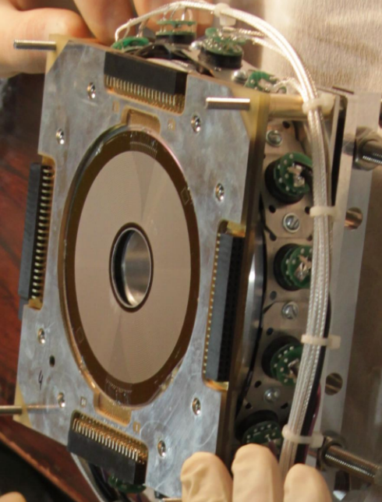
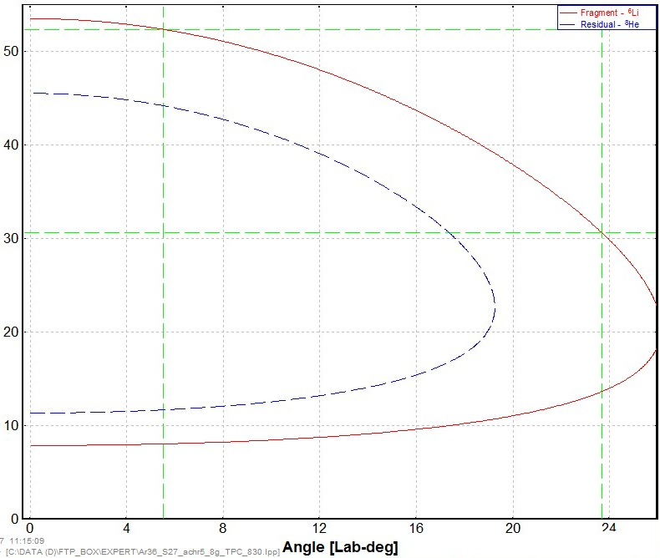

Plan on 2017: d(¹²Be,⁶Li)⁸He as a tool for the main run d(¹¹Li,⁶Li)⁷H
* alpha transfer cross section at 25 and 35 AMeV;
** useful kinematics to detect two stable particles via annular telescope;
*** could be done at I(¹⁵N) ~ 100 pnA ==> I(¹²Be) ~ 2*10⁴ pps; BT ~ 2 weeks
⁸He
⁶Li
Angular range
E.Rich et al., 2005 Proc. EXON, Peterhof, Russia ==>
d(⁸He,⁶Li)⁴n @ 15.4 AMeV dσ/dΩ ~ 0.2÷1.0 mb/sr

Slide 12
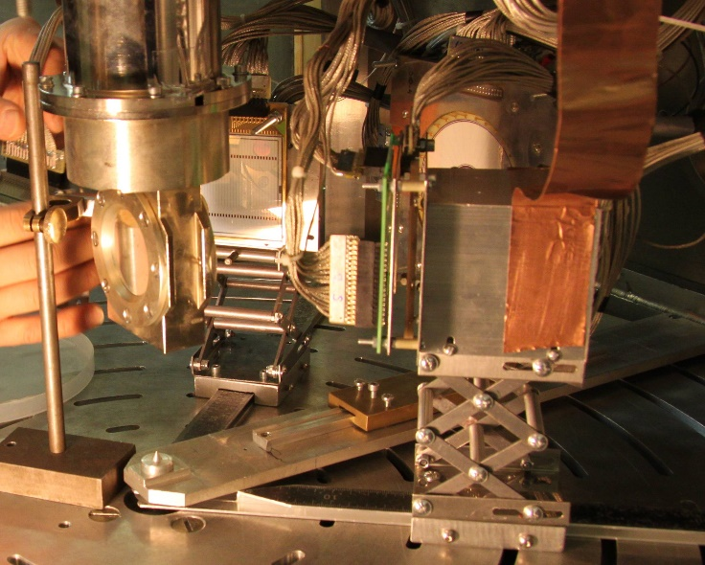
Plan on 2017: d(⁶He,³He)⁵H as a tool for the main run d(⁸He,³He)⁷H
* cross section values for the 1p and 1n transfer reactions in a wide θ_{CM}
** improvement in missing mass measurements via novel telescopes
BT ~ 1 week
⁶He
Si - 70 μ
Si - 1000 μ
CsI – 15 mm
(single)
Si - 22 μ
Si - 1000 μ
CsI – 45 mm
(16 units)
Stepantsov et al.,
NPA 738 (2004) 436
x4
~2
⁵H (left) and ⁵He (right) energy spectra depending on ³He-t coincidences

Slide 13
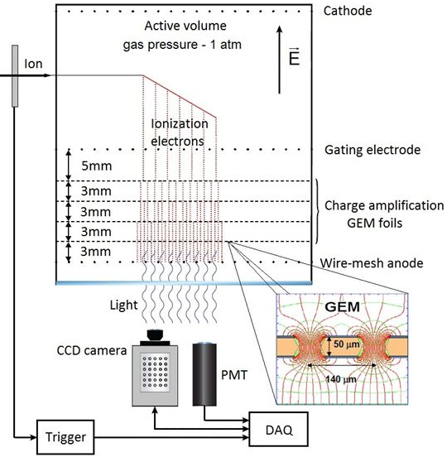
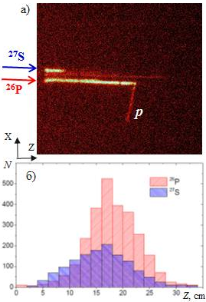
Beta-delayed proton emission from ²⁷S and ²⁶P
via Optical Time Projection Chamber /Janiak et al., PRC 95 (2017) 034315/
EPJ A12
²⁷S
Miernik et al., NIM A581 (2007) 194
Canchel et al., EPJ A12 (2001) 377
²⁶P |  |  |  | ²⁷S
P_{βp} 415 кэВ | P_{βp} ~800 кэВ | P_{β2p} | P_{tot} | P_{βp} 320 кэВ | P_{βp} 710 кэВ | P_{β2p} | P_{tot}
10.4(9)% ÷ 13.8(10)% | 1.1(3)% | 1.5(4)% | 35(2)% | 24(3)% ÷ 28(2)% | > 6.7(8)% | 3.0(6)% | 64(3)%
17.96(90)% | 2.5(3)% | 2.2(3)% | 39(2)% | 2.3±0.9% |  | 1.1±0.5% | ~ 4%
Thomas et al., EPJ A21 (2004) 419
P_{β3p} < 0.08%

Slide 14
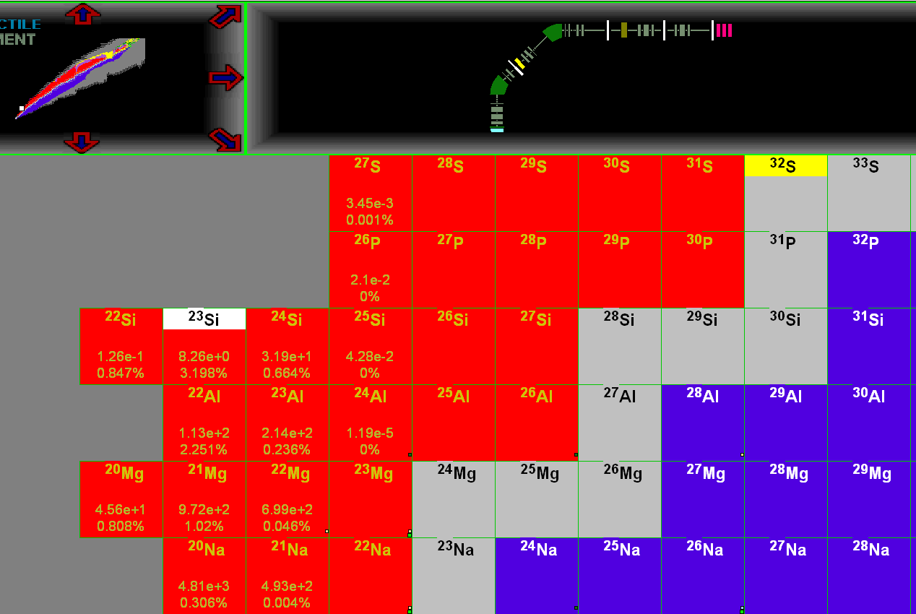
²³Si: β delayed ³He radioactivity search via OTPC
³²S(@52 AMeV, 100 pnA)
→ 8 pps ²³Si (T_{1/2} = 42.3 ms)
Acculinna-2
BT ~ 0.5 week
“… ²³Si has an open channel for the beta delayed ³He emission - never seen before. Moreover, this channel should be relatively easy to see, because the beta-alpha decay leads to the unbound ¹⁹Na. Thus, the ³He channel is the only one in which a single particle with Z=2 is emitted. The ³He emission is a sort of a mirror of tritium emission - this may contain some physics. This point was born in discussion with Karsten Riisager and Hans Fynbo in Aarhus. It would be
great if we could make the ²³Si experiment at Dubna.”
³He
Proposal by M. Pfützner et al.

Slide 15
Summary and outlook
ACCULINNA-2 fragment separator is commissioned in 2017,
the design parameters of this facility were experimentally confirmed.
The intensities obtained in the fragmentation reaction
¹⁵N (49.7 AMeV) + Be (2 mm) for the RIBs of ¹⁴B, ¹²Be, ^{9,11}Li, ^{6,8}He were on average 25 times higher in comparison with the values for old facility.
The first-priority experimental program with RIBs is focused on ⁷H and ²³Si nuclides and their possible exotic decays.
It will be started this year.
Thanks for your attention

Slide 16
Acculinna-2 since 2017/18
Request / Cost
Product name | T_{min} U400M | Beam, E, I | Method, equipment
²⁷S : P(β3p) – value/limit ²³Si : P(β³He) – yes/no/limit ²⁶S : observation, states | One week | ³²S, 52 AMeV, 0.2 − 0.5 pμA | OTPC, chopper & RF-kicker p(²⁸S,t)²⁶S missing mass & RF-kicker
¹⁷Ne : 2p decay for 3/2⁻ state Γ_{2p}/Γ_{γ} → 0.0002% ⁷Н : observation, states, 4n decay ¹⁰Li : Е and Γ for ground state | Two or more weeks | ²⁰Ne, 54 AMeV, 1.0 pμA ¹⁵N, 49 AMeV, 1.0 pμA | p(¹⁸Ne,d)¹⁷Ne* combined mass, zero angle spec. . d(⁸He,³He)⁷H d(¹¹Li,⁶Li)⁷H p(¹¹Li,d)¹⁰Li combined mass
¹⁰He : ¹³Li : ¹⁶Be : | Three or more weeks | ¹¹B³⁺, 34 AMeV, 4.0 pμA ²²Ne⁷⁺, 44 AMeV, 1.0 pμA | t(⁸He,p)¹⁰He t(¹¹Li,p)¹³Li t(¹⁴Be,p)¹⁶Be
Е, Γ, J^{π} of excited states, search for exotic decays 2n, 4n
tritium target, neutron array

Slide 17
ACC-2 @ U400M advantages:
Room T operating
Relatively low cost beam time
Runs during 2,3 and even more weeks are possible
Cryogenic targets ³He, ⁴He and all hydrogen isotopes
ToF length ~15 m
E_{RIB}, AMeV
Z

Slide 18
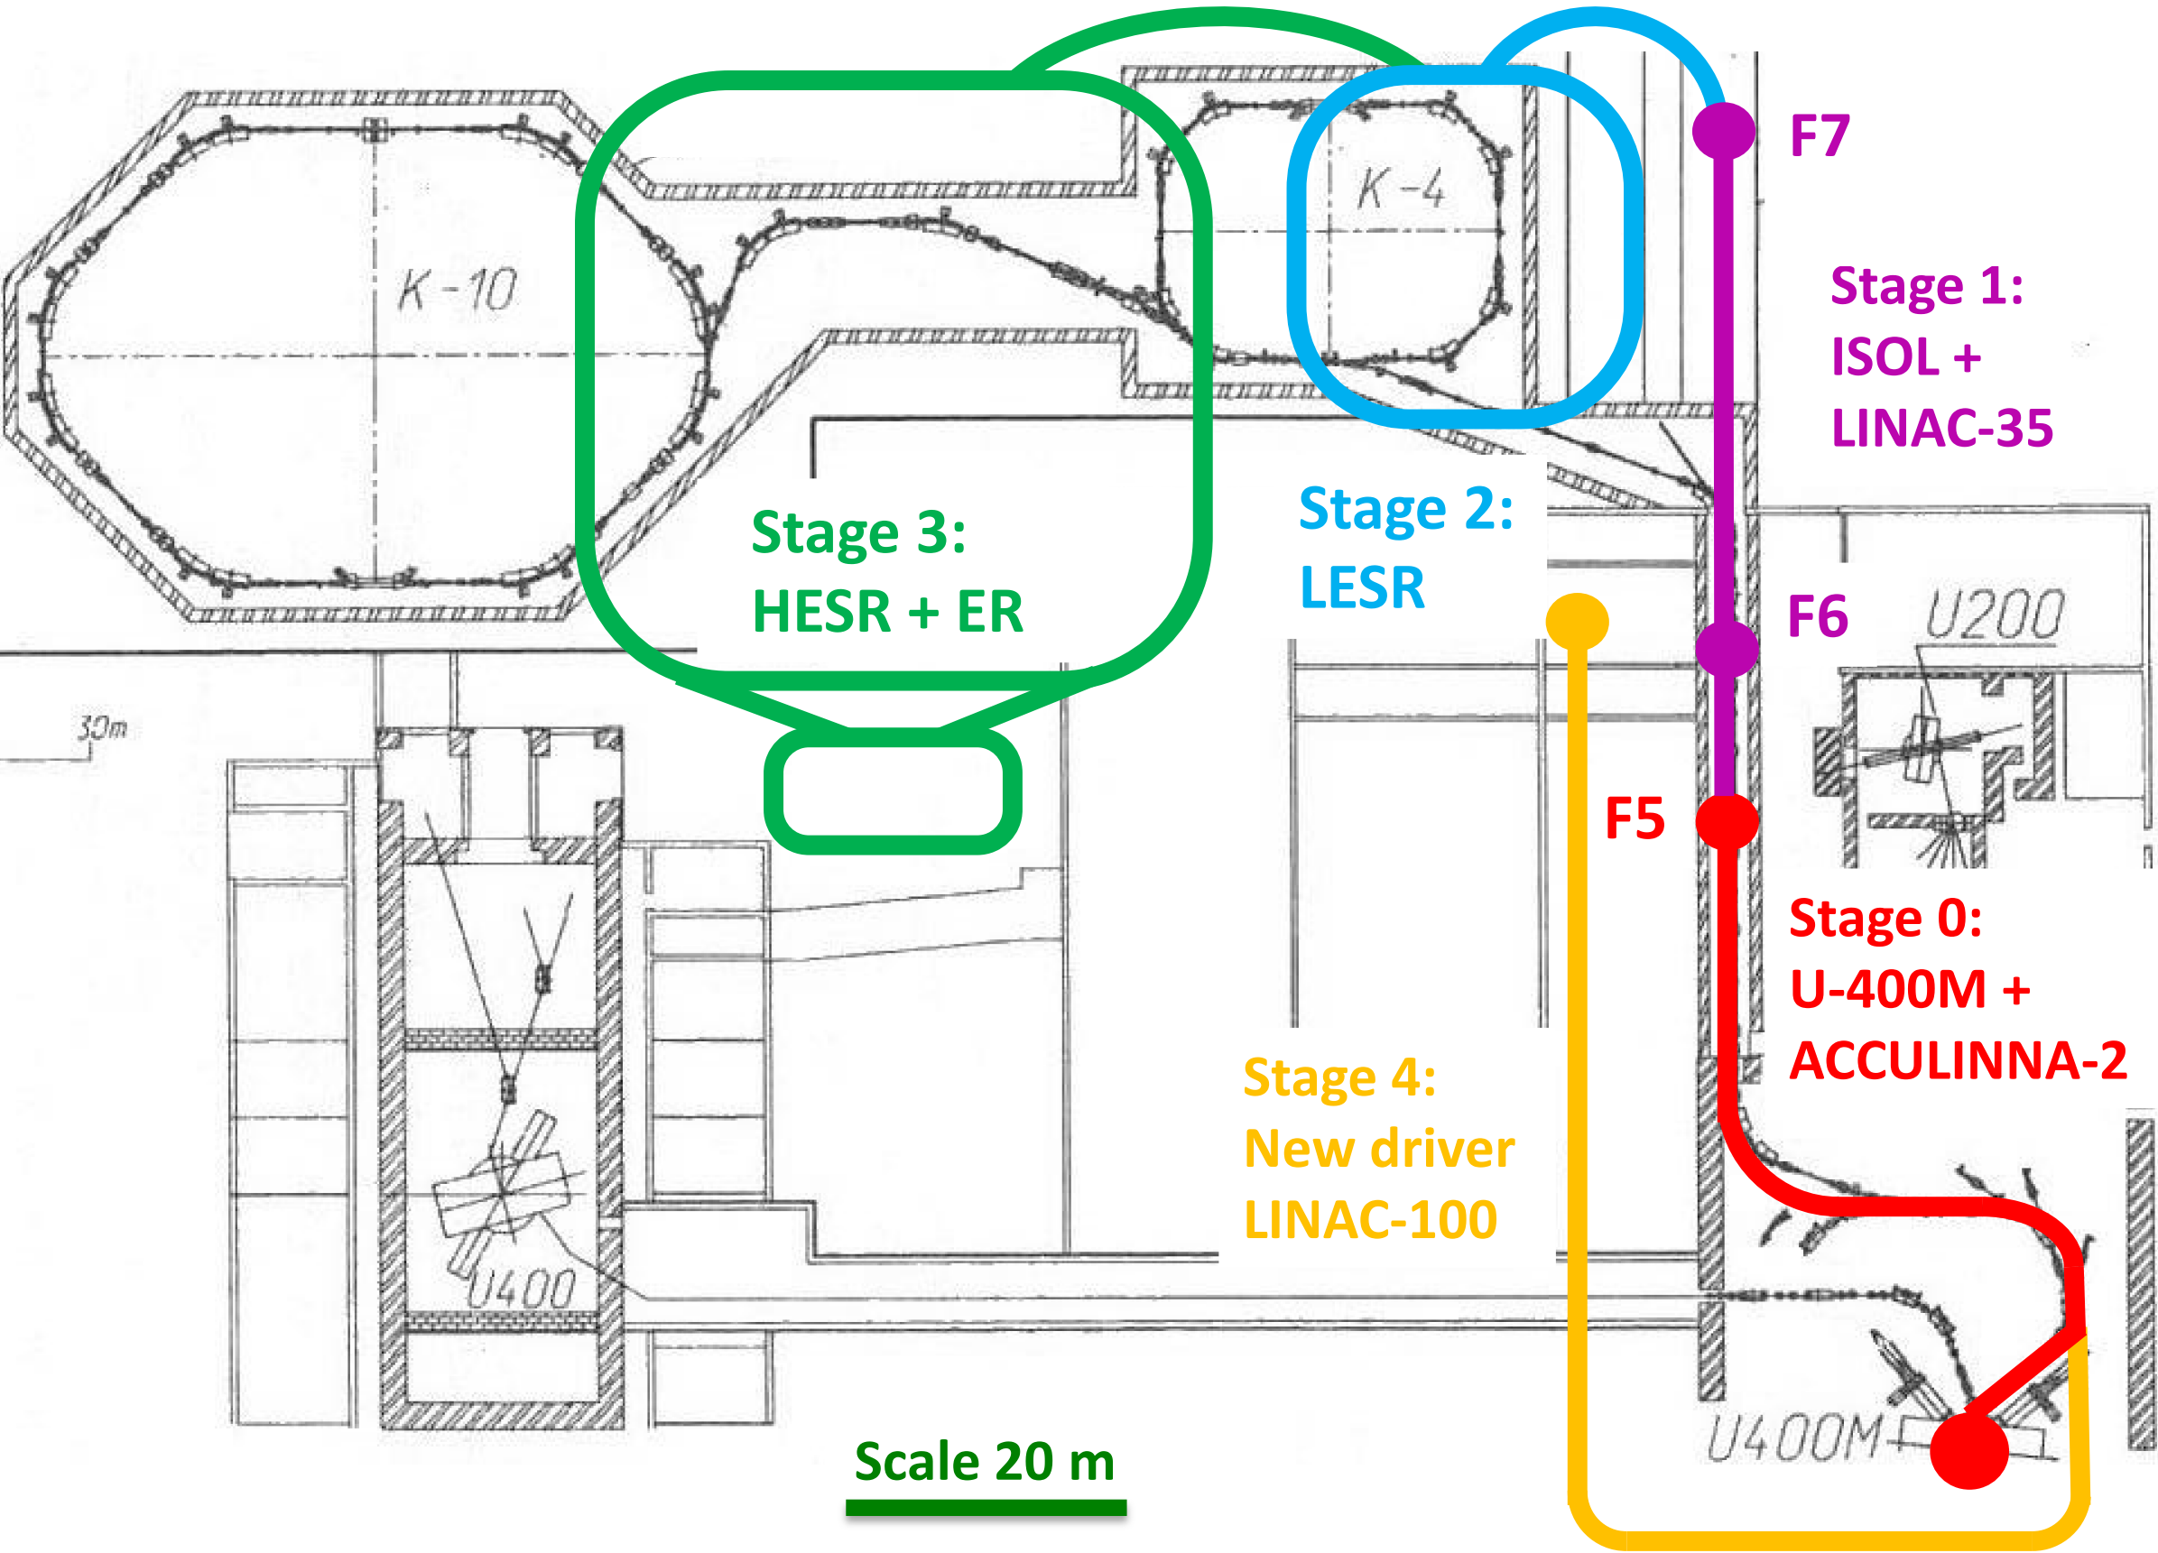
ERICA - Electron-Radioactive Ion Collider @ ACCULINNA-2
Oganessian et. al.,
K4-K10 project
Z. Phys. A341(1992)217

Slide 19
~ 25
Multipoles OFF
Multipoles ON
27 mm
~ 24
¹²Be transfers profile at F5 (by S.V. Stepantsov)

Slide 20
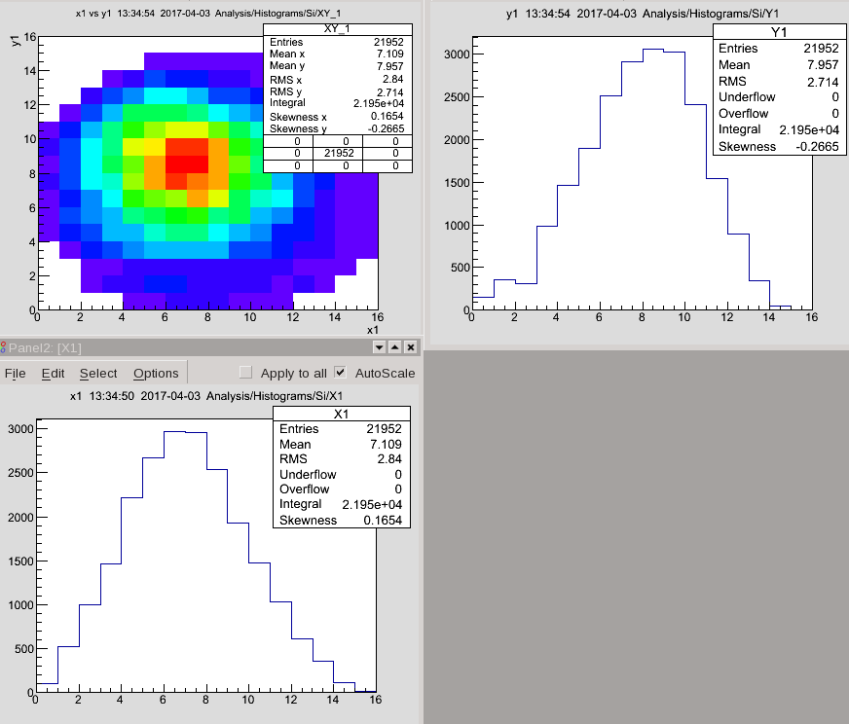
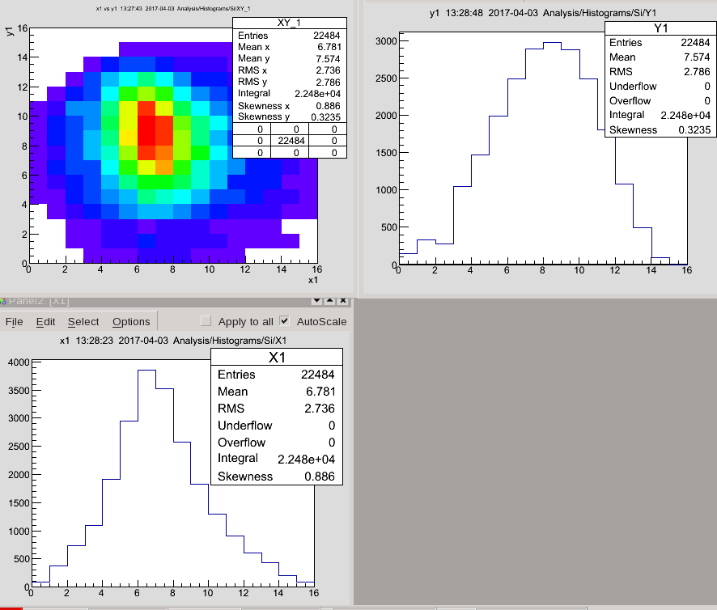
¹²Be transfers profile at F5
Multipoles OFF
Multipoles ON
↓
22 mm
26 mm
23 mm
Multipoles OFF
¹⁵N(49.7 AMeV) + Be(2 mm) →
¹²Be @ 39.4 AMeV;
Wedge(Be, 1 mm), Δp/p = 4%
20 mm
Multipoles ON

Slide 21
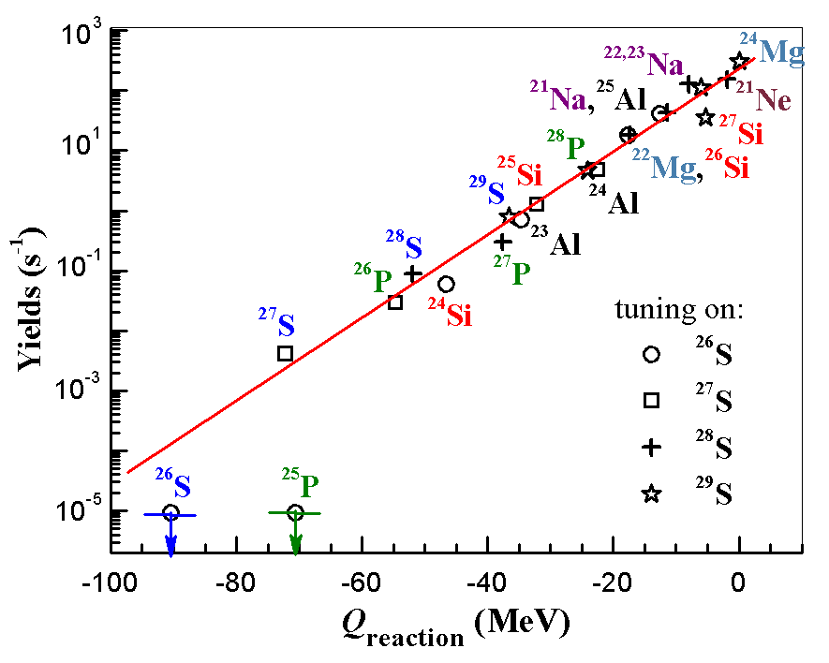
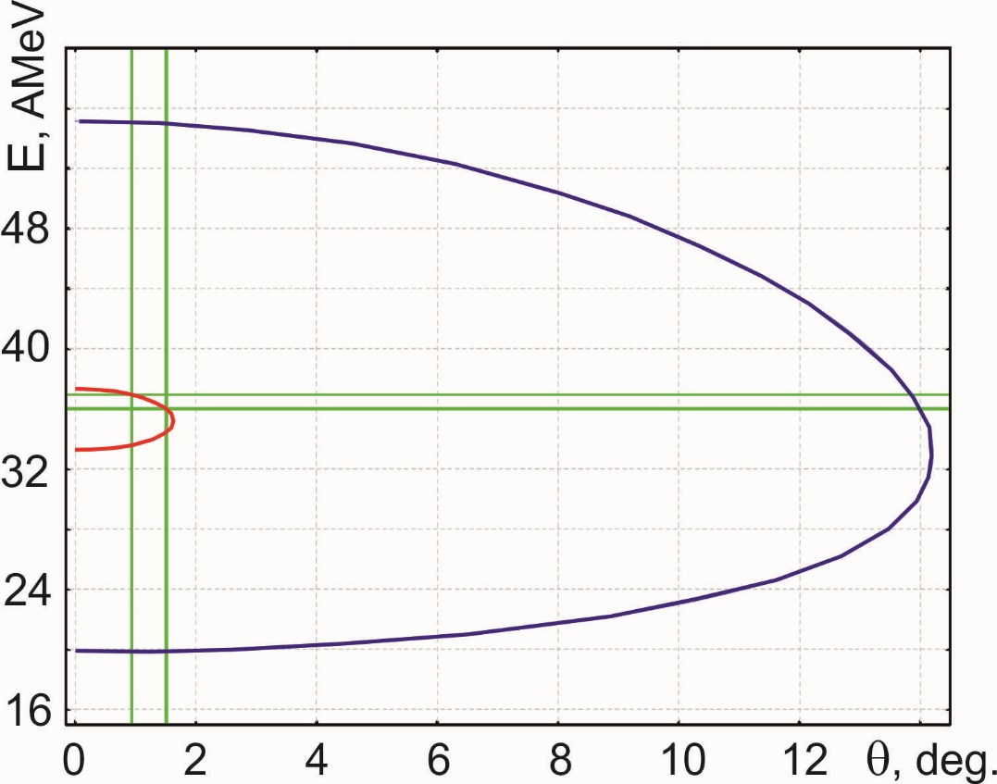
²⁶S: search via missing mass measurement
NNDC: T_{1/2} ~ 10 ms
Acculinna-1: ToF_{F1-F4} ~ 0.0003 ms
Experiment (implantation method):
T_{1/2} < 79 ns, Q_{2p} > 640 keV
Fomichev et al., IJMP E20 (2011) 1491
Acculinna-2 with RF-kicker
missing mass in p(²⁸S,t)²⁶S:
I(²⁸S)~10³ pps, P~12%, E~38 MeV/A,
1 mm liquid H₂ , σ~200 μb/sr ==>
~ 10 events ²⁶S per week
p(²⁸S,t)²⁶S
²⁶S
tritons

Slide 22
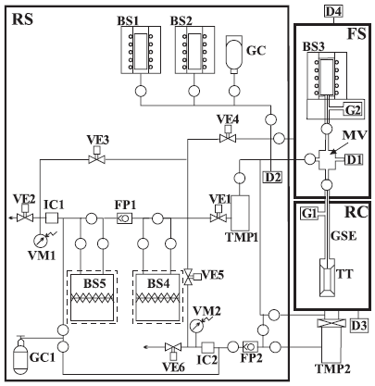
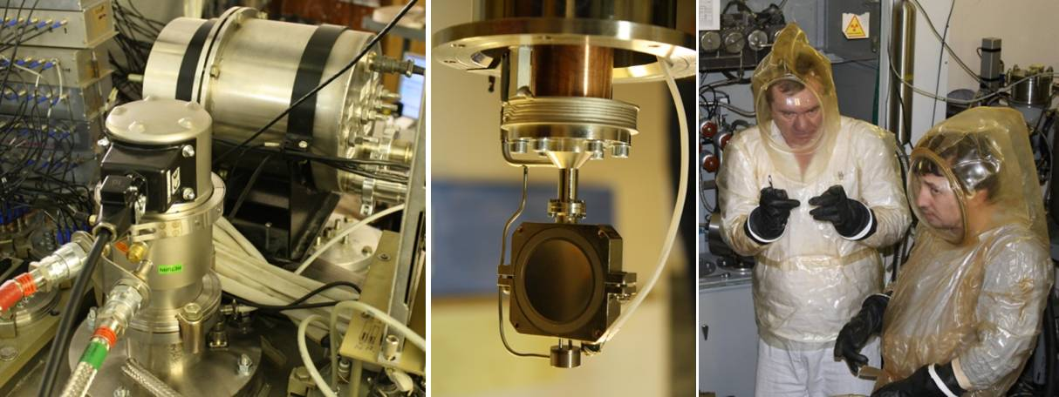
Physical unique targets H, He
Basic scheme of the complex.
FS—filling system; RS—tritium recovery and radiation
monitoring system; RC—reaction chamber; TT—tritium target; GSE—gas supply/evacuation line; BS1(2)—hydrogen (deuterium) source; BS3—tritium source; BS4, BS5—traps; GC, GC1—helium gas-cylinders; D1, D2—pressure gauges; D3, D4—vacuum gauges; FP1, FP2—vacuum pumps (BOC EDWARDS GVSP 30); TMP1, TMP2—turbo pumps (STR-300M); MV—measuring vessel (270 cm3); G1, G2—getters; VE1–VE6 valves (open circles show all other valves); IC1, IC2—ionization chambers; VM1, VM2—vacuum gauges blocking the gas release in ventilation in excess of a given level of the gas-specific volumetric activity.
A.A. Yukhimchuk et al.,
NIM A513 (2003) 439.
Gas:
ϕ=25 mm, d=3÷6 mm,
T=26 K, P=0.92 Atm,
x=3*10²⁰ Atm/cm²
Liquid:
ϕ=20 mm, d=0.4÷0.8 mm, w=2x8.4 μ stainless steel, x=1.1*10²¹ Atm/cm²
I ≤ 960 Ci (3.54*10¹³ Bq)

