Slide 1
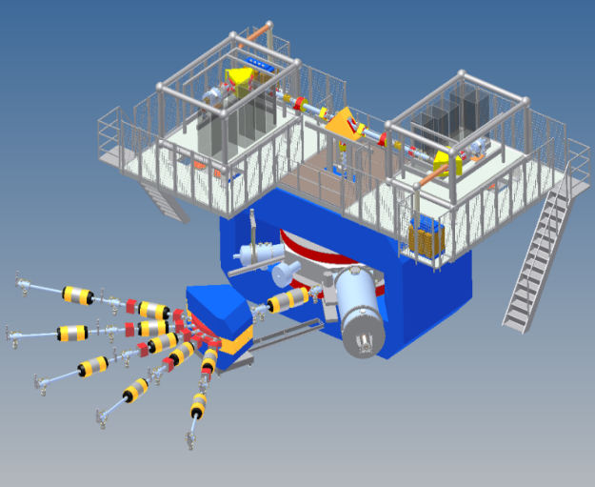
STATUS OF THE DC-280 CYCLOTRON for the Factory of Super Heavy Elements (SHEF)
G.G. Gulbekian, S.N. Dmitriev, Yu.Ts. Oganessian, B.N. Gikal, I.V. Kalagin, S.L. Bogomolov, I.A.Ivanenko, N.Yu.Kazarinov, G.N. Ivanov, N.F.Osipov
Igor Kalagin
FLEROV LABORATORY of NUCLEAR REACTIONS
JOINT INSTITUTE FOR NUCLEAR RESEARCH
PAC, Dubna 2017

Slide 2
Factory of Superheavy Elements – the main Goals
Synthesis of SHE and studying of their properties;
Search for the new reactions for SHE-synthesis;
Study of chemical properties of SHE;
Because of extremely low (σ<50 fb) cross sections of reactions the experiments require high intensities of primary beams for the best statistics.
The Factory will be based on the new DC-280 cyclotron. The cyclotron will produce high intensity ion beams.
DC-280 is being created in the new experimental building of the FLNR.

Slide 3
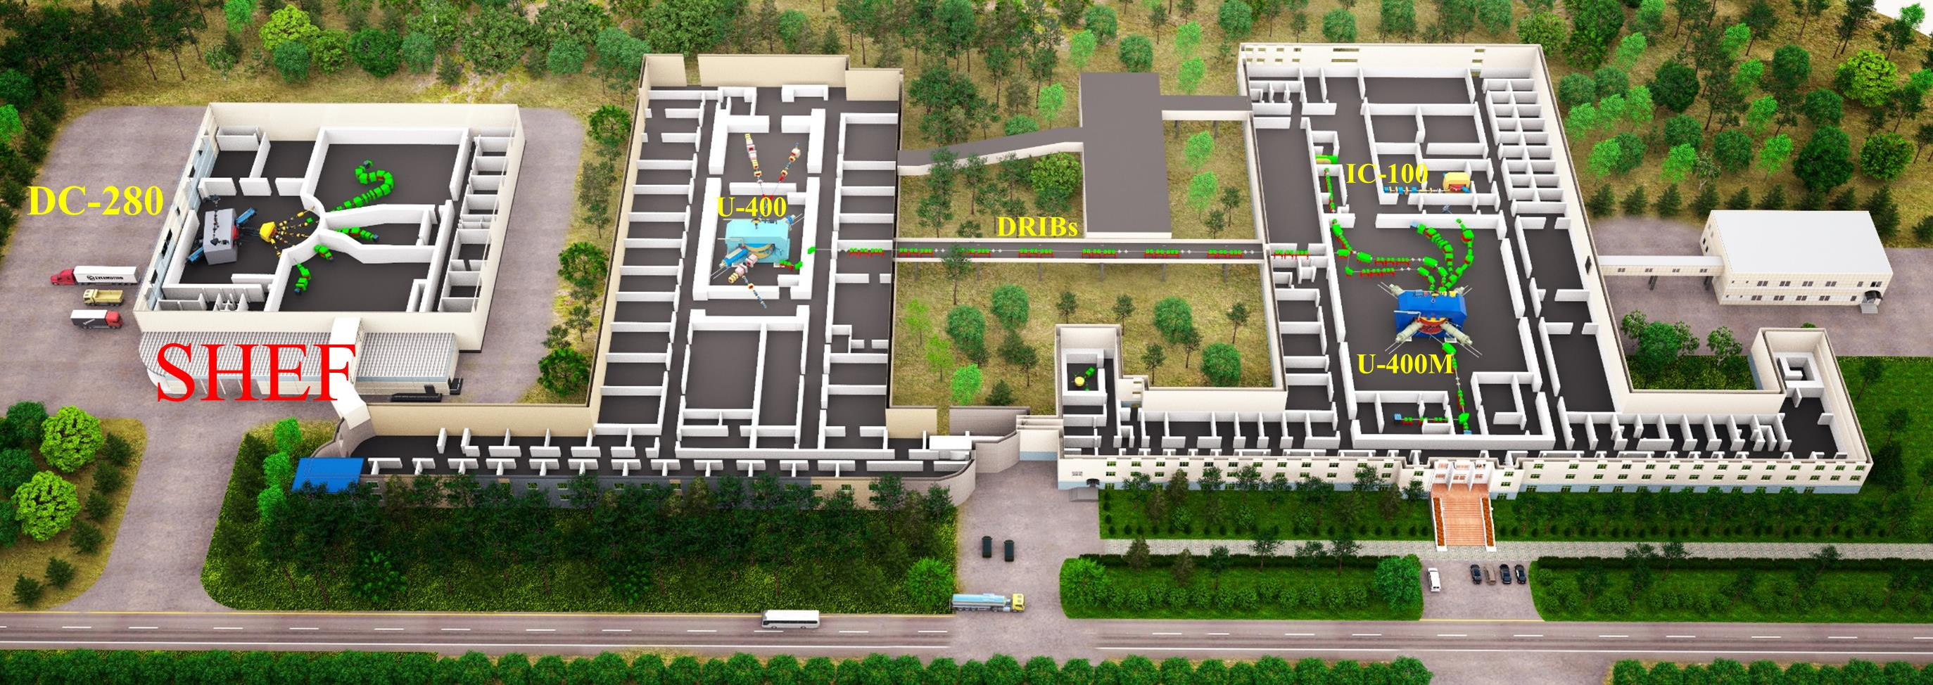
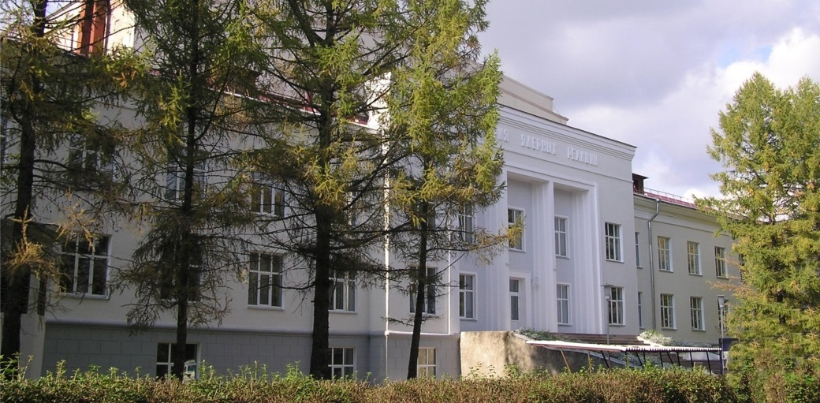
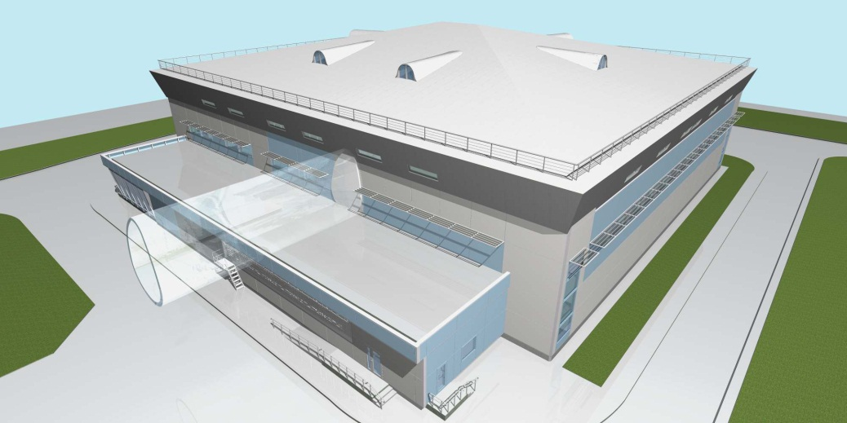
PLAN OF THE FLEROV LABORATORY OF NUCLEAR REACTIONS
The project of the SHEF experimental building
The FLNR main building

Slide 4
THE NEW FLNR ACCELERATOR –
THE DC-280 CYCLOTRON
To satisfy the Goals, the DC-280 must have the following parameters of the ion beams:
Ion energy 4÷8 MeV/n
Ion masses 10÷238
Intensities (A~50) >10 pµA
Beam emittance less than 30 π mm·mrad
Efficiency of beam transfer >50%
Ion energies correspond to total accelerating potential up to 40 MV

Slide 5
Basic principles of the DC-280 design
 | Principles | Expected results
1. | High injection energy of ions (>50 keV/Z) | Decreasing of ion beam emittance (typical injection energy of 15÷20 keV/Z). Effective transportation of ions through injection. Better efficiency of capture into acceleration.
2. | Low magnetic field (<1.5 Т) | Larger beam starting radius. Lower power of the main magnet.
3. | High accelerating voltage (>100 kV) | Higher turns separation. Lower vacuum losses of ions.
4. | Beam extraction by the electrostatic deflector together with the flat-top system | Effective ion extraction. Better beam quality.

Slide 6
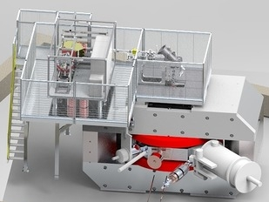
Actual configuration of the DC-280
Separating magnet
Accelerating tube
Electrostatic deflector
(Bender)
DECRIS-PM
ECR-source
(U_{max}=20 kV)
Magnet yoke
Magnet coils
HV platform N1
(U_{max}=60 kV)
Vacuum pump
Main RF-resonator
Flat –top resonator
Ion beam extraction

Slide 7
Main design parameters of the DC-280
Ion sources | DECRIS-PM - 14 GHz on the 1-st HV platform Superconducting ECR on the 2-nd HV platform (developing stage)
Injection energy | Up to 80 keV/Z
A/Z range | 4÷7.5
Energy | 4÷8 MeV/n
Magnetic field level | 0.6÷1.35 T
K factor | 280
Dee voltage | 2x130 kV
RF power consumption | 2x30 kW
Flat-top dee voltage | 2x13 kV
Flat-top power consumption | 2x2 kW

Slide 8
Expected beam parameters of the DC-280
ION | Z | Beam Intensity from ECR |  | HV platform N | Efficiency of acceleration | Expected beam intensities of (4÷8) MeV/n ions on targets pps
 |  | eμA | pps
20Ne | 3 | 150 | 3.10¹⁴ | 1 | 50% | 1.5·10¹⁴
40Ar | 7 | 300 | 3.10¹⁴ | 1 | 50% | 1.5·10¹⁴
48Са | 7/8 | 160 | 1.10¹⁴ | 1 | 50% | 6.2·10¹³
⁵⁰Ti | 8/9 | 75 | 5.10¹³ | 1 | 50% | 2.6.10¹³
⁵⁴Cr | 9 | 125 | 8.10¹³ | 1 | 50% | 4.10¹³
58Fe | 9/10 | 125 | 8.10¹³ | 1 | 50% | 4·10¹³
64Ni | 10/11 | 125 | 8.10¹³ | 1 | 50% | 4·10¹³
70Zn | 11/12 | 100 | 5.10¹³ | 1 | 50% | 2,5.10¹³
136Хе | 22/23 | 150 | 4.10¹³ | 1 | 50% | 2·10¹³
209Bi | 34/35 | 15 | 2,2.10¹² | 2 | 60% | 1·10¹²
238U | 39/40 | 1 | 1,5.10¹¹ | 2 | 60% | 1.10¹¹

Slide 9
Main systems of the DC-280
N | Item
1 | Magnetic system
2 | RF system
3 | Beam injection system
4 | Beam extraction system
5 | Beam transport system
6 | Diagnostic system
7 | Vacuum system
8 | Water cooling system
9 | Control system

Slide 10
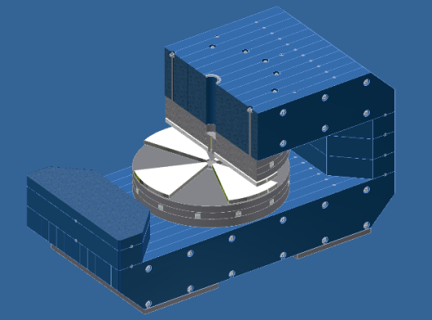
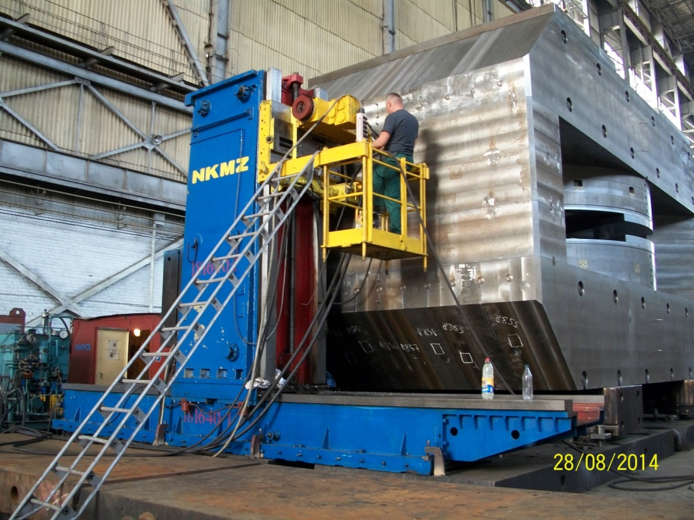
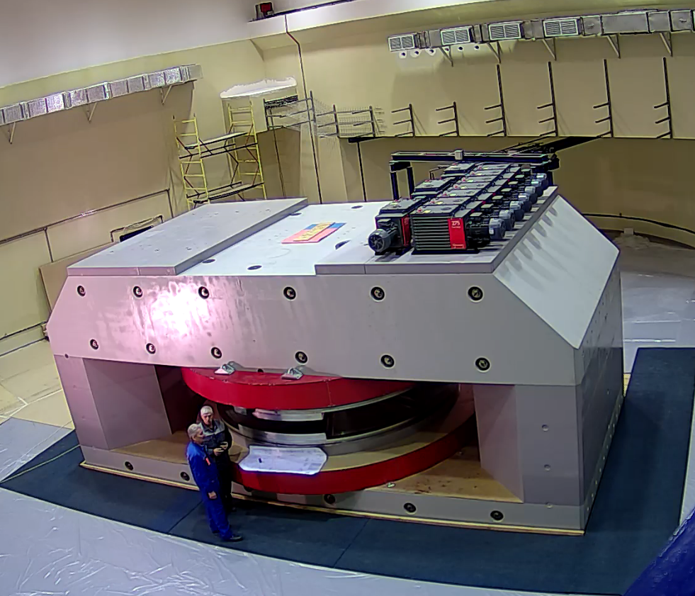
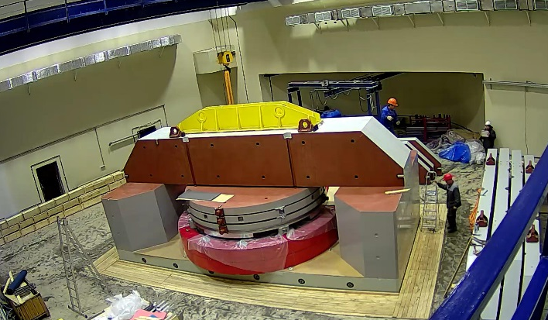
Magnetic system of ДЦ-280
Size of magnet yoke LхWхH | 8.76х4.08х4.84 m³
Pole diameter | 4 m
Gap between central plugs | 400 mm
Valley/hill gap | 500/208 mm/mm
Magnet weight | 1100 t
Magnet power | 300 kW
Maximal current | 905 A
Magnetic field level | 0.6÷1.35 T
DC-280- isochronous cyclotron
Magnet at the NKMZ, Ukraine (2014)
Magnet assembling (November 2016)
DC-280 magnet at the FLNR, February 2017
Main coils made in N&V, Romania (2016)

Slide 11
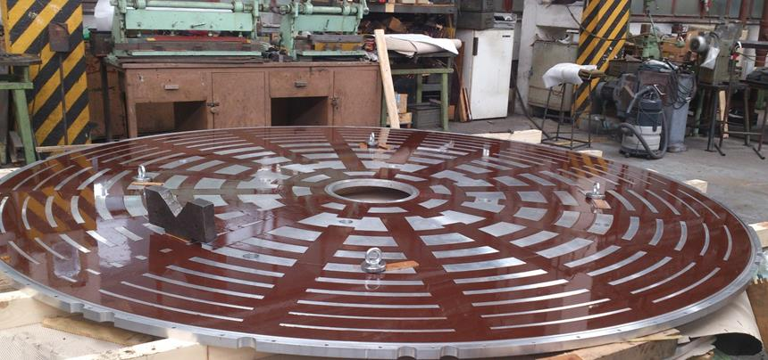
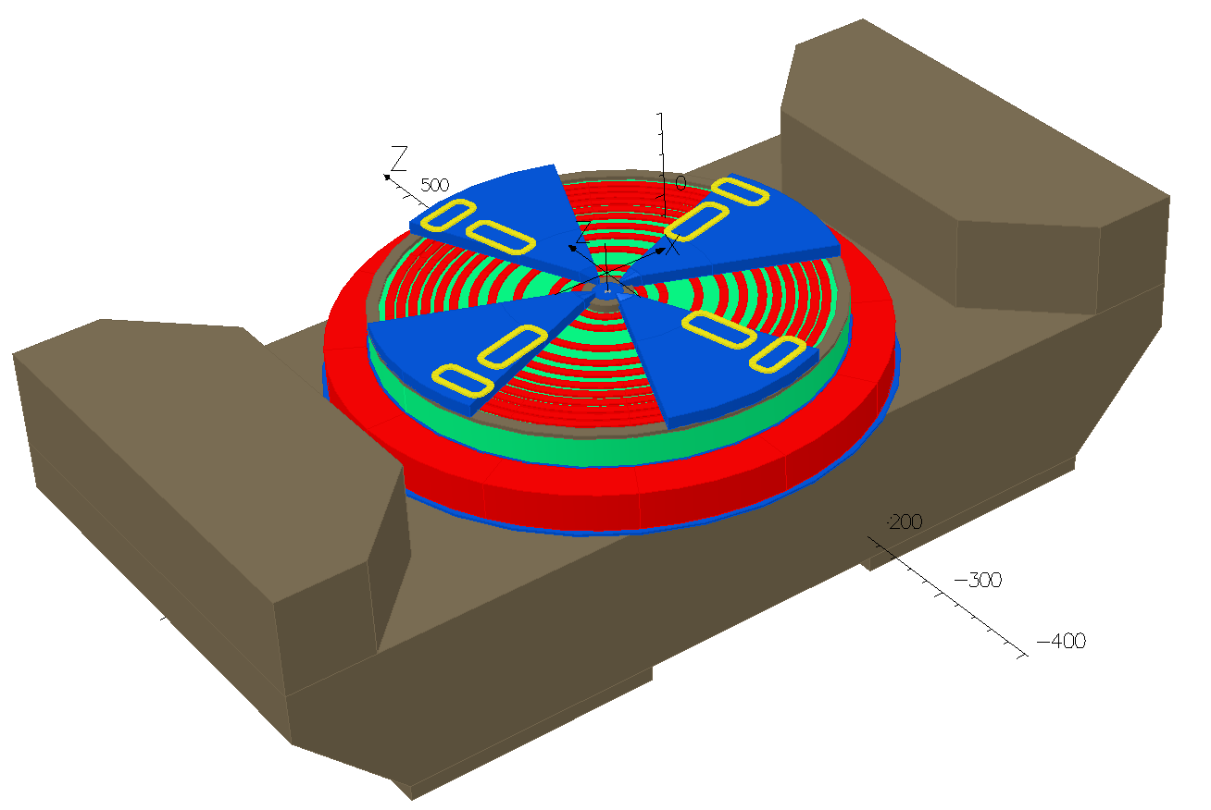
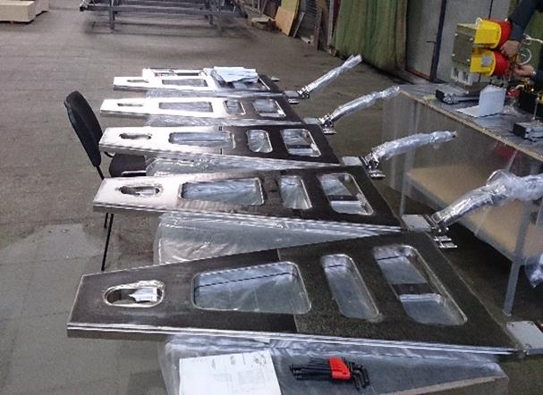
Magnet trimming coils
Azimuthal trimming coils
Radial trimming coils
Block of radial trimming coils
(EVPU, Slovakia)
Number of radial trimming coils | 11
Number of azimuthal trimming coils | 8
Blocks of azimuthal trimming coils (GKMP, Bryansk, Russia)

Slide 12
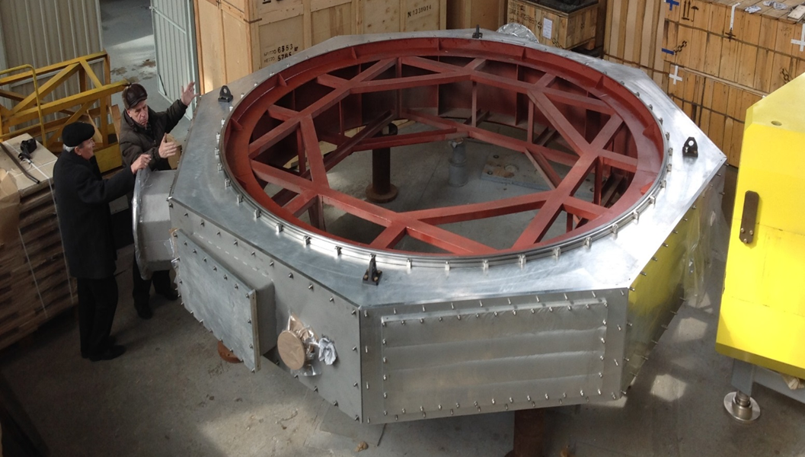
Vacuum chamber of the DC-280 magnet
Vacuum chamber has been manufactured at the NKMZ plant.
Vacuum tests have been made at the FLNR (2016)
Working vacuum is 10⁻⁷ mBar

Slide 13
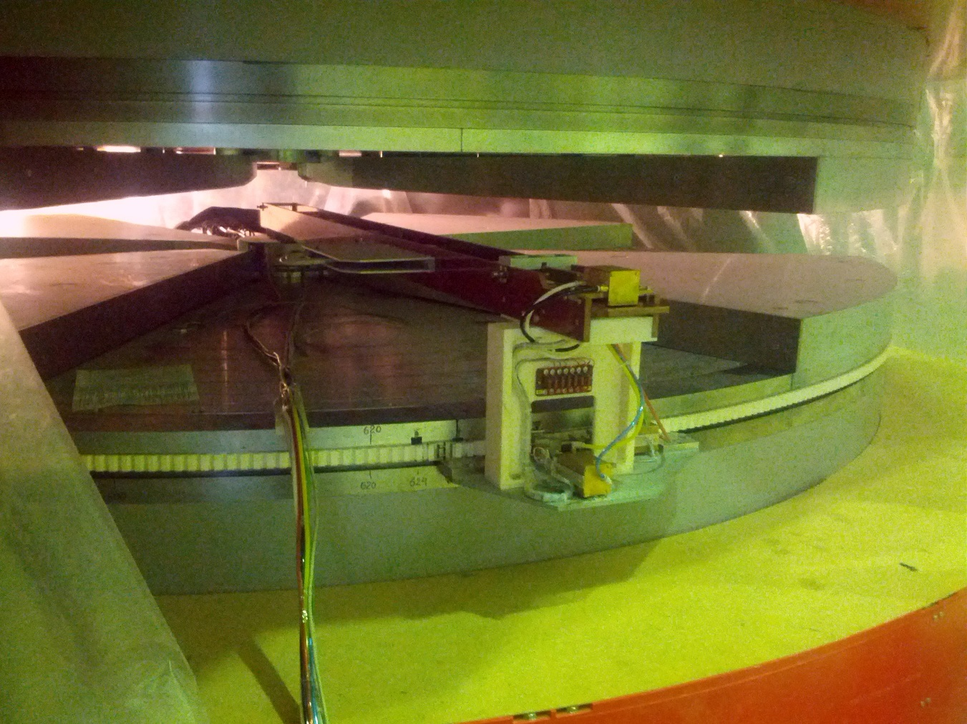
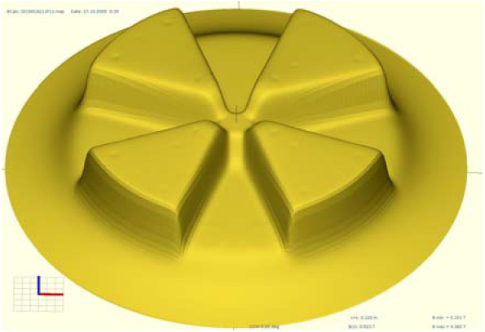
Magnetic field measurements
Top sectors
Magnetometer
Example: 3D field map
Toothed belt
Bottom sectors
The magnetometer with 14 Hall probes has been developed at the FLNR and was manufactured at the SPA “ATOM”, Dubna. Radial and azimuthal motions are carried by thepneumatic engines with using toothed belt for azimuthal stepping. Measuring accuracy of 10⁻⁴.
Actual period of magnetic field measurements: June - August of 2017.
The delay in the beginning of the measurements has been cased by the delay in obtaining permission from federal supervisory authorities on connection the magnet to the power supply.

Slide 14
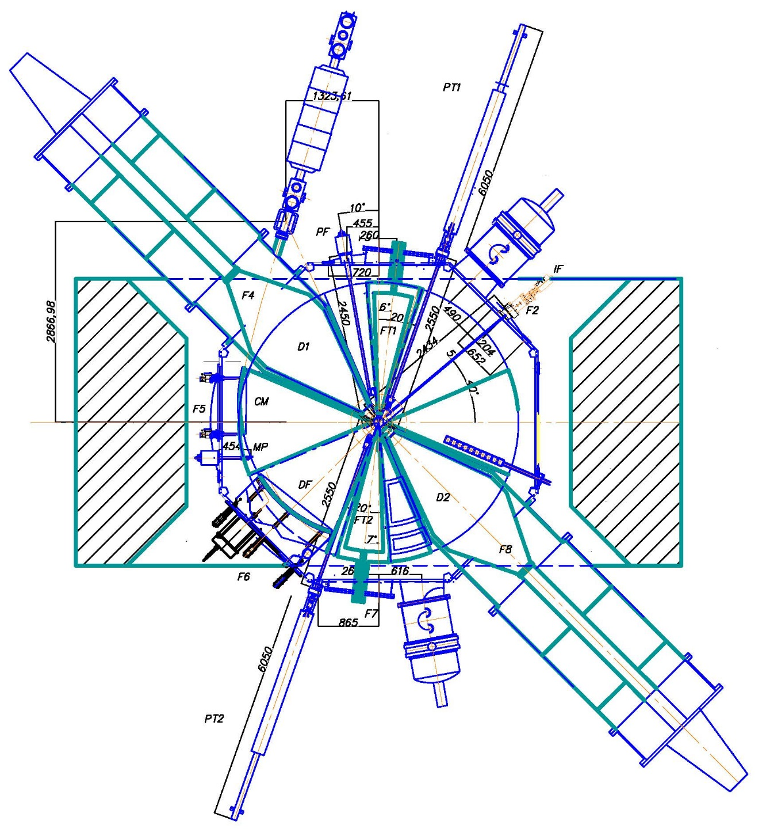
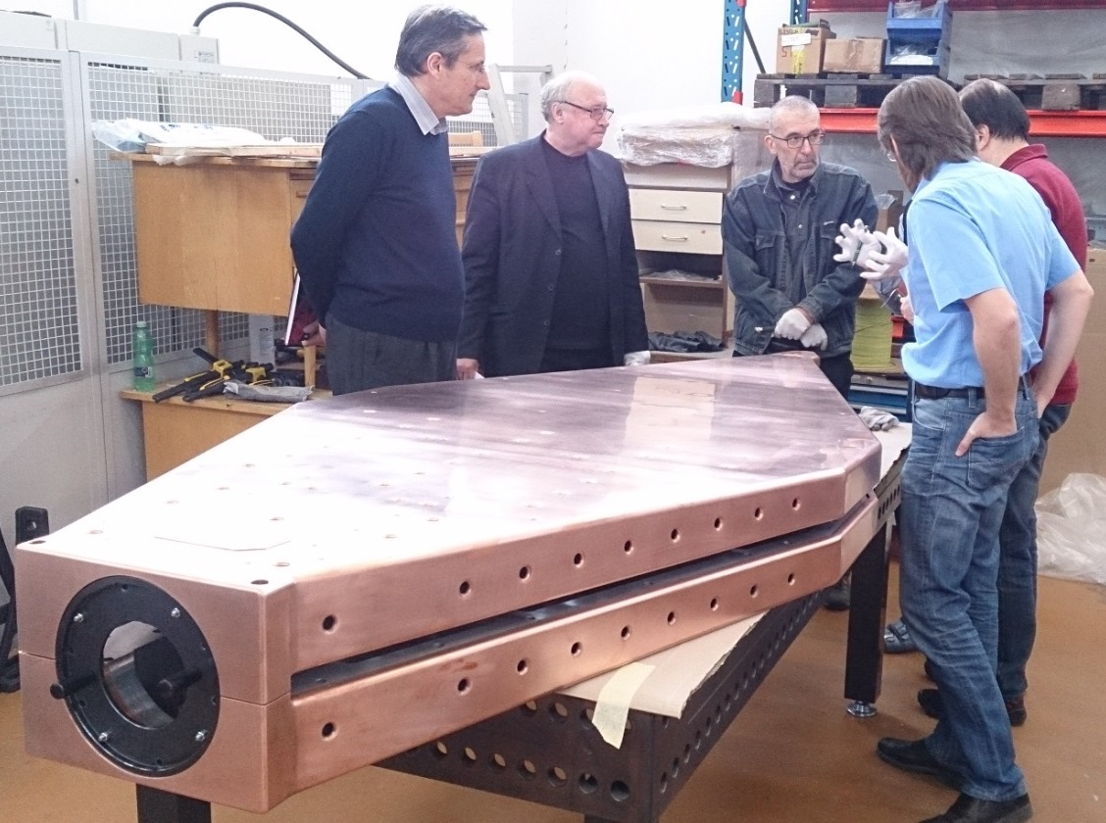
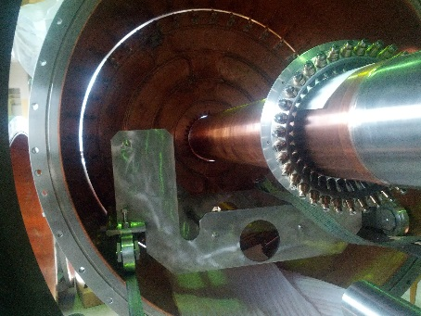
RF system
Configuration of the DC-280
The main dee (EVPU, Slovakia)
The RF resonator at the FLNR
(ZAVKOM, Tambov, Russia)
F_{rf}=7.32÷10.38 MHz
F_{ft}=21.96÷31.14 MHz
3F_{rf}
F_{rf}
Internal details of the resonator
The RF generators have been made in the QEI Corporation, NJ, USA

Slide 15
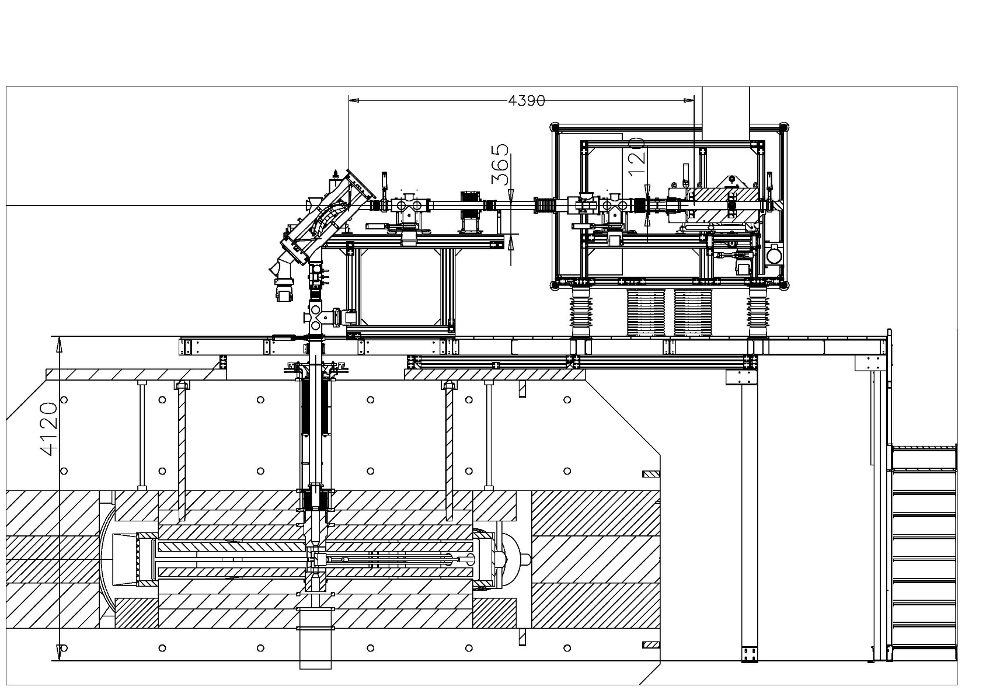
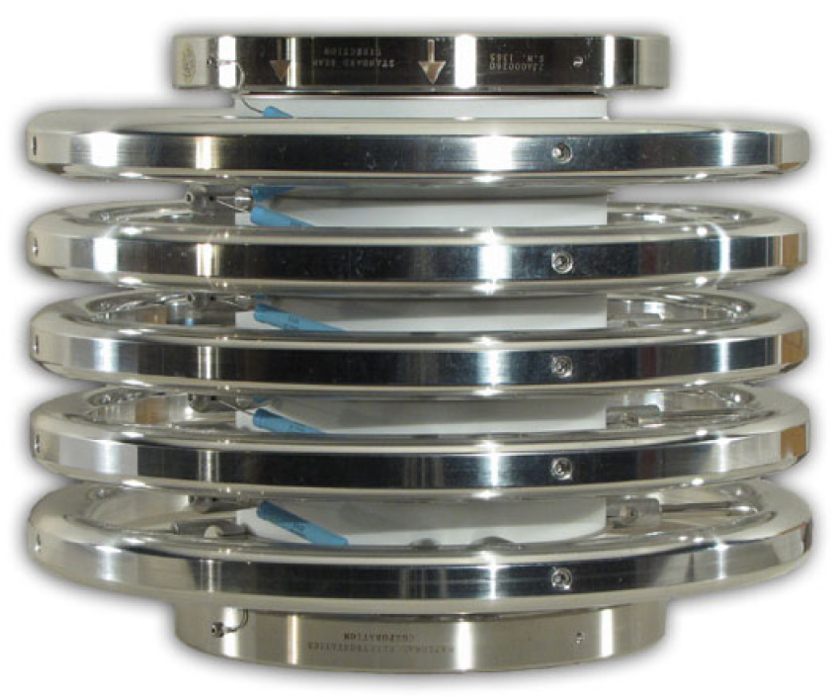
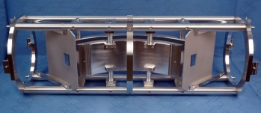
Beam injection system
Working vacuum in injection is 5·10⁻⁸ mBar
Vacuum volumes made by “Vacuum Praha”, Czech Republic
NEC,USA
HV platform
U_{max}=60 kV
Bender
±15 kV
“Vacuum Praha”
Buncher
Ion beam
Focussing solenoids
Magnet yoke
Median plane
Inflector

Slide 16
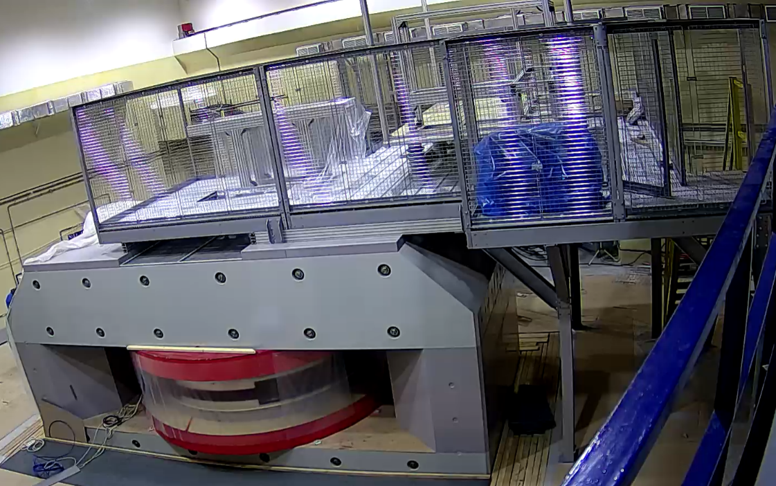
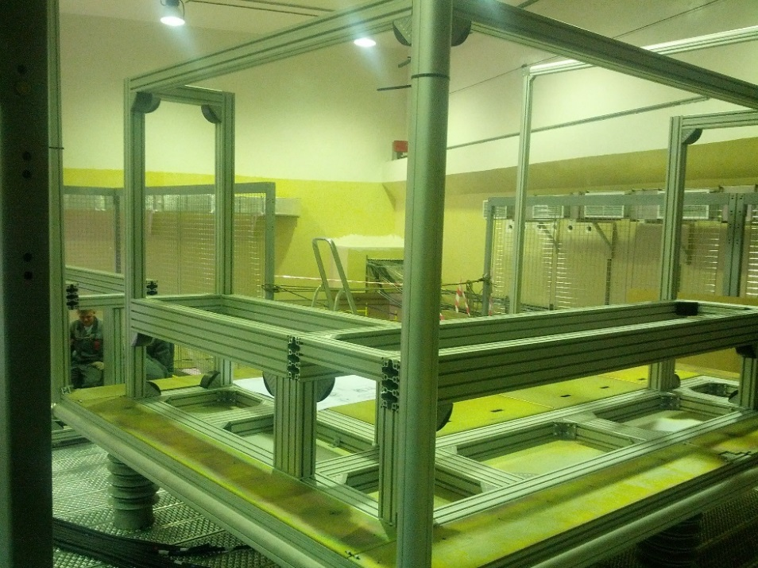
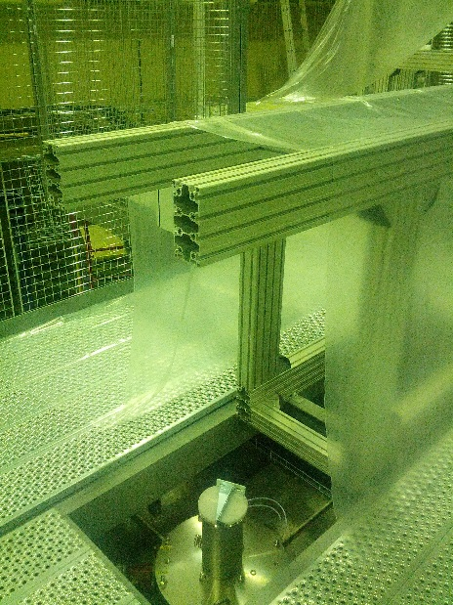
Beam injection system
The magnet with the base platform for injection
The HV platform N1 (May 2017)
Internal focusing solenoids have been installed to the cyclotron center (May 2017)
Magnetic elements for the injection made in EVPU, Slovakia

Slide 17
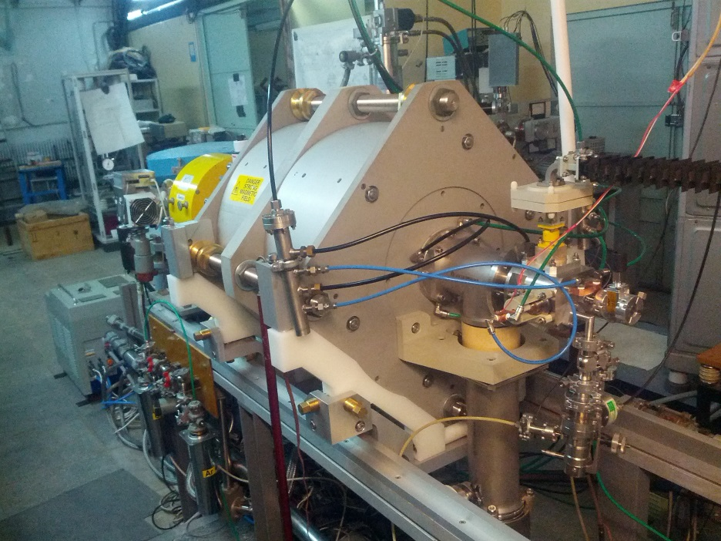
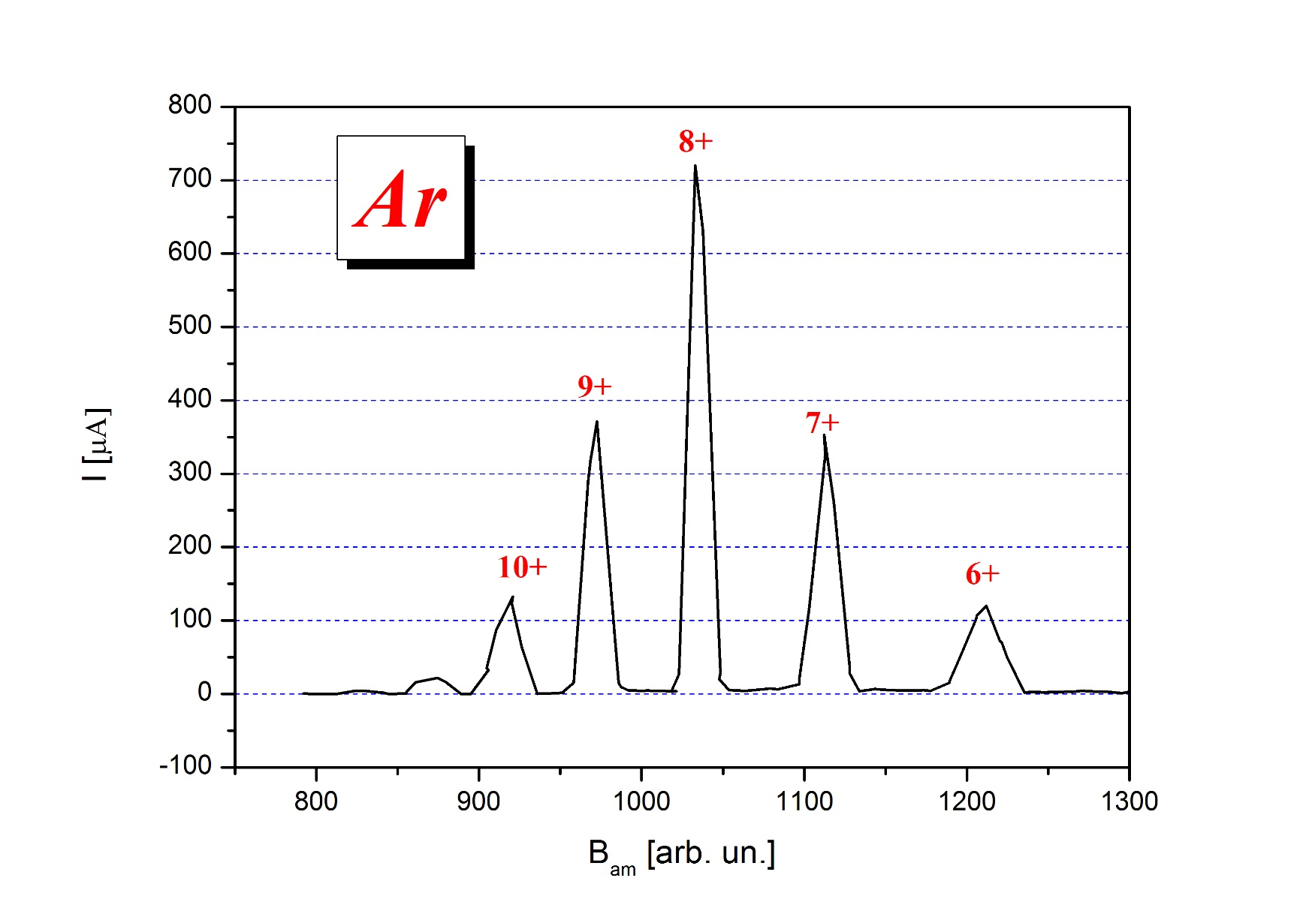
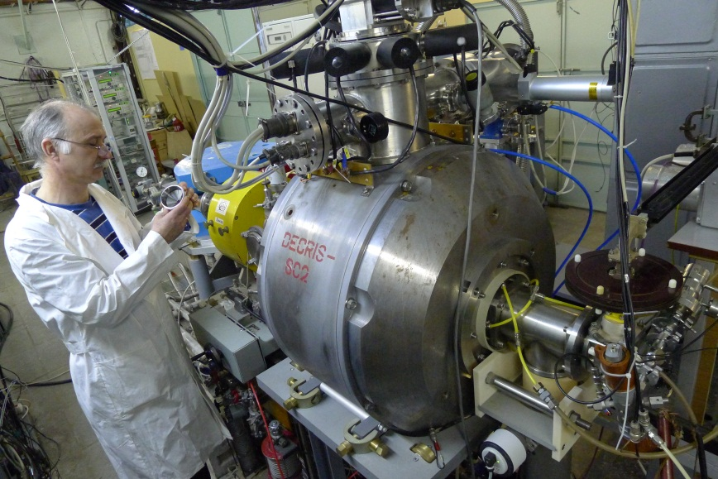
ECR-ion sources
The new ECR-ion source DECRIS-PM (14 GHz)
for the 1-st HV platform .
(FLNR and “ITT-Group”, Moscow).
Ion spectrum of DECRIS-PM (March 2017)
The FLNR has experience in developing and creation of DECRIS-SC and DECRIS-SC2 (18 GHz). The experience will be used for developing the new superconducting ECR for the 2-nd HV platform.

Slide 18
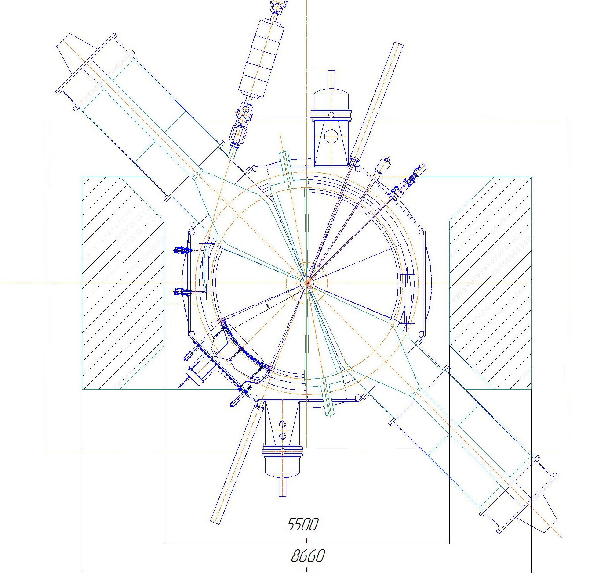
Beam extraction system
Extraction radius of R_{ext}=1.79 m
Ion beam
Focusing magnetic channel
Electrostatic deflector

Slide 19
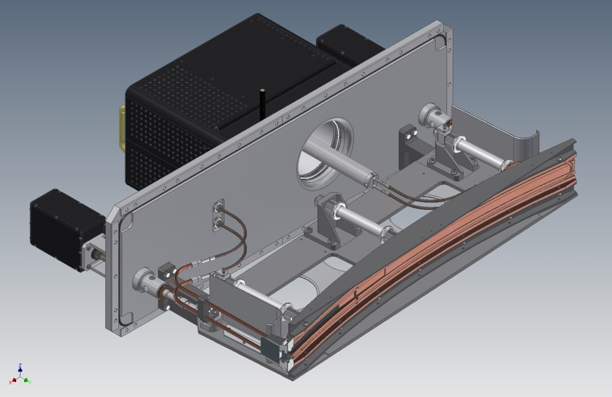
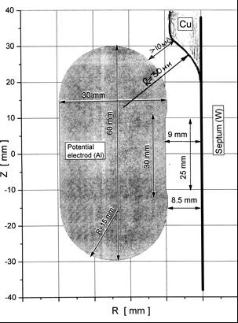
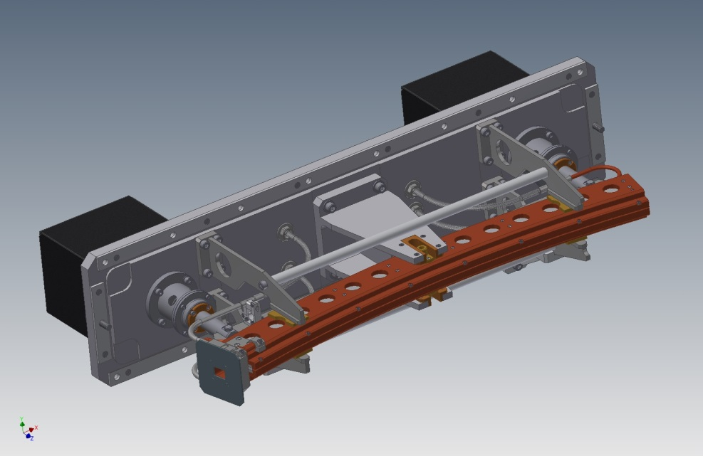
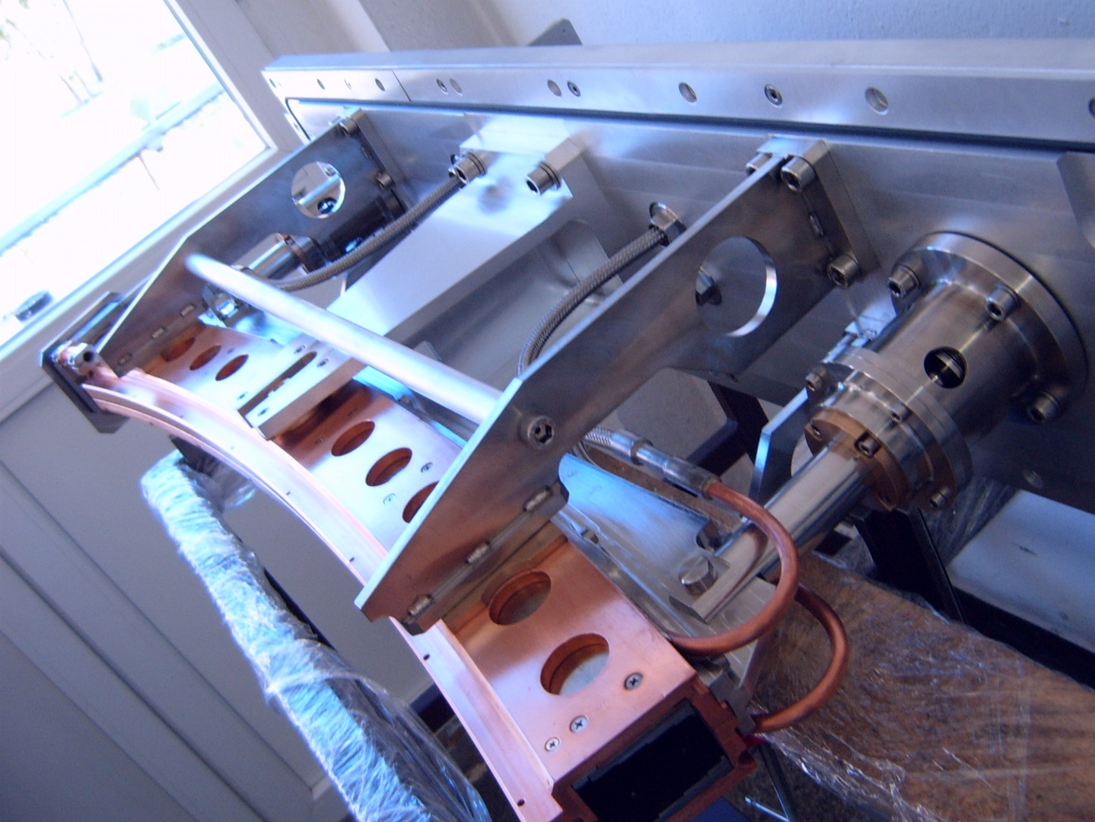
Length of electrostatic deflector | 1.3 m
Deflector voltage | 80 kV
Length of the magnetic channel | 0.9 m
Gradient of the magnetic channel | 4.6÷8.4 T/m
Electrostatic deflector
Magnetic channel
The magnetic channel has been produced at the Institute for Nuclear Research and Nuclear Energy of the Bulgarian Academy of Science.
Electrostatic deflector is being produced in the same Institute.

Slide 20
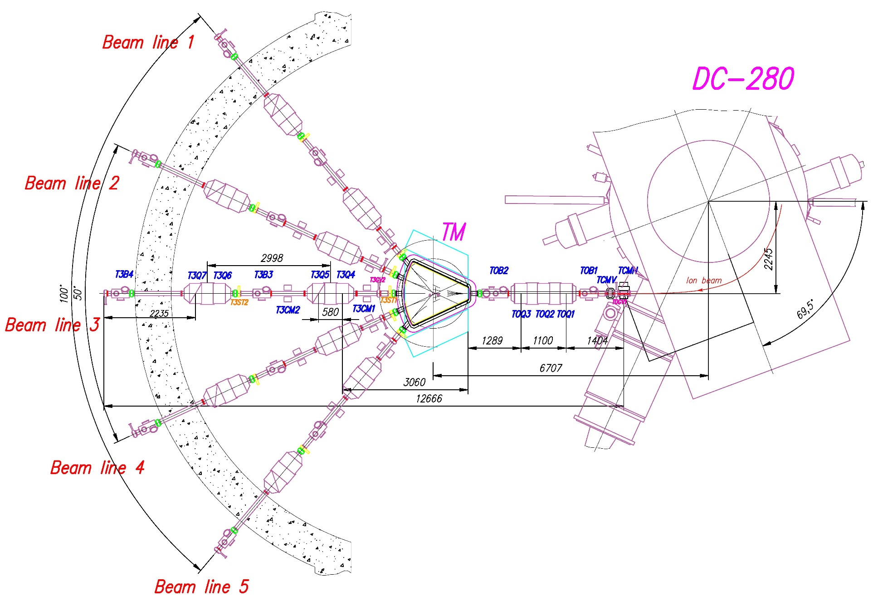
Beam transport system
MAX beam power ~2.5 kW
Ion beam
Bending magnet ±50°
Area of
experimental setups
Quadrupole lenses
Working vacuum is 10⁻⁷ mBar
Vacuum volumes of channels: “Vacuum Praha”, Czech Republic
Beam diagnostics: INR&NE of the Bulgarian Academy of Science

Slide 21
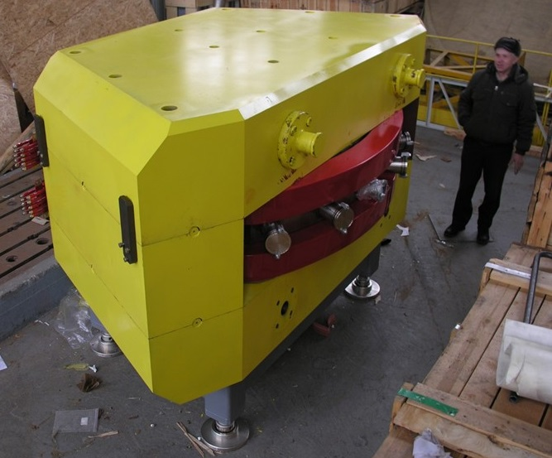
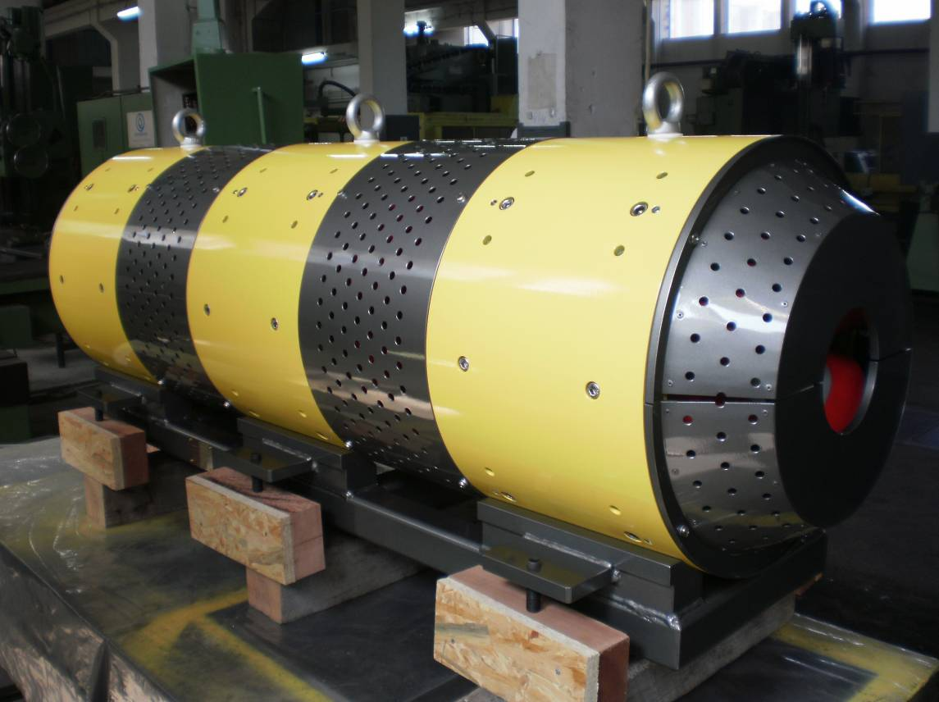
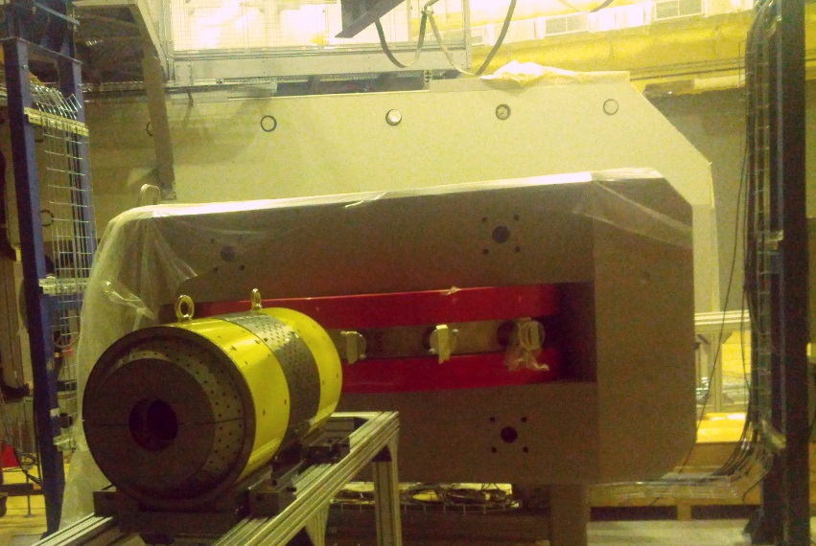
Magnetic optics
TM±50 bending magnet
(NKMZ, Ukraine)
The triplet of quadrupole lenses 11К30-700
(N&V, Romania)
Quadrupole doublet and TM±50 at the DC-280 hall

Slide 22
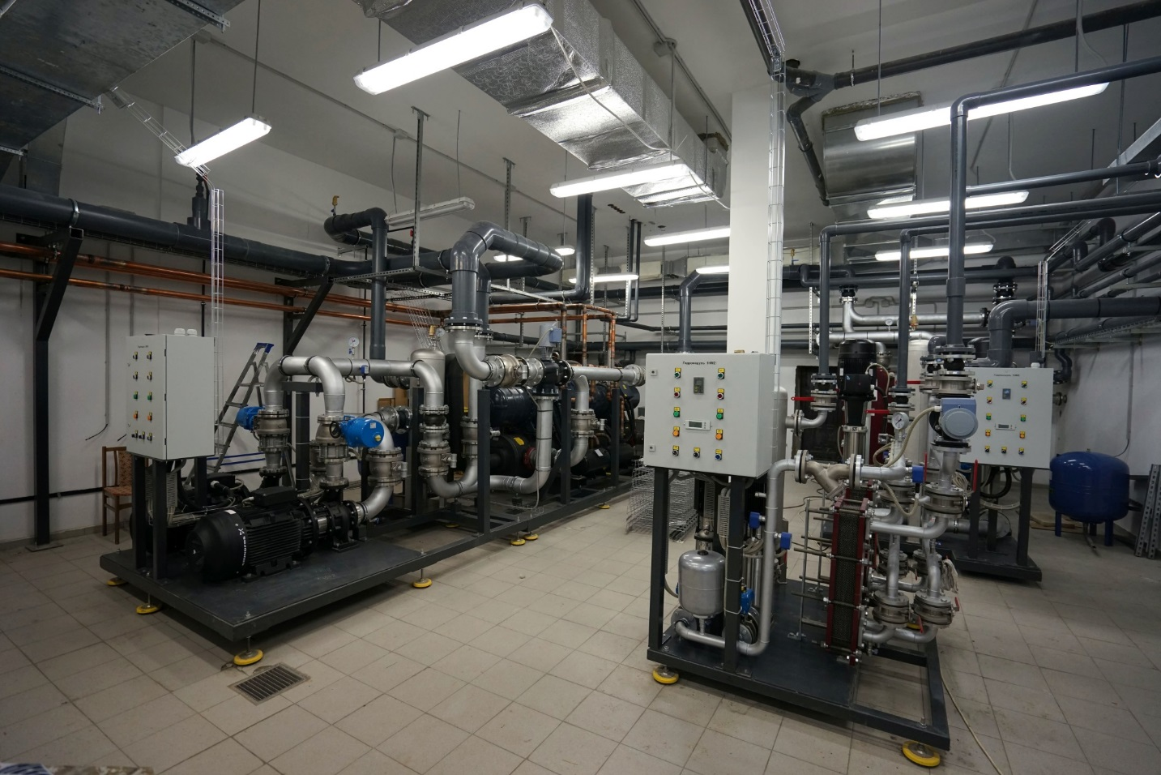
Water cooling system
The water cooling system was developed at the FLNR (equipment suppliers: Russia, Italy, Germany)

Slide 23
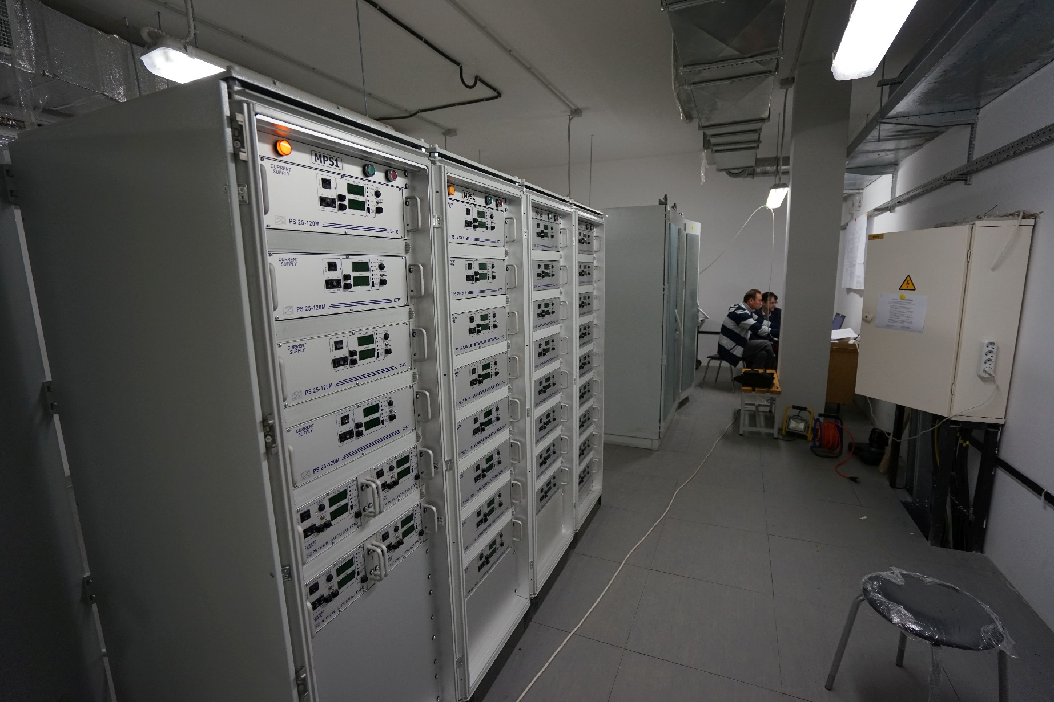
Control system
The control system based on FLNR developments and LabVIEW

Slide 24
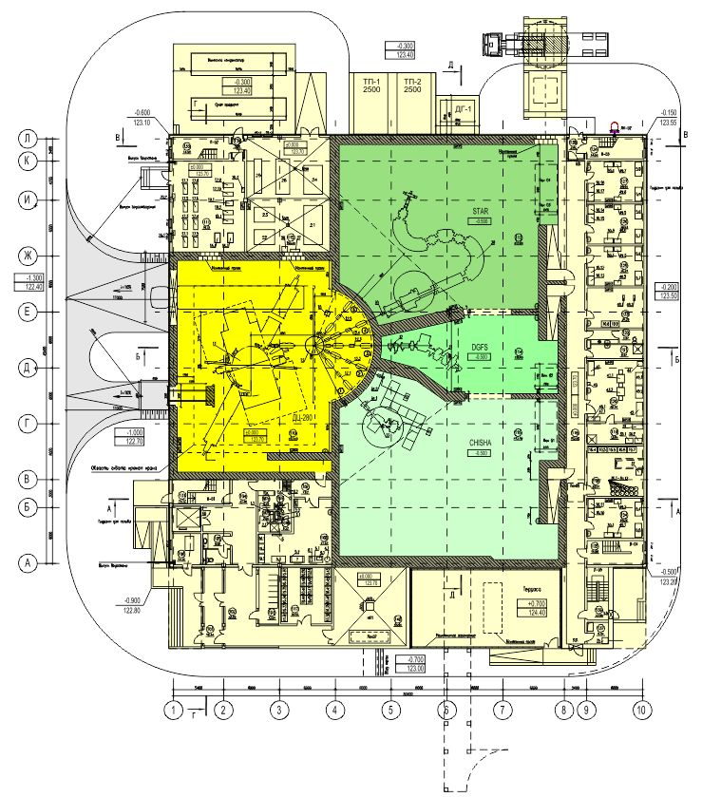
Plan of the 1-st floor of the SHEF
Experimental area ~1000 m² (3 halls)
Notes:
24

Slide 25
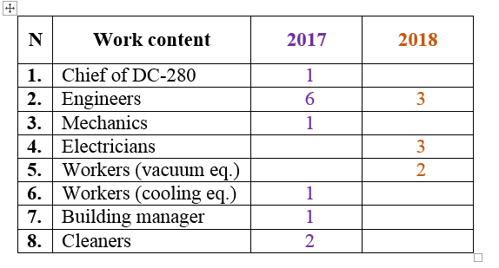
Schedule
Increasing of the FLNR staff for the SHEF
The JINR Directorate granted to the FLNR additional wages fund for 2017.

Slide 26
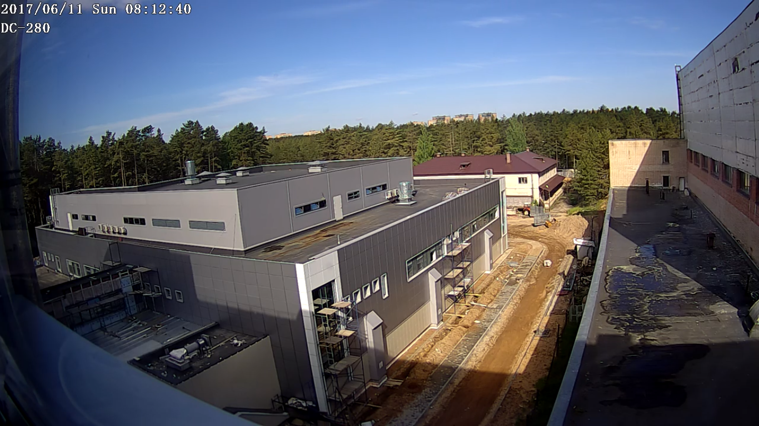
THANKS FOR YOUR ATTENTION!
The building of the SHEF
June 2017
The outline sketch of the building (2012)

Slide 27
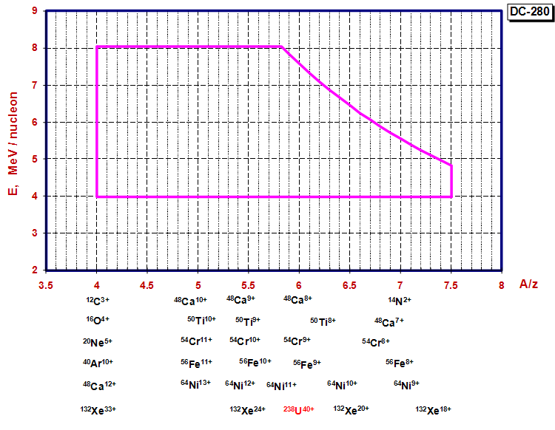
Working diagram of the DC-280

