Slide 1
Magnetic phenomena in intermetallic compounds RCo₂: studies of the limits of the itinerant electron metamagnetism concept
D.P. Kozlenko, E. Burzo, S.E. Kichanov, P. Vlaic,
A.V. Rutkauskas, E.V. Lukin, B.N. Savenko

Slide 2
The intermetallic compounds R-Co
Physical phenomena
Technological applications
Giant magnetoresistance effects
Magnetocaloric effects
Magnetoelastic effects
Structural phase transitions
Magnetic phase transitions
Permanent magnets
Magnetocaloric devices
Magnetoresistive data storage and recording
Strong correlated systems:
charge, structural, spin

Slide 3
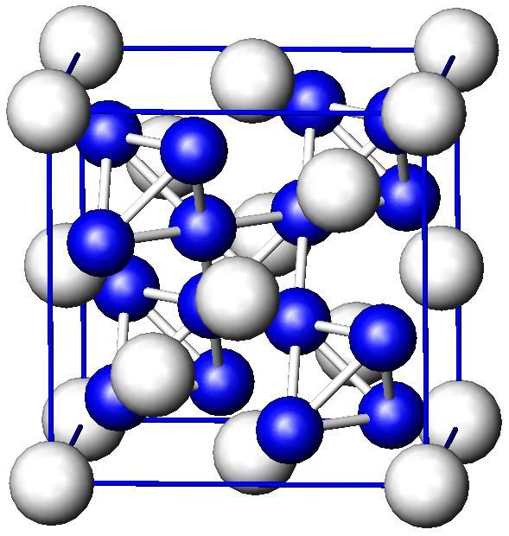
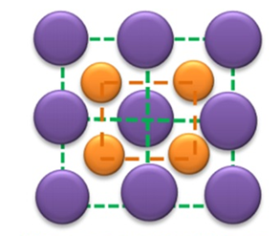
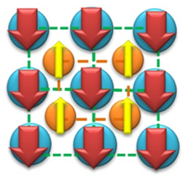
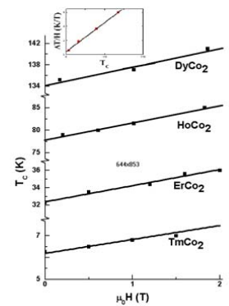
A metamagnetism of compounds R-Co
Non-magnetic R-ions:
YCo₂ or LuCo₂
M_{R} = 0 μ_{B}
M_{Co} = 0 μ_{B}
Paramagnetic state
up to 70-75 T
Magnetic R-ions:
TbCo₂, HoCo_{2,} ErCo₂, DyCo₂
M_{R} = 6-10 μ_{B}
M_{Co} = ~1 μ_{B}
R
R
Co

Slide 4
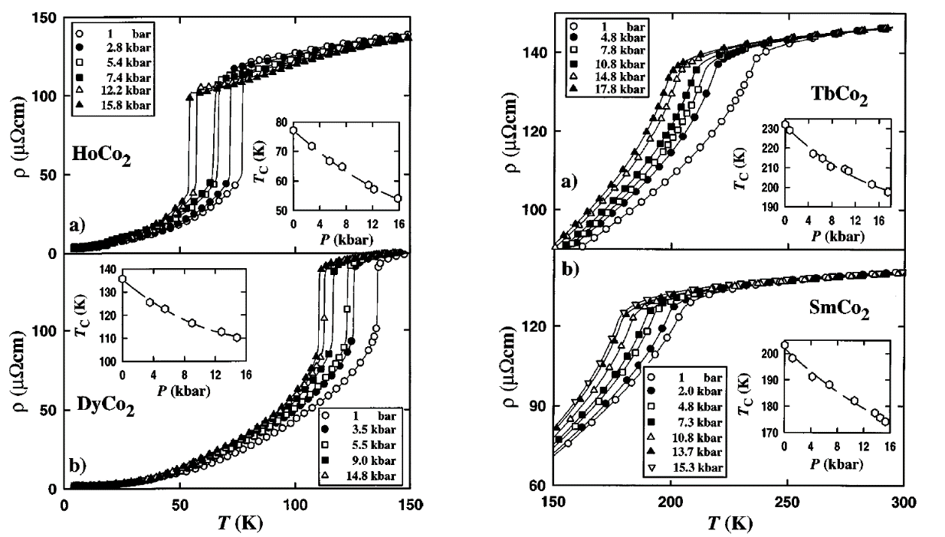
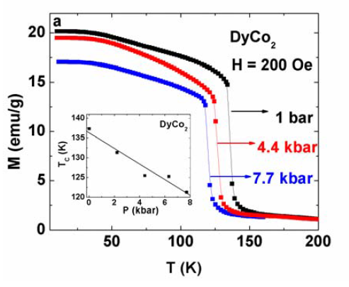
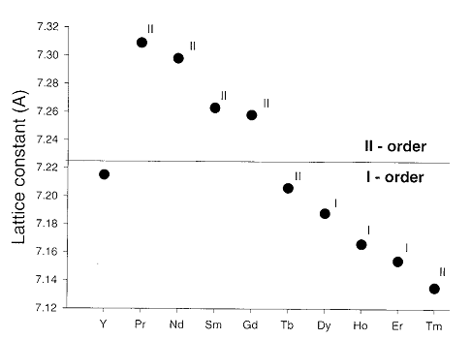
A pressure effect on the metamagnetism of RCo₂ compounds
Phys. Rev. B 57, 2904 (1998).
J. Phys. Condens. Matter 19, 036213 (2007).
P
E. Burzo, Repts. Progr. Phys. 61, 1099 (1998).

Slide 5
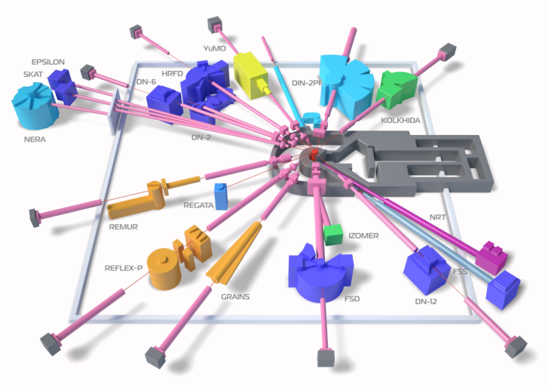
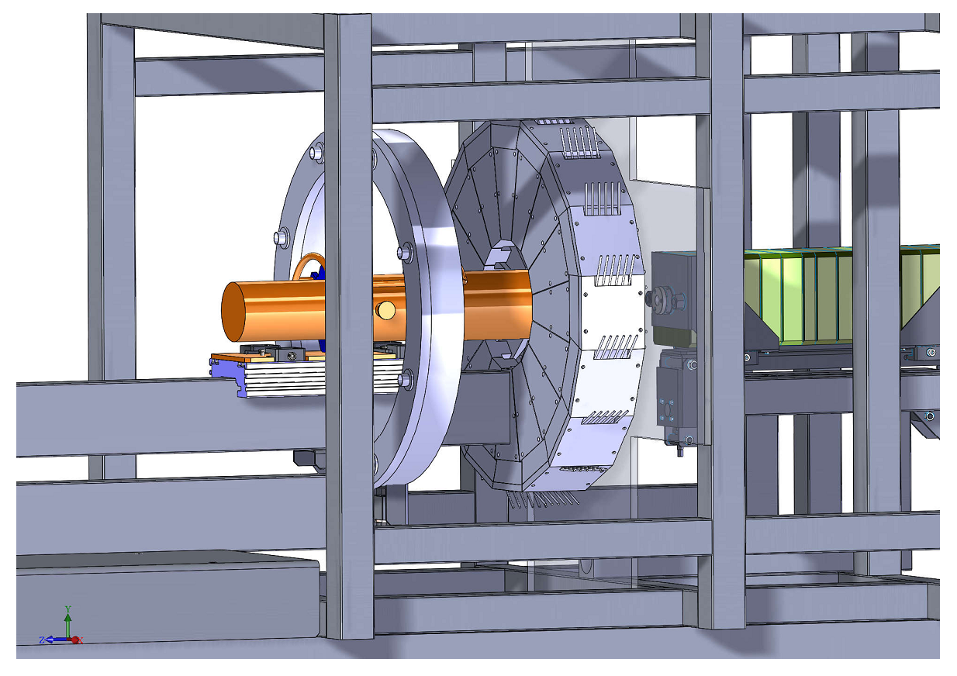
Advantages of IBR-2 pulsed neutron source for development of neutron scattering techniques under extreme conditions
Neutron diffraction at high pressure: structure aspects of magnetic properties origins
Lattice parameters, bond lengths and valence angle
Magnetic moments of R and Co
DN-12 diffractometer for studies of microsamples (~ 1 mm³)
DN-6 diffractometer for high pressure studies (~ 0.001 mm³)

Slide 6
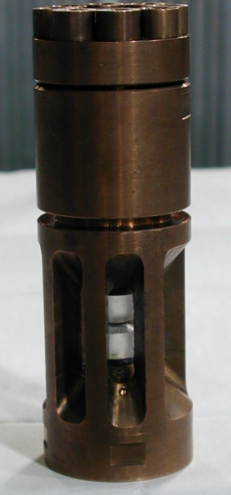
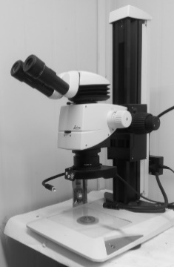
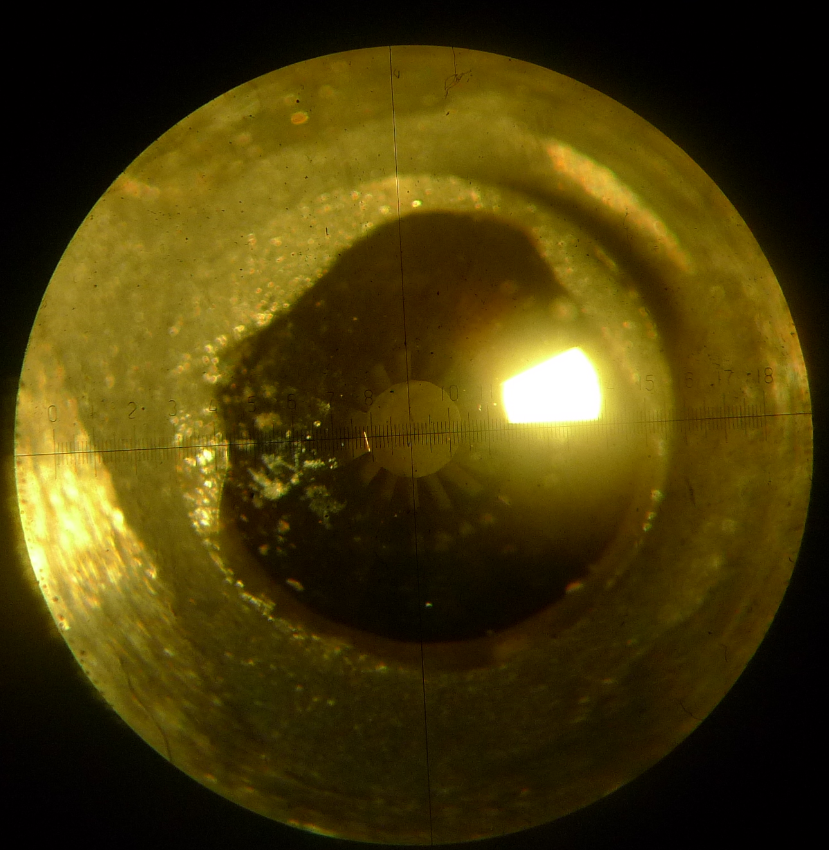
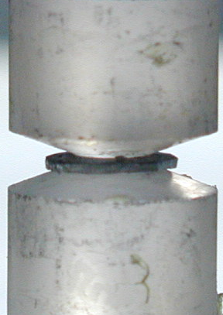
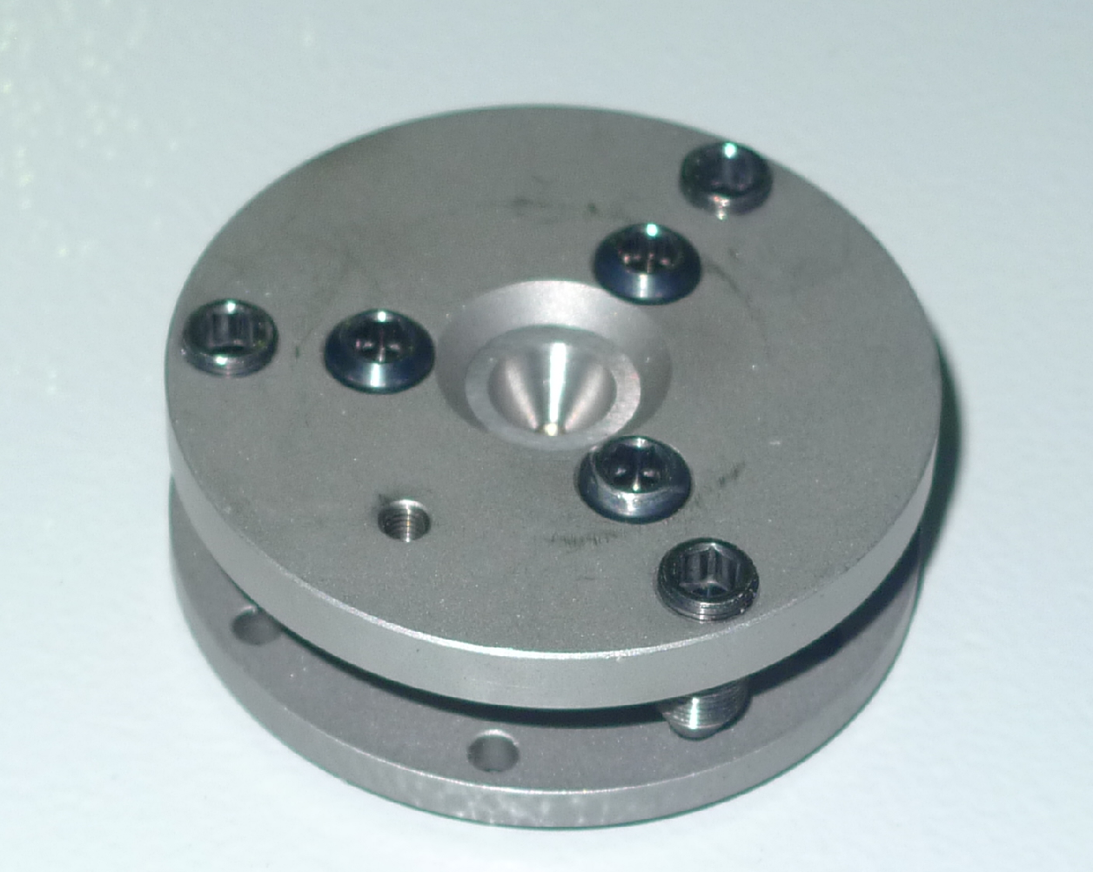
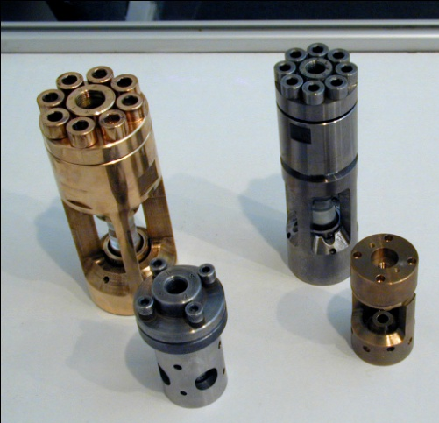
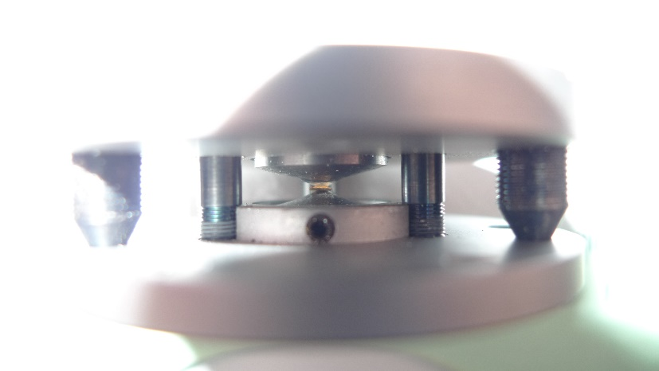
The neutron scattering techniques under extreme conditions
Maximum pressure is 8 GPa =80 000 atm
Maximum pressure is 40 GPa =400 000 atm

Slide 7
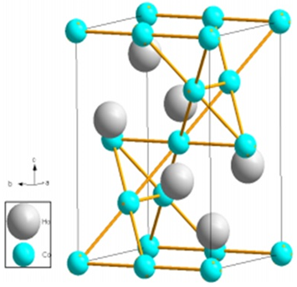
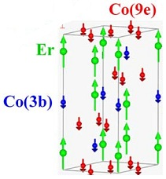
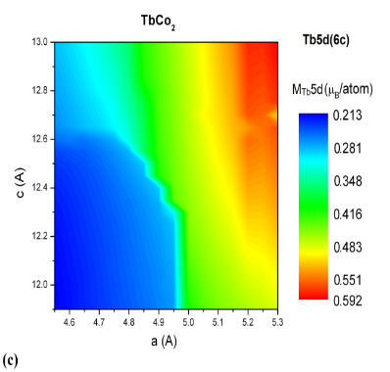
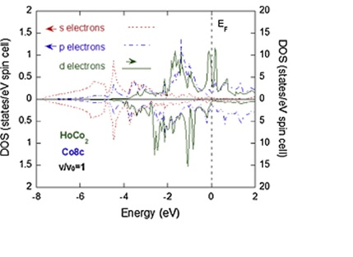
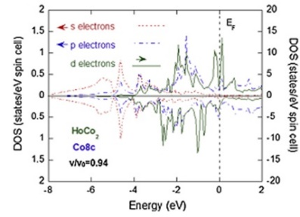
A pressure effect on the metamagnetism of RCo₂ compounds
Neutron diffraction data: lattice parameters, bond lengths and valence angle, magnetic moments of R and Co
Theoretical calculations: the ground state electronic structures and magnetic properties of RCo₂ compounds, the exchange and correlation energy

Slide 8
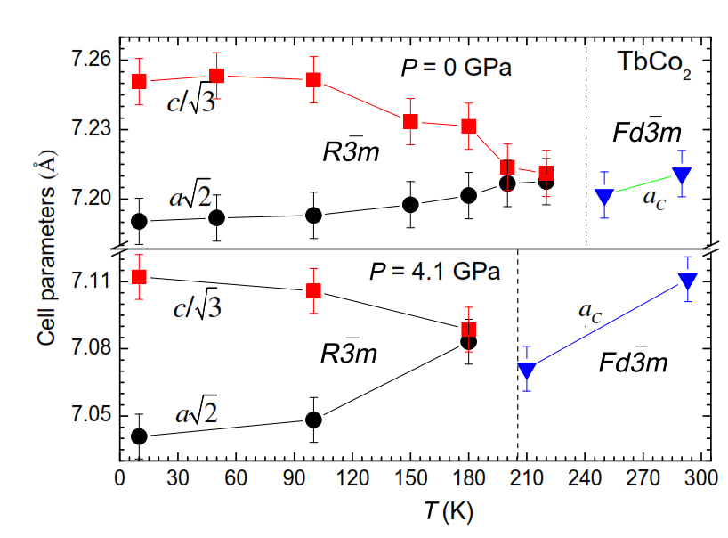
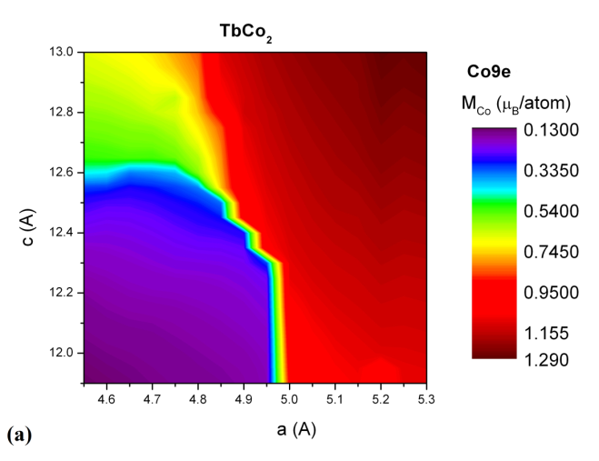
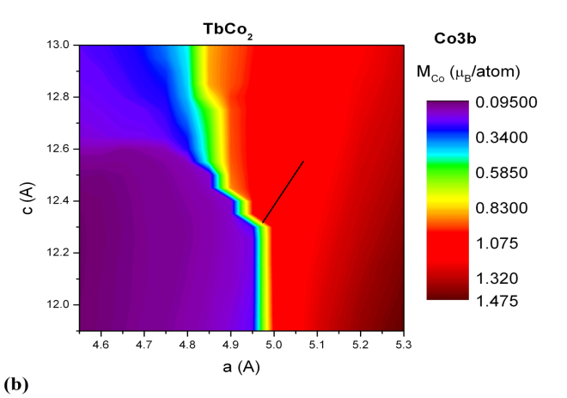
A pressure effect on the crystal and magnetic structure of TbCo₂
Theoretical dependences of Co9e and Co3b magnetic moments aon lattice parameters, describing pressure effect.

Slide 9
A pressure effect on the crystal and magnetic structure of TbCo₂
Tb
Tb
Co
Temperature dependencies of Tb and Co ordered magnetic moments at selected pressures

Slide 10
A pressure effect on the crystal and magnetic structure of DyCo₂

Slide 11
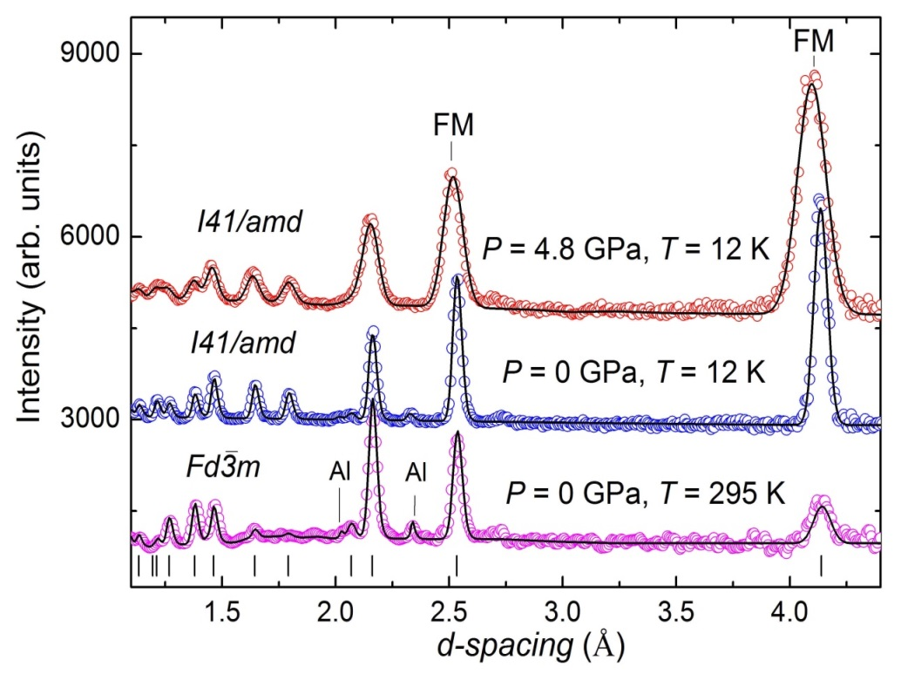
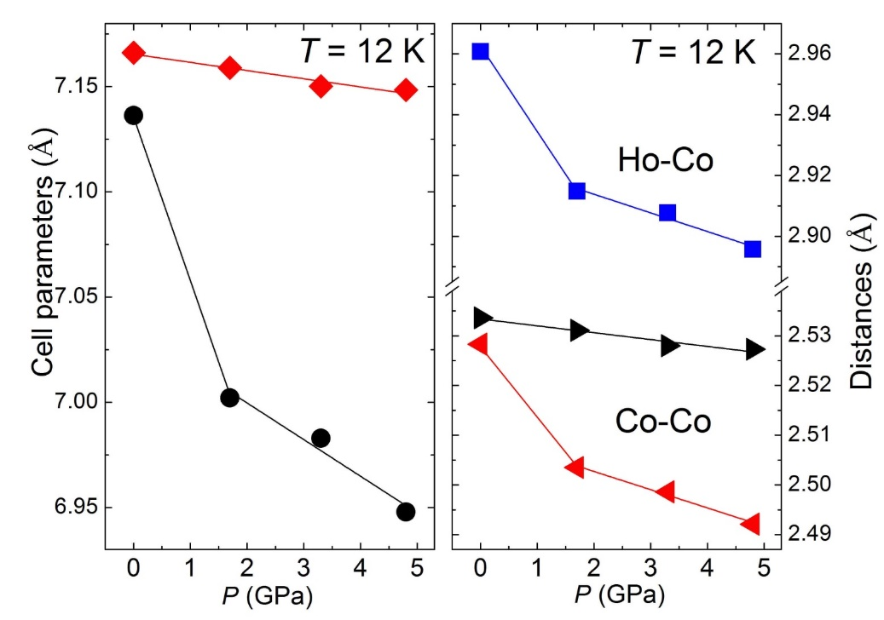
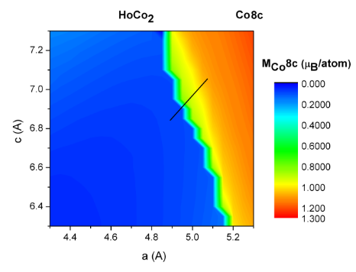
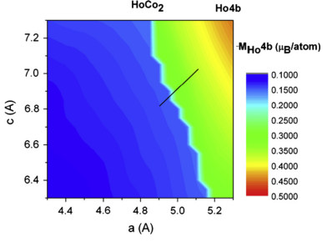
A pressure effect on the crystal and magnetic structure of HoCo₂
HoCo₂
The theoretically calculated dependence of Co8c magnetic moments and of Ho5d band polarizations, as function of (a,c) lattice parameters of I4₁/amd structure.

Slide 12
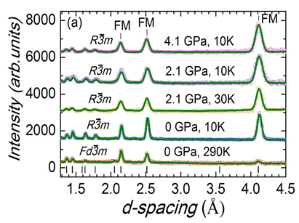
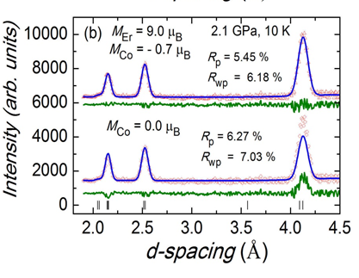
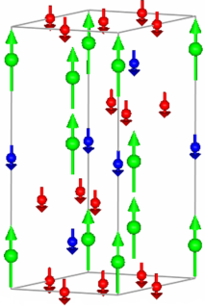
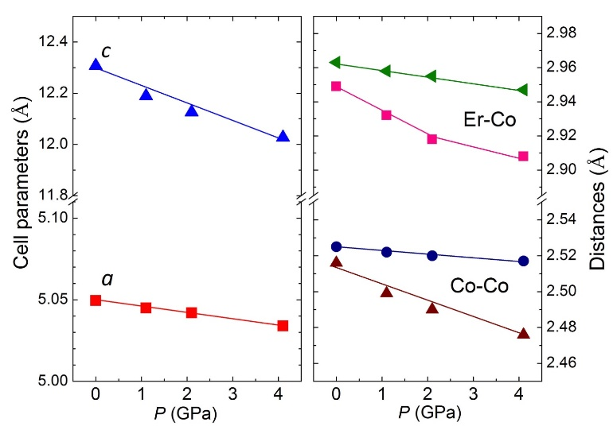
A pressure effect on the crystal and magnetic structure of ErCo₂
Neutron diffraction patterns of ErCo₂ compound, measured at selected pressures and temperatures and processed by the Rietveld method.
The parts of neutron diffraction patterns measured at P = 2.1 GPa and T = 10 K, and calculated profiles for fixed Er magnetic moment M_{Er} = 9.0 μ_{B} and two values of Co magnetic moments M_{Co} = -0.7 μ_{B} and 0.0 μ_{B}.
Er (6c)
Co(9e)
k_{a}= 0.0007(1) GPa⁻¹
k_{c}=0.0055(5) GPa⁻¹
Co(3b)
A strong anisotropy in baric changes in interatomic bonding

Slide 13
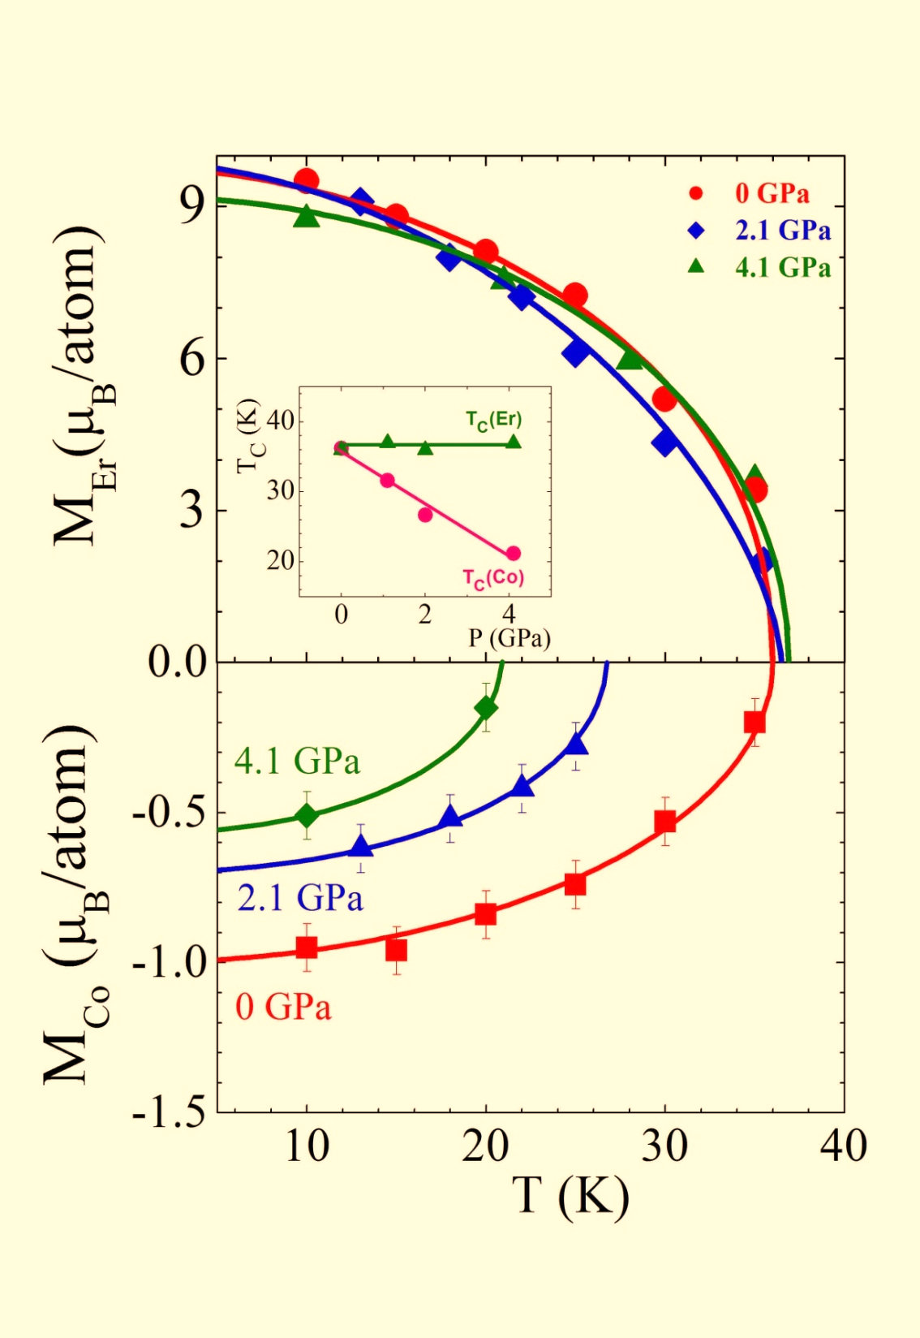
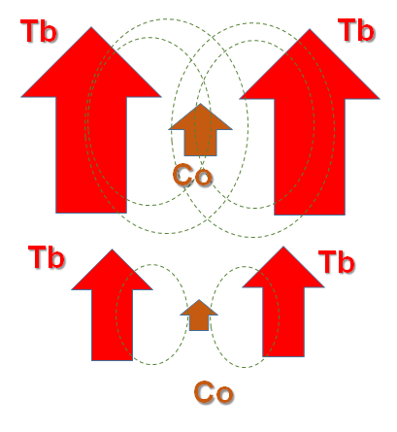
A pressure effect on the crystal and magnetic structure of ErCo₂
Er (6c)
Co(9e)
Co(3b)
-3.5 K/GPa

Slide 14
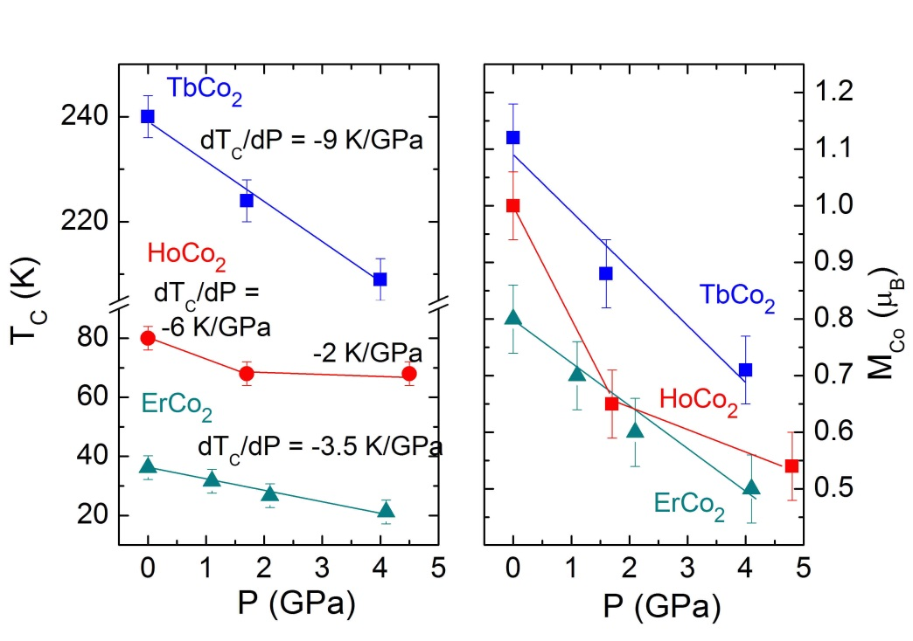
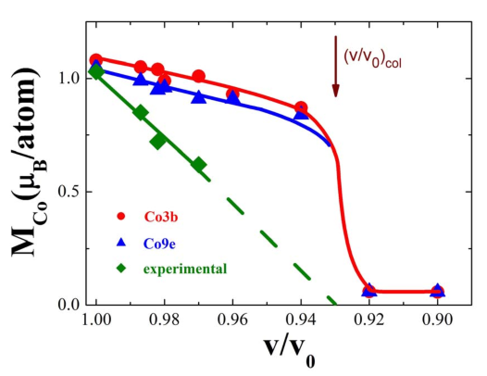
A pressure effect on the crystal and magnetic structure of RCo₂
The magnetic moments of R is pressure invariant
The pressure induced cobalt moments collapse
The dependence of cobalt moments at T=0 K on relative volume change.
The cobalt moments collapse

Slide 15
The limits of the itinerant electron metamagnetism concept
Tb
Tb
Co
Tb
Tb
Co
Non-magnetic R-ions:
YCo₂ or LuCo₂
Paramagnetic state
up to 70-75 T

Slide 16
A pressure effect on the crystal and magnetic structure of RCo₂
[1] D. P. Kozlenko, E. Burzo, P. Vlaic, S. E. Kichanov, A. V. Rutkauskas & B. N. Savenko “Collapse in ErCo2:Beyond the Limits of Itinerant Electron Metamagnetism” Sci. Rep. 5, 8620 (2015)
[2] E. Burzo, P. Vlaic, D.P. Kozlenko, S.E. Kichanov, N.T. Dang, A.V. Rutkauskas, B.N. Savenko “Magnetic properties, electronic structures and pressure effects of HoxY1-xCo2 compounds” Journal of Alloys and Compounds 584, 393–401 (2014).
[3] E. Burzo, P. Vlaic, D.P.Kozlenko, S.E.Kichanov, N.T. Dang, E.V.Lukin, B.N.Savenko “Magnetic properties of TbCo2 compound at high pressure” Journal of Alloys and Compounds V. 551, 702–710 (2013)
[4] E.Burzo, P. Vlaic, D.P.Kozlenko, “PRESSURE EFFECTS ON THE MAGNETIC BEHAVIOR OF COBALT IN RARE-EARTH COMPOUNDS” Rom. Journ. Phys. 60, 200-214 (2015).
[5] E. Burzo, I. Pop, D.P. Kozlenko, “Magnetic and magnetocaloric properties of some ferrimagnetic compounds” J. Optoelectron. Adv. Materials 12, 1105 (2010).
Encouraging Diploma for high-quality poster: “The high pressure studies of RCo2 compaund” – 2014
Frank Laboratory of Neutron Physics award 2015 "Magnetic phenomena in RCo2 intermetallides: investigation of the applicability limits of the concept of itinerant electron metamagnetism" I prize
Joint Institute for Nuclear Research award 2016 “Magnetic phenomena in intermetallic compounds RCo2: studies of the limits of the itinerant electron metamagnetism concept” I prize

Slide 17
Thank you for your attention!

