Slide 1
Report on the concluding theme
“Multimodal Platform for Raman and Nonlinear Optical Microscopy and Microspectroscopy for Condensed Matter Studies“ (04-4-1111-2013/2017)
Theme leader: Grigory Arzumanyan
and
proposal for opening new theme
“Modern Approaches and Developments in Raman Microspectroscopy and Photoluminescence for Condensed Matter Studies”
(for the period of 2018–2020).
Theme leaders:
Grigory Arzumanyan and Norbert Kučerka
46th meeting of the PAC for Condensed Matter Physics
19-20 June, 2017

Slide 2
Contents
Place of Raman spectroscopy and microscopy among
other microspectroscopic methods
(on the recommendation of the PAC for CMP).
Report on the activities in 2015-2017:
upgraded optical platform (2015)
research programme and results
user-friendly facility (first experience)
student programme
Modern challenges in Raman spectroscopy and photoluminescence – proposal on the opening of a new theme and the following project:
“Ultrasensitive SECARS microspectroscopy and luminescent core-shell nanostructures”.
2

Slide 3
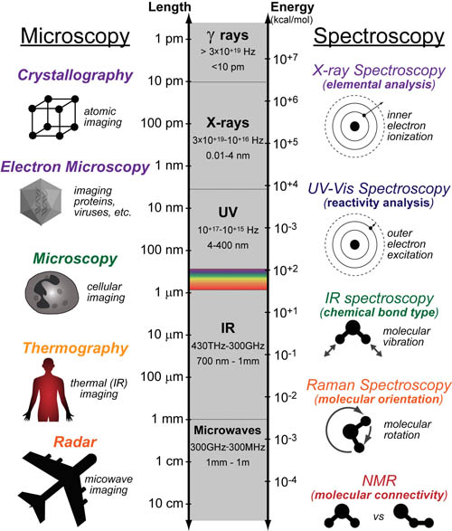
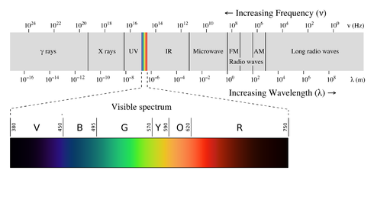
Kinds of Spectroscopy
Common Spectroscopic Methods Based on Electromagnetic Radiation
Classification by:
Spectroscopic technique
Typical wavelength range
Type of energy transfer
Type of quantum transition
Raman scattering or Raman effect was discovered by C.V. Raman (Nobel Prize, 1930) and K.S.Krishnan in liquids, and independently by G.S. Landsberg and L.I. Mandelstam in crystals.
3

Slide 4
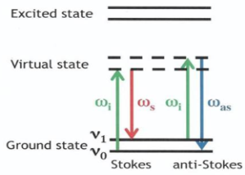
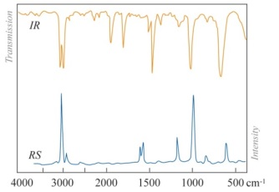
Place of Raman spectroscopy among the other spectroscopic methods
The main specificity distinguishing Raman/IR spectroscopy from other spectroscopic methods – both of them are molecular vibrational spectroscopy Raman is based on the inelastic scattering of incident radiation on molecular vibrations/rotations.
ϒ-rays, Mössbauer spect.
X-Ray: EXAFS, XANES
UV/Vis: absorp., emis., reflectance spectr.
Nuclear transit., (0.005–1.4 Å)
Resonant absorption and emission of ϒ-rays in solids.
Composition of iron-containing specimens (meteorites, rocks), oxidation state changes, etc.
Inner electrons, (0.1 – 100 Å)
X-ray absorption spectr.
Electronic structure technique, interatomic distances, lattice dynamics, valence state, energy bandwidth, etc.
Valence electr., (200-780 nm)
Analytic chemistry (kinetics), determination of analytes,
biological macromolecules,
detection of impurities, etc.
NMR
Raman & Infrared spectroscopy – complementary methods of vibrational spectroscopy
Spin of nuclei in a
magnetic field, resonance frequency in the range of ~ (60 – 1000 MHz)
Magnetic properties of atomic nucleus, molecular physics, medical imaging, etc.
Powerful tool, but low sensitivity and very expensive
COMMON
SPECTROSCOPIC METHODS
Raman scattering is also known as a “fingerprint spectroscopy”
Raman & IR – Vibration/rotation of
molecules – fingerprint spectroscopy
different selection rules,
IR – light absorption
Raman – light scattering
Usual spectral range:
Mid IR ~ (400 – 4000) cm⁻¹ Raman ~ (70 – 5000) cm⁻¹
Raman spectroscopy provides chemical identification of analyte molecules and has a number of advantages over the IR one:
no suffer of aqueous systems
non-destructive
simple sampling
EPR (ESR)
Photoluminescence
Spin of electrons in a
magnetic field, usual WL range ~ 3cm (10GHz)
Study of metal complexes or organic radicals, detection of
paramagnetic centers such as F-centres, etc.
Usual WL range – UV/Vis/IR
Stokes and anti-Stokes
radiative transitions.
X-ray fluorescence;
Fluorescence spectroscopy;
Atomic fluorescence spectr.
4

Slide 5
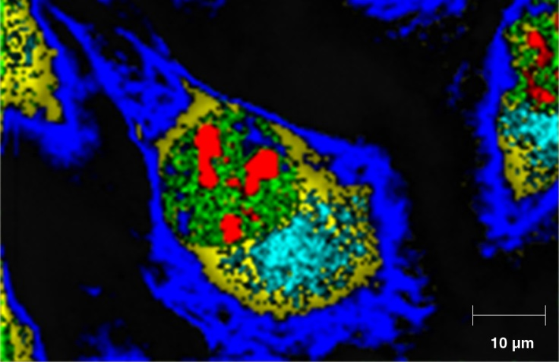
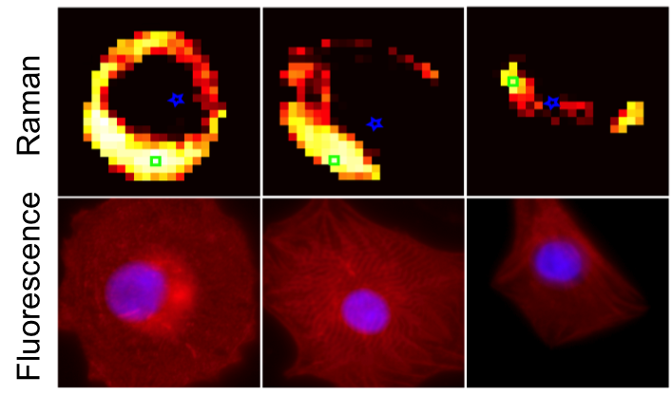
Raman microscopy (imaging) is a powerful tool for generating selective chemical images based on analyte Raman spectrum.
Raman peak intensity yields images of analyte concentration and distribution
Raman peak position yields images of molecular structure, conformation, stress/strain.
Raman peak intensity yields images of crystallinity and phase.
Raman microscopy is a good alternative to fluorescence microscopy, and Raman has a remarkable advantage over it: no photobleaching of the fluorophore, stable work with live cells.
5

Slide 6
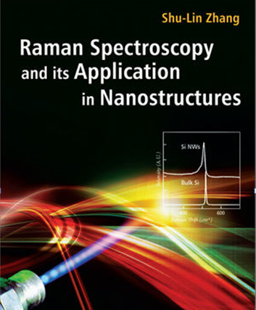
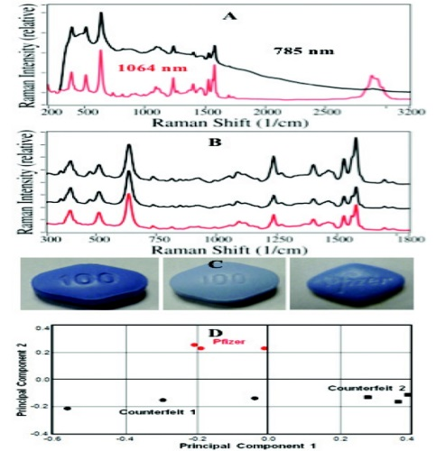
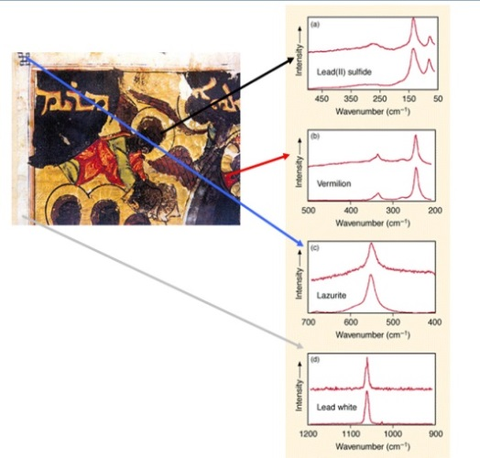
Raman applications
Raman spectroscopy is one of most versatile analytical techniques that provides chemical and structural information about samples.
Key applications
Other applications – any application where non-destructive, microscopic, chemical analysis and imaging is required: pharmaceutics, forensics, art, etc., etc.
6

Slide 7
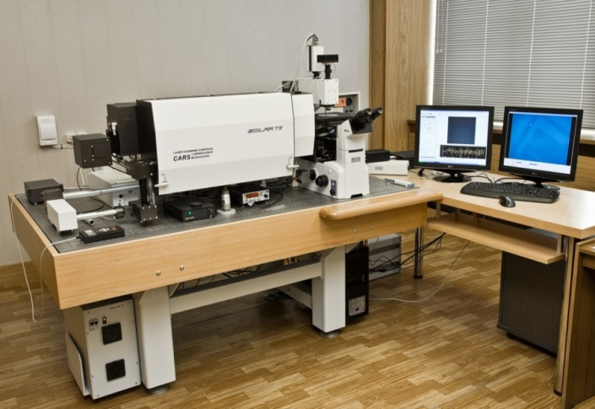
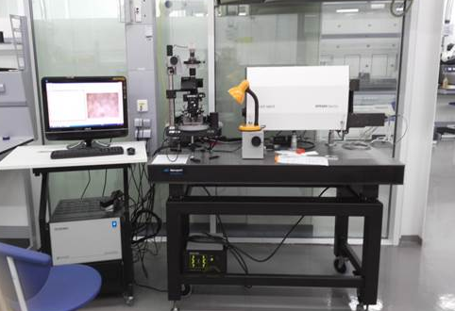
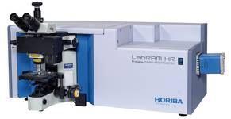
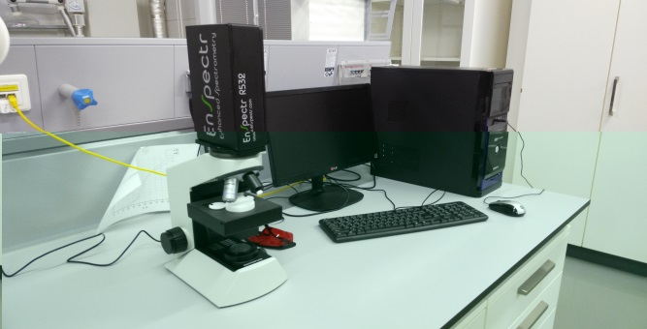
RAMAN SPECTROSCOPY at JINR
(presently 4 Raman spectrometers)
FLNP
JINR’s Nanocentre
Raman spectrometer coupled to AFM
“CARS” microspectrometer
LabRAM HR Evolution, Horiba
(photo from Horiba web-site)
microRaman “EnSpectr”
7

Slide 8
Report on the theme activities in 2015-2017
upgraded optical platform (2015)
research programme and results
student programme
user-friendly facility (first experience)
Abbreviation used:
CARS – Coherent Antistokes Raman Scattering
SERS – Surface Enhanced Raman Scattering
SECARS – Surface Enhanced CARS (in the focus of the new project)
SONICC – Second Order Nonlinear Imaging of Chiral Crystals
TERS – Tip Enhanced Raman Scattering
UCL – Up-Conversion Luminescence
PL – Photoluminescence
(detailed information on the report is available at the JINR web-site: http://indico.jinr.ru/)
8

Slide 9
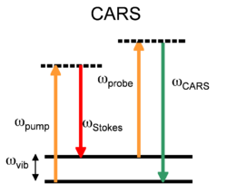
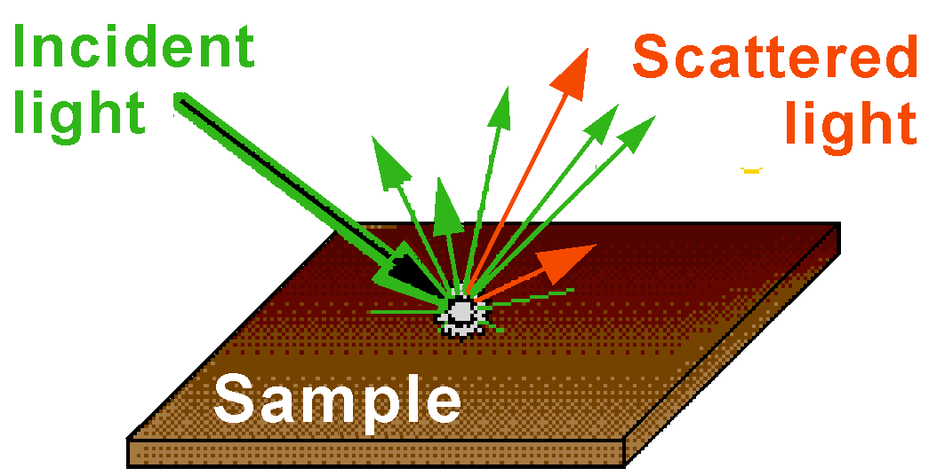
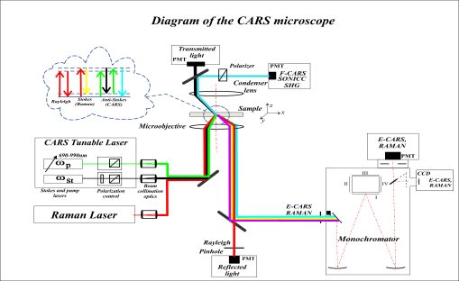
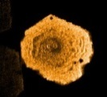
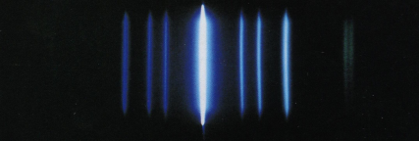
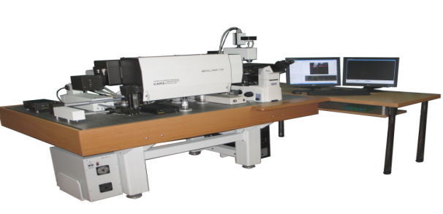
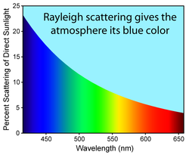
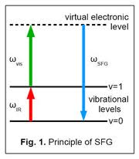
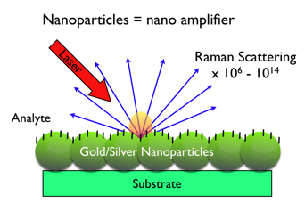
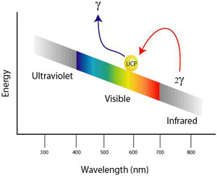
Upgraded and modified optical platform (2015)
RAMAN
CARS
P-CARS
Transmitted and reflected channels
SHG, SONICC
2015
“CARS” microscope
SERS and PL
Up-conversion luminescence
Sum frequency
generation
9

Slide 10
New major options of the upgraded platform
Polarization sensitive CARS microscopy (P-CARS)
Second Order Nonlinear Imaging of Chiral Crystals (SONICC)
Launch of SERS studies and photoluminescence (PL) along with upconversion luminescence
Installation of two new laser sources for Raman and PL: green laser (532nm) and NIR laser (785nm) with corresponding optics at the platform
At present microscope “CARS” is competitive at the world level !
As a result of the upgrade programme today FLNP’s optical platform on the basis of the “CARS” microscope is the only in its uniqueness Raman and photoluminescence multimodal facility in Russia and CIS countries by its characteristics and functionality.
10

Slide 11
Expected main results by the theme completion:
Obtaining of highly contrast nonlinear chemical mapping of protein crystals with a signal to noise ratio not less than 30:1 in the P-CARS and SHG/SONICC options.
First results aimed at achieving high sensitivity level of concentration detection using SERS as a newly developed modality at the optical platform.
A complex study of the structural and spectral properties of oxyfluoride glasses and glass-ceramics doped with various rare earth elements (REE).
Completion of photo- and up-conversion luminescence of glass-ceramics based on nanoscale ZnO crystals and co-doped with Eu³⁺/Yb³⁺ ions.
Plasmonic photo- and upconversion luminescence enhancement (not less than one order of magnitude) – background for the further research in 2018-2020.
11

Slide 12
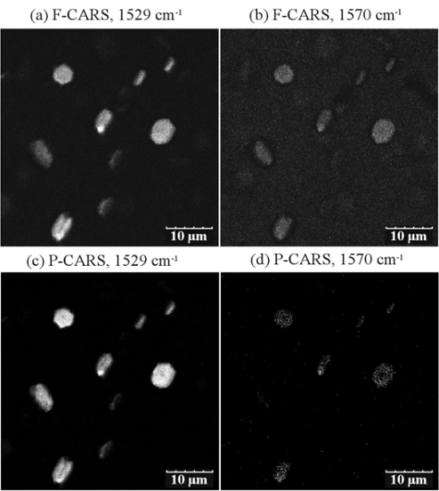
CARS vs Polarization-sensitive CARS (P-CARS) – suppression of the non-resonant component
Highly Sensitive and Contrast CARS and SHG/SONICC Imaging of Membrane Protein Crystals
C=C (retinal)
BR crystal Raman spectrum
Comparison of contrasts for F-CARS and P-CARS images of BR
in resonant (1529cm⁻¹) and non-resonant conditions (1570cm⁻¹)
12

Slide 13
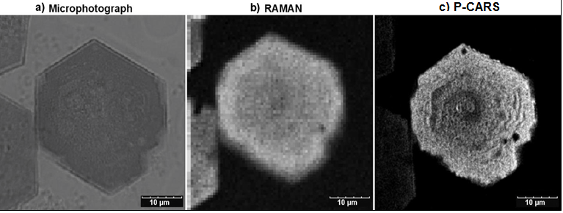
Visualization of BR crystals
1529cm⁻¹
1529cm⁻¹
Optical microscope image gives an impression that the crystal is perfect with the only visible edge defect.
The same conclusion can be made with the Raman image.
P-CARS resolves tiny features of BR morphology and displays several considerable defects visible as dark parts of the crystal, the edges of the crystal are not smooth.
Stair-like morphology of the surface of the crystal is well defined.
1529cm⁻¹
13

Slide 14
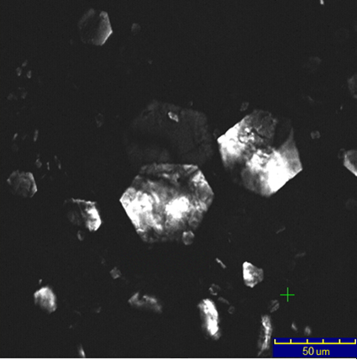
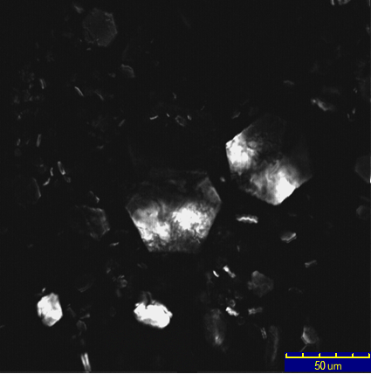
Panoramic chemical image of large (~60um) and
medium sized (15-20um) BR crystals
P-CARS vs SONICC
P-CARS at 1529 cm⁻¹
SONICC image
SONICC image
Scan area 225x225um
Resolution: 2pl/1um
Data accumulation time ~2s
Pump =915.4nm, Stokes = 1.06um
P-CARS image at ~ 1529cm⁻¹ (802nm)
Scan area 225x225um
Resolution: 2pl/1um
Data accumulation time ~2s
Pump (Stokes) = 1.06um
SONICC image at 532nm

Slide 15
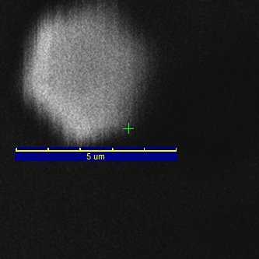
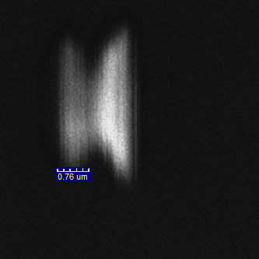
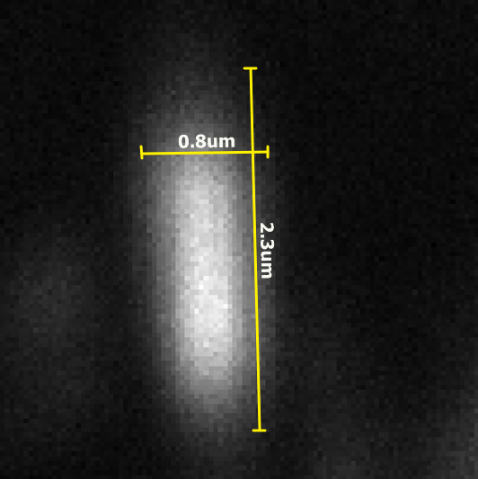
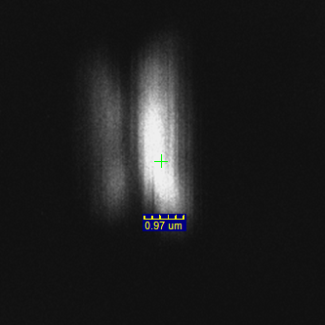
Small sized (~5um down to submicron) BR crystals
P-CARS vs SONICC
P-CARS, 3x3um
P-CARS, 8x8um
P-CARS, 8x8um
P-CARS, 8x8um
Scan area 8x8um
Resolution: 2pl/1um
Data acquisition time ~2s
P-CARS image at ~ 1529cm⁻¹
SONICC image at SHG-532nm
SONICC, 8x8um
15

Slide 16
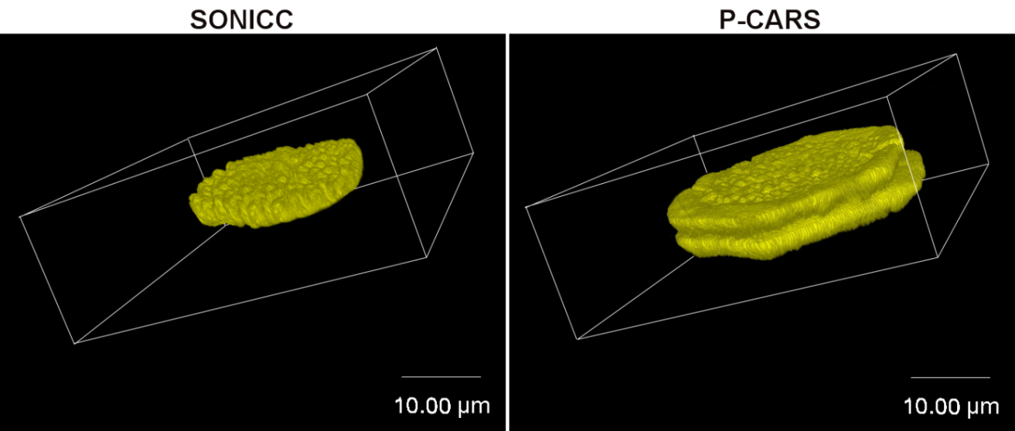
Imaging of merohedral twinned BR crystals –
one of the most common crystal-growth defects in protein crystallography.
Scan area 48x48um, resolution: 2pl/1um,
data accumulation time ~ 2s
3D-sectioning
The boundary rim is not well ordered part of the crystal
and SONICC fails to display any signs of the rim.
Raman spectra in the central part
of the BR crystal is similar to that of in the boundary rim.
16

Slide 17
SUMMARY
A new extremely sensitive and contrast approach of the imaging of membrane protein crystals based on polarization-sensitive (P-CARS) microscopy was demonstrated and described.
With a high spatial resolution and high contrast, chemical images of the crystals of bacteriorhodopsin and lysozyme were obtained in a large range of scales from 100μm to submicron sizes.
We observed with some of the crystals that the shape of the same crystals imaged by CARS and SHG are different. We suggest that it happens in cases when some parts of the crystals are not well ordered (thus providing information about the level of order in crystal packing).
Expressive sensitivity of the P-CARS imaging of twinned bR crystals was demonstrated (twinned crystals cannot be optically distinguished).
Thus, complementary application of CARS and SHG (SONICC) techniques provides a unique opportunity to study the growth of protein crystals on a large range of scales.
Arzumanyan G.M., Gordeliy V.I., Mamatkulov K.Z., et al., JACS, 2016, Volume 138(41)
17

Slide 18
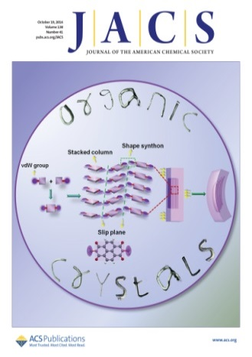
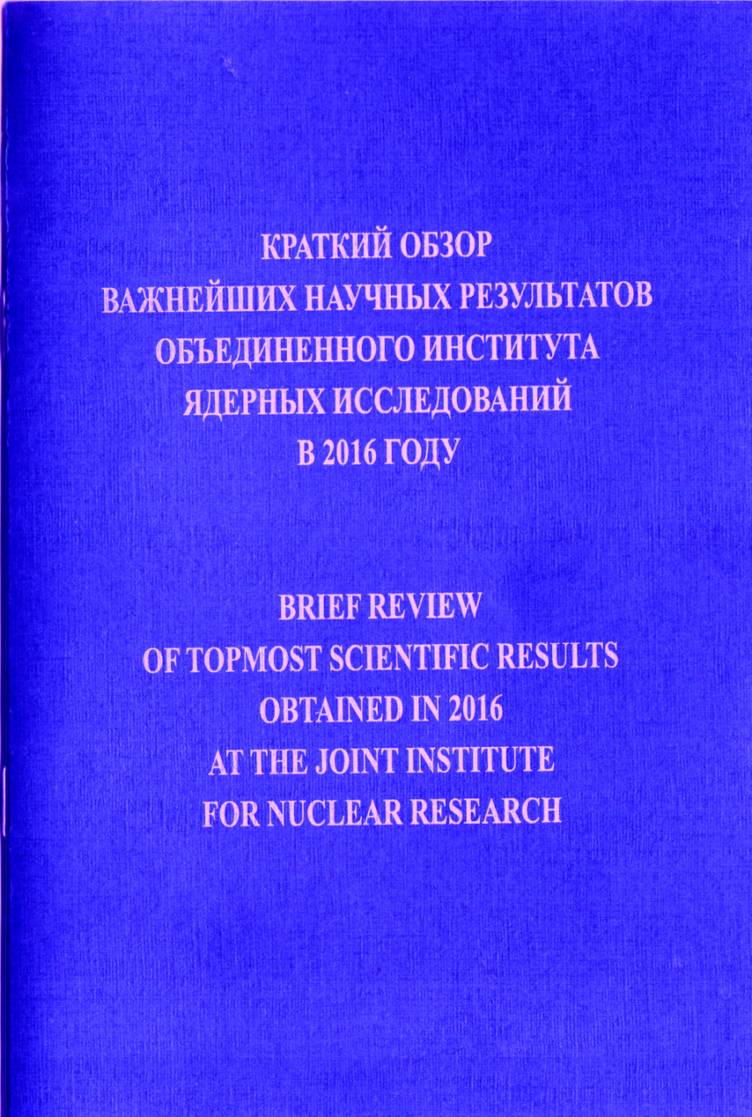
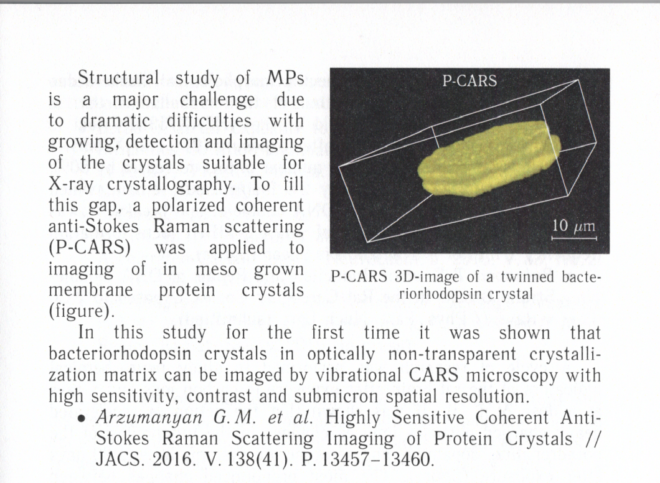
IF = 13.06 (2016)
18

Slide 19
Surface Enhanced Raman Scattering (SERS)
Detection limit measurements (or lowest detectable concentration of analyte molecules) in our first SERS experiments
SERS is a plasmonic-based process characterized as a label-free and high-sensitive spectroscopy.
SERS is a technique that was developed to detect extremely small quantities of molecules by determining their characteristic Raman signal.
19

Slide 20
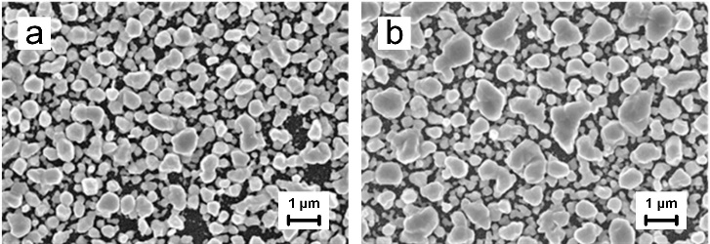
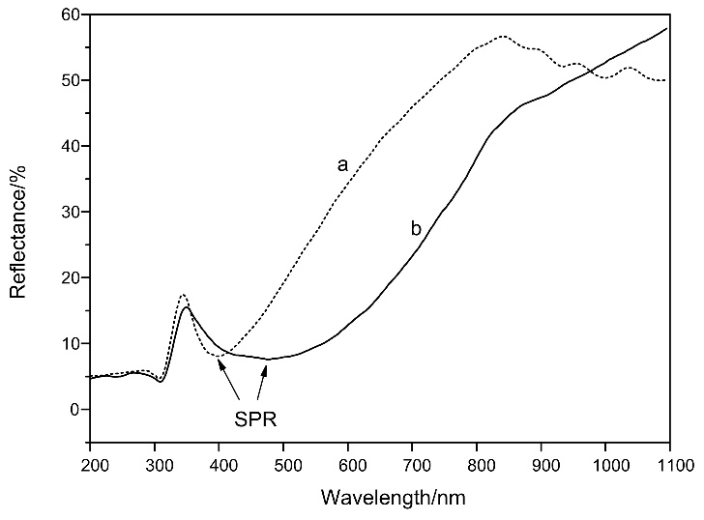
SERS-active substrates based on porous silicon
Developer: Belarus State University of Informatics and Radioelectronics
Plasmonic nanostructure design:
Template: porous silicon (PSi) formed by an electrochemical anodization in a solution of HF (45%)
Ag nanoparticles: immersion plating in 1mM AgNO₃ aqueous solution with an ethanol additive during 5-25 min.
The formed PS layer had the thickness of 5 µm and the porosity of 75 %.
SEM images of the samples formed by the immersion deposition of silver on PS for (a) 5 and (b) 25 min
The packing density of the silver particles is estimated to be 60 % after 5 min immersion and 75 % after 25 min immersion.
Reflectance spectra of the samples:
for (a) 5 and (b) 25 min immersion.
20

Slide 21
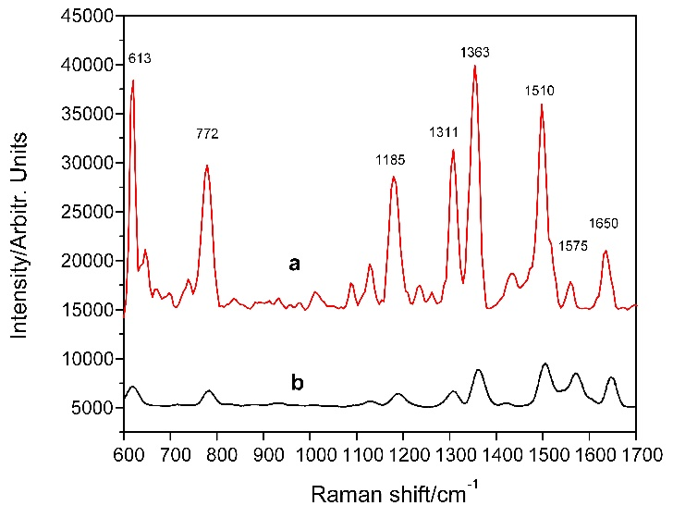
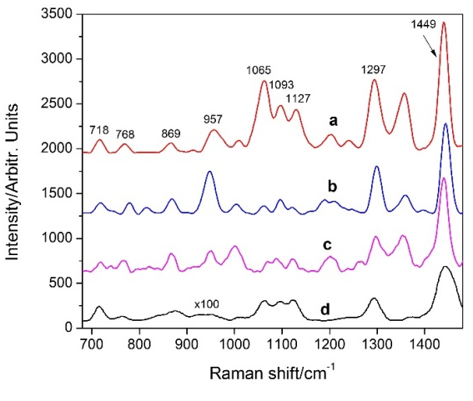
Phospholipid detection by surface enhanced Raman scattering (SERS) using silvered porous silicon substrates
Phospholipids are ubiquitously presented in nature forming a bilayer of the cell membranes of all living tissues.
Detection of their type, concentration and ratio in physiological liquids helps to recognize pulmonary, hepatic, sclerotic and many other diseases.
Thus sensitivity of the detection technique plays an important role in early diagnostics.
Wave-number (cm⁻¹) | Assignment
718 | C‒N str.
769 | O‒P‒O sym. str.
869 | trans C‒C str.
957 | P‒O sym. str.
1065 | trans C‒C str.
1093 | gauche C‒C str.
1127 | trans C‒C str.
1297 | CH₂ twist
1449 | CH₂ bend
SERS spectra of (a) 10⁻⁶ M and (b) 10⁻¹⁵ M
R6G collected at the 532 nm wavelength.
SERS (a, b, c) and Raman (d) spectra of (a) 10⁻⁶ M, (b) 10⁻⁹ M, (c) 10⁻¹² M and (d) 10⁻² M DPPC collected at the 532 nm wavelength.
8 Raman signals are observed at 613 cm^{–1} (C-C-C ring ip bend), 772 cm^{–1} (out of plane bend), 1185 cm^{–1} (C-H ip bend), 1311 cm^{–1} (C-O-C stretch), 1363, 1510, 1575 and 1650 cm^{–1} (aromatic C–C stretch),
Arzumanyan G., Doroshkevich N., Mamatkulov K.,
Bandarenka H, et al, recently accepted to PSS-A, 2017
21

Slide 22
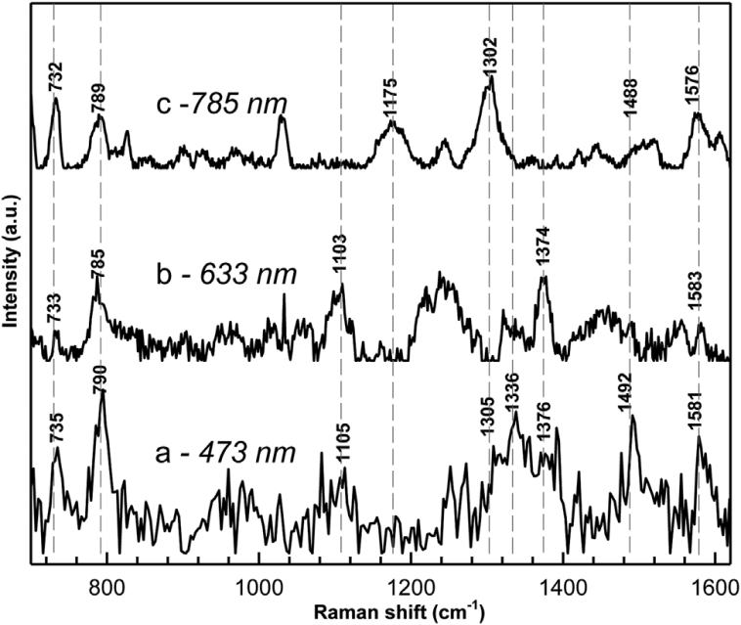
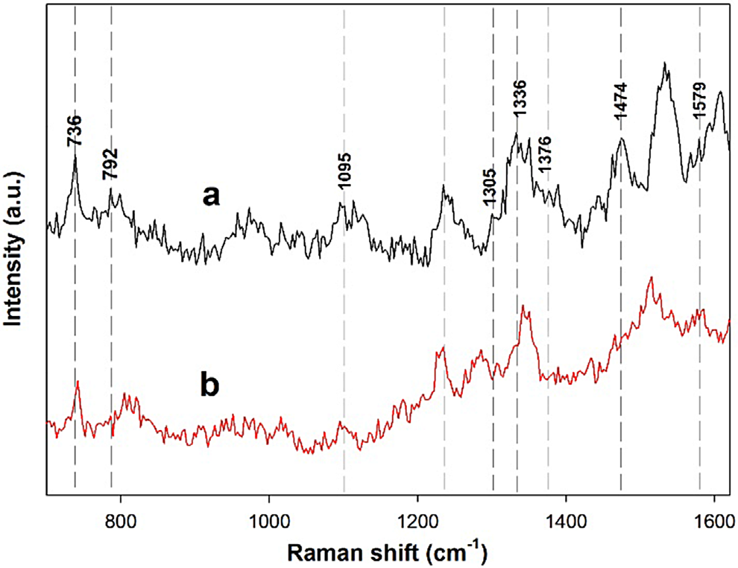
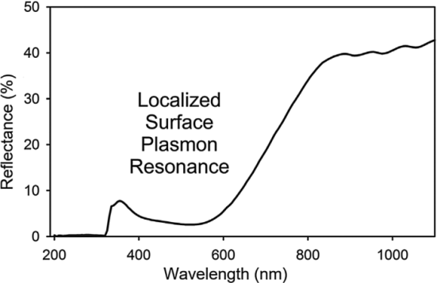
Detection of DNA molecules by SERS
SERS spectra of the 10⁻⁸M herring sperm DNA collected under the 473, 633, and 785 nm excitations.
SERS spectra of the 10⁻⁸M (a) and 10⁻¹⁰M (b) herring
sperm DNA collected under the 473 nm excitation.
The most promising result is in the detection of the DNA molecules at very low concentration of (10⁻¹⁰ M).
To our knowledge detection of such a small amount of DNA has not yet been reported elsewhere..
Reflectance spectrum of the PS samples: 3mM AgNO₃ solution for 70 min.
G. Arzumanyan, K. Girel, H. Bandarenka, et al. Phys.SS A 213, No. 11, 2911–2915 (2016)
22

Slide 23
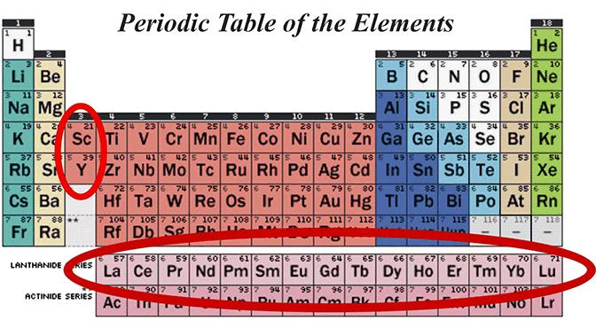
Spectroscopic Properties of Rare Earths in Optical Materials
Photo- and upconversion luminescence studies using various optical matrices activated with rare earth elements (REE).
Why are we doing this? - The main goals:
New fundamental knowledge
Raman is always accompanied by luminescence
Further application in bio-imaging making it as an complementary imaging tool to CARS microscopy – united program on imaging to be realized at our multimodal optical platform
23

Slide 24
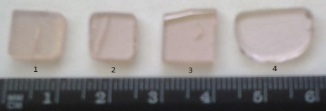
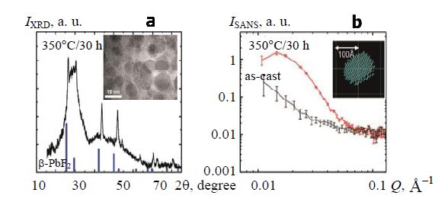
Novel Transparent Oxyfluoride Glasses and Glass-ceramics:
Spectral and Structural Properties
Composition: 43SiO₂–6GeO₂–38PbO–13PbF₂ (mol %)
Synthesized: by a melt-quenching technique
Doped: Er₂O₃ (1.0 mol.%), N_{Er} = 4.4×10²⁰ cm^{–3}
Co-doped with: Er₂O₃ (0.3 mol.%) / YbF₃ (4.3 mol%) N_{Yb} = 9.8×10²⁰ cm^{–3}
Structural studies: XRD, SANS, HR-TEM, SEM + EDS
XRD pattern of GC heat treated at 350°C/30 h; vertical lines correspond to the peaks of the bulk β-PbF₂ crystal; the inset represents an HR-TEM image;
intensity of the SANS vs the modulus of the scattering vector, Q, for the precursor glass and GC; the inset represents a ATSAS modeled shape of the nanocrystal.
24

Slide 25
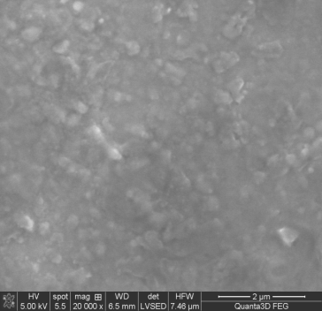
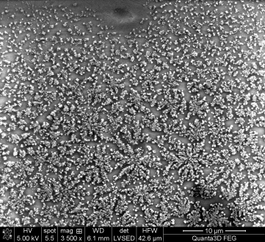
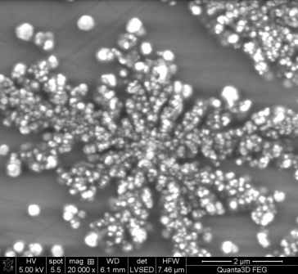
Scanning Electron Microscopy (SEM)
precursor
glass-ceramics
precursor
glass-ceramics
10µ
glass-ceramics
2µ
SEM images showing dendritic shape of PbF₂ nanocrystals embedded in the glassy matrix
Energy Dispersive Spectrum (EDS) of 1.0 mol% Er3⁺ doped glass and glass-ceramics
25

Slide 26
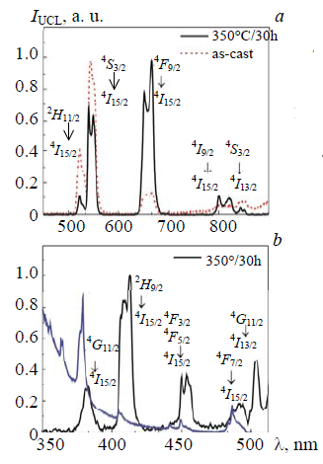
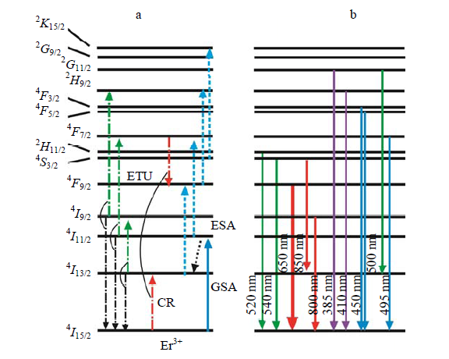
11 UCL bands are detected in the UV, visible,
and near IR for glass-ceramics
a) the scheme of the energy levels of Er³⁺ ions in the studied GC with the possible mechanisms of excitation;
b) observed emission channels for the UCL; GSA and ESA are the ground and excited-state absorption, CR is cross-relaxation, ETU is energy-transfer up-conversion.
26

Slide 27
UCL emission significantly enhanced by factors of ~ 25 (green band) and ~ 150 (red band) upon heat treatment of precursor samples (glass-ceramics).
precursor
glass-ceramics
Decay curves for the visible and IR luminescence of Er-doped glass and GC (under resonant excitation).
Main mechanisms of UCL enhancement in GC:
increase of the local concentration of Er³⁺ ions in the PbF₂ nanocrystals (as compared with the as-cast glass), leading to increased efficiency of the CR and ETU processes for the population of the excited-states;
lower phonon energy of Er³⁺ ions in the PbF₂ nanocrystals environment;
substantial increase of the lifetimes of several excited states, in particular of the ⁴F_{9/2} (from 0.6 to 71 μs)
Comparison of the UCL emission spectra of precursor sample (top) with that of the glass ceramics (bottom).
27

Slide 28
SUMMARY
Novel composition of transparent oxyfluoride glasses and glass ceramics doped with Er³⁺ and Er³⁺/Yb³⁺ were synthesizes.
A complex XRD, SANS, HR-TEM and SEM+EDS structural analysis of samples was done.
Detailed UCL spectrum comprising 11 bands in the UV, visible, and near-IR are detected for glass-ceramics and explained.
Dramatic rise of UCL intensity by factor of ~ 150 was recorded and analyzed for glass-ceramic samples.
The redistribution of intensity between the green and red emissions with the heat treatment is explained from the point of view of the lifetime measurements.
Publications, patent and conferences on this topic:
G.M. Arzumanyan, V. Vartic, A.I. Kuklin, et al. J. Phys. Sc. And Appl., 4(3), 150-158, 2014
G.M. Arzumanyan, H.A. Othman, D. Möncke, J. Optical Materials 62, 689-696, 2016
P.A. Loiko, G.E. Rachkovskaya, G.M.Arzumanyan, et al. J. of Appl. Spectroscopy, 84(1), 2017
Invention patent of the Russian Federation “Luminescent glass-ceramics”, # 2579056, 2016
Presented at the 5 international conferences
28

Slide 29
Photo- and upconversion luminescence in
transparent glass & glass-ceramics based on
ZnO nanocrystals co-doped with Eu³⁺, Yb³⁺ ions
Potassium-zinc-aluminosilicate optical system
Initial glass:
K₂O–ZnO–Al₂O₃–SiO₂ system co-doped with Eu₂O₃ and Yb₂O₃ prepared by the melt-quenching technique.
Glass-ceramics:
Transparent ZnO glass-ceramics was obtained by secondary heat treatments at (680 – 860)ºC.
2
3
Sample 1 – glass
Sample 2 – GC (680ºC, 12 h)
Sample 3 – GC (860ºC, 2h)
1
The photos of the samples under study.
The figures stand for heat-treatment schedule (temperature, ºC/duration, h).
29

Slide 30
XRD study and absorption spectroscopy
⁷F_{0,1}→⁵L₆ (393 nm)
⁷F₀→ ⁵D₂ (465 nm)
⁷F_{0,1} → ⁵D₁ ~525,532nm)
⁷F_{0,1} →⁵D₀ (578 nm)
Fig.1. XRD patterns of the:
initial glass co-doped with 1 mol% Eu₂O₃ and 1.5 mol% Yb₂O₃ (1);
initial glass co-doped with 1 mol% Eu₂O₃
and 1.0 mol% Yb₂O₃ (2)
GC with 1 mol% Eu₂O₃ and 1 mol% Yb₂O₃ :
• 680ºC/12h (3)
• 860 ºC/2h (4)
Fig. 2. Absorption spectra of the:
initial glass co-doped with 1 mol% Eu₂O₃ and
1.5 mol% Yb₂O₃ (1);
initial glass co-doped with 1 mol% Eu₂O₃ and
1.0 mol% Yb₂O₃ (2)
GC with 1 mol% Eu₂O₃ and 1 mol% Yb₂O₃ :
• 680ºC/12h (3)
• 860 ºC/2h (4)
30

Slide 31
SPECTROSCOPIC STUDIES:
Photoluminescence (PL), photoluminescence excitation (PLE),
and up-conversion luminescence (UCL) spectra
at 300K, 78K, 4.2K
1
Sample 1 – initial glass
Sample 2 – GC (680ºC, 12 h)
Sample 3 – GC (860ºC, 2h)
GC – glass-ceramics
31

Slide 32
The PL and PLE spectra measured at room, 78 K and 4.2 K temperatures for glass (Sample 1) and glass-ceramics (Samples 2,3)
523nm
612nm
397nm
467nm
591nm
397nm
523nm
467nm
703nm
414nm
653nm
(1)
(2)
(3)
Normalized PLE (a) and PL spectra for glass (Samp.1) and GC (Samp. 2,3) recorded at the excitations: 467 nm (b) and 397 nm (c) at room temp.(1); at 78K (2), and at 4.2K (3).
32

Slide 33
Near-edge luminescence from ZnO nanocrystals in UV region
Sample 1 – initial glass
Sample 2 – GC (680ºC, 12 h)
Sample 3 – GC (860ºC, 2h)
370nm
Top: PL spectra of the 3 samples (glass and GS), excitation @ 325nm
Bottom: GC – sample 2 (left), GC – sample 3 (right)
Most importantly, for the first time, in glass ceramics a band of luminescence of free excitons from ZnO nanocrystals with a maximum in the spectral region of 365–380 nm was observed in a wide range of measurement temperatures.
33

Slide 34
Orange-reddish up-conversion luminescence
UCL spectrum of the sample 1 recorded @ 976 nm laser excitation.
CIE diagram of the Eu3+, Yb3+ co-doped
initial glass: X = 0,603, Y = 0,396
dominant wavelength – 595nm (Amber)
34

Slide 35
SUMMARY
The novelty of our research:
The luminescence from Eu³⁺ ions had never been studied before for the given type of glass and glass-ceramics based on ZnO nanocrystals. It revealed the following:
- intense PL from intracenter f-f optical transitions of Eu³⁺ ions;
- certain temperature regularities, unknown before, of luminescence and luminescence excitation spectra changes caused by the local surrounding of Eu³⁺ ions.
For the first time, an intense near-edge luminescence band with a peak at ~370nm (~3.35eV) associated with radiative recombination of free excitons in ZnO nanocrystals was observed in Eu³⁺-doped glass-ceramics in a wide temperature range.
Bright orange-reddish upconversion luminescence spectrum was recorded in the initial glass co-doped with Eu³⁺/Yb³⁺ ions.
Arzumanyan G.M., Kuznetsov E.A. , et al., J. Opt. Mat., 62, 2016
35

Slide 36
Report on the theme activities in 2015-2017:
research programme and upgraded optical platform
user-friendly facility (first experience)
student programme
publications, conferences, patents, grants
36

Slide 37
Three external users from:
Belarus – Raman in biomedical studies, Institute of Physiology, NAS RB
United Kingdom – meteorites studies,
University of Buckingam
Russia – towards SECARS modality, Inst. of Gen. Phys., RAS, Moscow
(results are included in the last part of presentation)
Prof. Vladimir Kulchitsky,
Deputy Director of the Inst. of Phys.
Prof. Richard Hoover
in our lab.
37

Slide 38
Raman spectrometer as an diagnostic tool
Institute of Physiology, NAS Rep. of Belarus
The comparison of Raman spectra of rat’s SC (stem cells) and C6 glioma cells.
Microphotographs and CARS images
MSC and C6 glioma cells
Raman spectroscopy revealed a striking similarity of scattering spectra from rat’s SC (stem cells) and C6 glioma cells (nearly identical “fingerprints”).
This phenomenon helps to understand the difficulty encountered by immune defense system in tumor-bearing organism, showing one of the ways for tumor cells to escape from protective activity of immune cells.
Our results also show a potential pitfalls in the cancer diagnostics.
Kulchitsky V.A., Arzumanyan G.M., et al.// JSCRT, Vol 1(1), Dec. 2016
38

Slide 39
Raman study of meteorites: Murchison and Polonnaruwa meteorites
Lonsdaleite (1326 cm⁻¹)
Raman spectrum of Murchison meteorite and mapping of the lonsdaleite (badly deformed diamonds) Raman band
Diatoms (unicellular algae)
from Polonnaruwa meteorite
Raman spectrum of diatom indicating on
the presence of Si-H bond at 2100cm⁻¹
on the shell of diatom
39
Notes:
.

Slide 40
STUDENT PROGRAMME
2015 – 2016: 3 students – defense of bachelor’s degree
2) 2016 – 2017: 3 students, current preparation of master’s theses
3) 2016 – 8th JINR UC Summer School, Practical training of students
and postgraduates from Egypt
4) 2 students, Summer Student Program and practical training in 2016
(JINR UC), in 2017 – planned for September
40

Slide 41
List of main publications and patent
Conferences with our participation
Publications, conferences, grants, programmes
17 publications (in total)
19 conferences
1 patent of Russian Federation
Grants of Plenipotentiaries: Romania and Slovak Republic
Support from JINR–Belarus cooperation programme
41

Slide 42
CONTENT
Modern challenges in Raman spectroscopy and proposal on the opening of a new theme and project:
“Ultrasensitive SECARS* microspectroscopy and luminescent core-shell nanostructures”.
Project leaders: G.M. Arzumanyan and N. Kučerka
SECARS will provide ultrasensitive, highly-contrast and selective method for condensed matter studies of extremely low concentrations of analyte molecules down to a single molecule detection level.
* Surface-Enhanced Coherent Antistokes Raman Scattering
42

Slide 43
Analysis of the State of the Art – Raman Spectroscopy Modern challenges
“The most important recent advances have been developments in instrumentation (CARS, SERS, TERS) that have pushed Raman spectroscopy further into life sciences and biomedicine”.
“Certainly, we see the increased interest in SERS for various applications. It is really becoming possible to talk about using Raman to investigate individual molecules”.
“Developments in coherent Raman scattering microscopy approaches such as CARS/SECARS microscopy offer exciting potential in biological imaging applications”.
A panel of experts in honor of Spectroscopy’s celebration of 30 years covering the latest developments in material analysis (2016)
The full text is available at:
http://www.spectroscopyonline.com/analysis-state-art-raman-spectroscopy
43

Slide 44
Modern challenges in Raman
RS – Raman scattering (spontaneous)
CARS – coherent anti-Stokes Raman scat.
RRS – resonance Raman scattering
SERS – surface enhanced Raman scattering
SECARS – surface enhanced CARS
(start in 2017, to be fully implemented in 2020)
TERS – tip-enhanced Raman spectroscopy
SMD – single molecule
detection (10⁻¹⁵)
SERS
CARS
44

Slide 45
OUR PRESENT BACKGROUND in SECARS
45

Slide 46
Analytes (reporter molecules): DTNB and MPBA
Dithionitrobenzoic acid
(DTNB)
mercaptophenylboronic acid
(MPBA)
SERS-active substrate: Al/CeO₂/AuNP
29×29 μm
∼ 8×5 μm
Optical image
SEM image of facet CeO₂ films with Au-NP
46

Slide 47
SERS spectra of DTNB and MPBA molecules
SERS (DTNB)
SERS (MPBA)
SERS spectrum of DTNB is dominated by the strong peaks at 1338cm⁻¹ and 1555cm⁻¹ assigned as the symmetric stretch of the nitro group ν_{s}(NO₂) and the aromatic ring stretch, respectively.
SERS spectrum of MPBA is dominated by the strong bands at 1073cm⁻¹ and 1585cm⁻¹ assigned to the in-plane bending and stretching modes β_{CCC}+ν_{CS} and ν_{CC}, respectively.
47

Slide 48
Highly-contrast Surface Enhanced Coherent (SECARS) micro-images from CeO₂/Au/DTNB film
SECARS intensity mapping at the characteristic Raman frequency of DTNB molecules (1338cm⁻¹) has been recorded with a high contrast better than 1.5×10⁴.
48

Slide 49
Correlation of the intensity distributions of SERS and SEСARS signals from CeO₂/Au/MPBA film
SERS
SECARS
Scan area: 29×29 μm (30×30 pl)
SERS (left): 785nm, 1mW, 1571 см⁻¹;
CARS: 1571cm⁻¹ 0.9 mW (pump)+1.2 mW (Stokes)
49

Slide 50
Surface Enhanced micro-CARS from Gold Nanoparticle-Immobilized Organic Molecules at a Nanostructured CeO₂/Al Film
The first SECARS experiment in Russia has been done at FLNP’s optical platform based on the “CARS” microscope in close cooperation with following leading Moscow institutes:
Prokhorov General Physics Institute of RAS
Lomonosov State University (Fac. of Chemistry)
Emanuel Institute of Biochemical Physics RAS
Institute for Theoretical and Applied Electrodynamics RAS
Int. conf. ECONOS-2017, April, 2-5, Abbe Center of Photonics, Jena, Germany
50

Slide 51
Core-shell UC nanostructures –
efficient phosphors and biomarkers
Advantages of UCNPs :
unique luminescent properties
low background signal
high penetration depth into tissues
high resistance to photobleaching
Core-shell nanoparticles have major advantages over simple UCNPs leading to the improvement of properties such as:
diverse chemical composition – multifunctionality
with modified propertis
bio- and cyto-compatibility
less cytotoxicity
better conjugation with other bioactive molecules
increased thermal and chemical stability
Classes of core-shell NPs:
inorganic/inorganic
inorganic/organic
organic/organic
organic/inorganic
The choice of shell material is generally strongly dependent on the end application.
51

Slide 52
Core-shell structure proposed
UCNPs – NaYF₄ : Yb, Er, Tm - one of the most promising UCNP
– “core” part of the core-shell nanostructure
Shells – SiO₂, Ag/Au NPs, Porphyrins, …
Basic advantage of SiO₂ shell – one of the most chemically inert material
52

Slide 53
PRESENT BACKGROUND
Plasmon-enhanced up-conversion luminescence
a)
b)
UCL and SE-UCL spectra of:
a) NaYF₄: Yb³⁺, Er³⁺ (a) with an enhancement factor of ~ 200 in “hot” spots,
b) NaYF₄: Yb³⁺, Tm³⁺ (b) with an enhancement factor of ~ 18 in “hot” spots.
53

Slide 54
Present background for the united imaging platform
UCL spectrum of
NaYF₄: Yb³⁺, Er³⁺ nanocrystals
Our results
Micrograph
UCL image of
cotton fibers
CARS image of cyanobacteria
Upconversion luminescence NPs are promising alternative to traditional organic dyes making UCL visualization competing technique with fluorescence microscopy.
54

Slide 55
Main stages of the theme activities in 2018-2020
Development of scientific and technical requirements for the hardware and software upgrade of the "CARS" microspectrometer under the ultrasensitive modality SECARS.
Study of spectral and plasmonic characteristics of SERS-active substrates based on silver and gold nanoparticles with different configurations.
Systematic experiments on SECARS spectroscopy and intensity mapping with picosecond laser pulses at SERS-active substrates.
Detection of extremely low concentrations of organic molecules in SECARS mode – microspectroscopy of single molecules.
Development of theoretical model of SECARS process.
Study of spectral-structural characteristics of up-conversion phosphors based on "core-shell" type of nanostructures.
Development of the concept of a united optical platform for a contrast bioimaging of samples using nonlinear Raman microscopy and upconversion luminescence.
Test application of luminescent nanostructures "core-shell" in biomedicine, in particular, in photodynamic therapy of cancer.
Verification of tumor and stem cells by Raman microspectroscopy.
Extension of the “CARS” microscope program as a "user friendly facility".
55

Slide 56
Expected main results upon the theme completion:
The establishment of upgraded optical platform for ultrasensitive spectroscopy SECARS.
Selection of the most optimal, by their spectral and plasmonic characteristics, of SERS-active substrates for a surface-enhanced CARS (SECARS) process.
Reproducible detection of organic single/unit molecules Raman scattering spectra with SERS and SECARS.
A theoretical model of the nonlinear interaction of picosecond pulses with analyte molecules adsorbed on SERS-active substrates (SECARS intensity map modeling).
Spectral and structural characteristics of “core-shell” upconversion phosphors with various rare earth elements located in the core.
Operation of unified optical platform for complementary bioimaging in two options: Raman microscopy and upconversion luminescence.
Identification of the effectiveness of the use of cationic / metal-porphyrins as shells, and nanocrystals NaYF₄: Yb³⁺, Tm³⁺ / Er³⁺ as a core, in photodynamic therapy of cancer.
Data on similarities and differences in Raman spectra of rat brain tumor cells and stem cells. Recommendations based on the obtained results.
56

Slide 57
Schedule proposal for the years 2018-2020
57

Slide 58
Terms of the theme implementation: 2018 – 2020
Structure and staff
Sector of Raman spectroscopy, FLNP
Staff number – 11, among them young researchers – 7 (˂ 35)
Including staff from JINR Member States – 2
Total estimated cost of the theme implementation according to JINR's Seven-Year Plan:
YEAR | k$
2018 | 153
2019 | 163
2020 | 174
Materials and equipment ~ 22 %
Research contracts ~ 7 %
International cooperation ~ 17 %
Maintenance of the platform ~ 4 %
58

Slide 59
International collaboration:
Armenia, Yerevan, Inst. of biochemistry, NAS RA
Belarus, Minsk:
Inst. of physiology, BSUIR, “SOL Instruments”
Bulgaria, Sofia, Inst. of microbiology, BAS
Germany (Jülich, FZJ)
Latvia, Riga, ISSP, Lat. University
Poland, Wroclaw Univ.; Poznan, Adam Mickiewicz Univ.
Russia, Moscow, GPI RAS, MSU
Slovakia, Košice, Pavol Jozef Safarik University
Ukraine (Donetsk Nat. Univ.)
United Kingdom (Buckingham, Univ. of Buckingham
59

Slide 60
SUMMARY
We are ready to start and ask for your support!
60

Slide 61
Thank You!
61

