Slide 1
Report on the closing theme “Development of Experimental Facilities for Condensed Matter Investigations with Beams of the IBR-2 Facility” and the project “Development of PTH sample environment system for diffractometer DN-12 of the IBR-2 reactor”
and proposal for extension of the theme for 2018-2020 and the project and opening of a new project “Development of a wide-aperture backscattering detector (BSD) for the HRFD diffractometer”
04-4-1122- 2015/2020
S.A. Kulikov, V.I. Prikhodko

Slide 2
Expected results of the theme
1. Development and construction of a control system of the CM-201 moderator. Start-up and adjustment of CM-201 after the completion of installation. Carrying out of trial loading of the moderator chamber. Maintenance and routine modernization of the CM-202 cold moderator with control systems. Carrying out experiments to study radiation resistance of materials.
2. Development and application of VITESS and other software packages for simulation of neutron scattering in samples and in individual components of spectrometers. Complex calculations and optimization of spectrometers.
3. Equipping of IBR-2 spectrometers with detectors. Study of the possibility to use high-current operation modes of gas detectors for neutron detection. Development of detectors with a non-helium neutron converter. Development of a prototype of a position-sensitive detector with a resolution less than 1 mm and study of its characteristics.

Slide 3
Expected results upon completion of the theme
4. Development of PTH sample environment system for diffractometer DN-12 of the IBR-2 reactor (Project). Development and modernization of cryostats on the IBR-2 spectrometers.
5. Development of data acquisition systems, control systems of actuating mechanisms, of sample environment equipment and spectrometer choppers. Upgrading of the spectrometers’ software.
6. Development of the FLNP network and information technology infrastructure according to the demands of the Laboratory and the development strategy of the JINR computer network.

Slide 4
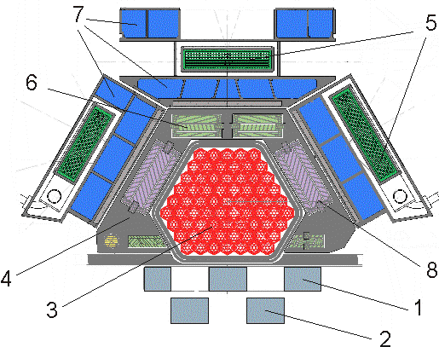
Complex of moderators of the IBR-2 reactor
(cold moderators and ambient temperature water moderators)
Cold
Cold
Cold
Cold+
Therm
Therm
Cold
Cold
Cold
Cold
Cold
Therm

Slide 5
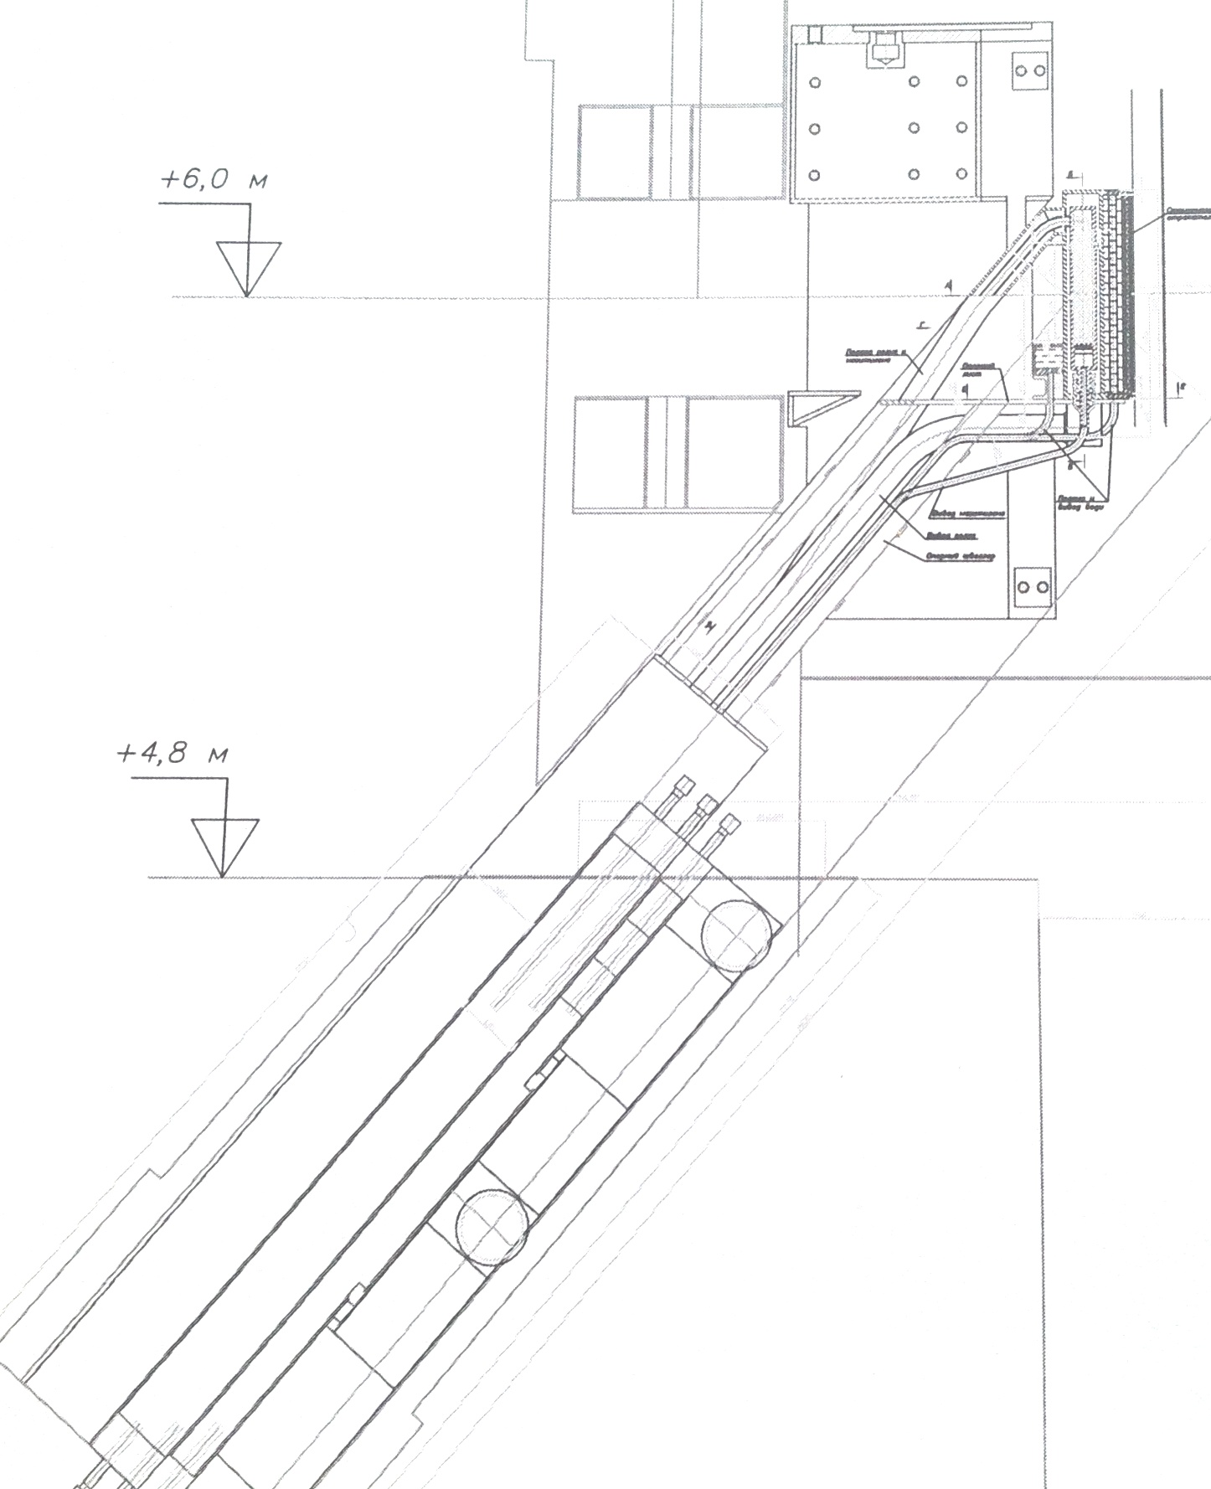
Cold moderator for beams 1, 4, 5, 6, 9
(6 instruments)
To lift beads on ~4 m height with inclination angle of 50 degrees

Slide 6
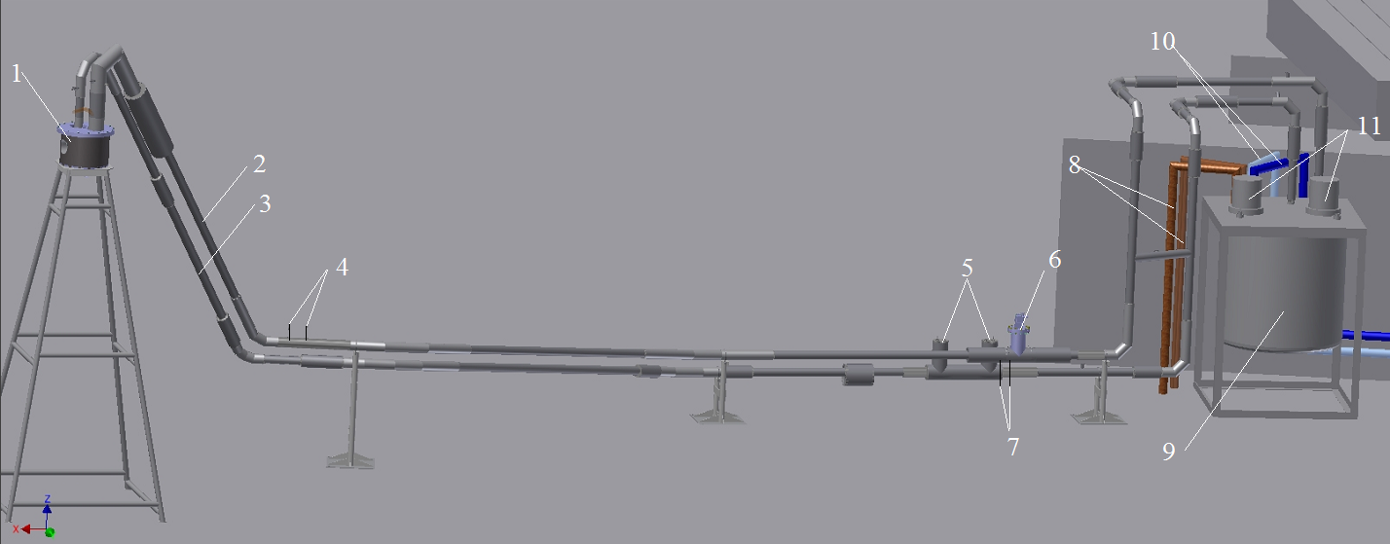
3D-model of a test stand of CM-201 cryogenic moderator
1 – simulator-chamber in a vacuum cylindrical housing; 2 - pipeline for feeding helium to the simulator-chamber; 3 – pipeline for removing helium from the simulator-chamber; 4, 7 – leads for differential pressure sensors to monitor movement of pellets in the pipeline; 5 – Pitot tubes; 6 – dosing device; 8 – pipelines for feeding and removing helium of KGU, 9 – cryostat with a heat exchanger, 10 – pipelines for feeding and removing helium of CM-202 moderator, 11 – helium gas blowers

Slide 7
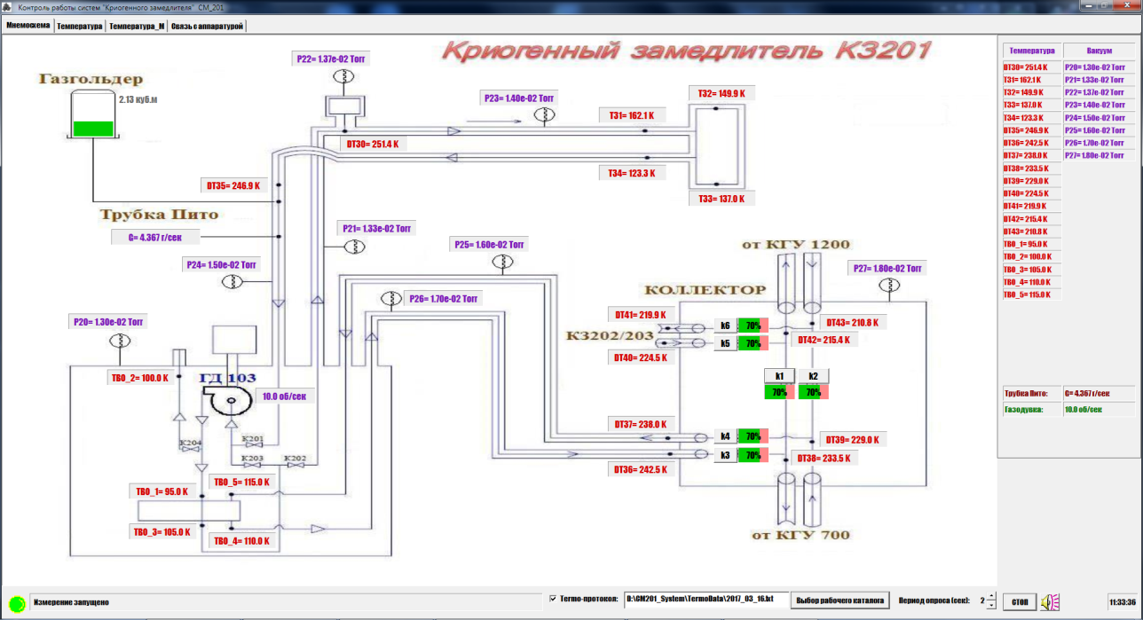
New graphic interface of developed control system (hardware and software) for a new cold moderator

Slide 8
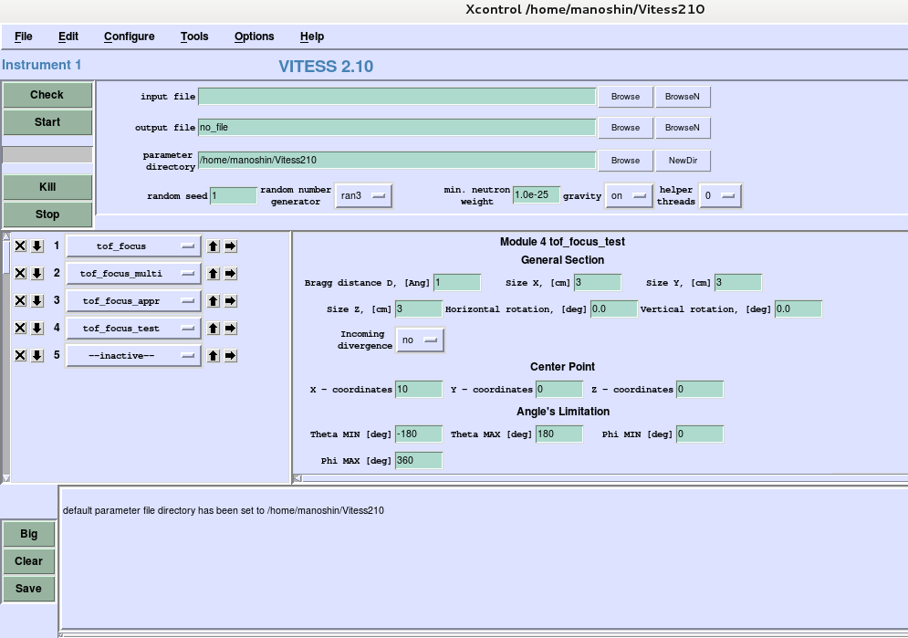
Development and application of VITESS
VITESS graphical user interface
The simulation of various flippers and spin-echo spectrometers with constant and time-dependent magnetic fields has been successfully carried out.
Virtually all existing neutron-optical elements:
neutron guides, benders, mirrors, lenses, prisms and their combinations
have been built into VITESS (and successfully used) as well as the possibility of simulating neutron detectors (including position sensitive ones) with time focusing has been provided.

Slide 9
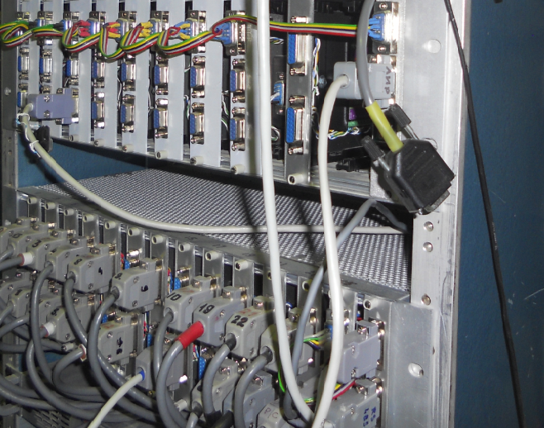
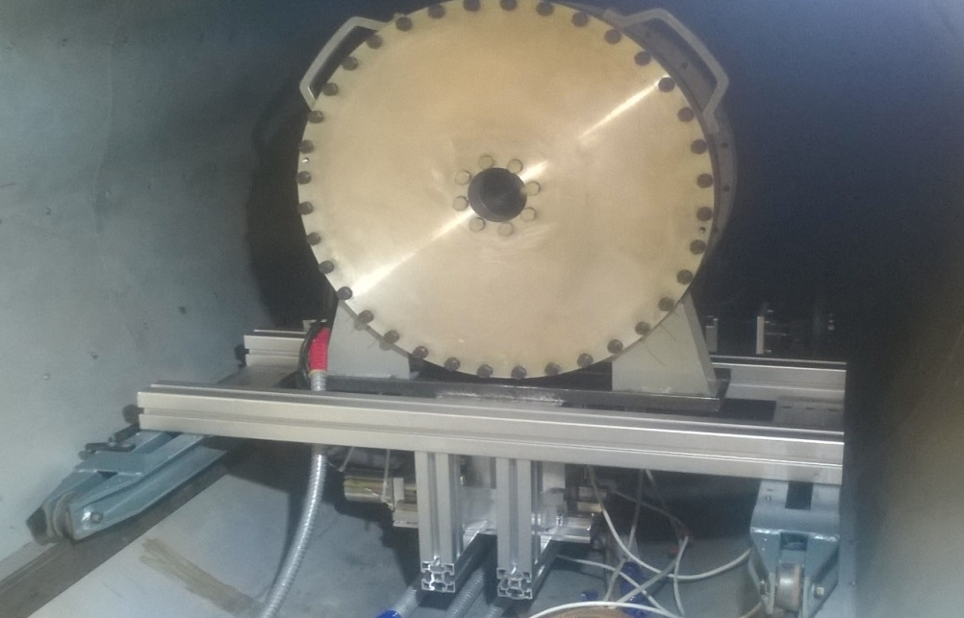
Control systems of actuators, sample environment equipment and spectrometer choppers
On all spectrometers we have modernized the control systems for the parameters of the experimental setup, as well as communications with the controllers of individual parameters of the spectrometer.
Temperature control systems based on "LakeShore" with modernized interface converters AC4 (USB-RS485) and АС3М (RS485-RS232) have been put into operation on FSD, HRFD, NERA-PR, RTD and REMUR spectrometers.
The number of control channels on each of the GRAINS, ESPILON, YUMO and REFLEX spectrometers has exceeded 32, and their total number on the IBR-2 spectrometers is more than 200.
Control system of actuators of the REMUR spectrometer for 32 control channels
Platform with a detector mounted on the position adjustment mechanism for moving in the horizontal and vertical directions

Slide 10
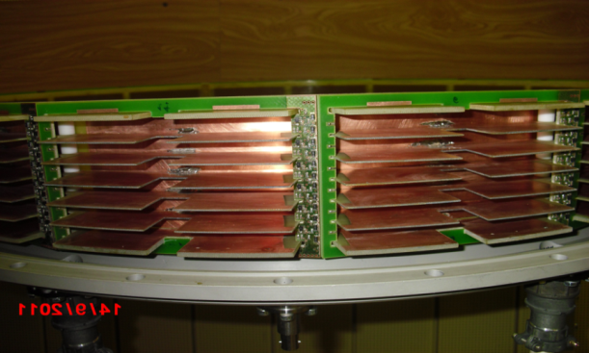
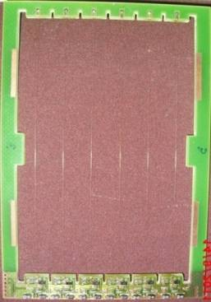
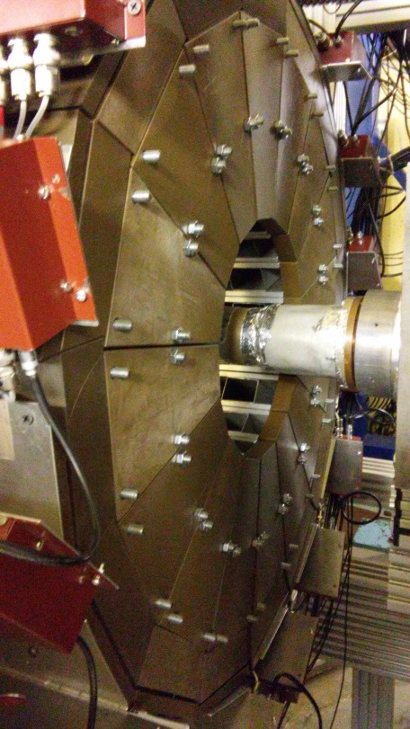
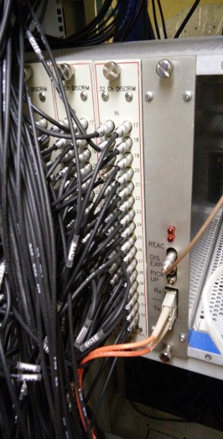
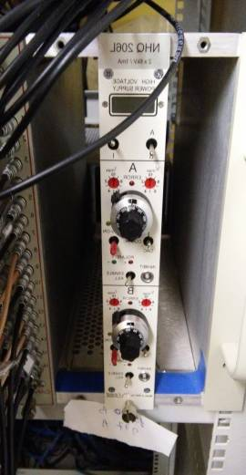
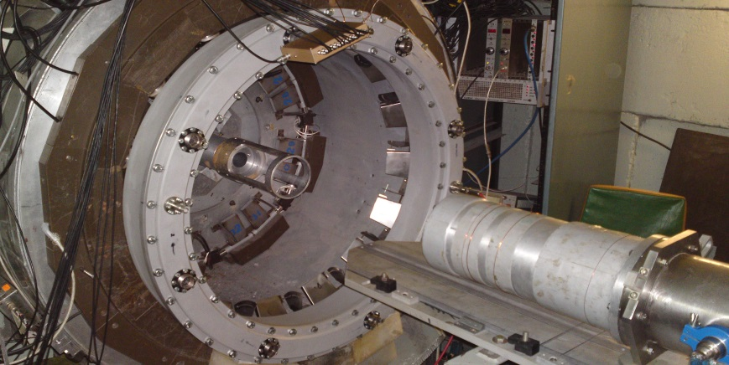
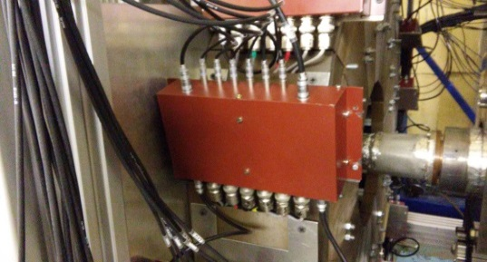
Equipping of the IBR-2 spectrometers with detectors
Available multi-section ring neutron detector
New ring detector
- 96 independent detectors in common gas volume;
- 3 modules of 32-channel amplitude discriminators
- 96 individual helium-3 proportional counters;
- 3 modules of 32-channel amplitude discriminators
Common 192 – channel data acquisition and accumulation module
New detector system for DN-6 diffractometer

Slide 11
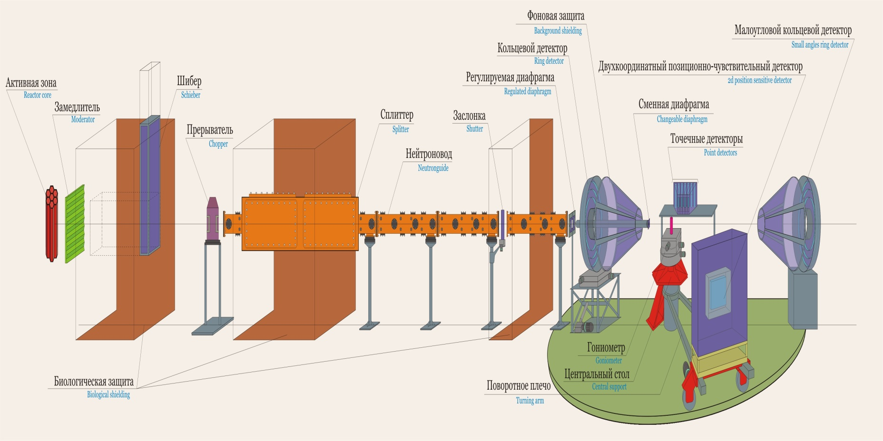
Real time diffractometer (RTD)

Slide 12
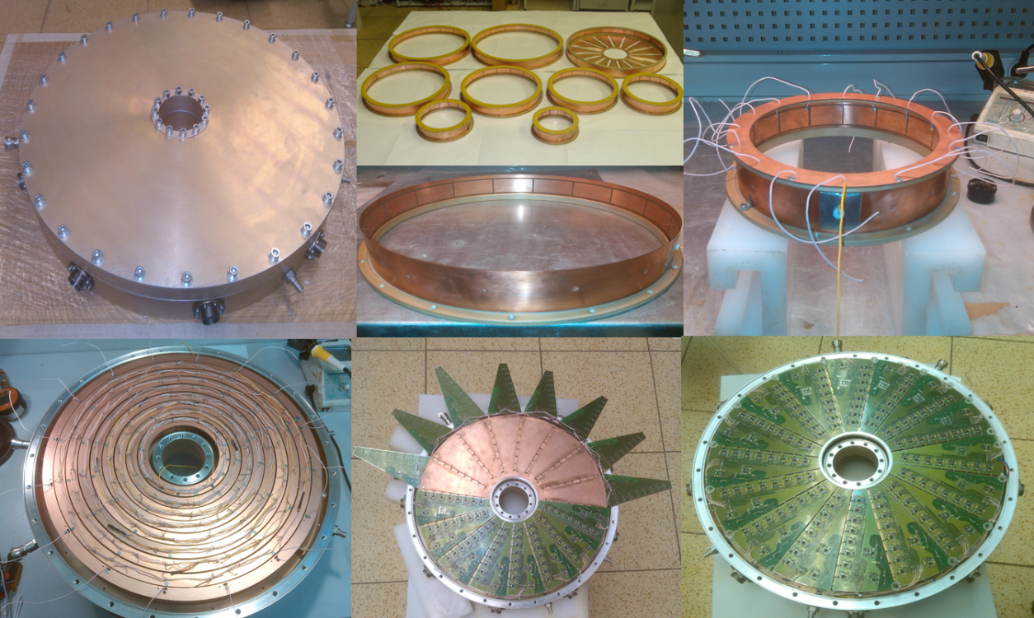
New ring gas detector for detecting small-angle scattering of thermal neutrons on the RTD diffractometer
Photos of the housing (left), internal part of the detector and 9 independent coaxial rings (right)

Slide 13
New ring gas detector for detecting small-angle scattering of thermal neutrons on the RTD diffractometer
Amplitude spectra from cathodes
(one from each of 16- sectors)
Amplitude spectra from anodes
The detector is divided into 9 independent equidistant coaxial rings. The cathodes of each ring are divided into 16 independent sectors. The signal pickup is performed from anode wires (shared by all rings) and from each of the 16 cathodes. Thus, this detector system consists of 144 + 9 independent detectors.

Slide 14
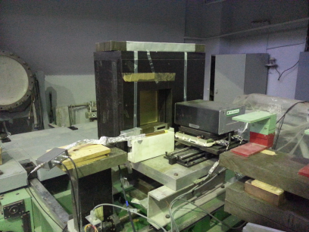
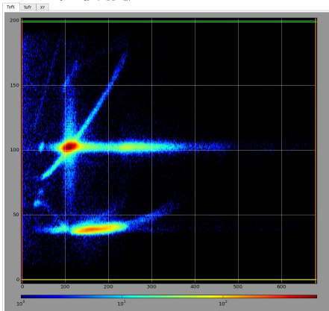
Development of two dimension position sensitive detectors
New 2D PSD detectors has been created and put into operation on the spectrometers:
REMUR, RTD and REFLEX

Slide 15
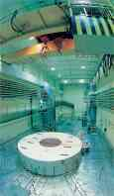
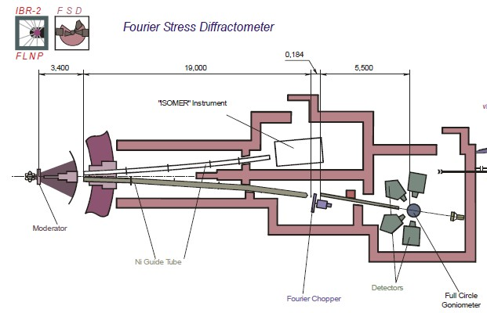
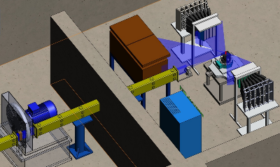
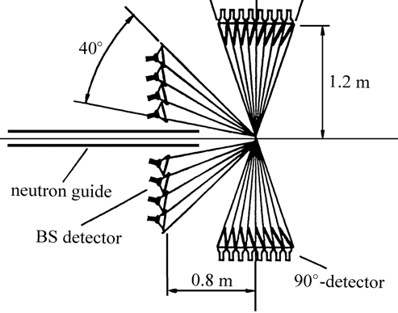
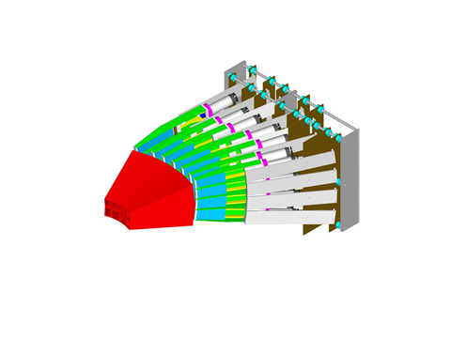
Fourier Stress Diffractometer (FSD)
90°- ASTRA detector

Slide 16
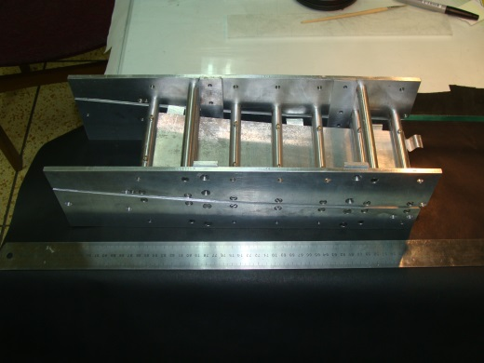
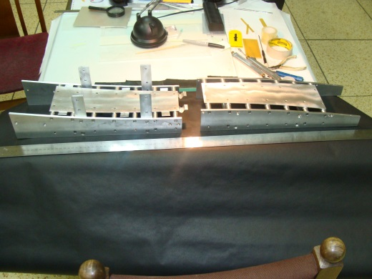
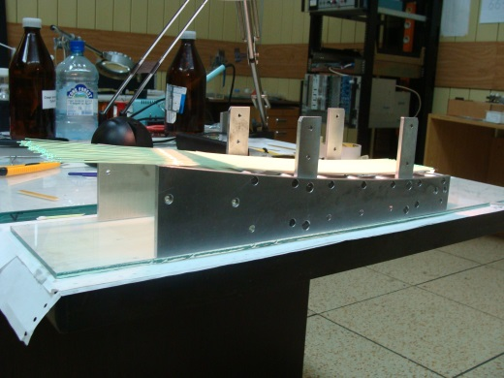
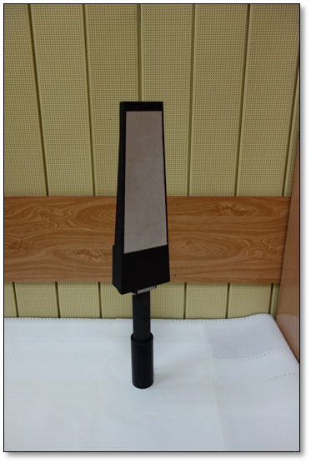
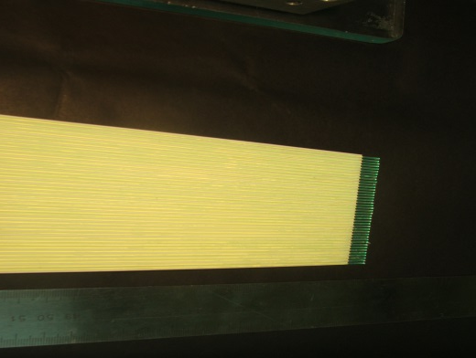
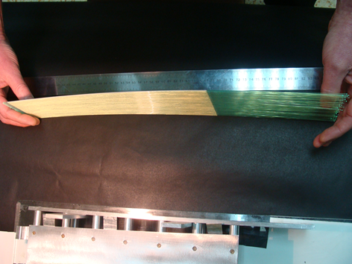
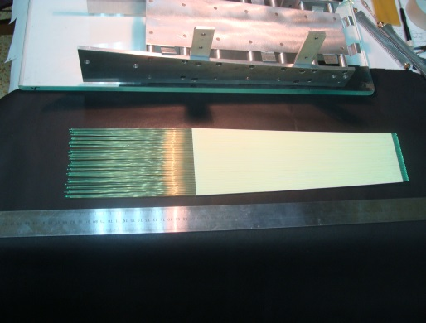
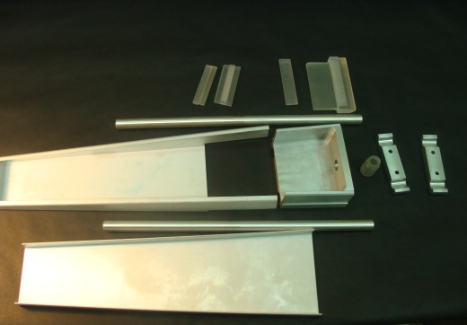
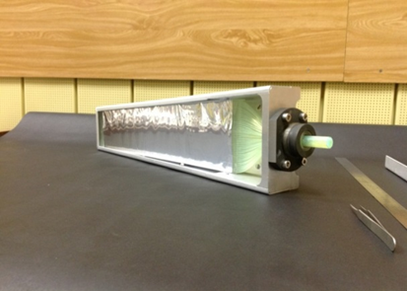
The process of production of a scintillation counters

Slide 17
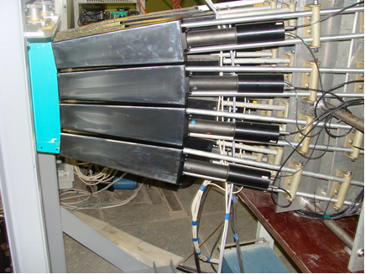
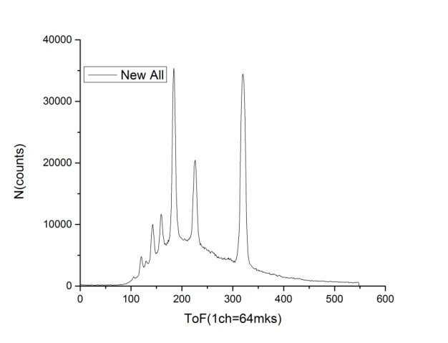
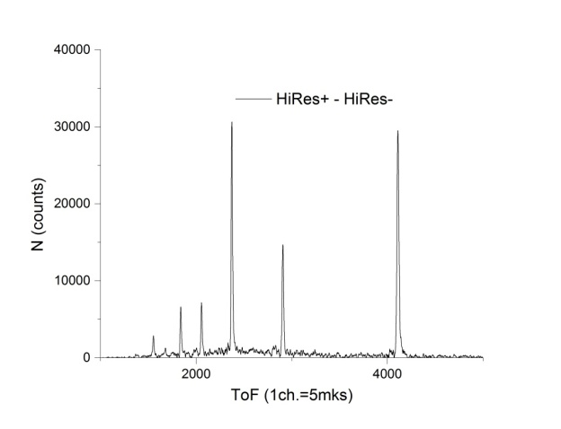
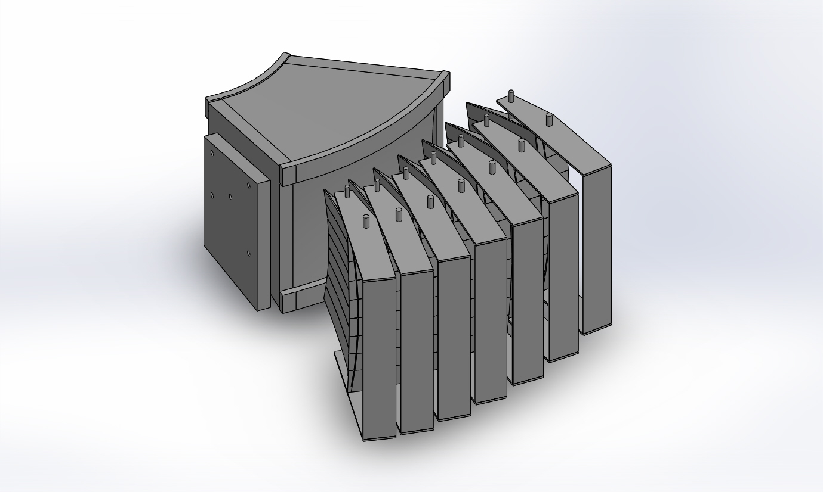
Scintillation counters of section 4 of the ASTRA detector, which are installed on the FSD diffractometer.
Spectra of low and high) resolution obtained using section 4 of the ASTRA detector
3D view of the left arm of the ASTRA-M detector

Slide 18
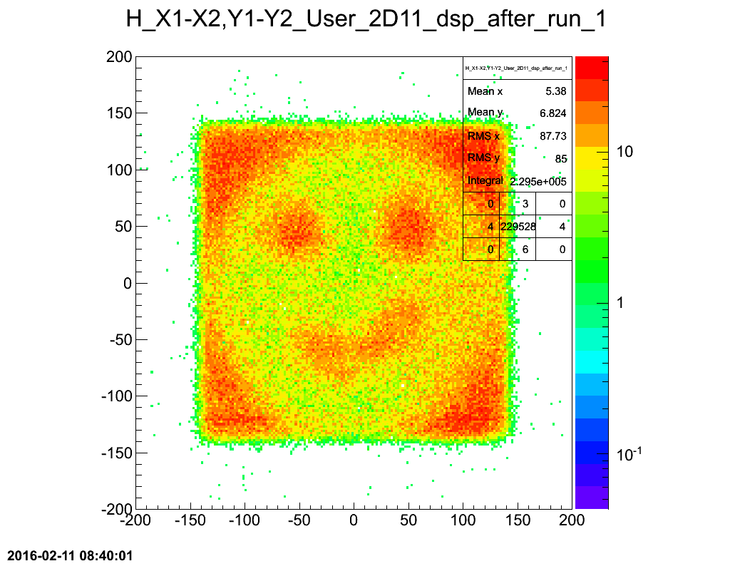
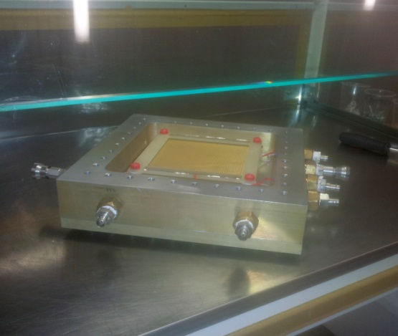
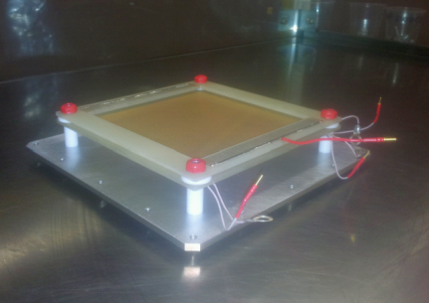
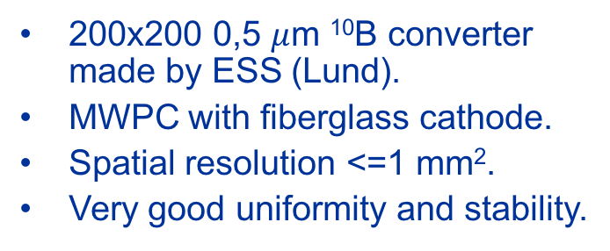
¹⁰B with MWPC
200х200 0,5 $μ$m ¹⁰B converter made by ESS (Lund).
MWPC with fiberglass cathode.
Spatial resolution <=1 mm².
Very good uniformity and stability.

Slide 19
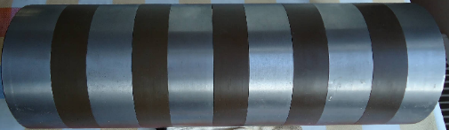
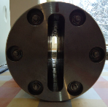
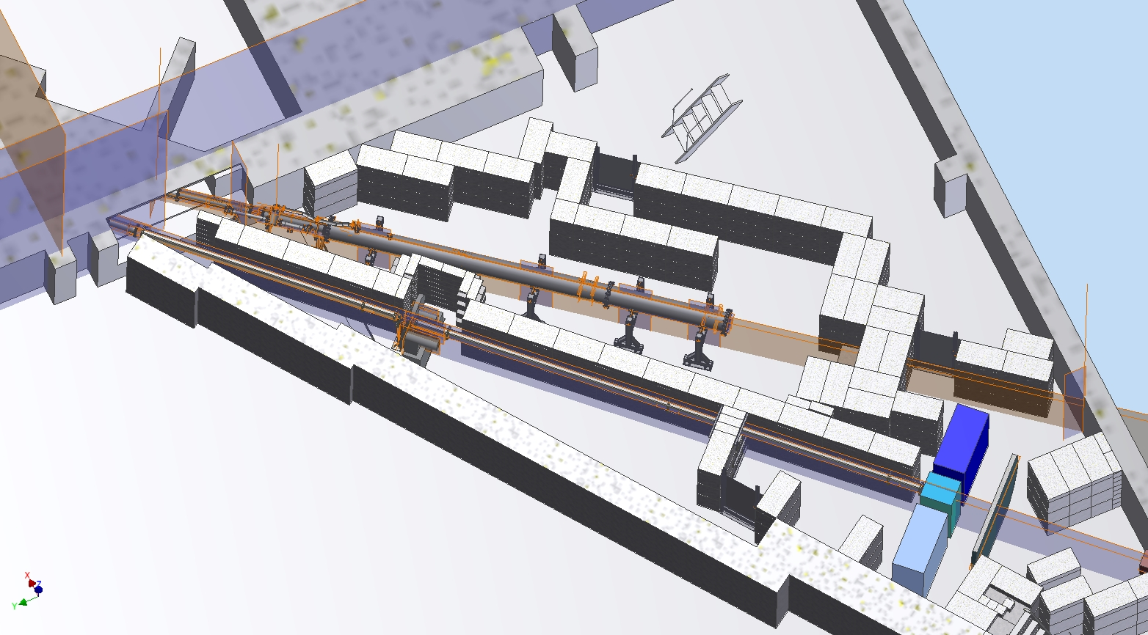
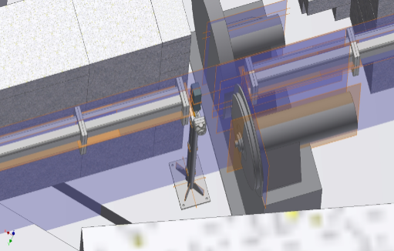
FSS diffractometer, beamline 13 at the IBR-2
steel collimator
neutron guide
Beamline 14 - NRT
Beamline 13 - FSS
detector system
F-chopper(s)

Slide 20
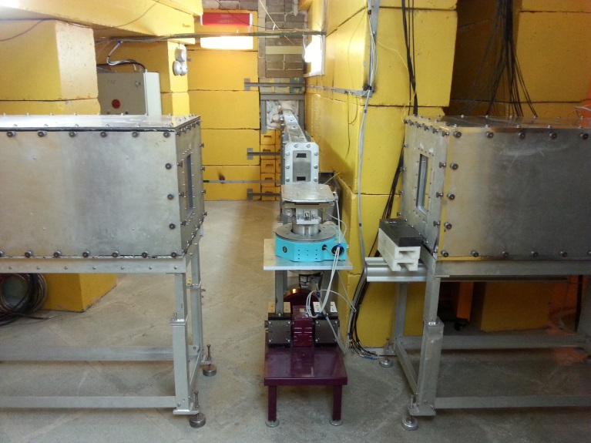
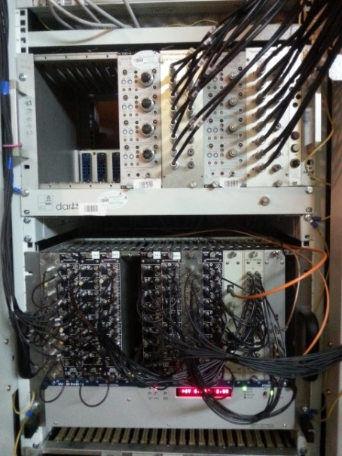
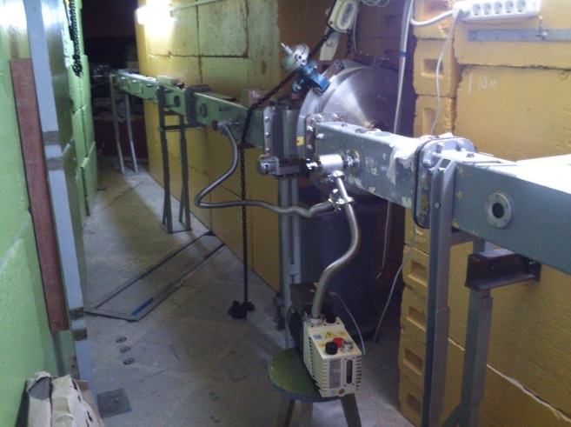
FSS diffractometer, beamline 13 at IBR-2
A sample table with a goniometer and 90° scintillation detectors "Ost" and "West" on IBR-2 beamline 13.
Electronics of high-voltage power supply of detectors (top crate), modules of detector electronics and MPD data acquisition electronics (bottom crate)
Starting section of the curved neutron guide and Fourier chopper on IBR-2 beamline 13

Slide 21
All the detectors described are equipped with the unified blocks of analog and digital electronics and software developed in our department at FLNP.
The digital data acquisition systems consist of two basic electronic modules, (Delidaq 1,2 and MPD), one of which processes and accumulates data from one- and two-dimensional PSD, and another – from an array of point detectors (gas and scintillation counters).
All parameters of the modules are programmed. New systems allow one to work both in the histogram mode and in the mode of accumulation of raw data – ”ListMode” (with subsequent off-line processing).

Slide 22
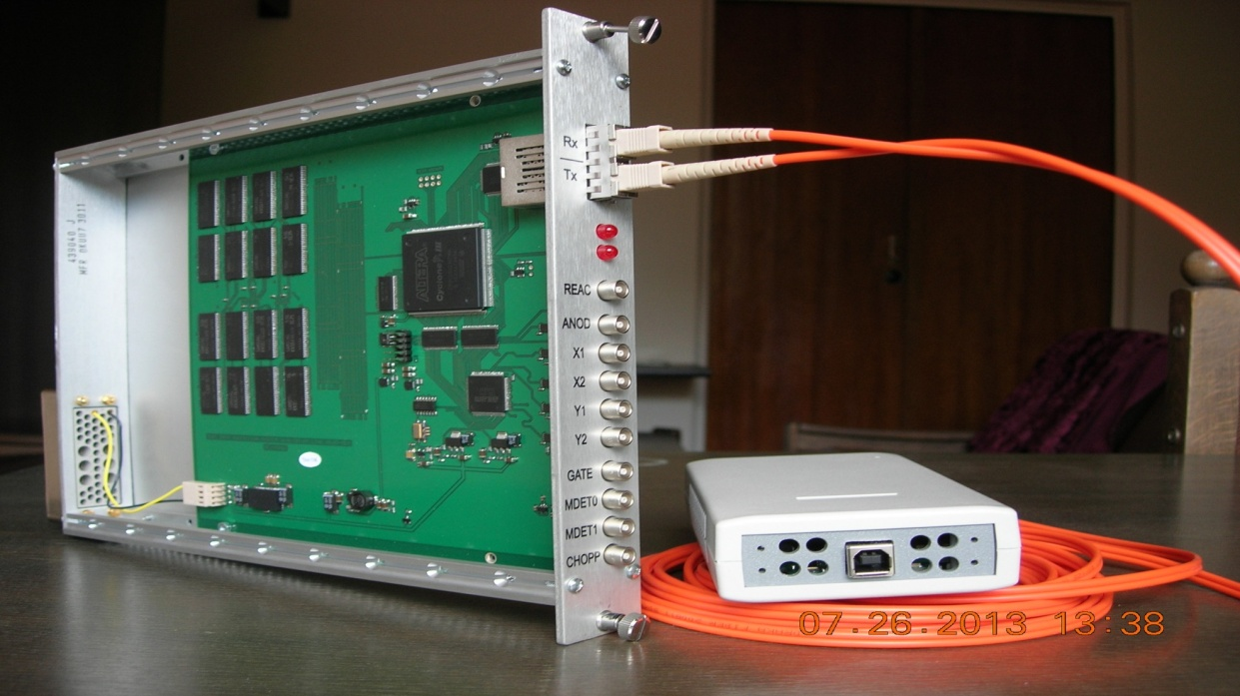
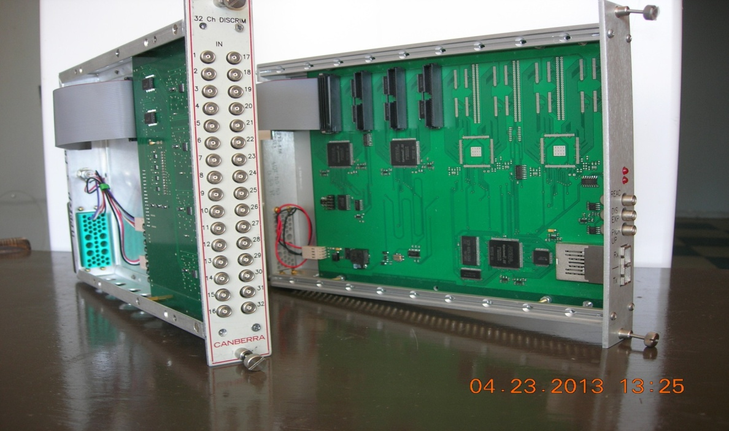
DAQ boards (NIM) for detectors
FPGA
EP1C6Q240C6
Hist.
Memory
1GByte
From MWPC
Anode
NIM-TTL
Data
FPGA1
TDC-GPX
64 d
FPGA1
X1
64 d
SerDes
X2
WR
FPGA5
SerDes
64 d
FPGA5
Y1
WE
RAS
CAS
64 d
FPGA2
Y2
RD
FPGA2
TOF
64 d
16
64 d
FPGA3
FPGA3
Optical Converter
Gate
HM (64MB)
Optical Converter
Parallel2Serial
Serial2Parallel
HM (64MB)
48 d
48 d
FPGA4
FPGA4
Fiber Link
Fiber Link
1.25Gb/s
40МB/s
Fiber Link
40МB/s
Optical
Converter
Daughter Board
De-Li-DAQ-2 block for 2D PSD (MWPC)
DAQ electronics for multi-point detector (MPD)

Slide 23
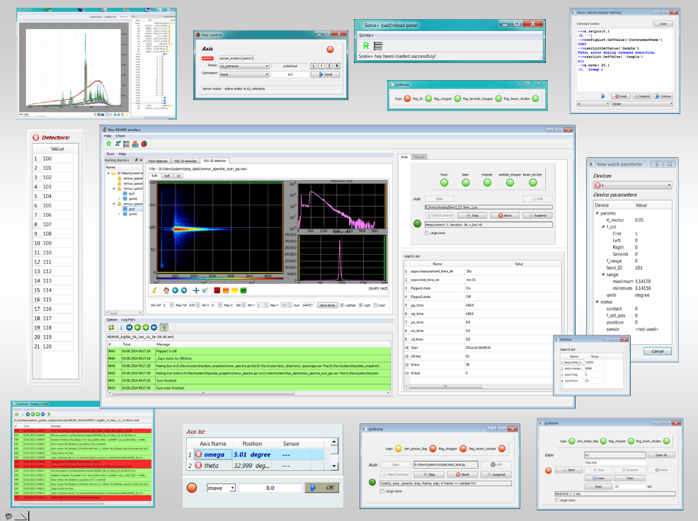

Developments of instruments software Sonix+
Among the most important activities in software development were the following:
development of new components for controlling equipment of a number of spectrometers (RTD HRFD, REMUR, GRAINS, DN-6, FSD, FSS);
supplementation of a basic set of widgets and improvement of programs of graphical user interface;
development of a new version of the command library for reflectometers, in which preliminary data processing is conducted simultaneously with the continuation of exposure.
An improved version of WebSonix 4.7 for remote control over experiments, has been developed and put into operation. Eight spectrometers (YuMO, HRFD, FSD, SKAT, NERA, EPSILON, DIN-2PI, REFLEX) have been connected to this service

Slide 24


Computing Infrastructure
The outdated network switches in buildings some buildings of Laboratory have been replaced to provide a data rate of 1Gbit/s for all end users in the offices.
A centralized network data storage was organized on the basis of a file-server Supermicro with two CPU Intel Xeon, 16 GB RAM and 72 TB disk memory. This storage system provides an automatic transfer of data from the control computer to the file-server during the experiment.
The storage capacity is quite sufficient for recording and storing data from all IBR-2 spectrometers.

Slide 25
Leader of the Project : Chernikov A.N.
Report of the Project:
Development of PTH sample environment system for diffractometer DN-12 of the IBR-2 reactor

Slide 26


DN-12 (Neutron Diffractometer for Investigations of Micro-Samples at High Pressure)
Experiments demand:
Environment on the sample provided simultaneously:
(H) magnetic field 4 T.
- (T) temperature in the range of 3 - 300 K
(P) pressure up to 15 GPa
Realization of the project gives opportunity to widen types of investigated magnetic materials on the diffractometer as well as it makes possible to investigate 3D magnetic phase diagrams P-T-H. As result the DN-12 will be leading diffractometer among other facilities in the world for such investigations.

Slide 27


3D model of horizontal dry cryostats with split-coil HTSC magnet and cold anvils-insert at diffractometer DN12
1
4
n
n
9
Two detectors rings
of DN-12
7
8
5
6
2
1 - first cryostat with coils HTSC magnet (YBCO – superconductor tape); 2 - magnet second cryostat with pressure cell; 4 – current lead; 5 – high pressure chamber; 6 и 7 – detectors DN12; 8 –cryorefrigerator SRDK408S, 9 – cryorefrigerator SRDK101D

Slide 28

Map of magnetic field of pair cols magnet
n
B
Distance between coils 40 mm
300 A - current

Slide 29
Cryostat with HT superconducting magnet
1. Magnetic field – 4 T
2. Field uniformity in the area of 2 cm^3 - less than 1 %
3. HTSC tape - YBCO, 12 mm wide, 0.1mm thickness,
~300A – critical current at 77K, >300A at 20 K
4. Temperature monitoring in 8 points
5. Apertures for scattering neutrons (due to detector dimensions and positions):
orthogonal to cryostat – 2 degrees
at 45 degrees – 1 degree.
6. Cooling by closed cycle cryorefrigerator (SRDK408S)
Inner cryostat with high pressure cell
Temperature range (3-300) К
Cooling by closed cycle refrigerator (SRDK101D).
3. Sample exchange without warming up of the magnet
4. Inner diameter is 78 mm for cryogenic part with existing high pressure cell.

Slide 30



Cryostat with HT superconducting magnet

Slide 31


The magnet cooling process (February 2017 test). 1, 3 – HTSC current leads at the first stage; 2, 4 –flanges at the first stage; 5 – the second stage of SRDK408S; 6, 7 – the top and the bottom of the magnet.
По данному проекту выполнены следующие основные работы:
Разработана техническая документация на криостат и магнит с величиной поля до 4 Тл.
Разработан и изготовлен станок для намотки катушек магнита из сверхпроводника с высокотемпературной проводимостью.
Изготовлен криостат для охлаждения магнита.
Изготовлен магнит.
Разработан и испытан горизонтальный криостат для охлаждения камер высокого давления. Этот криостат с камерой вводится в магнитное поле сверхпроводящего магнита.
Введен в эксплуатацию источник питания сверхпроводящего магнита с рабочим током до 300А.
Проведены испытания криостата с магнитом. Измерена постоянная магнита равная 0.0154 Тл/A. Введен ток величиной 90 А. Получена величина магнитного поля 1.386 Тл. Для увеличения величины поля проводятся работы по улучшению электрических контактов и тепловых связей.
Temperature and voltage evolution during charging/discharging the magnet
1, 2 – temperature on the top and at the bottom of the magnet case; A, B, C – junctions potentials; D, E – HTSC current leads potentials. The magnet constant is 0.0154 T/A. The achieved field magnitude of 1.5 T in the first test.

Slide 32



The low value of the current (30A) in comparison with the previous value obtained in February 2017 (of 115A), shows a possible “degradation” of the parameters of the HTS coil.
Potentials measured in a test with cryocooler
Exfoliation of the outer layer of the tape
We are asking PAC to extend the project "Development of PTH sample environment system for the DN-12 diffractometer at the IBR-2 facility" for 2018-2020

Slide 33

Schools for student and PhD student from countries members of JINR
Starting from 2010, the International School for Young Scientists and Students “Instruments and Methods of Experimental Nuclear Physics. Electronics and Automatics of Experimental Facilities” has been held annually in Dubna.

Slide 34
Staff 2014
Structure : 6 groups
Staff – 49 (17 – scientists,12 – technical staff, 20 – engineers)
____________________
Young scientist and specialists: 14.
Staff 2017
Structure : 6 groups
Staff – 52 (18 – scientists,5 – technical staff, 29 – engineers)
____________________
Young scientist and specialists: 22.
        Publications, grants, projects:
        35 publications, more than 20 talks on conferences, 3 dissertations and some diploma works have been prepared;
        JINR second prize
        IAEA contract, contracts with institutes from RF and Czech Republic;
        Grants of Plenipotentiaries of JINR participation countries and Projects: Czech Republic, Romania.

Slide 35
Proposal for extension of the theme “Development of Experimental Facilities for Condensed Matter Investigations with Beams of the IBR-2 Facility” for 2018-2020
04-4-1122- 2015/2020
S.A. Kulikov, V.I. Prikhodko

Slide 36
Workplans for 2018-2020:
Cold moderators:
Development and construction of the control and automation systems of the moderator CM-201 for IBR-2 beamlines № 1, 4, 5, 6, 9. Carrying out trial loading of the moderator chamber CM-201 without power and at the IBR-2 reactor power. Routine modernization and maintenance of the equipment of the moderator CM-202 complex system.
Study of the radiation resistance and the moderating features of hydrogen-containing materials of the cold moderator for extending the time of operation on the physical experiment.
Development and study of the working conditions of the auger-type off-loading facility for the moderator CM-201.
Study of the radiation resistance of materials on the facility for radiation research.
Cryogenics
Development of continuous-flow cryostats on the basis of closed cycle cryocoolers for experiments on the IBR-2 reactor. Development of the current cryogenic stand and its adaptation for development, manufacture and adjustment of the continuous-flow cryostats’ elements.
Manufacture of new tapings and installation of superconducting magnet for the DN-12 diffractometer. Testing of the combined horizontal-vertical cryostat with superconducting magnet on the DN-12 diffractometer and putting it into operation
Development and implementation of new equipment as well as support of the current cryogenic and vacuum equipment on the IBR-2 spectrometers.

Slide 37
Workplans for 2018-2020:
Calculations and simulation of spectrometers:
Development and application of the VITESS and other software packages for simulation of neutron scattering in samples and separate components of spectrometers. Complex calculations and optimization of spectrometers.
Detectors and electronics:
Completion of the manufacturing activities on “Astra-M” detector system at the FSD spectrometer and putting it into operation in 2018. Modernization of the NERA spectrometer detector system.
Development and manufacturing of the back-scattering detector units at the HRFD diffractometer in accordance with the plan-schedule of the BSD project. Development and manufacturing of the multi-detector system units for the DN-12 diffractometer and development of a new data acquisition and accumulation system from multilevel systems on the basis of PSD.
Developments of the prototype of small-angle detector measurements, spectrometer detectors of fast neutrons, monitor of the IBR-2 reactor beams and detectors on the basis of boric-converter.
Equipping of all detector systems with current electronics MPD and DE-Li-DAQ and development of the infrastructure for creation of neutron detectors.

Slide 38
Workplans for 2018-2020:
Control systems of actuators, sample environment equipment and spectrometer choppers:
Further activities on the development of control systems for actuators:
- modernization of actuators on the YuMO and REFLEX spectrometers;
putting new mechanisms into the structure of spectrometers at the request of users;
equipping of the REMUR spectrometer with position sensors.
Improvement of control systems for physical instruments and temperature regulation systems:
- change of temperature controllers Eurotherm on Lakeshore;
putting into new measurement devices and controllers upon the requests of the persons responsible for the facility;
unification of amplifiers used in the temperature regulation systems.
Modernization of control systems for choppers on the beams 11 and 13.
Software:
Maintenance and development of the software package Sonix+ at the request of users.
Development of concept of central storage organization of measurement results on the IBR-2 reactor and its implementation, putting the storage into operation.
Local area network:
Development of the FLNP network infrastructure in accordance with the development strategy of the JINR computer network.
Modernization of power supply system of the FLNP Central network complex.

Slide 39
Collaboration with scientific organizations from:
Bulgaria, Belarus, Russian Federation, Romania, Ukraine, Czech Republic, Argenitina, Great Britain, Hungary, Germany, Republic of Korea, Sweden, Switzerland, RSA
The full funding of the theme upon the economic budget items, corresponding to the scheduled figures of the 7-year plan for the development of JINR for 2017-2023:
Activities: | Cost of operations, kUSD
 | 2018 | 2019 | 2020
Development of the control system for neutron cold moderators and actuators | 250 | 250 | 210
Development of detectors, sample environment systems, cryogenic equipment, data acquisition and accumulation systems; development of the FLNP computing infrastructure | 1120 | 1220 | 1370
Total: | 1370 | 1470 | 1580
Other financial sources:
Grants of the plenipotentiaries of JINR member-countries (Romania, Belarus, the Czech Republic), contracts with IAEA etc.

Slide 40
Development of a wide-aperture backscattering detector (BSD) for the HRFD diffractometer
PROJECT LEADER: Kruglov V.V.

Slide 41
The HRFD diffractometer at the IBR-2 reactor is one of three or four neutron diffraction instruments in the world where it is possible to perform experiments that require the resolution Δd/d ≈ 0.001 or higher. HRFD is mainly intended for:
- Precision analysis of polycrystal structure;
- Monocrystal diffraction peaks shape analysis with Δd/d ≈ 0.001;
- Internal stress analysis in bulk items and materials.

Slide 42

Diffractometer HRFD
Layout of HRFD at the IBR-2 reactor
Disadvantages of current back scattering detector:
current solid angle of detector ~0.16 sr;
a high sensitivity to γ-background (⁶Li glasses).
As a result the diffraction spectrum obtained with the TOF diffractometer POWGEN3 (SNS/ORNL, Δd/d ≈ 0.001) due to a large-area ZnS(Ag)-based detector (solid angle 1.5 sr) will have a low background and ~10 times better statistics than the spectrum from the same sample measured using HRFD.

Slide 43

Wide-aperture backscattering detector (BSD)
The new detector covers the scattering angle interval 2ϴ=(133-175)° with the corresponding total solid angle of approximately Ω_{Q}≈2.0 sr. The technological and technical solutions used at the present time in the Laboratory make it possible to almost completely eliminate event losses due to the detector design for this solid angle. Thus, as compared to the existing detector at HRFD, the solid angle will increase by a factor of ~12.5.
To ensure high and ultra-high resolution, the detector is designed on the basis of a thin 0.42-mm-thick ZnS(Ag)/⁶LiF scintillation screen. The collection and transmission of light from scintillation screens to photomultipliers are done using optical wavelength shifting fibers.
Detector consists of 216 elements

Slide 44



Dependence of the detector efficiency on the scattering angle
Ring 6
Ring 6
Ring 5
Ring 4
Ring 5
Ring 4
Ring 3
Ring 3
Ring 2
efficiency
Ring 2
Ring 1
Ring 1
scattering angle
scattering angle
Element of the scintillation screen (white plate) together with the optical wavelength shifting fibers glued to it on both sides. The curved shape of the screen is determined by the requirement of space-time focusing

Slide 45


3D graphic presentation of a large-aperture backscattering detector.
Δd/d ≈ 0.001
$$∅_{samp},mm$$ | 1 | 2 | 3 | 4 | 5 | 6 | 7 | 8
$${<∆}_{1}>$$ | $$4.0×{10}^{−5}$$ | $$6.9×{10}^{−5}$$ | $$1.0×{10}^{−4}$$ | $$1.3×{10}^{−4}$$ | $$1.7×{10}^{−4}$$ | $$2.0×{10}^{−4}$$ | $$2.3×{10}^{−4}$$ | $$2.6×{10}^{−4}$$
$${<∆}_{2}>$$ | $$4.6×{10}^{−5}$$ | $$7.3×{10}^{−5}$$ | $$1.0×{10}^{−4}$$ | $$1.3×{10}^{−4}$$ | $$1.7×{10}^{−4}$$ | $$2.0×{10}^{−4}$$ | $$2.3×{10}^{−4}$$ | $$2.6×{10}^{−4}$$
$${<∆}_{3}>$$ | $$5.1×{10}^{−5}$$ | $$7.6×{10}^{−5}$$ | $$1.1×{10}^{−4}$$ | $$1.4×{10}^{−4}$$ | $$1.7×{10}^{−4}$$ | $$2.0×{10}^{−4}$$ | $$2.3×{10}^{−4}$$ | $$2.6×{10}^{−4}$$
$${<∆}_{4}>$$ | $$5.5×{10}^{−5}$$ | $$7.9×{10}^{−5}$$ | $$1.1×{10}^{−4}$$ | $$1.4×{10}^{−4}$$ | $$1.7×{10}^{−4}$$ | $$2.0×{10}^{−4}$$ | $$2.3×{10}^{−4}$$ | $$2.6×{10}^{−4}$$
$${<∆}_{5}>$$ | $$5.8×{10}^{−5}$$ | $$8.1×{10}^{−5}$$ | $$1.1×{10}^{−4}$$ | $$1.4×{10}^{−4}$$ | $$1.7×{10}^{−4}$$ | $$2.0×{10}^{−4}$$ | $$2.3×{10}^{−4}$$ | $$2.6×{10}^{−4}$$
$${<∆}_{6}>$$ | $$6.1×{10}^{−5}$$ | $$8.2×{10}^{−5}$$ | $$1.1×{10}^{−4}$$ | $$1.4×{10}^{−4}$$ | $$1.7×{10}^{−4}$$ | $$2.0×{10}^{−4}$$ | $$2.3×{10}^{−4}$$ | $$2.6×{10}^{−4}$$
Geometric contribution to the total resolution of the diffractometer.
– error value for the i-th ring of the detector.

Slide 46
Network schedule of the Project
Development of a wide-aperture backscattering detector (BSD) for the HRFD diffractometer
N |  | 2018 |  | 2019 |  | 2020
 |  | I | II | I | II | I | II
1 | Development of technical design of backscattering detector
2 | Manufacturing of equipment for manufacturing detector elements
3 | Purchase of equipment and consumables
4 | Construction of data acquisition and accumulation electronics (240 channels)
5 | Purchase of power supply source for systems with a large number of photomultipliers
6 | Manufacturing of detector frame and elements of detector sections
7 | Assembling of first detector section (prototype) with data acquisition and accumulation systems and software
8 | Tests of first section in laboratory conditions and at the beam

Slide 47

The main materials and equipment
Photomultipliers : 216
The surface of scintillator S > ${\text{10} м}^{2}$
The approximate length of fibers L=36000 м
Hi voltage (CAEN)
2 NIM creates
Pre-amplifiers and Data Acquisition and Accumulation System will be developed in the Department (The system allows one to receive and process information from 240 independent detectors, suppressing events caused by background gamma-rays. The System is designed in the NIM standard. In its full configuration, it consists of 8 units of amplifiers-discriminators with 32 inputs each and one data accumulation unit.)
Manufacturing main construction elements
Consumables
FPGA1
64 d
FPGA1
64 d
SerDes
FPGA5
SerDes
64 d
FPGA5
64 d
FPGA2
FPGA2
64 d
16
64 d
FPGA3
FPGA3
Optical Converter
HM (64MB)
Optical Converter
HM (64MB)
48 d
48 d
FPGA4
FPGA4
Fiber Link
40МB/s
Fiber Link
40МB/s
DAQ electronics for multi-point detector (MPD)

Slide 48
Main units of equipment, resources, financing sources |  |  | Costs (k$) | Proposals of the Laboratory on the distribution of finances and resources
 |  |  | Resource requirements | 2018 | 2019 | 2020
Main units of equipment | 1. Sets of photomultipliers |  |  |  | 190
 | 2. Fibers |  |  |  | 120
 | 3. Scintillator |  |  | 130
 | 4. Power supply |  |  |  | 100
 | 5. Data acquisition and accumulation electronics |  |  |  | 20 | 20
 | 6. Mount fitting and consumables |  |  | 50 | 90 | 90
Financing sources | Budget | Theme | 810 | 180 | 520 | 110
Working group:
1 – Project leader
2 - scientists
6 - engineers
2 - workers
+ students
Total: 11 staff members + students

Slide 49
To extend the theme "Development of Experimental Facilities for Condensed Matter Investigations with Beams of the IBR-2 Facility" and the project "Development of PTH sample environment system for the DN-12 diffractometer at the IBR-2 facility" for 2018-2020 with the first priority and provide all of the resources requested.
Open a new project “Development of a wide-aperture backscattering detector (BSD) for the HRFD diffractometer” for 2018-2020 in the framework of the theme "Development of Experimental Facilities for Condensed Matter Investigations with Beams of the IBR-2 Facility" and to provide resources in accordance with the presented work plan.

Slide 50


Thank you for your attention!
Notes:
50
50

