Slide 1
A highly reliable data center network topology Tier 1 at JINR
A.S. Baginyan
Senior Engineer, CCNP
Scientific Supervisor:
V.V. Korenkov, DSc
Joint Institute for Nuclear Research
Dubna, 2014

Slide 2
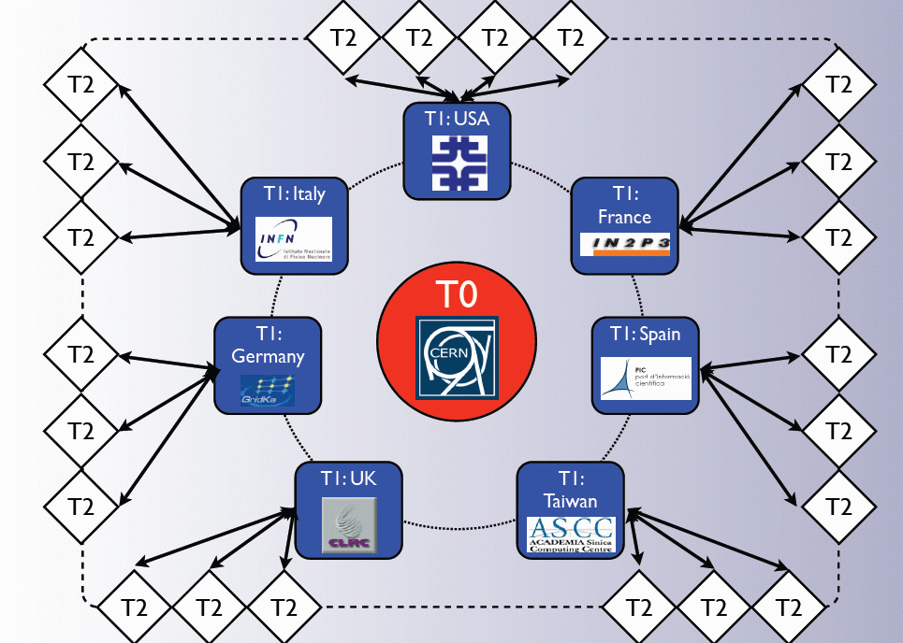
Worldwide LHC Computing Grid
TIER 0
accepts RAW data from the CMS Online Data Acquisition and Trigger System.
repacks the RAW data received into primary datasets based on trigger information .
distributes RAW data sets among the next tier stage resources (Tier-1) so that two copies of every piece of RAW data is saved, one at CERN, another at a Tier-1.
TIER 1
receives a subset of the data from the T0 related to the size of the pledged resources in the WLCG
provides tape archive of part of the RAW data (secure second copy) which it receives as a subset of the datasets from the T0
provides substantial CPU power for scheduled:
re-reconstruction
skimming
calibration
AOD extraction
TIER 2
services for local communities
grid-based analysis for the whole experiment (Tier-2 resources available to whole experiment through the grid)
Monte Carlo simulation for the whole experiment

Slide 3
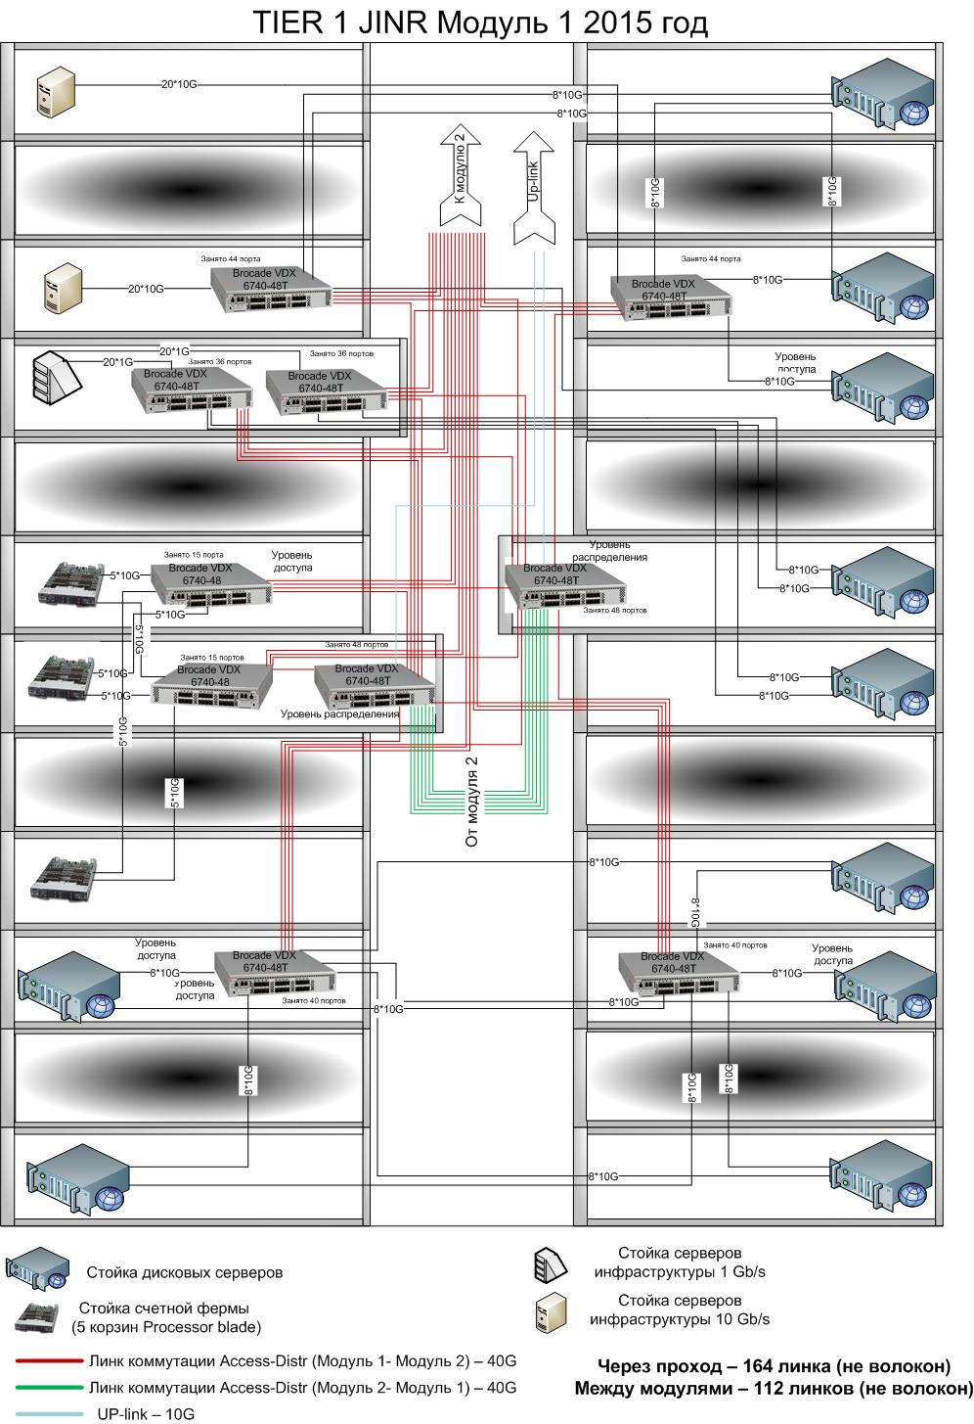
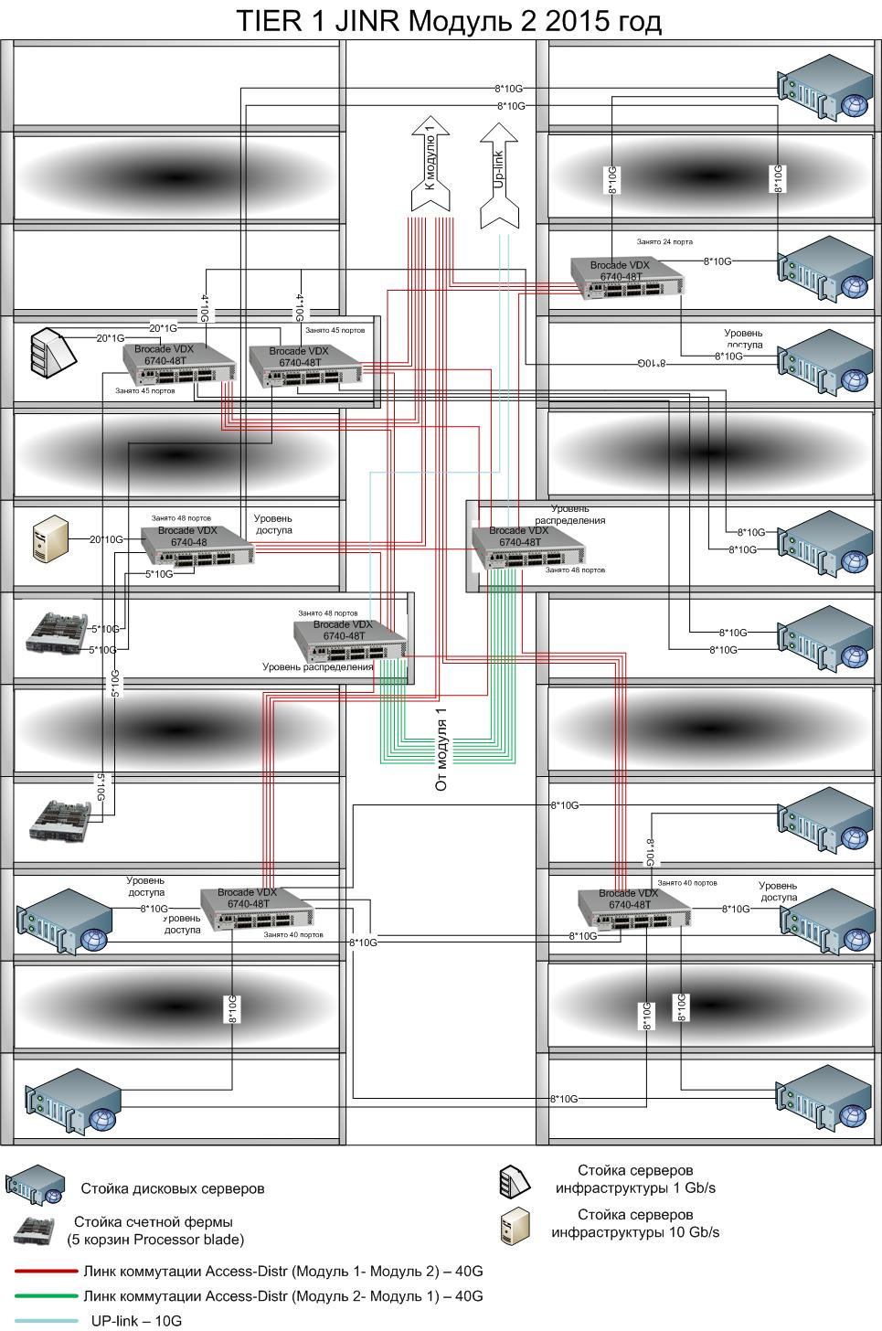

Slide 4
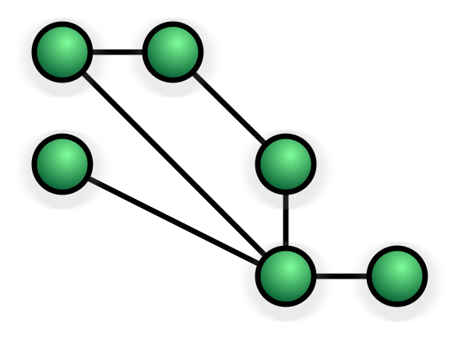
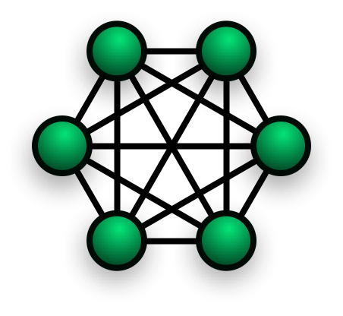
Network topologies
Star topology
Mesh topology
Full mesh topology

Slide 5
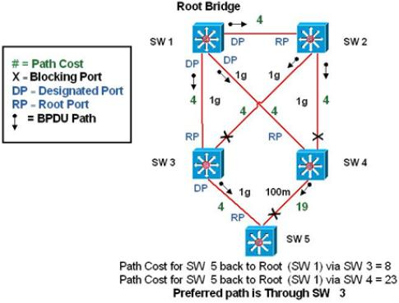
Spanning Tree Protocol (STP)
Real-life example of «spanning tree protocol» calculation

Slide 6
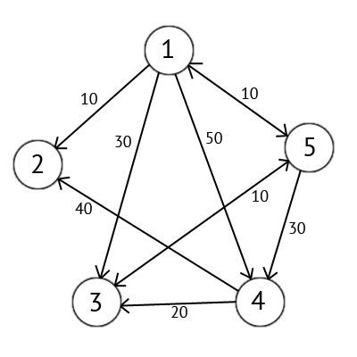
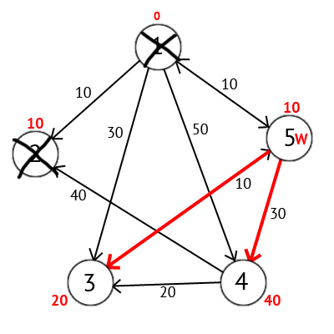
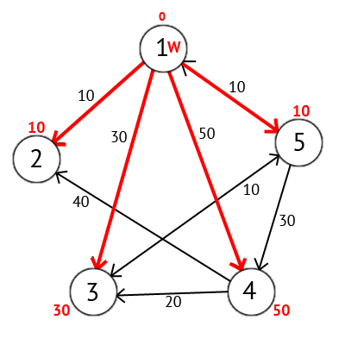
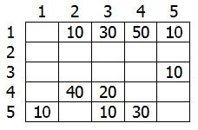
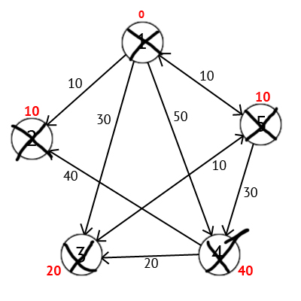
Dijkstra’s algorithm

Slide 7
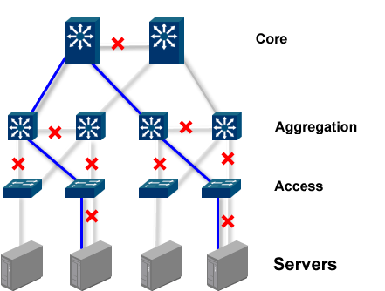
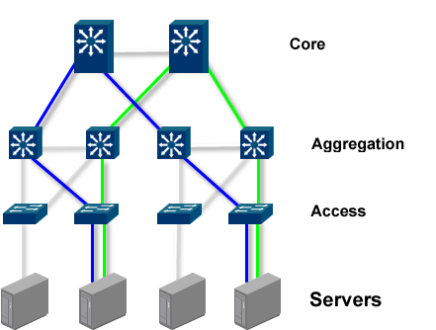
Transparent Interconnection of Lots of Links (TRILL)
STP Layer 2 single paths
TRILL Layer 2 multiple paths

Slide 8
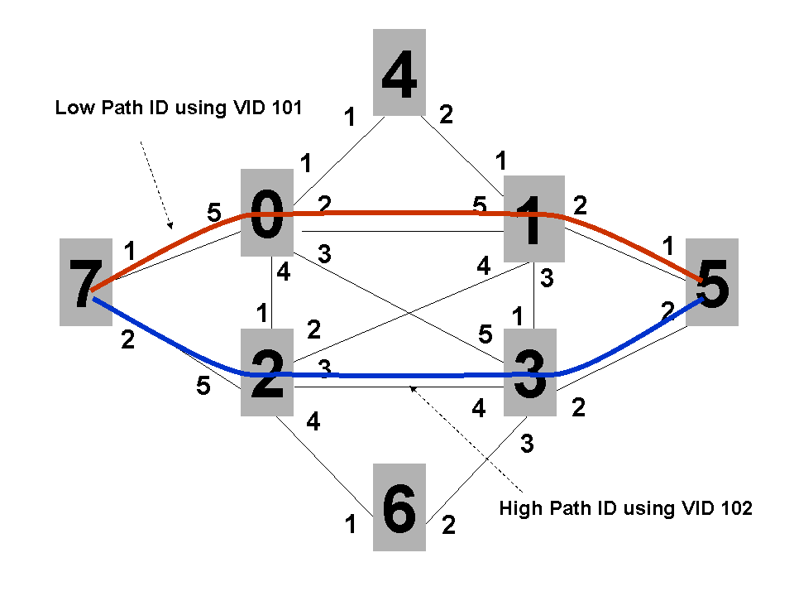
Shortest Path Bridging (SPB)

Slide 9
Compare and Contrast Shortest Path Bridging and Transparent Interconnection of Lots of Links
Characteristic | Shortest Path Bridging | Transparent Interconnection of Lots of Links
Multi-Pathing Support | Yes | Yes
Eliminates Need for Spanning Tree and Blocked Links | Yes | Yes
Interoperability with Spanning Tree | Yes | Yes
Loop Prevention | RPFC | TTL-based & RPFC
Uses IS-IS as the Layer 2 Routing Protocol | Yes | Yes
IS-IS Interoperability | Uses existing IS-IS with TLV extensions | New type of IS-IS instance with new PDU types
Dynamically Changes Network Paths for Traffic Flows | Yes | Yes
Cut-through Switching | Possible | Possible but difficult due to options field in header
Virtualization Support | Service Instance using I-SID (16Mio) | VLAN only (4k)
Low-Touch Configuration | Yes; need to configure VLAN to Service Instance Mapping | Yes

Slide 10
TIER 1 JINR

Slide 11
Thank you for your attention

Slide 12
A highly reliable data center network topology Tier 1 at JINR
A.S. Baginyan
Senior Engineer, CCNP
Scientific Supervisor:
V.V. Korenkov, DSc
Joint Institute for Nuclear Research
Dubna, 2014

