Slide 1
Benchmarking ARM System on chips
Robert Reed | University of the Witwatersrand
Notes:
Good morning ladies and gentlemen. We are living in a world more connected than ever before. I am not talking about internet access but rather mobile internet access.
Email, Instant messaging, Navigation and Information are literally at our fingertips.
This has all been made possible by a little guy in this Smartphone. More specifically the system on chip or SoC.
My name is Robert Reed and I will be presenting a Benchmarking Characterization of ARM based System on Chips.

Slide 2
Overview
Data Stream Computing
ARM SoCs
Benchmark Results and Power Consumption
Summary
Notes:
A quick overview. I will recap what Mitch said in the previous talk about Data Stream Computing.
I will give a little more detail about the ARM SoCs and why the Intel Atoms are not included in this presentation.
Then I will get into the meat of the presentation and explain which benchmarks are used and all results obtain.
Summary.

Slide 3
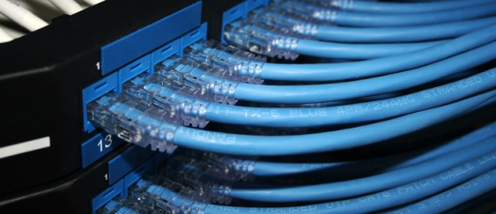
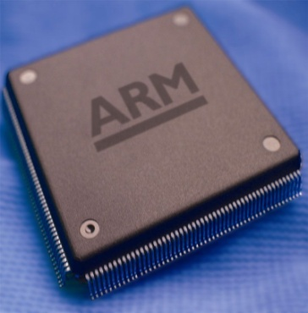
Data stream computing
No Offline Storage
High Data Throughput
Generic Programming
Notes:
Data stream computing. Introduced by Mitch Cox in the previous presentation.
No offline storage – Data produced faster than we can store (many years). Disk speeds have not improved as much as processing power. At a point we want to stream.
High data throughputs – This goes with the territory. If there wasn’t high data throughput then we could use offline storage.
Generic Programming – The whole process must remain generic. No low level coding.
To achieve this we don’t just need good performing CPU’s but more critically the correct balance between RAM, Connectivity and CPU performance. Keeping power consumption in mind.
Getting this balance right for BIG DATA problems can be rather difficult.

Slide 4
Data Stream Computing
Notes:
Understanding the balancing act requires a better understanding of each component and I will be focusing on the SoCs.

Slide 5
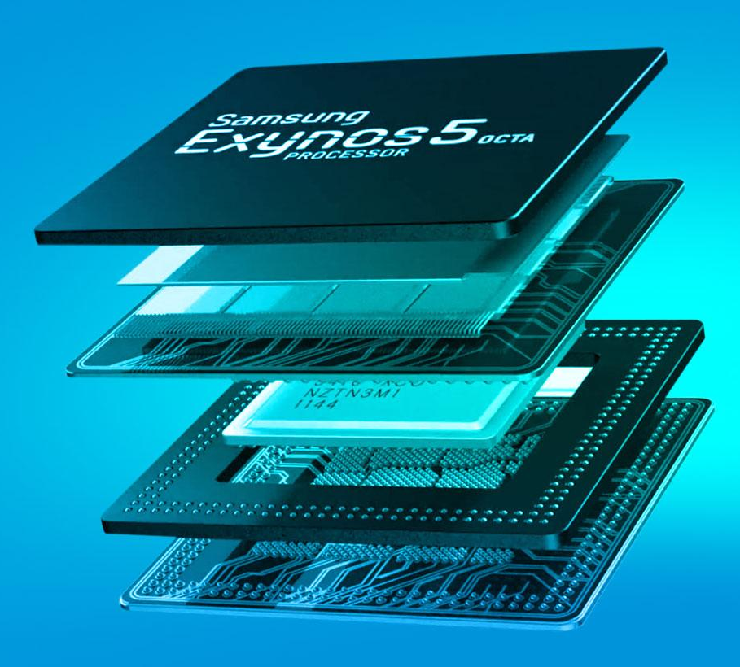
Introduction
What is an ARM Processor
Advanced RISC Machine
Where is it being used
95% of Smartphone Market
Consumer Products
Why use them?
Power efficient
Low capital cost
2 Quad Cores in the Samsung S4
Notes:
Before I get started on ARMS, why not Intel Atoms? The simple answer is Atoms are slightly more difficult to buy and we have only recently got an NDA to buy the latest chips. So we are not married to ARM… We are still in the dating phase and seeing which one has more money. By that I mean performance.
Advanced RISC machine. Reduced instruction set computing. This was introduced in the 1970’s when IBM did a study which showed that 20% of the instructions being used were doing almost 80% of the work. RISC is simpler than CISC and therefore easier to optimise in term of power consumption.
This explains why they are largely being used in the Mobile Market. Almost 95% of smartphones today have ARM processors. Consumer products like tablets or digital televisions.
Since the ARM technology is being driven by the consumer market it results in the chips being mass produced and inexpensive.

Slide 6
Coremark
by
10s
A7 : -O3 -mfpu=neon-vfpv4 -march=armv7-a -mtune=cortex-a7
A9 : -O3 -mfpu=neon -march=armv7-a
A15 : -O3 -mfpu=neon-vfpv4 -march=armv7-a
Notes:
Overall understanding. Supported by ARM for SoCs instead of Dhrystone.
4 common algorithms in real llife. The result is then displayed as Iterations per second. This allows one to compare across different platforms.
Installation Combo of 16 flags. A7 performed well with the tune option. A9 and A15 did not. GCC 4.7.3 not much support for A15.
CoreMark also has Strict submission rules. One being the test must run for 10 seconds or more we can see from the graph on the right that at 10s we are well on the plateau. This means that the database of CoreMark results is a good standard to compare platforms against one another.

Slide 7
CoreMark
Notes:
Point out atoms and intel I7.
A15 and N2800 similar performance per core. A15 has double the cores.
ARM support increasing for compilers. Don’t discard ARM because of that.
Mention max TDP.
Arm includes peripherals

Slide 8
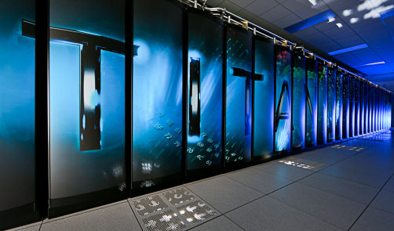
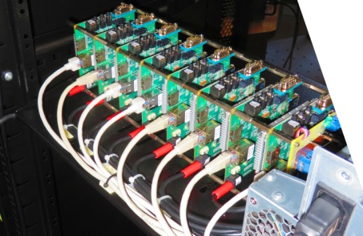
High Performance Linpack
17.59 PFLOPS
Notes:
CoreMark overall not number of calcs. Turn to HPL
By Jack Dongarra used TOP500. Pics, wandboard array not number 1.
Solves N x N matrix which is limited by the available RAM. Measured as the number of Floating Point Operations Per Second or FLOPS. Obviously talking about a mathematical matrix… not the movie.
Unlike with CoreMark compiler flags no difference. Only about 1.6% increase from worst case to best case. Work done by Library calls not code itself.

Slide 9
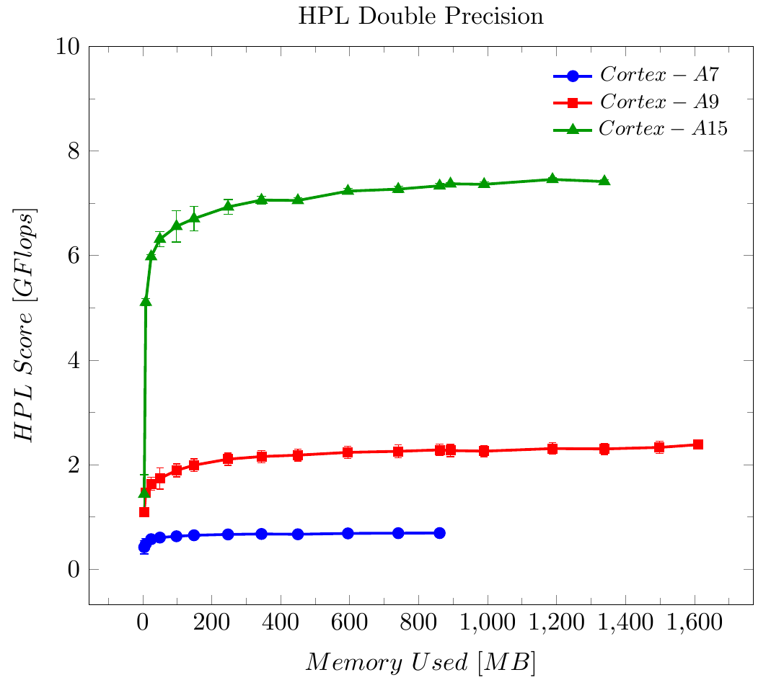
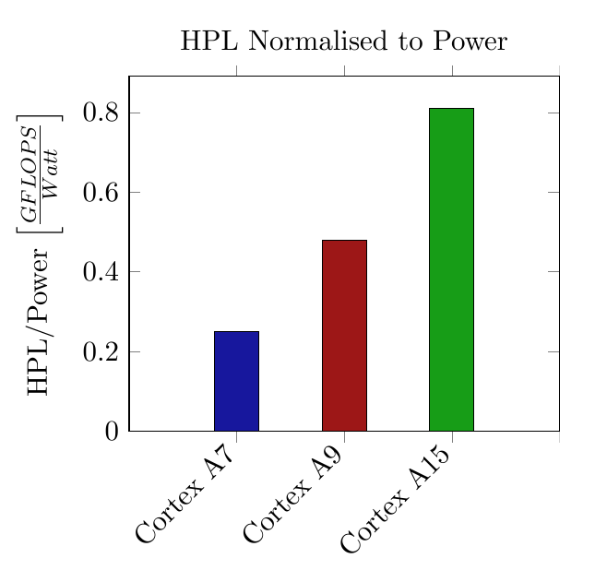
High Performance Linpack
~7
~ 2
~ 0.8
Notes:
Note over heads at low Problem size. Plateau quickly when CPU bound
Large improvement between A9 and A15. 3.5 times more.
A7 designed same time as A15. Low powered and dual core expected low performance.
Efficiency doubles from each architecture to next. For embedded devices this is very good but still not close to the super computing standards where Tiahne-2 gets about 1.9 GFLOPS/Watt

Slide 10
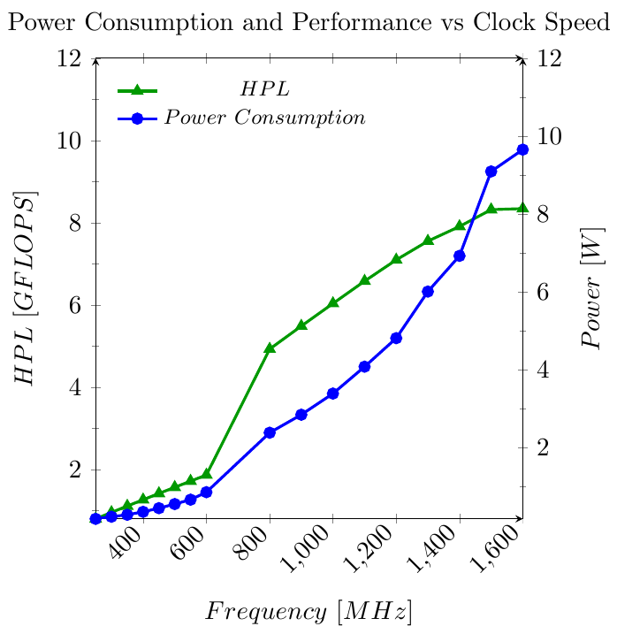
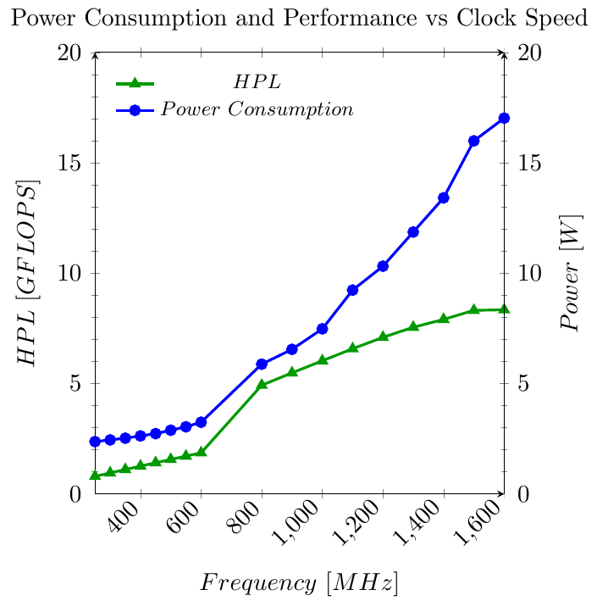
High Performance Linpack
Exynos 5 Octa
Quad-Core A7 + Quad-Core A15
Cluster Migration (only 1 CPU active at a time)
Only A7 and A15 Chips
All Peripherals
Notes:
The power measurements of the Cortex-A15 were very interesting.
Exynos 5 has two CPUs. Seen by the jump between 600 – 800 MHz.
Odroid XU+E came with sensors built in to measure specific components like the CPU, Ram and GPU power consumption.
HPL is almost linear and power is quadratic.
Interested in GFLOPS/Watt, high at low freq but no performance.

Slide 11
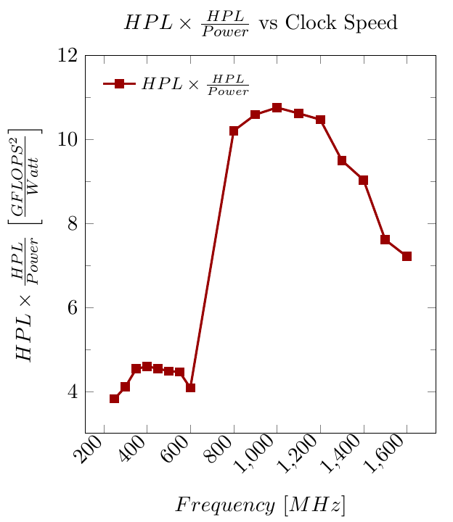
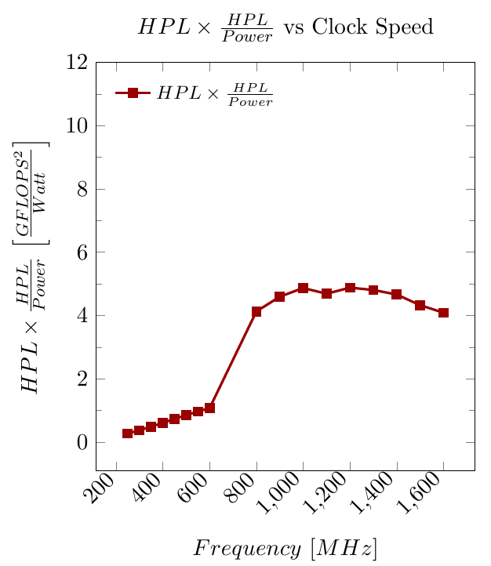
High Performance Linpack
Exynos 5 Octa
Quad-Core A7 + Quad-Core A15
Cluster Migration (only 1 CPU active at a time)
Only A7 and A15 Chips
All Peripherals
Notes:
So performance X HPL/Watt. We see two distinct profiles for each CPU.
Flattens out when Peripherals are taken into account.
Around 400 MHz for A7 and 1GHz for A15.

Slide 12
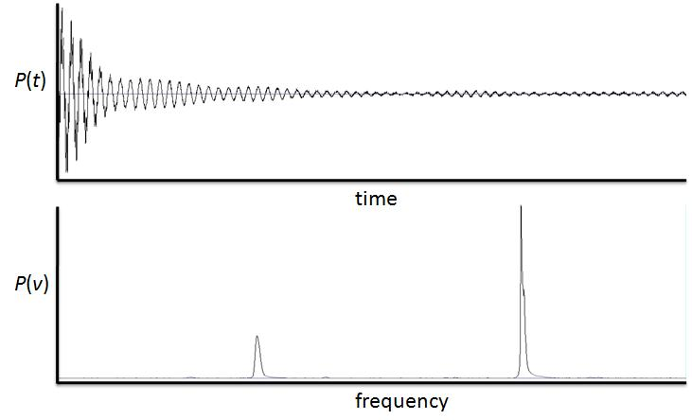
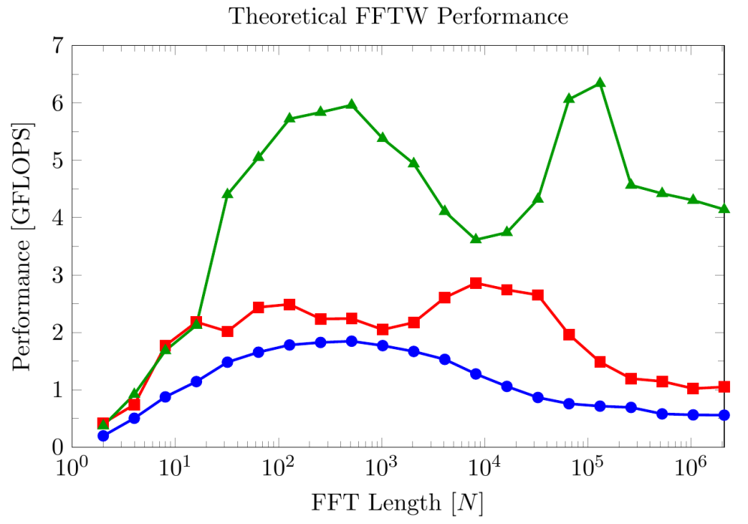
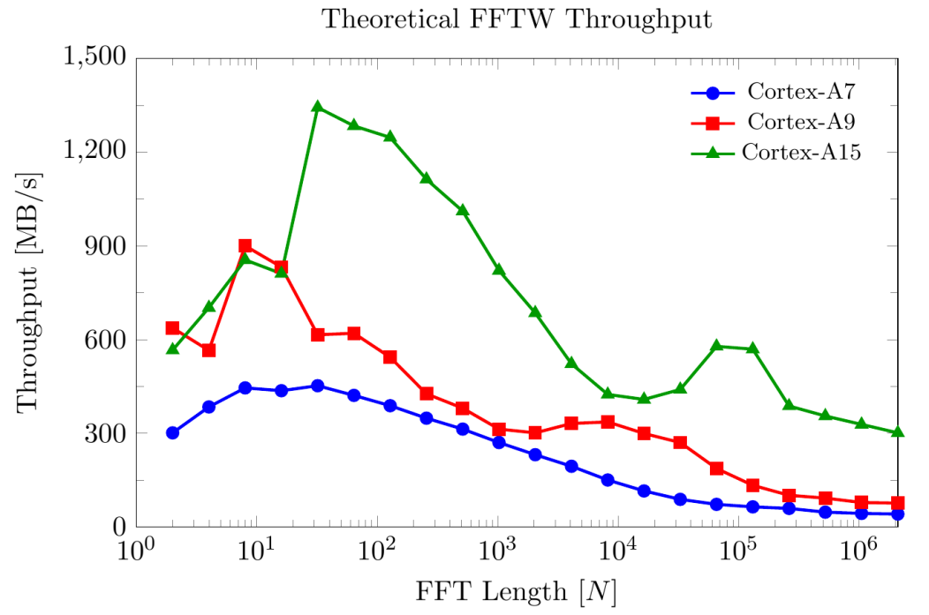
Fast Fourier Transforms
Notes:
The Discrete Fourier Transforms is an important transformation because it can be solved computationally.
Many applications – Partial Differential equations, Digital signal processing, image processing etc. Used in all areas of science. This makes it of interest as a benchmark.
Time domain to freq domain - High freq decays with low freq (multiplied)
Complexity order NlogN -> Theorectical performance and throughput.
Similar results to HPL
Shape is not smooth -> Cache, architectures, memory controllers etc

Slide 13
High Performance Linpack
~7
~ 2
~ 0.8
Notes:
Similar performance.

Slide 14
Fast Fourier Transforms
Notes:
The Discrete Fourier Transforms is an important transformation because it can be solved computationally.
Many applications – Partial Differential equations, Digital signal processing, image processing, radio signalling. Used in all areas of science. This makes it of interest as a benchmark.
Time domain to freq domain - High freq decays with low freq (multiplied)
Time complexity order NlogN -> Theorectical performance and throughput.
Similar results to HPL
Shape is not smooth -> Cache, architectures, memory controllers etc

Slide 15
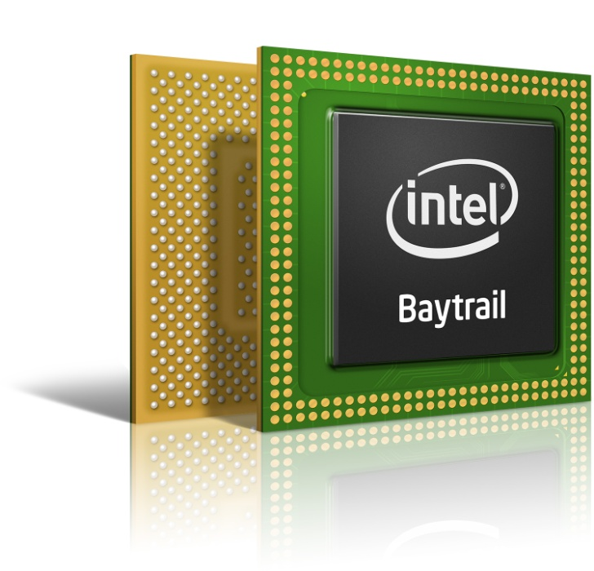
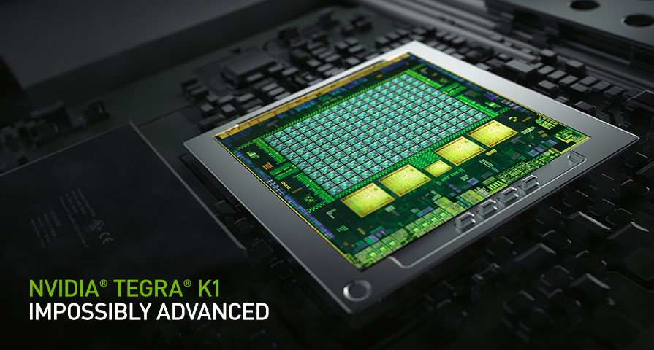
Summary
Energy Efficient
0.8 GFLOPS/Watt
High throughput possible
500 MB/s on A15
Need better performance
~7 GFLOPS
GPU co processing?
~ 350 GFLOPS
~ 15 Watts
~ 20 GFLOPS/Watt
Notes:
What can we conclude.
CoreMark – ARM and ATOM are close. ARM have improved very quickly from generation to next. SoCs are more power efficient.
FFTW – Using lower powered CPUs we can still get High throughput. Application dependent.
HPL – Shows improvements needed GLOPS/Watt
GPU co-processing – TEGRA K1 192 CUDA Core Cortex A15 10 Gb/s
ATOM SoC – Silvermont micro architecture, bay trail for tablets released end of last year, in process of getting these new chips.
With the coming of new SoCs such as the Cortex A50s and Cherry trail Atoms we expect a new era of high throughput computing.

Slide 16
Benchmarking ARM System on chips

Slide 17
Benchmarking ARM System on chips
BACKUP SLIDES
Notes:
We are living in a world more connected than ever before. I am not talking about internet access but rather mobile internet access.
Email, Instant messaging, Navigation and Information are literally at our fingertips.
This has all been made possible by a little guy in this Smartphone. The ARM processor.
My name is Robert Reed and I will be presenting a Benchmarking Characterization of ARM based processors.

Slide 18
CoreMark Flags
Cortex A7 Flag Testing
Test | Floating Point | Neon AutoVec | Optimisation | -mfpu | -march | -mtune | -mcpu
0
1 | mfloat-abi=hard | ffastmath | O2 | neon-vfpv4 | armv7-a | cortex-a7
2 | mfloat-abi=hard | ffastmath | O2 | neon-vfpv4 | armv7-a
3 | mfloat-abi=hard | ffastmath | O2 | neon-vfpv4 |  | cortex-a7
4 | mfloat-abi=hard | ffastmath | O2 | neon-vfpv4 |  |  | cortex-a7
5 | mfloat-abi=hard | ffastmath | O2 | neon | armv7-a | cortex-a7
6 | mfloat-abi=hard | ffastmath | O2 | neon | armv7-a
7 | mfloat-abi=hard | ffastmath | O2 | neon |  | cortex-a7
8 | mfloat-abi=hard | ffastmath | O2 | neon |  |  | cortex-a7
9 | mfloat-abi=hard | ffastmath | O3 | neon-vfpv4 | armv7-a | cortex-a7
10 | mfloat-abi=hard | ffastmath | O3 | neon-vfpv4 | armv7-a
11 | mfloat-abi=hard | ffastmath | O3 | neon-vfpv4 |  | cortex-a7
12 | mfloat-abi=hard | ffastmath | O3 | neon-vfpv4 |  |  | cortex-a7
13 | mfloat-abi=hard | ffastmath | O3 | neon | armv7-a | cortex-a7
14 | mfloat-abi=hard | ffastmath | O3 | neon | armv7-a
15 | mfloat-abi=hard | ffastmath | O3 | neon |  | cortex-a7
16 | mfloat-abi=hard | ffastmath | O3 | neon |  |  | cortex-a7

Slide 19
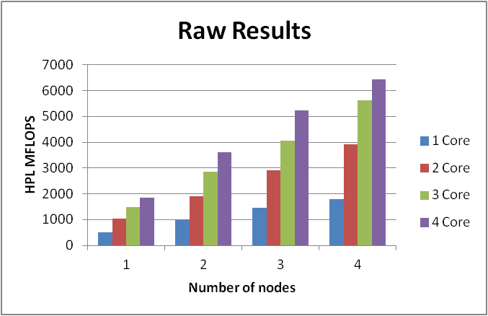
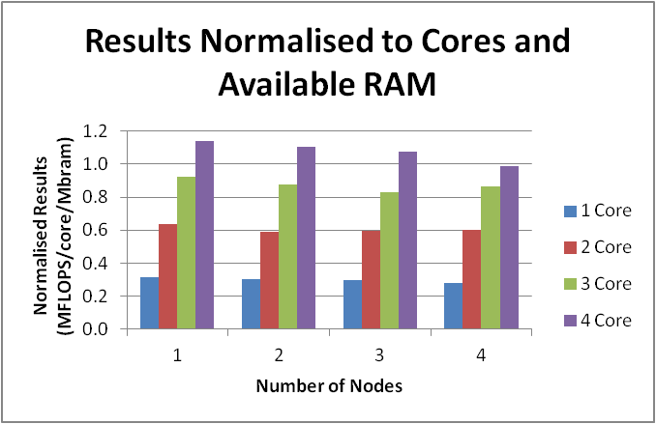
Results - HPL
Scalability – 4x A9
Raw results
Cores | Nodes
 | 1 | 2 | 3 | 4
1 | 509.4 | 984.5 | 1452.0 | 1803.0
2 | 1030.0 | 1915.0 | 2905.0 | 3908.0
3 | 1497.0 | 2854.0 | 4052.0 | 5626.0
4 | 1851.0 | 3595.0 | 5239.0 | 6437.0
Problem Size | 14592.0 | 20672.0 | 25280.0 | 29184.0
Total Problem MB | 1624.5 | 3260.3 | 4875.8 | 6498.0

Slide 20
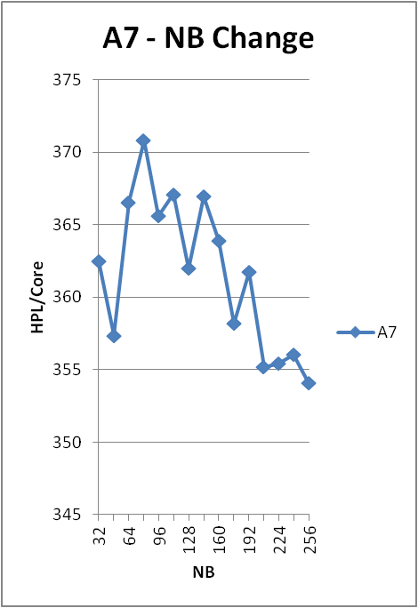
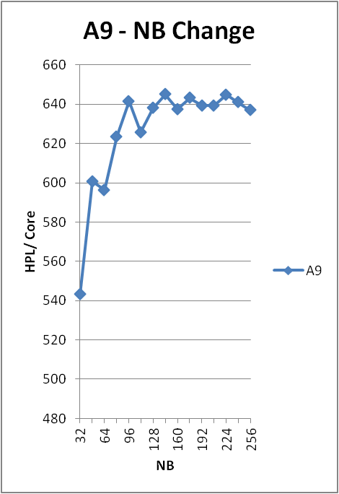
Results - HPL
Block Size
 | A7 | A9
Peak NB | 80 | 144

Slide 21
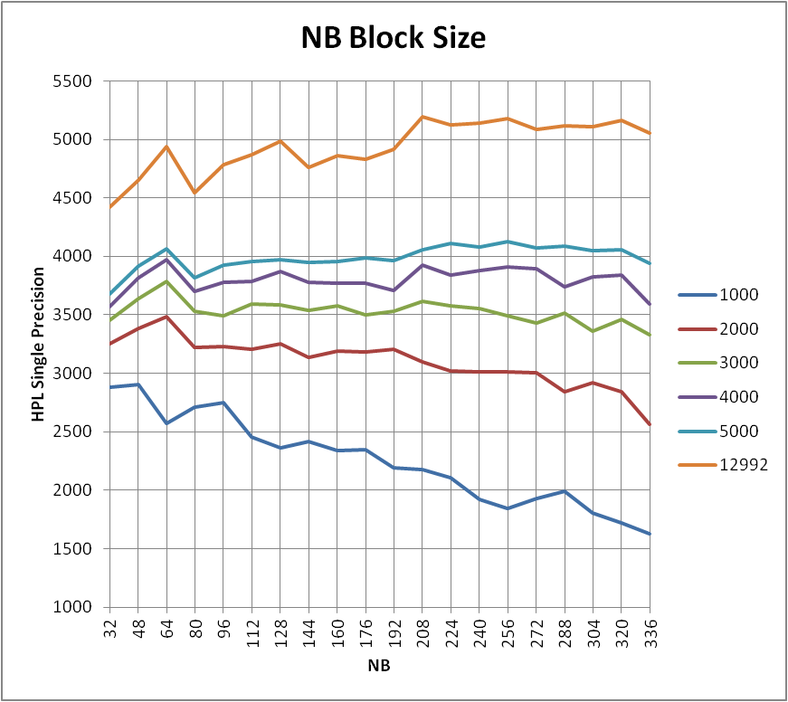
Understanding the benchmarks
Changing Block Allocation NB
NB test for the A9
Dependant on array size
Larger array = large NB
Dependant on whole system
Notes:
Backup

Slide 22
Results - HPL
Multi Precision
Total RAM | Cortex A9 |  |  | Cortex A7
1972 | ATLAS-vfpv3d16 | ATLAS-neon | % Improved | ATLAS-vfpv4d16 | ATLAS-neonvfpv4 | ATLAS-neon | % Improved
Real Single | 4.184 | 4.602 | 9.990% | 3.170 | 3.280 | 3.286 | 3.659%
Real Double | 2.335 | 2.272 | 2.773% | 1.315 | 1.439 | 1.398 | 9.430%
Complex Single | 4.363 | 4.835 | 10.818% | 3.374 | 3.113 | 3.213 | 8.384%
Complex Double | 2.470 | 2.502 | 1.296% | 1.251 | 1.355 | 1.363 | 8.953%
Old Complex Double | 2.519 | 2.55 | 1.231%
Notes:
I mentioned briefly that HPL tested using double precision. Some applications such as Radio Astronomy can use single precision. So how does the ARM respond to single precision.

Slide 23
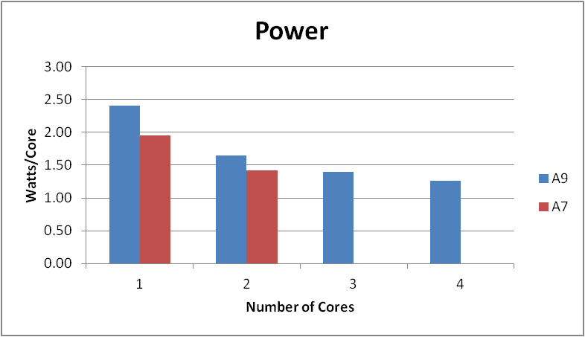
Results - HPL
Power Measurements
A9 |  |  |  |  | A7
Voltage | 5 | V |  |  | Voltage | 5 | V
Resistor | 0.01 | Ohms |  |  | Resistor | 0.01 | Ohms
IDLE | 2.5 | mV |  |  | IDLE | 2.3 | mV
Cores | 1 | 2 | 3 | 4 | 1 | 2
mVolts | 4.80 | 6.60 | 8.40 | 10.10 | 3.90 | 5.70
Amps | 0.48 | 0.66 | 0.84 | 1.01 | 0.39 | 0.57
Watts | 2.40 | 3.30 | 4.20 | 5.05 | 1.95 | 2.85
Watts/core | 2.40 | 1.65 | 1.40 | 1.26 | 1.95 | 1.43
Notes:
Mention flops/watt

