Slide 1
Exact calculation of a posteriori
probability distribution
with distributed computing systems
Kirill Kholodkov, Igor Aleshin
Schmidt Institute of Physics of the Earth RAS

Slide 2
Introduction
Determination of anisotropic parameters of crust and upper mantle
Key facts:
Anisotropy is detectable on the surface

Slide 3
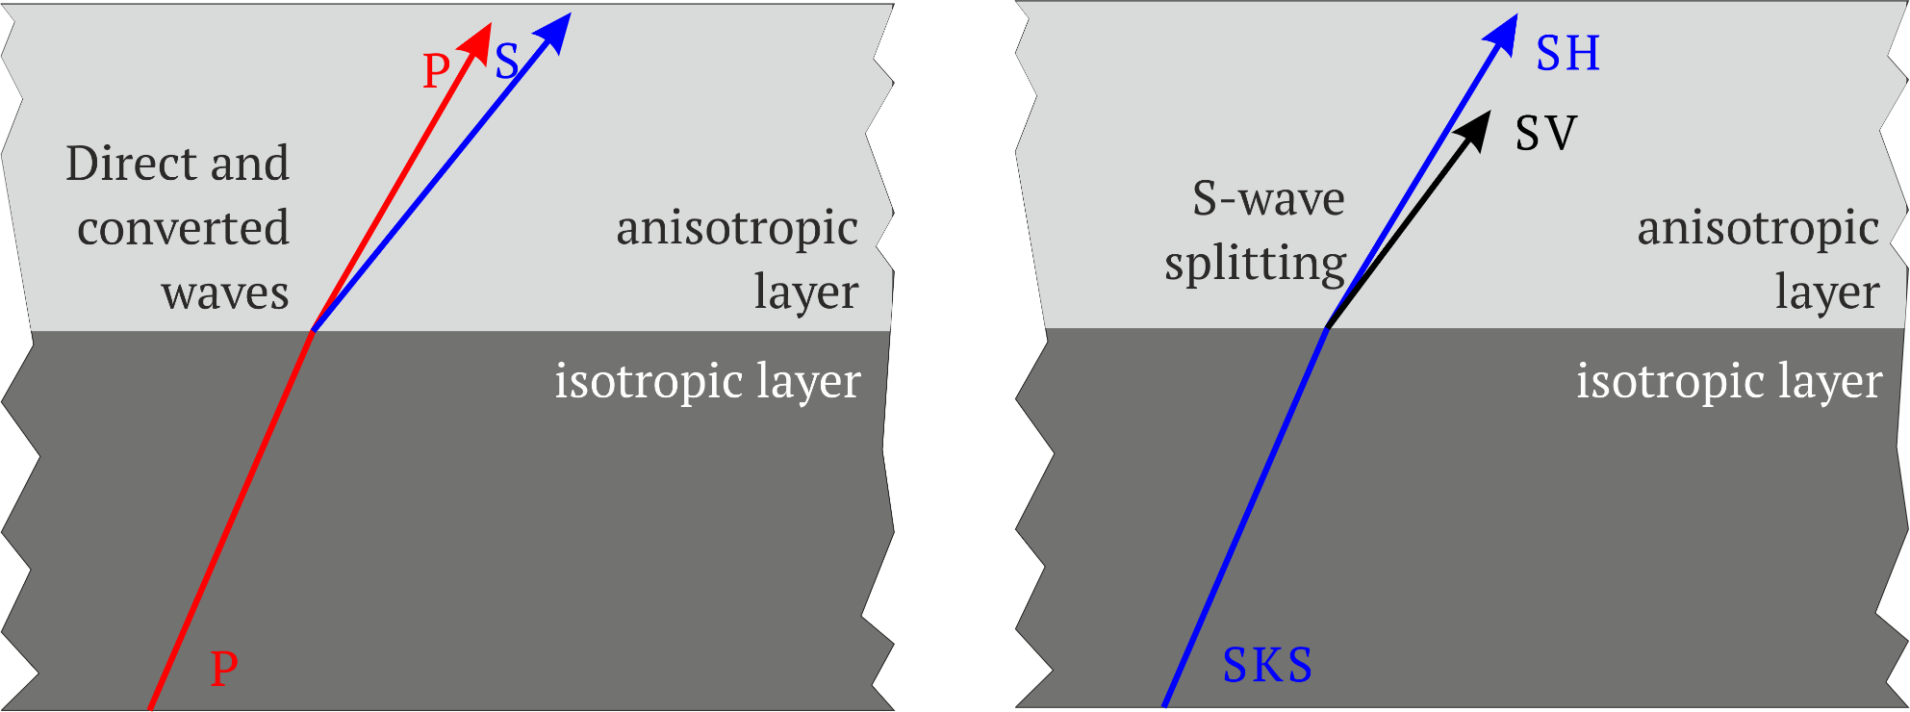
Introduction

Slide 4
Introduction
Determination of anisotropic parameters of crust and upper mantle
Key facts:
Anisotropy is detectable on the surface
The cause of anisotropy is believed to be LPO of olivine crystals

Slide 5
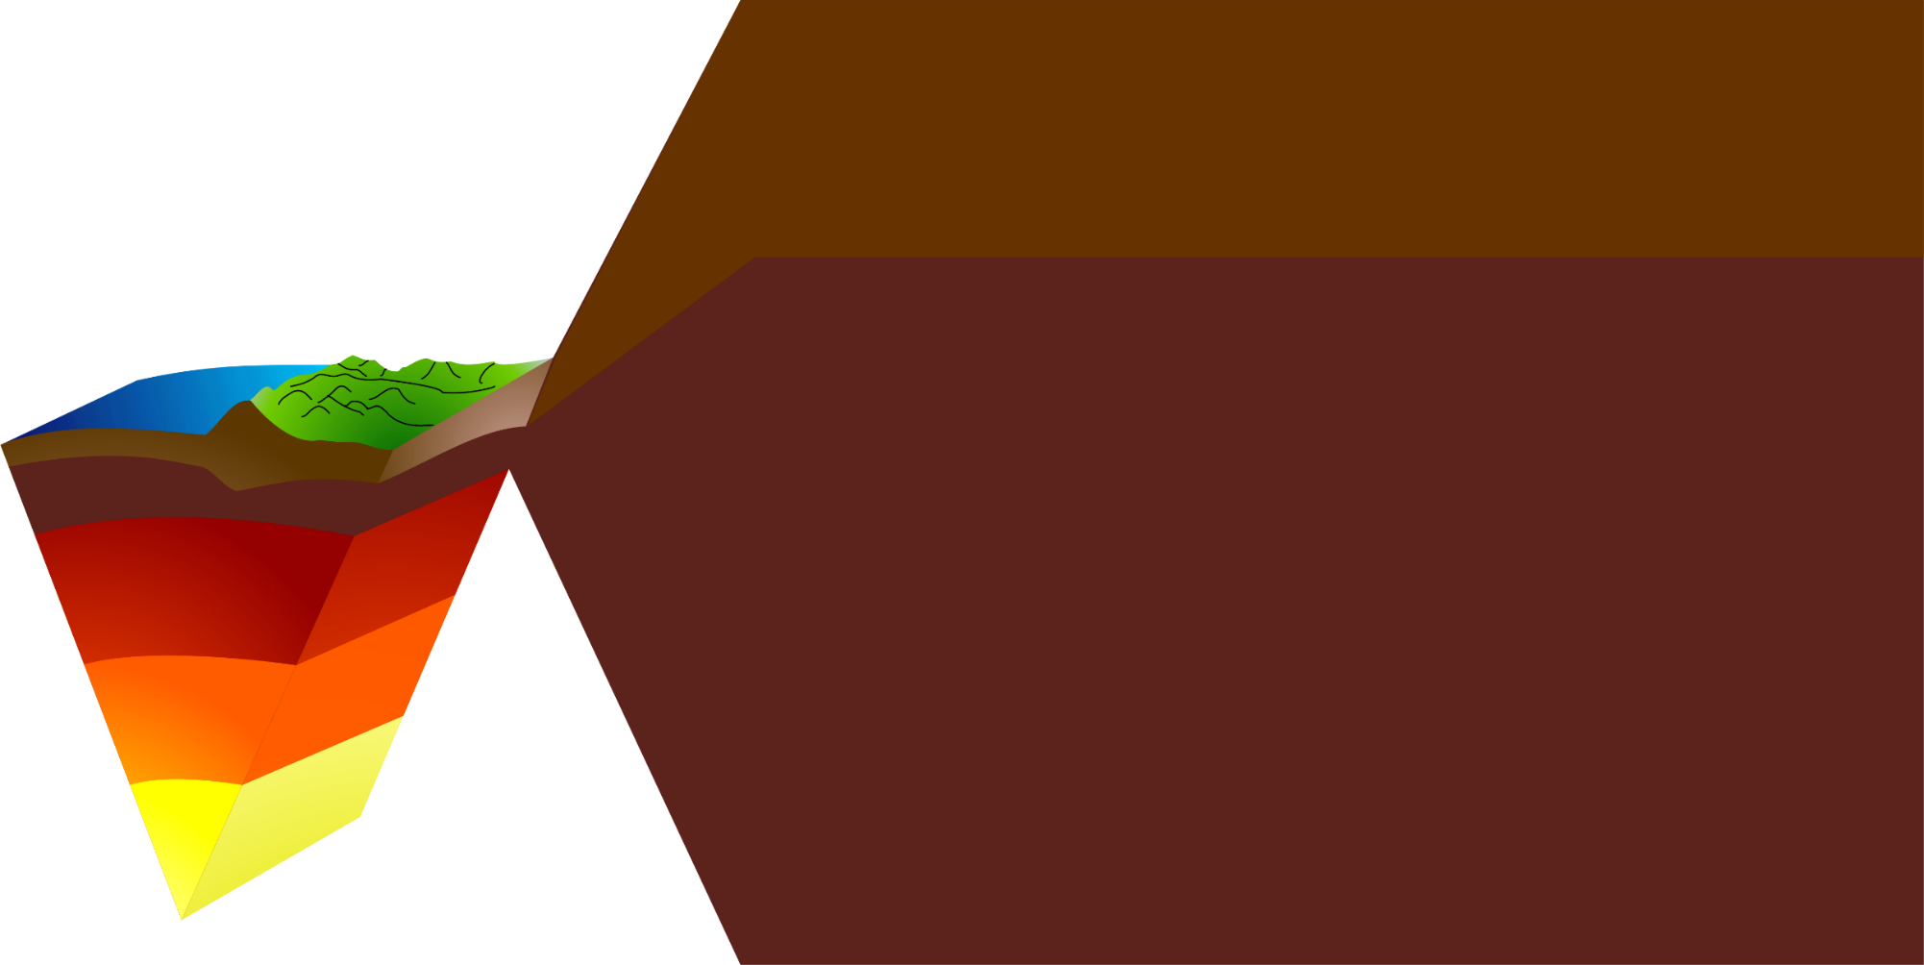
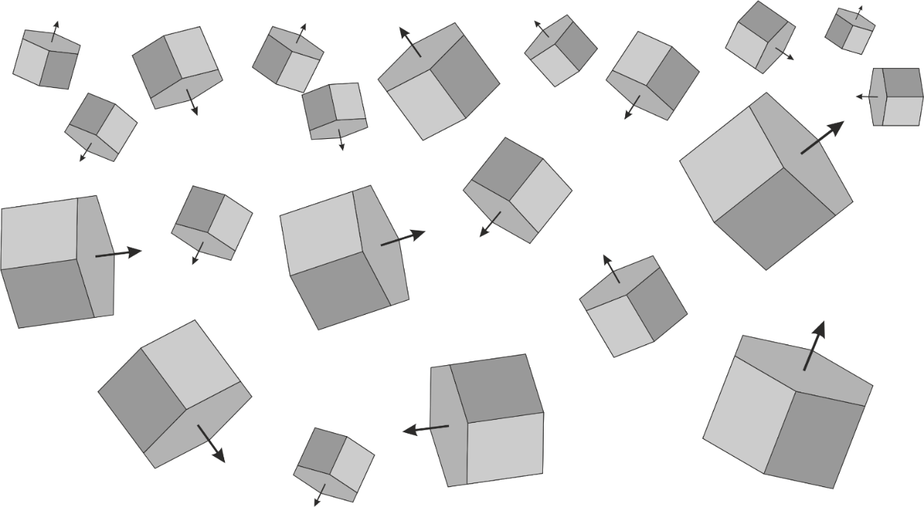
Introduction

Slide 6
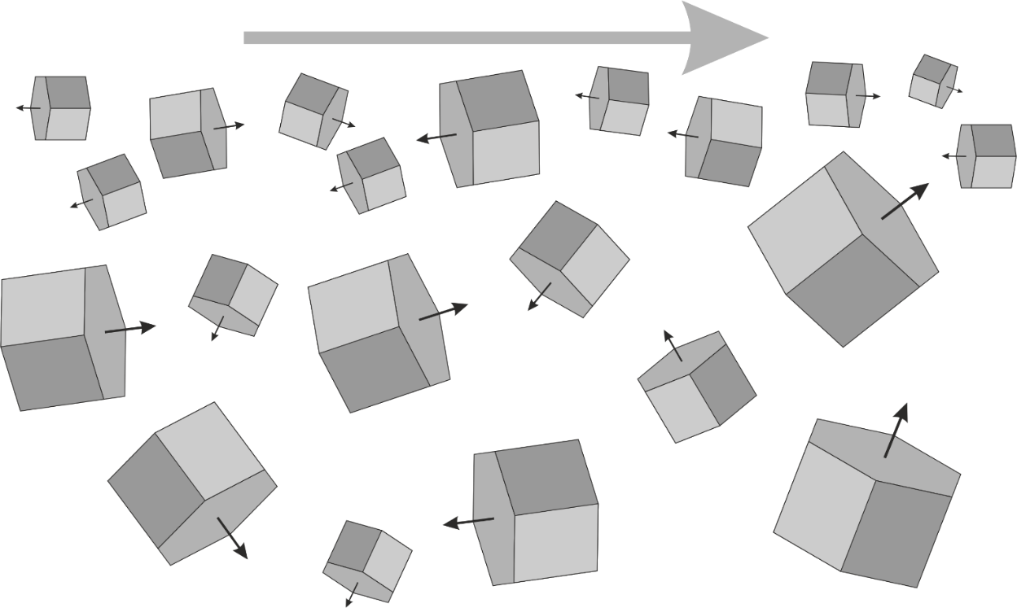
Introduction

Slide 7
Introduction
Determination of anisotropic parameters of crust and upper mantle
Key facts:
Anisotropy is detectable on the surface
The cause of anisotropy is believed to be LPO of olivine crystals
The latter is caused by recrystallization because of tectonic movement. This allows us to learn of plate movement direction (or historical directions).

Slide 8
Introduction
Determination of anisotropic parameters of crust and upper mantle
What do we have:
signals $D$
the model S = S ($\vec{m}$), $\vec{m}=\{m_{1},m_{2},$…,$m_{M}\}$
the cost function $\left\|D,S\right\|$

Slide 9
Introduction
$${\vec{m}}_{0}= arg\min_{{\vec{m}}_{0}}{C(D,S\left(\vec{m}\right))}$$
$$C\left(D,S(\vec{m})\right)<ε$$

Slide 10
Introduction
$$σ\left(\vec{m},D\right)=Aρ_{D}(D)ρ_{m}(\vec{m}) e^{− \frac{C(D,S\left(\vec{m}\right))}{ε}}$$

Slide 11
Introduction
$$σ\left(\vec{m},D\right)=Aρ_{D}(D)ρ_{m}(\vec{m}) e^{− \frac{C(D,S\left(\vec{m}\right))}{ε}}$$
Allows to study the dependency on parameters with expected values, variance, kurtosis etc…
But we need $σ$ to be computed for every parameter set
The dimension of $\vec{m}$ is not fixed hence compute time grows almost exponentially with parameter count increase.
The good news: $σ$ computes independently for each parameter set.

Slide 12
Distributed systems
Previously we’ve:
tested manual launches on lcg*.sinp.msu.ru (2009)
created own testbed of two small clusters managed by the Globus Toolkit middleware
created a simple application web interface for Globus Toolkit

Slide 13
Distributed systems
Drawbacks:
Globus is too complex
No middleware flexibility

Slide 14
Distributed systems
Plan:
Look for another way to make a grid
Develop a more flexible application

Slide 15
Distributed systems
Gridway with DRM4G
allows use of Gridway without
intermediate middlewares
https://meteo.unican.es/trac/wiki/DRM4G

Slide 16
Distributed systems

Slide 17
Distributed systems

Slide 18
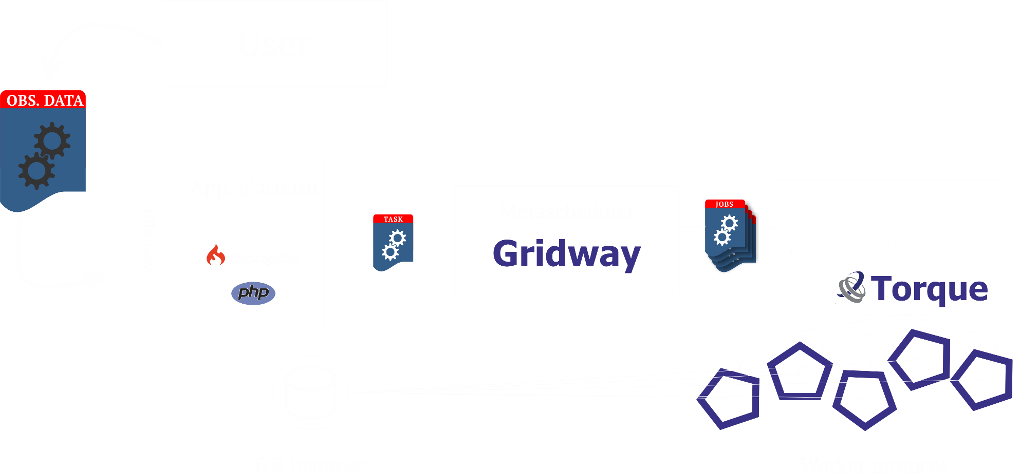
Application

Slide 19
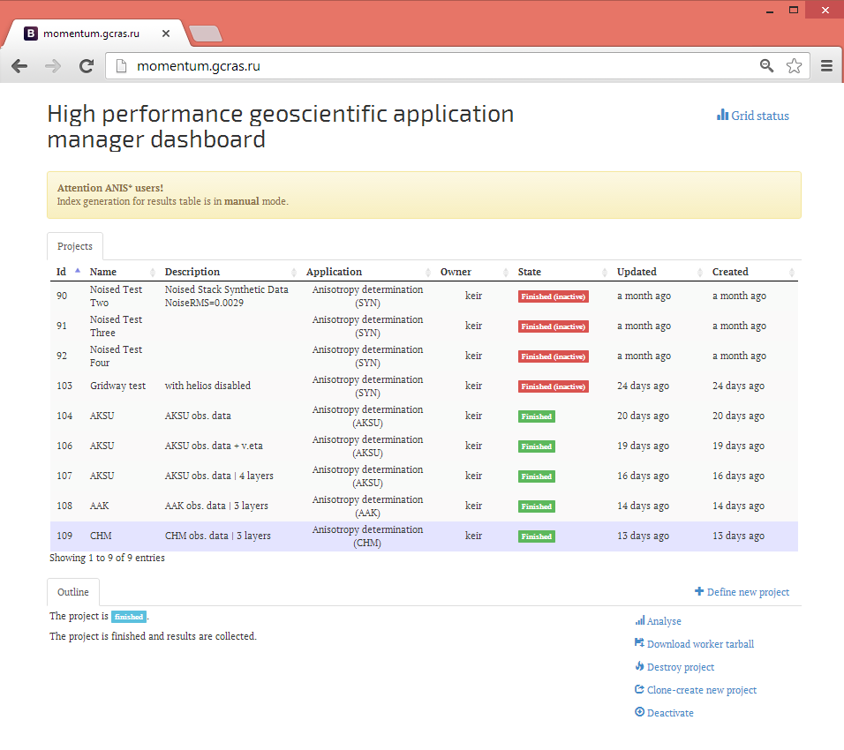

Slide 20
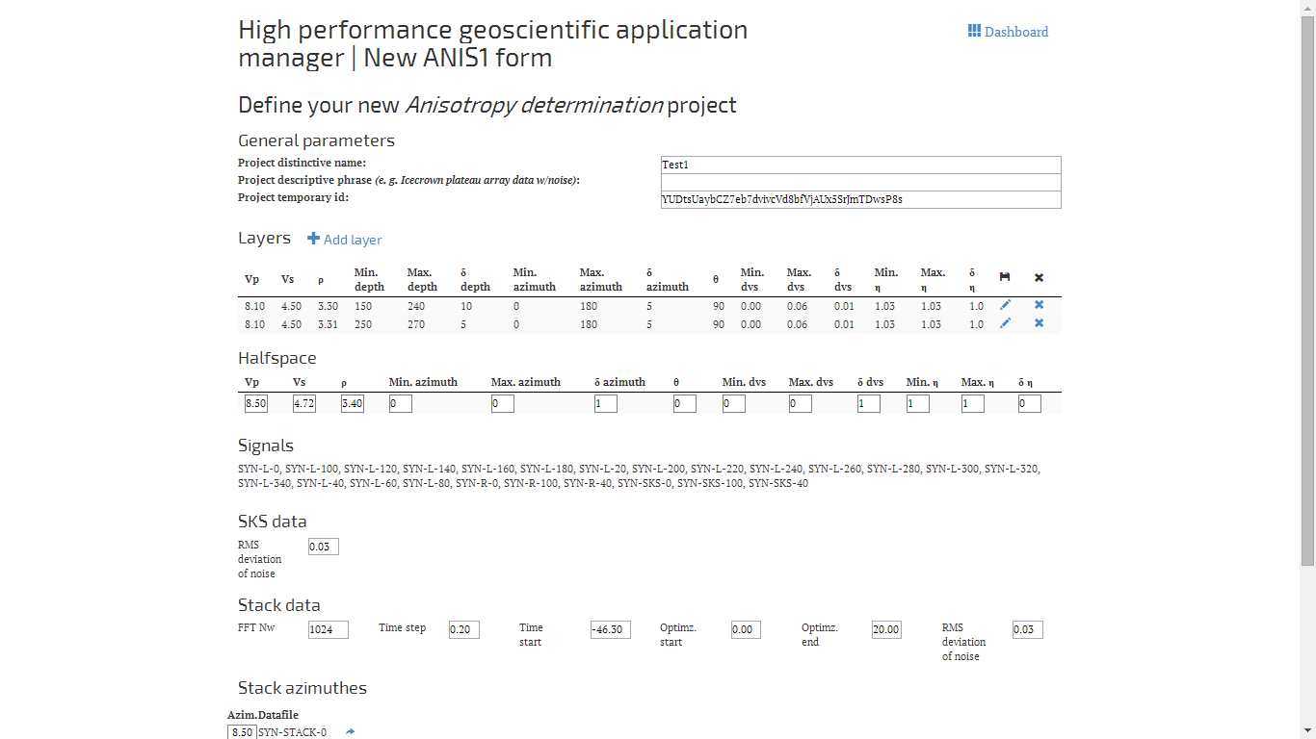

Slide 21
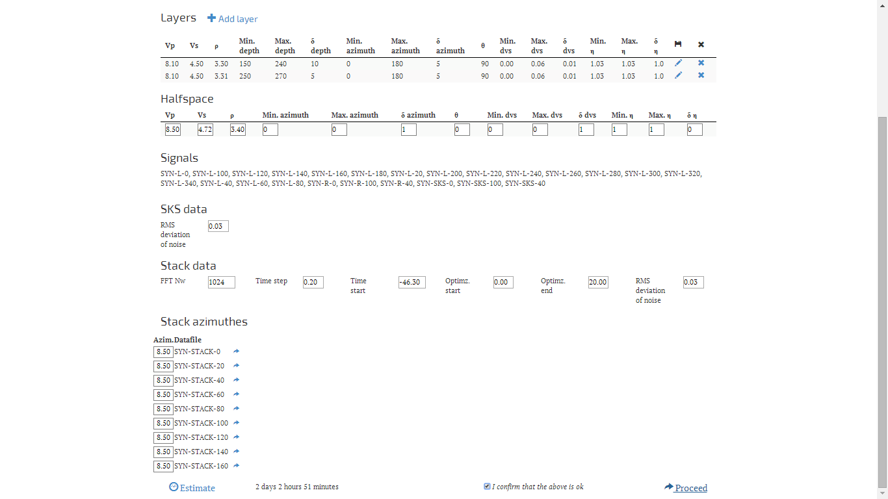

Slide 22
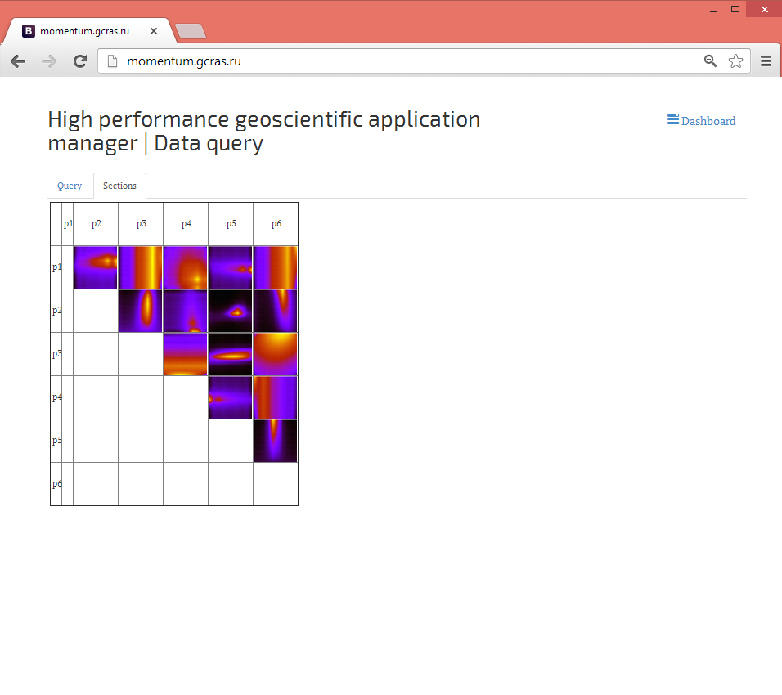
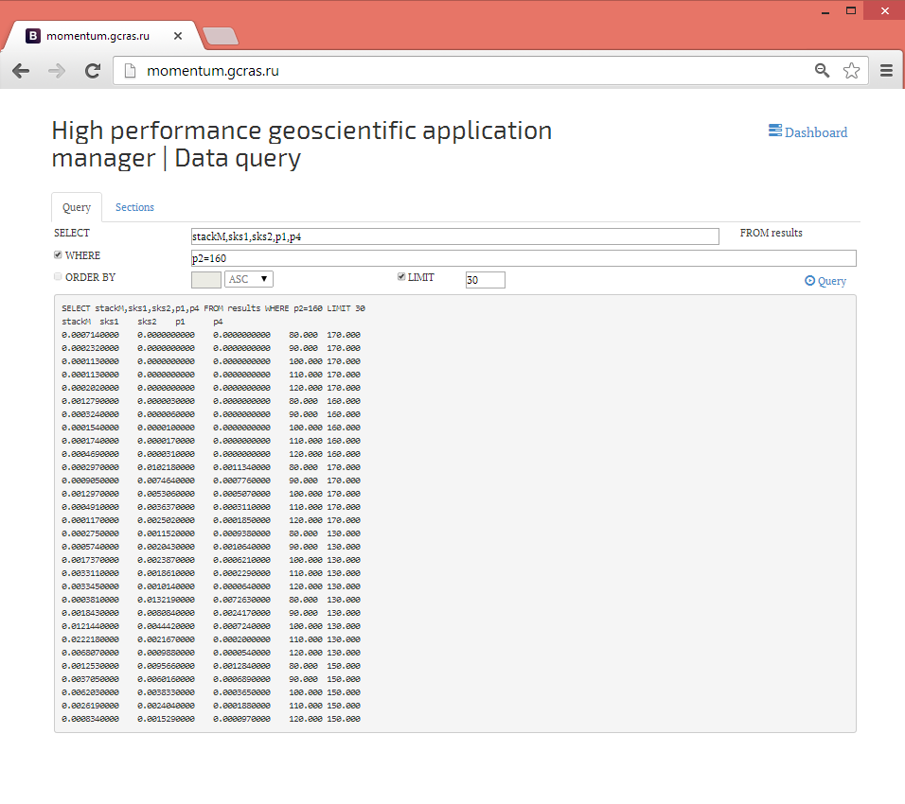

Slide 23
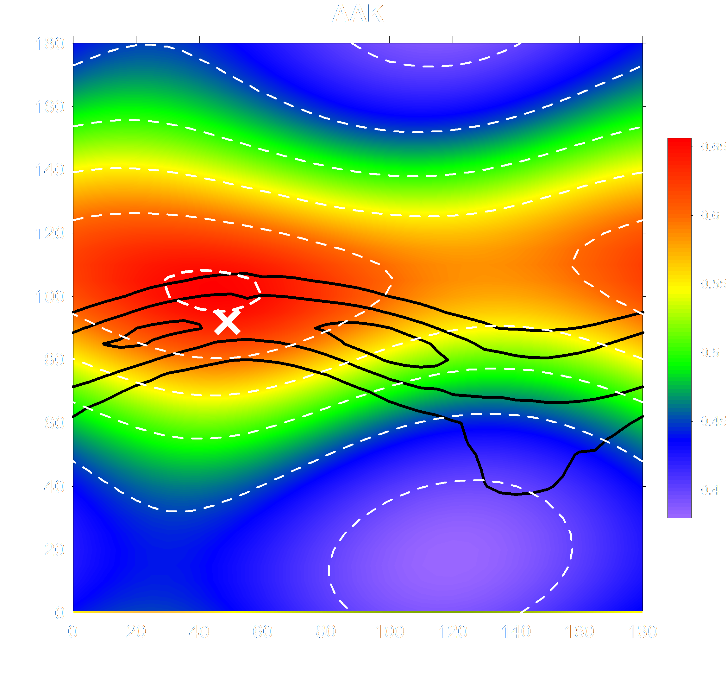

Slide 24
Thank you!

