Slide 1
A Memory Benchmarking Characterisation of ARM-Based Systems-on-Chip
Thomas Wrigley
University of the Witwatersrand, Johannesburg, South Africa
GRID 2014, Dubna

Slide 2
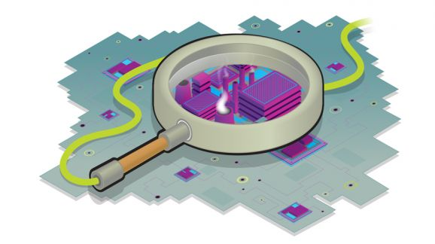
Overview
Introduction
Using SoCs for DSC
Benchmark Results
Discussion & Analysis
Future Work & Next Steps

Slide 3
Data Stream Computing
High throughput
No/limited offline storage
Programming simplicity
Requires real-time processing of large amounts of data – must address bandwidth efficiency and memory latency issues

Slide 4
Key Challenges
Some of the problems and concerns faced:
Energy-efficiency
Offline storage capacity
Cost (hardware, electricity, cooling)
Memory latencies & bandwidth inefficiencies

Slide 5
Existing/Previous Work
Relevance of memory performance being increasingly more widely acknowledged
Lots of military-led and/or -funded research (DIS & HPCC)
Graph500 Benchmark & Green Graph500 (2010 – present)
High Performance Conjugate Gradient (HPCG) benchmark – proposed successor to High Performance LINPACK (HPL) → Jack Dongarra
Intel has proposed using COTS i7s for signal processing

Slide 6
Using SoCs for DSC
Looking at the potential for use of SoCs
Commercial off-the-shelf (COTS) components
Low Power
Low-Energy Consumption
Require many SoCs – potential for large parallelism
Potentially more energy-efficient
Implementation & usage tends to be easier

Slide 7
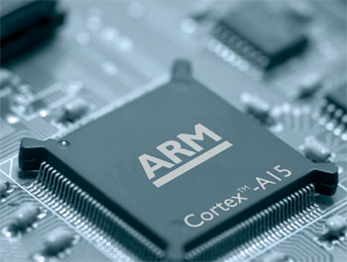
Using SoCs for DSC (continued)
Consumer-grade ARM chips tend not to have ECC RAM
Potentially problematic
Tested three ARM-based SoCs
Will test in due course

Slide 8
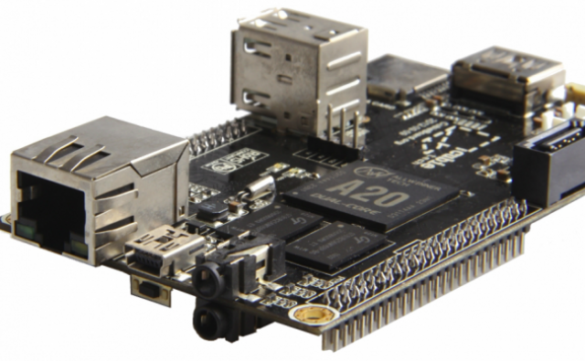
General Specifications
 | Cortex-A7 | Cortex-A9 | Cortex-A15
Cores | 2 | 4 | 4 (+ 4 Cortex-A7)
Max CPU Clock (MHz) | 1008 | 996 | 1596

Slide 9
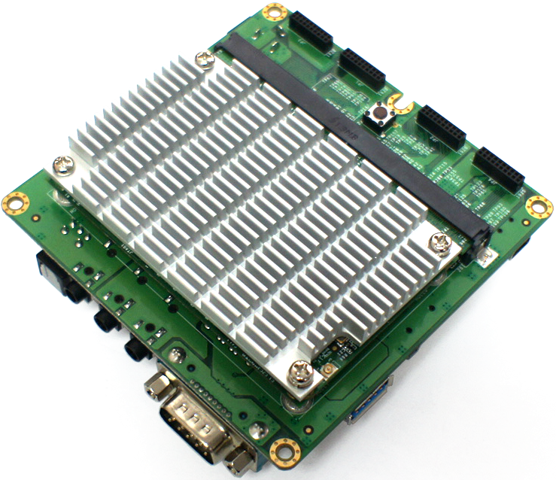
General Specifications
 | Cortex-A7 | Cortex-A9 | Cortex-A15
Cores | 2 | 4 | 4 (+ 4 Cortex-A7)
Max CPU Clock (MHz) | 1008 | 996 | 1596

Slide 10
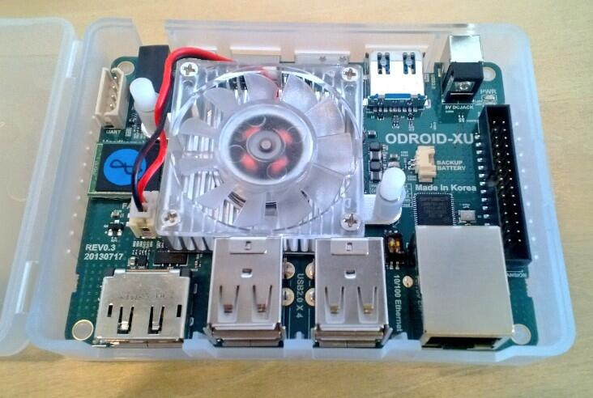
General Specifications
 | Cortex-A7 | Cortex-A9 | Cortex-A15
Cores | 2 | 4 | 4 (+ 4 Cortex-A7)
Max CPU Clock (MHz) | 1008 | 996 | 1596

Slide 11
Memory Specifications
 | Cortex-A7 | Cortex-A9 | Cortex-A15
L1 Cache (kB) | 32 | 32 | 32
L2 Cache (kB) | 256 | 1024 | 2048
RAM (MB) | 1024 | 2048 | 2048
RAM Type | 432 MHz 32 bit DDR3 | 528 MHz 64 bit DDR3 | 800 MHz 64 bit DDR3
Theoretical Max Bandwidth (MB/s) | 3296 | 8054 | 12 207

Slide 12
Memory Specifications
 | Cortex-A7 | Cortex-A9 | Cortex-A15
L1 Cache (kB) | 32 | 32 | 32
L2 Cache (kB) | 256 | 1024 | 2048
RAM (MB) | 1024 | 2048 | 2048
RAM Type | 432 MHz 32 bit DDR3 | 528 MHz 64 bit DDR3 | 800 MHz 64 bit DDR3
Theoretical Max Bandwidth (MB/s) | 3296 | 8054 | 12 207

Slide 13
Memory Specifications
 | Cortex-A7 | Cortex-A9 | Cortex-A15
L1 Cache (kB) | 32 | 32 | 32
L2 Cache (kB) | 256 | 1024 | 2048
RAM (MB) | 1024 | 2048 | 2048
RAM Type | 432 MHz 32 bit DDR3 | 528 MHz 64 bit DDR3 | 800 MHz 64 bit DDR3
Theoretical Max Bandwidth (MB/s) | 3296 | 8054 | 12 207

Slide 14
LMBench
Benchmark suite – memory performance
Focus here is on latencies
 | Cortex-A7 | Cortex-A9 | Cortex-A15
Clock Cycle Time (ns) | 0.992 | 1.004 | 0.627
L1 Latency (ns) | 3.02 | 4.02 | 2.51
L2 Latency (ns) | 9.2 | 30.8 | 13.8
RAM Latency (ns) | 58.5 | 119.8 | 104.8

Slide 15
LMBench
Best
Worst
 | Cortex-A7 | Cortex-A9 | Cortex-A15
Clock Cycle Time (ns) | 0.992 | 1.004 | 0.627
L1 Latency (ns) | 3.02 | 4.02 | 2.51
L2 Latency (ns) | 9.2 | 30.8 | 13.8
RAM Latency (ns) | 58.5 | 119.8 | 104.8

Slide 16
The STREAM Benchmark
Generates array of random numbers (which is stored in RAM) and then performs four types of operations
Test | Equation
Copy | $$A\left(i\right)=B(i)$$
Scale | $$A\left(i\right)=q ×B\left(i\right)$$
Add | $$A\left(i\right)=B\left(i\right)+C(i)$$
Triad | $$A\left(i\right)=B\left(i\right)+q ×C(i)$$

Slide 17
STREAM
Bandwidth efficiency – percentage of theoretical maximum obtained
STREAM Results

Slide 18
pmbw - Parallel Memory Bandwidth Benchmark
Sustained memory bandwidth
Parallel memory bandwidth of multi-core machines
Basic inner loops – sequential scanning and random memory access
12 subtests
Useful to compare to LMBench and STREAM results – potentially greater insight

Slide 19
pmbw - Parallel Memory Bandwidth Benchmark
One benchmark – 12 subtests
The things that vary:
Sequential Scanning vs Random Pointer Permutation
Scan vs Perm
Read vs Write
12 subtests
~ 200 to 300 iterations per subtest
$≈$ 2400 to 3000 observations
Operations per loop
Simple (1) vs Unroll (16)
Pointer-based iteration vs Index-based array access
Ptr vs Index
Bit size of memory transfer
32 vs 64 bits

Slide 20
Statistical Analysis
Analysis of Variance (ANOVA)
Are any of the subtest groups different from one another? (statistical significance)
How do the subtests compare to:
Each other?
To STREAM results?
Furthermore: How do these subtests group together?

Slide 21
Subtest Groupings

Slide 22
Subtest Groupings
Similar profile to STREAM results
Notes:
Before the test benchmark routine is called, the array area of each thread is filled with a random cyclic permutation of pointers. Thus for two threads, the allocated array will have the following layout:

Slide 23
Subtest Groupings
A9 → double A7
A15 → only 1.5 times better than A9
Notes:
Before the test benchmark routine is called, the array area of each thread is filled with a random cyclic permutation of pointers.
Measured time is the raw bandwidth and latency of a single memory fetch cycle

Slide 24
Discussion & Analysis
Clear correlation between age of SoC design and memory performance
Existing ARM-based SoCs perform fairly well – A15 is particularly promising
New ARMv8-based SoCs should perform significantly better
Promising for ARM-based SoCs in DSC

Slide 25
Next Steps & Future Work
HPCG & Graph500 Benchmarks
DIS & HPCC suites
Test newer SoCs (Intel Atom & ARMv8 64 bit)
Database stream management software (DBMS) & other benchmarks

Slide 26
Cпасибо Questions or Comments?

Slide 28
Back-up slides

Slide 29
STREAM
 | Cortex-A7 | Cortex-A9 | Cortex-A15
STREAM
Copy (MB/s) | 1996 | 1329 | 6066
Scale (MB/s) | 1444 | 1110 | 6114
Add (MB/s) | 757 | 1448 | 5413
Triad (MB/s) | 702 | 1290 | 5275
RAM (Theoretical MB/s) | 3296 | 8054 | 12 207
RAM BW Efficiency (%) | 37 | 16 | 47

Slide 30
Subtest Groupings

Slide 31
Random Pointer Permutation

Slide 32
pmbw Subtest Names
PermRead32SimpleLoop
PermRead32UnrollLoop
ScanRead32PtrSimpleLoop
ScanRead32IndexSimpleLoop
ScanWrite32IndexSimpleLoop
ScanWrite32PtrSimpleLoop
ScanRead32PtrUnrollLoop
ScanRead64PtrSimpleLoop
ScanRead64PtrUnrollLoop
ScanWrite32PtrUnrollLoop
ScanWrite64PtrUnrollLoop
ScanWrite64PtrSimpleLoop

Slide 33
Random Pointer Permutation C++ Code
// PermRead32SimpleLoop uint32_t p = *array; while( (uint32_t*)p != array ) p = *(uint32_t*)p; | // PermRead32UnrollLoop uint32_t p = *array; while( (uint32_t*)p != array ) { p = *(uint32_t*)p; // ... 14 more times p = *(uint32_t*)p; }

Slide 34
Data-Intensive Systems (DIS) Stressmark Suite
Comes from an early 2000s DARPA (US military)-led project
Focused on new approaches to solving communication bottlenecks – data-starved systems
Several project groups proposed very different approaches
Approaches ranged from projects with solely software modifications to project groups which proposed and prototyped brand-new architectures, compilers and software

Slide 35
High Performance Computing Challenge (HPCC)
More recent (again) DARPA-led project
Focused on data-intensive computing
Consists of 7 tests:
Test | HPL | DGEMM | STREAM | PTRANS | RandomAccess | FFT | b_eff
Tests | Floating point rate of execution | Floating point rate of execution (double precision) | Sustainable memory bandwidth | Simultaneous inter-processor communication | Rate of integer random updates of memory (GUPS) | Floating point execution of DP complex 1D DFT | Communication and bandwidth latency

Slide 36
Graph500 & Green Graph500 Benchmark
Graph500 – benchmark of data-intensive computing
Alternative/competitor to TOP500 List
List is in its infancy
RAM requirements exceed current cluster capacity
Green Graph500
Energy-efficiency data-intensive communication benchmark
Slight modification of Graph500 benchmark

Slide 37
PMBW Homogenous Subsets - Odroid
Bandwidth
Tukey HSD^{a,b}
Function Name | N | Subset
 |  | 1 | 2 | 3 | 4 | 5 | 6
PermRead32UnrollLoop | 196 | 786740597.190892700000000
PermRead32SimpleLoop | 196 | 791325508.475172800000000
ScanWrite32IndexSimpleLoop | 196 |  | 1746008294.740390000000000
ScanWrite32PtrSimpleLoop | 196 |  | 1758569517.305840300000000
ScanRead32PtrSimpleLoop | 196 |  | 1777096605.063134400000000
ScanRead32IndexSimpleLoop | 196 |  | 1784669478.268580000000000
ScanWrite64PtrSimpleLoop | 196 |  |  | 2499297218.797544000000000
ScanWrite32PtrUnrollLoop | 196 |  |  | 2666443396.454691400000000 | 2666443396.454691400000000
ScanRead64PtrSimpleLoop | 196 |  |  | 2670323598.653305500000000 | 2670323598.653305500000000
ScanWrite32PtrMultiLoop | 196 |  |  | 3038413137.236012000000000 | 3038413137.236012000000000
ScanRead32PtrUnrollLoop | 196 |  |  | 3158685815.765973600000000 | 3158685815.765973600000000
ScanWrite64PtrUnrollLoop | 196 |  |  |  | 3297129002.845765600000000
ScanRead32PtrMultiLoop | 196 |  |  |  |  | 4289022493.191038600000000
ScanRead64PtrUnrollLoop | 196 |  |  |  |  |  | 5037445503.439437000000000
Sig. |  | 1.000 | 1.000 | .105 | .150 | 1.000 | 1.000
Means for groups in homogeneous subsets are displayed. Based on observed means. The error term is Mean Square(Error) = 4423590835132220900.000.
a. Uses Harmonic Mean Sample Size = 196.000.
b. Alpha = .05.

Slide 38
NAS Parallel Benchmarks
Derived from Computational Fluid Dynamics (CFD) simulations
CFD is processor-intensive, but two of the NAS benchmarks have memory-intensive aspects to them

Slide 39
NAS Parallel Benchmarks
Board SoC | Cortex-A7 | Cortex-A9 | Cortex-A15
Operation Type | Floating Point | Floating Point | Floating Point
Benchmark | Conjugate Gradient, irregular memory access and communication
Processes | 4 | 4 | 4
Mop/s | 21.04 | 73.72 | 315.15
Mop/s/process | 5.26 | 18.43 | 78.79
Benchmark | Multi-Grid on a sequence of meshes, long- and short-distance communication, memory intensive
Processes | 4 | 4 | 4
Mop/s | 154.88 | 305.76 | 967.62
Mop/s/process | 38.72 | 76.44 | 241.90

Slide 40
pmbw – Parallel Memory Bandwidth
14 sub-tests, each run several hundred times (dependent on array size) – lots and lots of info
Used Analysis of Variance (ANOVA) to help make sense of this:
 | Cortex-A7 | Cortex-A9 | Cortex-A15
Sig. difference between means? | p = 0.000 | p = 0.000 | p = 0.000
Effect size
N | 2744 [14*196] | 4200 [14*300] | 4200 [14*300]
Homogenous subsets (test-groupings) | 6 | 6 | 5

