Slide 1
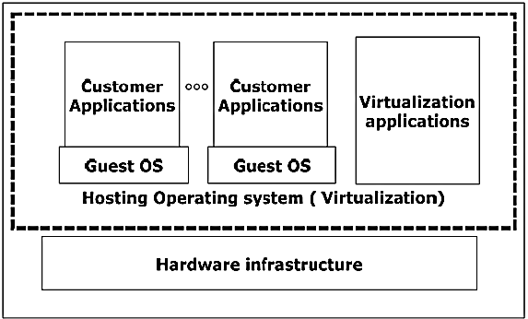
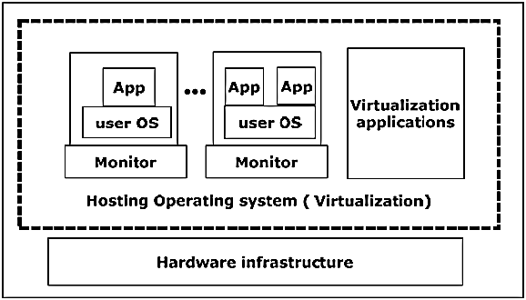
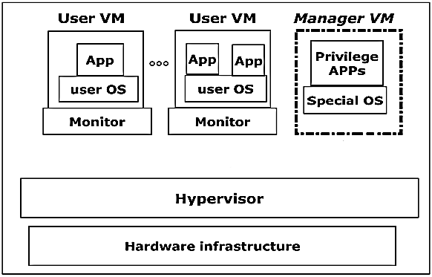
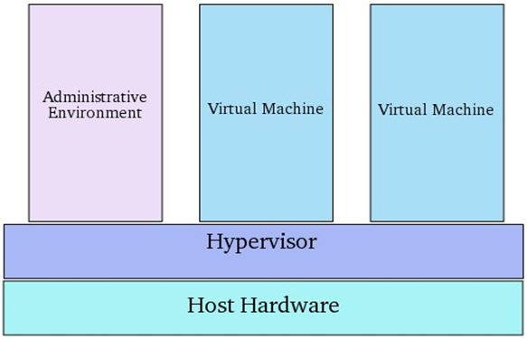
IMPROVEMENT OF COMPUTATIONAL ABILITIES IN COMPUTING ENVIRONMENTS WITH VIRTUALIZATION TECHNOLOGIES
Alexander Bogdanov, Kyaw Zaya, Pyae Sone Ko Ko
Emails: bogdanov@csa.ru, kyawzaya4436@gmail.com, pyaesonekoko@gmail.com
Abstract
Virtualization Methods
Analyzing Performance
We illustrates the ways to improve abilities of the computing environments by using virtualization, single system image (SSI) and hypervisor technologies’ collaboration for goal to improve computational abilities. By using virtualization technologies, cloud computing environment is able to virtualize and share resources among different applications with the objective for better server utilization, better load balancing and effectiveness. New technologies allow us to create relatively cheap multi-machine systems with shared computing resource, simplicity to manage heterogeneous resources and control large amount data transfer among them. Such systems provide relatively low computational cost, highly scalable, have high levels of reliability are proven tools for designing, debugging and performance analysis of parallel programs.
Operating System-Based Virtualization
Application-based virtualization
Hypervisor-based virtualization
We manage heterogeneous resources, create a virtual computing clusters under the control of a hypervisor and combine computing resources into a single computing system, which shown in figure 3. Without virtualization technologies computing environment inability to control computer processes and dynamic load balancing between nodes to improve performance during execution of parallel and multi-threaded applications.
Hypervisor
Allows several operating systems to share a single hardware host. Each operating system appears to have the host’s processor, memory and resources to itself.
Control the host processor and resources, distributing what is needed to each operating system in turn and ensuring that the guest operating systems or virtual machines are unable to disrupt each other.
Master control program with the maximum privilege level, and the VMM manages one or more operating systems.
Figure 2 . Methods Of Virtualization
Integration of Single System Image and Virtualization
Figure 4 . Performance Testing On Virtual Computing Environment
Distributed resources are organized to a uniform unit for users, users can not be aware of the existence of every node that makes up of the computer system. SSI includes attributes such as single memory space, single process space, single I/O space, single log on point, single file system, single loads management.
Conclusion
Virtualization, that is increasingly attractive for commercial systems, as implemented by a small hypervisor that runs below the usual OS layer, has the same potential to benefit HPC applications in the dimensions of flexible OS variety, productivity, performance, reliability, availability, security and simplicity. Combination of virtualization and single system image allows processes to more easily migrate between nodes in the cluster for better load balancing and effectiveness of the computing environment.
Application
Single system Image – SSI
References
Client
Client
Client
Client
1. T. C. Rajkumar Buyya, “Single system image (ssi),” the International Journal of High Performance Computing Applications, vol. 15, pp. 124–135, 2001.
2. Arun Babu Nagarajan, Frank Mueller, Christian Engelmann, Stephen L. Scott: Proactive fault tolerance for HPC with Xen virtualization. ICS 2007: 23-32.
3. Liang Yong. Network Center of Nanchang University, Single System Image with Virtualization Technology for Cluster Computing EnvironmentNanchang 330031, China.
4 Farzad Sabahi. Secure Virtualization for Cloud Environment Using Hypervisor-based Technology,2012.
VM
VM
Virtual Network
Hypervisor
Figure 1 . Hypervisor
Hardware Infrastructure
Figure 3 . Integration Of SSI and Virtualization

