Slide 1
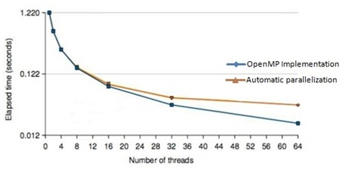
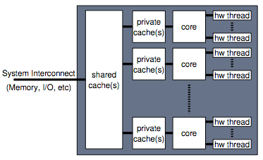
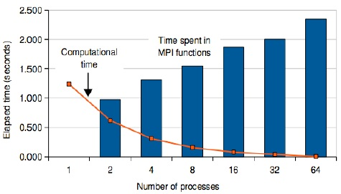
PERFORMANCE OF THE OPENMP AND MPI IMPLEMENTATIONS ON ULTRASPARC SYSTEM
Alexander Bogdanov (Institute for High-performance computing and the integrated systems)
Email: bogdanov@csa.ru
Pyae Sone Ko Ko (Saint-Petersburg state marine technical university)
Email: pyaesonekoko@gmail.com
Kyaw Zaya (Saint-Petersburg state marine technical university)
Email: kyawzaya4436@gmail.com
Abstract
Why Parallelization?
Performance Results
Programmers and developers interested in utilizing parallel programming techniques to enhance application performance. The Oracle Solaris Studio software provides state-of-the-art optimizing and parallelizing compilers for C, C++ and Fortran, an advanced debugger, and optimized mathematical and performance libraries. Also included are an extremely powerful performance analysis tool for profiling serial and parallel applications, a thread analysis tool to detect data races and deadlock in memory parallel programs, and an Integrated Development Environment (IDE). The Oracle Message Passing Toolkit software provides the high-performance MPI libraries and associated run-time environment needed for message passing applications that can run on a single system or across multiple compute systems connected with high performance networking, including Gigabit Ethernet, 10 Gigabit Ethernet, InfiniBand and Myrinet. Examples of OpenMP and MPI are provided throughout the paper, including their usage via the Oracle Solaris Studio and Oracle Message Passing Toolkit products for development and deployment of both serial and parallel applications on SPARC and x86/x64 based systems. Throughout this paper it is demonstrated how to develop and deploy an application parallelized with OpenMP and/or MPI.
Parallelization is another optimization technique to further enhance the performance. The goal is to reduce the total execution time proportionally to the number of cores used. If the serial execution time is 20 seconds for example, executing the parallel version on a quad core system ideally reduces this to 20/4 = 5 seconds. This is illustrated in Figure2.
The results were obtained on a Sun SPARC Enterprise T5120 server from Oracle. The system had a single UltraSPARC T2 processor with 8 cores and 8 hardware threads per core. In Figure the elapsed times in seconds for the Automatically Parallelized and OpenMP implementations are plotted as a function of the number of threads used. Note that a log scale is used on the vertical axis.
Figure.2. Parellelization reduces the execution time
Parallel Architectures & Parallel Programming Models
Multicore Processor Technology
In a multicore processor architecture there are multiple independent processing units available to execute an instruction stream. Such a unit is generally referred to as a core. A processor might consist of multiple cores, with each core capable of executing an instruction stream. Since each core can operate independently, different instruction streams can be executed simultaneously. Nowadays all major chip vendors offer various types of multicore processors. A block diagram of a generic multicore architecture is shown in Figure1.
These are generic descriptions without any specific information on systems available today.
The Symmetric Multiprocessor (SMP) Architecture
The Non-Uniform Memory Access (NUMA) Architecture
The Hybrid Architecture
The Cache Coherent Non-Uniform Memory Access (cc-NUMA) Architecture
There are many choices when it comes to selecting a programming model for a parallel system.
Automatic Parallelization
The OpenMP Parallel Programming Model
The Message Passing Interface (MPI) Parallel Programming Model
The Hybrid Parallel Programming Model
Figure.3. Performance of the Automatically Parallelized and OpenMP implementations.
.
In Figure4 the performance of the MPI implementation is plotted as a function of the number of processes. Both the computational time (solid line) as well as the total time spent in the MPI functions (bar chart) are shown.
Conclusion
The goal of parallel computing is to reduce the elapsed time of an application. To this end, multiple processors, or cores, are used to execute the application. The expected speed up depends on the number of threads used, but also on the fraction of the execution time that can be parallelized. The choice of the programming model has substantial consequences regarding the implementation, execution and maintenance of the application. We strongly recommend to carefully consider these before making a choice.
Figure.1. Block diagram of a generic multicore architecture.
Figure.4. Performance of the MPI implementation.

