Slide 1
Big Data transfer over computer networks Initial
Sergey Khoruzhnikov
Vladimir Grudinin
Oleg Sadov
Andrey Shevel
Anatoly Oreshkin
Elena Korytko
Alexander Shkrebets
Vladimir Titov
Oleg Lazo
Arsen Kairkanov (presenter)
Faculty of Infocommunication Technologies
ITMO University St.Petersburg, Russian Federation

Slide 2
Outlook
Sources of the Big Data.
Ecosystem of the Big Data.
Technology of the Big Data transfer.
Our recently started research.

Slide 3
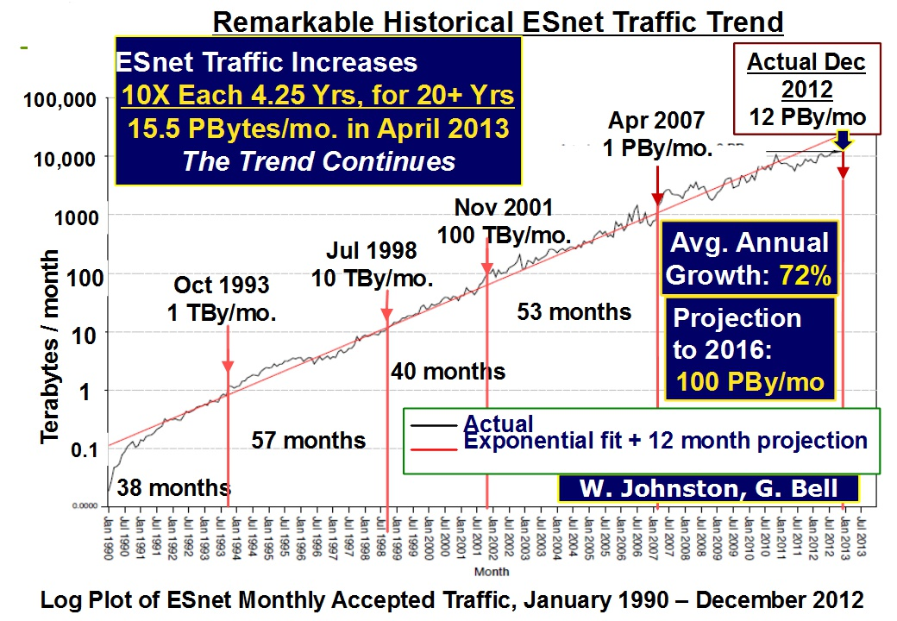
Network traffic growth

Slide 4
Scientific sources of Big Data
Scientific experimental installations
http://www.lsst.org - Large Synoptic Survey Telescope
15 TB per night (may be 10 PB/year)
https://www.skatelescope.org/ - Square Kilometre Array
300-1500 PB/year
http://www.cern.ch — CERN
~ 20PB/year (FAIR ~ same)
http://www.iter.org - International Thermonuclear Experimental Reactor
~ 1 PB/year
http://www.cta-observatory.org/ - CTA - The Cherenkov Telescope Array
~ 20 PB/year

Slide 5
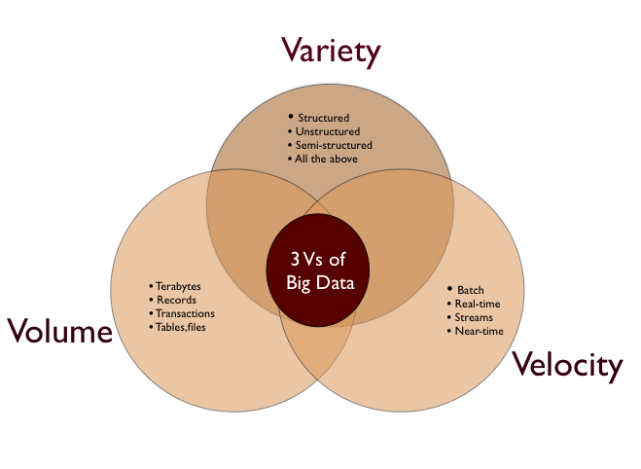
3 Vs of Big Data

Slide 6
Big Data ecosystem
Big Data Provider
(Organizations)
Big Data Consumer
(organizations, end users)
Big Data Management
(data transfer, every day management,
security, etc)
Big Data distributed Framework Provider
(Clusters, Storages, Networks, etc)

Slide 7
Peculiarity of the Big Data transfer
Big Data transfer might consume many hours or days.
The situation in channel might be changed: RTT, % of lost network packages, data link bandwidth).
Finally, it might occured the interruption (hours?, days?) in operation of data link .
Obviously it is useful to have access to two or more independent data links.

Slide 8
Technology peculiarities with Big Data transfer
Still main protocols — stack of TCP/IP.
Number of network parameters in Linux (around ½ thousand). /proc
-bash-4.1$ /sbin/sysctl -a | grep "^net\." | wc -l
Important parameters: e.g. size of block, size of TCP Window, etc. Main method to decrease the transfer time (even over one data link) is using the multi-stream data transfer.

Slide 9
Testing on the first stage (program tools)
BBCP - http://www.slac.stanford.edu/~abh/bbcp/
GridFTP - http://www.globus.org/toolkit/data/gridftp/
BBFTP - http://doc.in2p3.fr/bbftp/
FDT - http://monalisa.cern.ch/FDT/
FTS3 - http://fts3-service.web.cern.ch/
Also technology components to watch the data links status, e.g. perfSONAR.

Slide 10
Ideas to compare the data transfer tools
Availability.
API.
Performance.
Reliability.
Operation tracking.
Ability to predict the time to transfer the data on the base of existing tracking records.
Required resources: memory, CPU time, etc.
Others.

Slide 11
Research topic at ITMO University: the transfer of Big Data
In laboratory of network technologies http://sdn.ifmo.ru/ at ITMO University http://www.ifmo.ru/ the new research «Big Data transfer over Internet» has been formed .
It is planned to implement the special testbed (100 TB of disk storage + server 96 GB of main memory under OS RedHat/ScientificLinux on each side).
Comparative study of the existing tools of the data transfer (testing and measurements).
To use the testbed as instrument to compare various tools (tracking for the measurements + results).
Extended automatic tracking information about measurements is under development.

Slide 12
Process of the Data transfer

Slide 13
Planned measurements
Local and long distant sites with existing data links (not only most advanced links).
The idea is to use more than one data link in parallel.
Recently we obtained some experience with Software Defined Networks (SDN) approach (protocol Openflow) and now we plan to use it in the Big Data transfer.
Notes:
Sdn – вынести вперед, сделать акцент на sdn

Slide 14
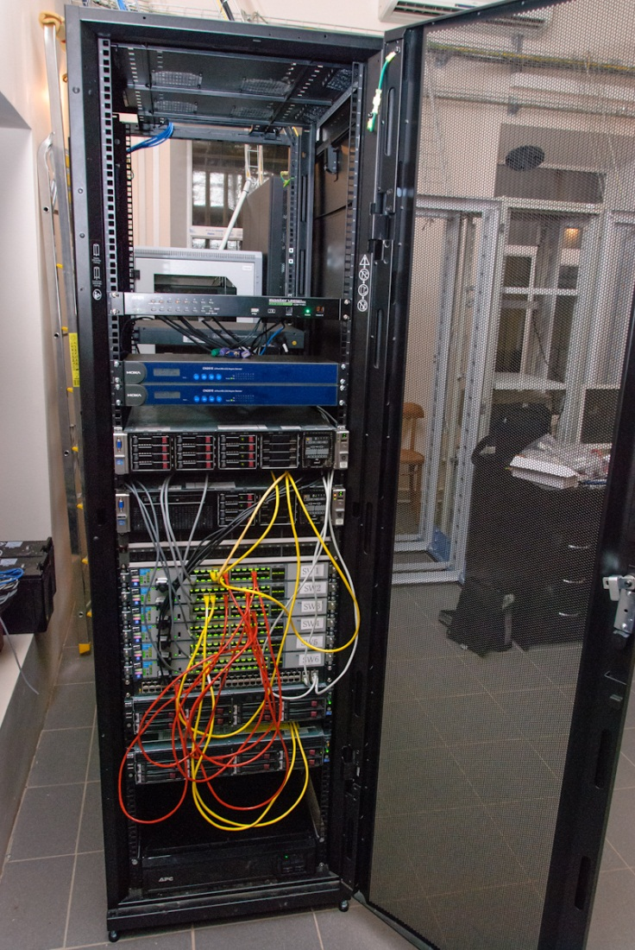
What was done until now
There were deployed
Two servers HP DL380p Gen8 E5-2609, Intel(R) Xeon(R) CPU E5-2640 @2.50GHz, 64 GB under Scientific Linux 6.5.
Six HP-3500-24G-PoE yl (OpenFlow 1.0)
Pica8 P-3920 (OpenFlow 1.2)
Openstack Havana with appropriate set of Virtual Machines to test a number of mentioned utilities.
PerfSonar
Scripts for testing https://github.com/itmo-infocom/BigData

Slide 15
Main goals
Combining the developed contemporary components and methods with ideas, developments, experience to achieve maximum speed for Big Data transfer on existing links.
To create the testbed which would be used as place where researchers might compare theirs (new) tools for data transfer with earlier recorded measurement results.
To sugggest the collaboration with … (suggestions?)
To invite students from … (suggestions?)

Slide 16
Partners (ideas exchange)
Laboratory of Information Technology (LIT) http://lit.jinr.ru/index.php?lang=lat
@ Joint Institute for Nuclear Research (JINR.ru)
The Application Research Center for Computer Networks at Moscow University http://arccn.ru/
We are starting to collaborate with GENI http://www.geni.net/
The work is supported by the Saint-Petersburg University of Information Technology, Mechanics & Optics
(ITMO University www.ifmo.ru)
Notes:
Сказать про сотрудничество и студентов

Slide 17
Questions?

Slide 18
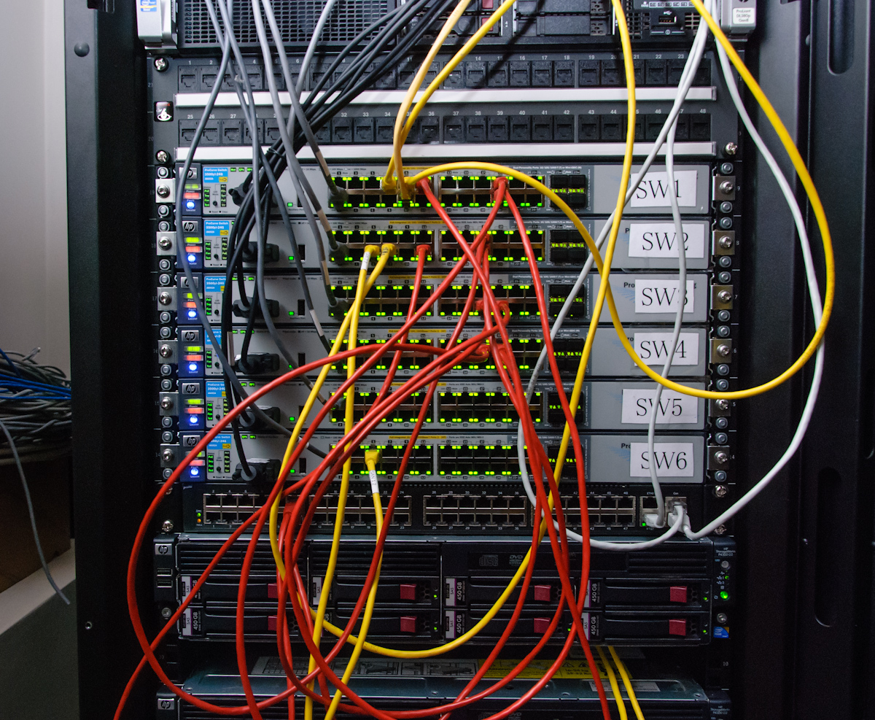
OF Switches

Slide 19
bbcp
TCP Window size;
number of TCP streams;
I/O buffer size;
compression on the fly;
multi-directory copy;
resuming failed copy;
authentication with ssh;
using pipes, where source or/and destination might be pipe;
special option to transfer small files;
and many other options dealing with many practical details.

Slide 20
bbftp
◦ encoded user name and password at connection;
▪ SSH and Grid Certificate authentication modules;
▪ multi-stream transfer;
▪ big windows as defined in RFC1323;
▪ on-the-fly data compression;
▪ automatic retry
▪ customizable time-outs;
▪ transfer simulation;
▪ AFS authentication integration.

Slide 21
gridFTP
◦ two security flavors: Globus GSI and SSH;
◦ the file with host aliases: each next data transfer stream will use next host aliases (useful for computer cluster);
◦ pipes;
◦ special debugging mode to find bottleneck in data transfer;
◦ backend module name for source and destination sites;
◦ number of parallel data transfer streams;
◦ buffer size;
◦ restart failed operations and number of restarts.

Slide 22
Other utilities
Xdd – utility developed to optimize data transfer and I/O processes for storage systems.
fdp – Java utility for multi-stream data transfer;
FTS3
UDT
RDMA
MP TCP

