Slide 1


Testing of electronic components at accelerator complex of the FLNR JINR
Flerov Laboratory of Nuclear Reactions
S. Mitrofanov, B. Gikal, G. Gulbekyan, I. Kalagin, N. Osipov, S. Paschenko, V. Skuratov, Y. Teterev (FLNR JINR, Dubna)
V. Anashin (JSC URSC ISDE)
International Workshop on Biophysics and Materials at NICA , December 12, 2016. JINR.

Slide 2
Outline
Formulation of the problem
Test Standards and Guidelines
FLNR testing facility introduction
Fitting the problem with U400 and U400M.
Beam monitoring: detector’ Zoo - ‘’pro et contra’’
Further steps: R&D, upgrade and modernization.
Milli beams: Here be dragons
Conclusions
International Workshop on Biophysics and Materials at NICA , December 12, 2016. JINR.

Slide 3
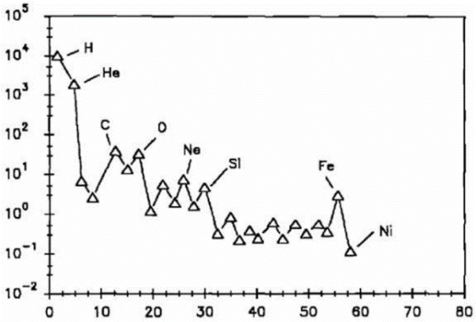
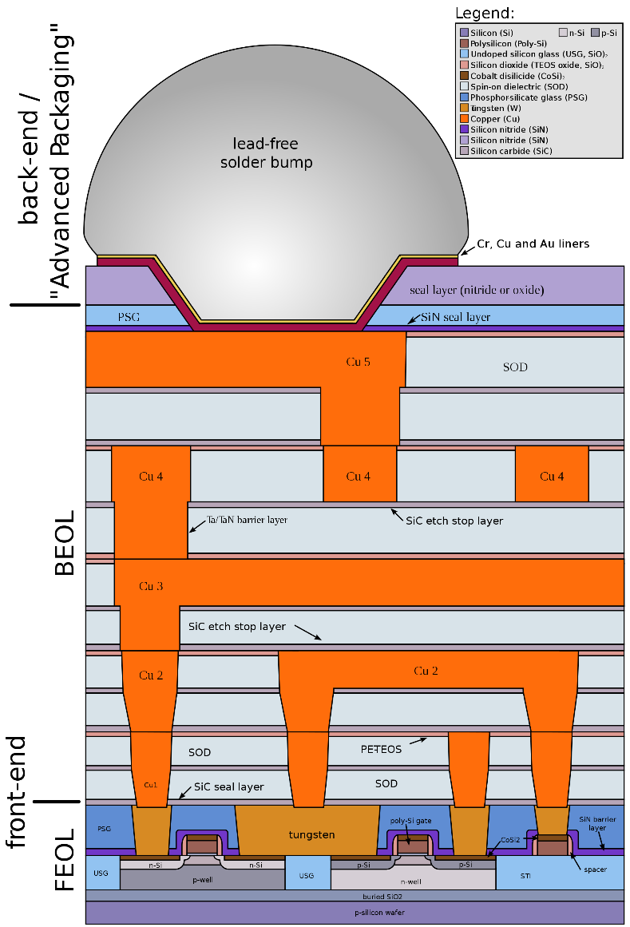
Question point for R&D: Cosmic ray
Of primary cosmic rays, which originate outside of Earth's atmosphere, about 99% are the nuclei (stripped of their electron shells) of well-known atoms, and about 1% are solitary electrons of the nuclei, about 90% are simple protons, i. e. hydrogen nuclei; 9% are alpha particles, and 1% are the nuclei of heavier elements.
Cosmic ray flux as a function of atomic mass.
Question – what will be if…
…you have TOO much species in your “sandwich”
…. or ONE is enough???
- What does it mean for FLNR ??
- Using the accelerator complex to irradiate
the DUT (Device Under Test) with
the heavy ion beams (with well-known characteristics).
- What does it mean for Users ??
- To observe response and operate the DUT under exposure.
*Courtesy to Wiki
International Workshop on Biophysics and Materials at NICA , December 12, 2016. JINR.

Slide 4
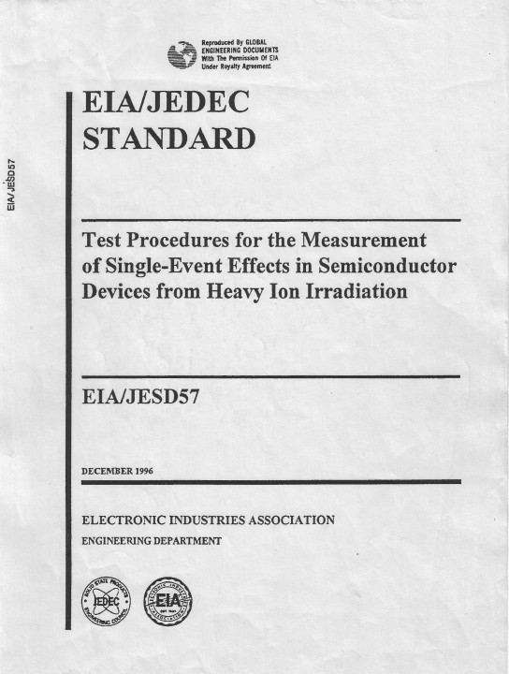
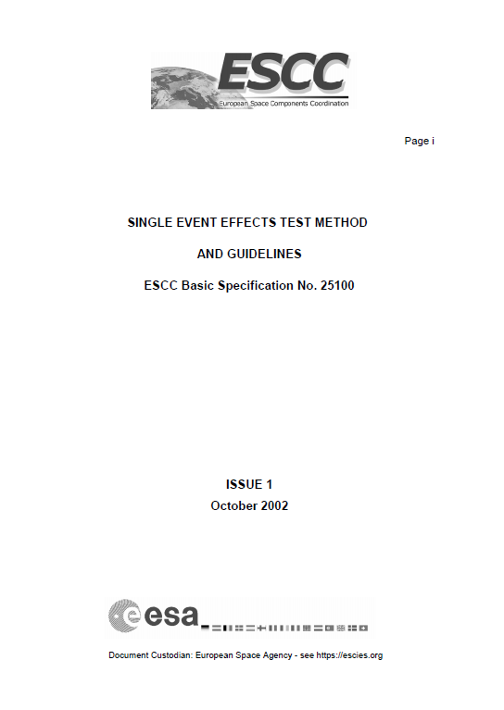
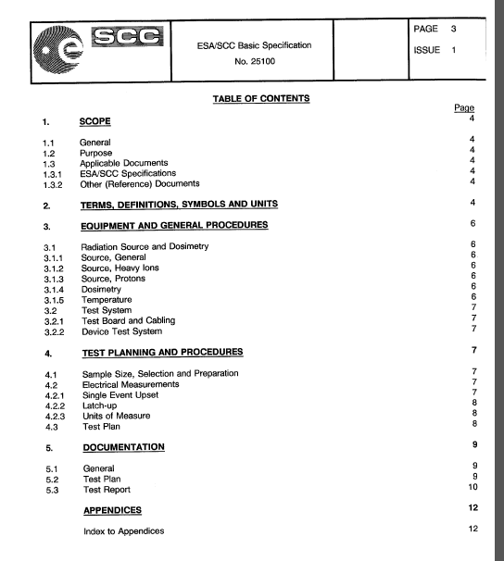
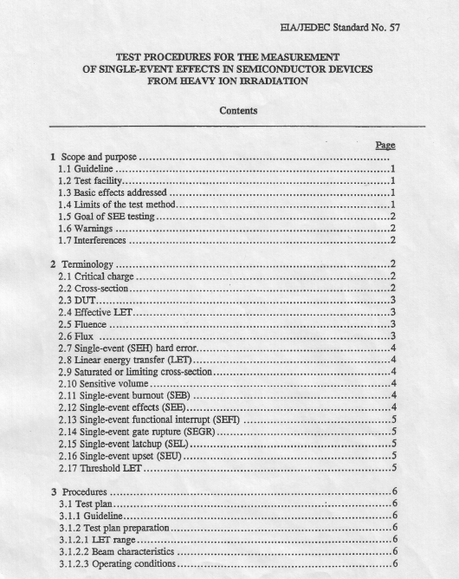
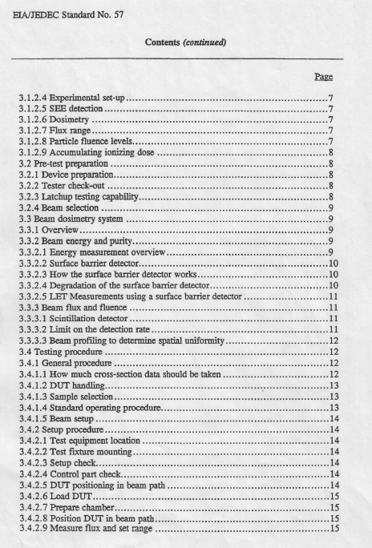
Test Standards and Guidelines
Electronic industry association
European space agency
International Workshop on Biophysics and Materials at NICA , December 12, 2016. JINR.

Slide 5
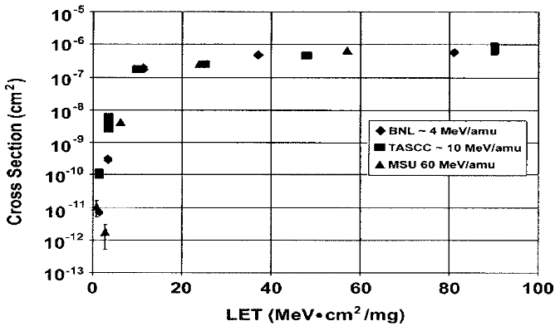
So, what's the bottom line?
Major points for the electronic components testing
Ion energy: few measurements at different effective LET (linear energy transfer) levels
Tilting
Beam intensity: 10¹ ÷ 10⁵ сm⁻²s⁻¹
Fluence: ≥ 10⁷
Beam uniformity: ± 10 % (over the DUT area)
Energy accuracy: ± 10 %
Ion range in Si: ≥ 30 mkm (ion energy > 3 MeV/nucleon)
Beam operation time for testing: at least 2000 hours per year – based on SEE’ symposium reports
Lack of the beam time in the world.
Example cross-section curves for a Matra 32 K 8 SRAM*
Goal:
Obtaining experimental data within Earth limits
to predict SEE rate in space.
*IEEE TRANSACTIONS ON NUCLEAR SCIENCE, VOL. 50, NO. 3, 2003
International Workshop on Biophysics and Materials at NICA , December 12, 2016. JINR.

Slide 6
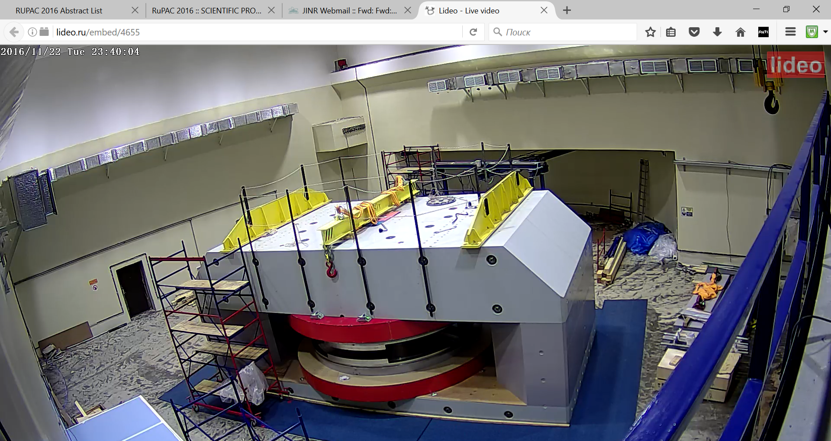
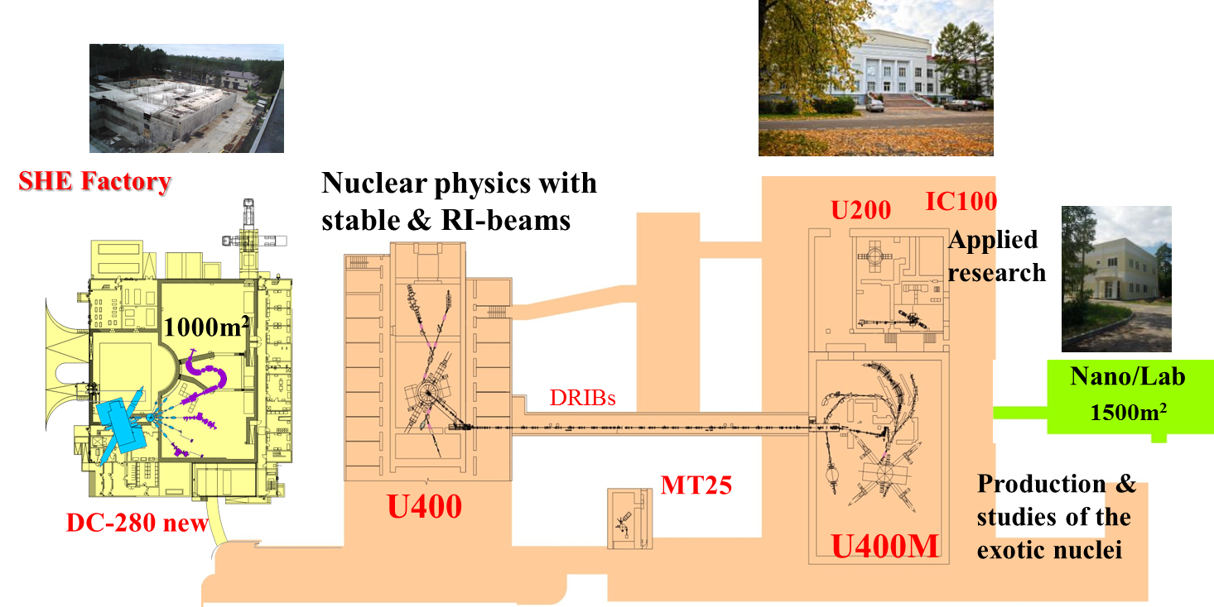
FLNR accelerator complex in 2016.
4 cyclotrons and microtron (e-beams)….
Beam operation time – 7 years review: ~ 15 000 hours/year of the ion beams ON physical targets
International Workshop on Biophysics and Materials at NICA , December 12, 2016. JINR.

Slide 7
Does it (FLNR accelerator complex) fit well ?
Ion beam parameters for the singe event effect (SEE) testing.
Ions: O, Ne, Ar, Kr, Xe, Fe and Bi
Ion energy 3 - 64 MeV / nucleon (it means LET values: up to 100 MeV×cm2/mg )
Beam intensity: 10¹ ÷ 10⁵ сm⁻²s⁻¹
Irradiation areas: ø 6 cm, 15.5*20 cm, 20*20 cm
Beam uniformity: 10 ÷ 30 %
Energy accuracy: 10 %
Ion range in Si: ≥ 30 mkm
Beam operation time, dedicated to SEE testing in 2016 up to date is 2500 hours !!!
2014: 2300 hours
2015: 2100 hours
2016: 2500 hours
International Workshop on Biophysics and Materials at NICA , December 12, 2016. JINR.

Slide 8
U400M experimental hall.
High energy (15.5 - 64 MeV/nucleon) ion beam-line
Low energy (3-6 MeV/nucleon) ion beam-line
International Workshop on Biophysics and Materials at NICA , December 12, 2016. JINR.

Slide 9
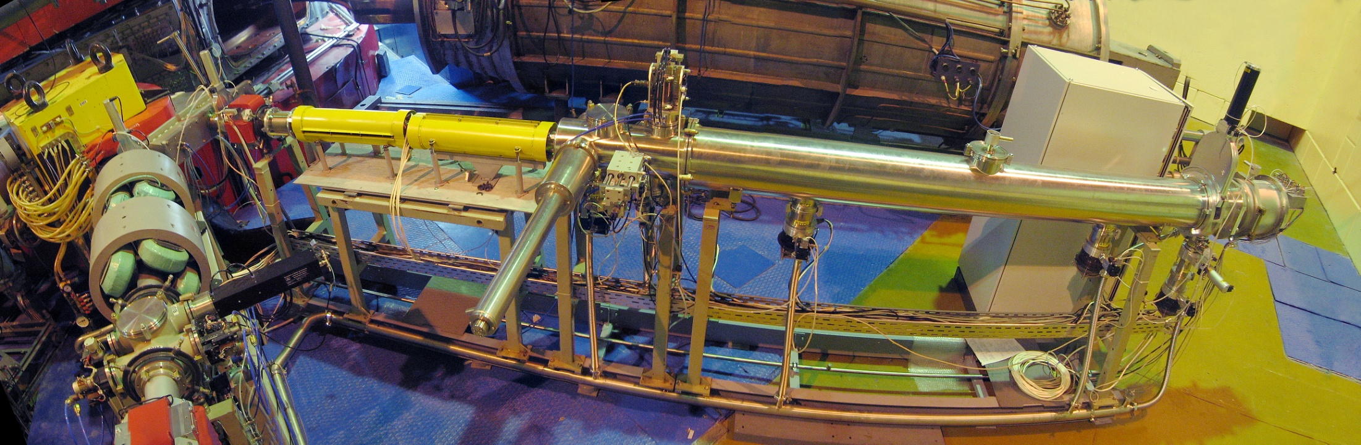
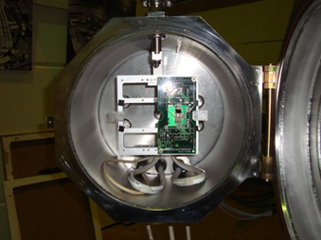
The low energy ion beam line based on U400M.
Bending magnet
TOF measurement
X-Y correction magnets
Vacuum gate valve
Faraday cup
Luminophore drive
Ta foils (5-27 μm) drive
Test chamber
X-Y scanning system (50 Hz)
Turbo molecular pumps
Dedicated beam-line for low energy (3 ÷ 6 MeV/nucleon)
ions (usially Ne, Ar, Kr, Xe, Fe or Bi)
Irradiation area – 200x200 mm².
Beam uniformity better then 30%
Beam flux 1 ÷ 10⁵ cm⁻²s⁻¹
International Workshop on Biophysics and Materials at NICA , December 12, 2016. JINR.

Slide 10
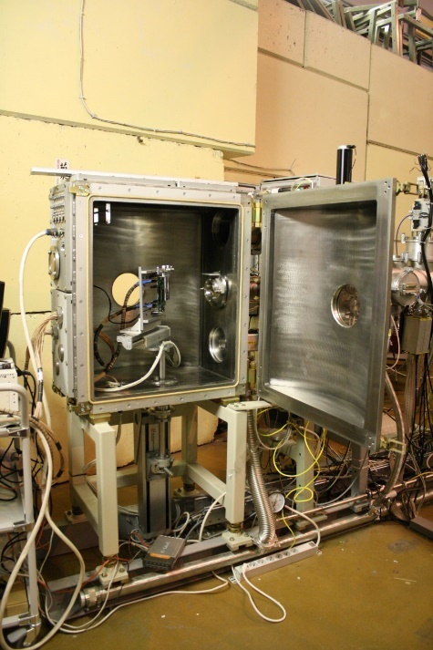
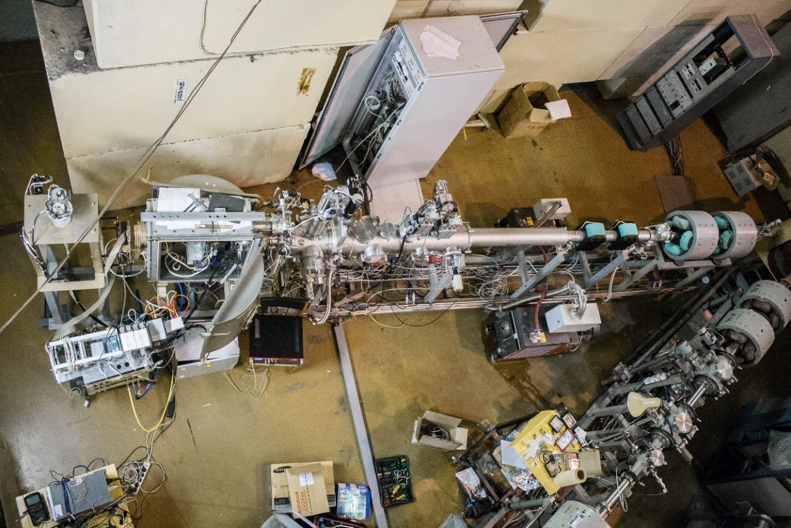
The high energy beam-line based on U400M.
Design of the experimental chamber allows:
the SEE testing in vacuum (10⁻² Torr) and air ambient
irradiation area of 60 mm in diameter.
automatic movement of the DUT in two orthogonal axes
(X and Y) in respecting of the beam direction (Z).
to change beam incident angle in the range of 0-90 degrees.
installation of degraders set.
Energy 15.5 - 64 MeV/nucleon (done in 2015)
Beam uniformity better than 20%
In 2017 automatic tilting of the DUT will be added
International Workshop on Biophysics and Materials at NICA , December 12, 2016. JINR.

Slide 11
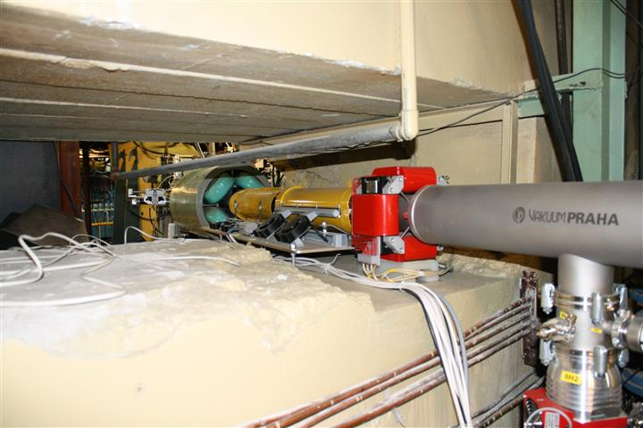
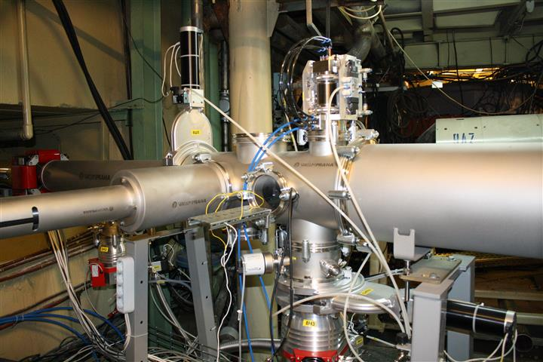
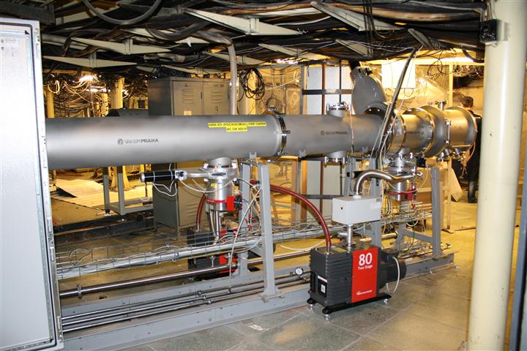
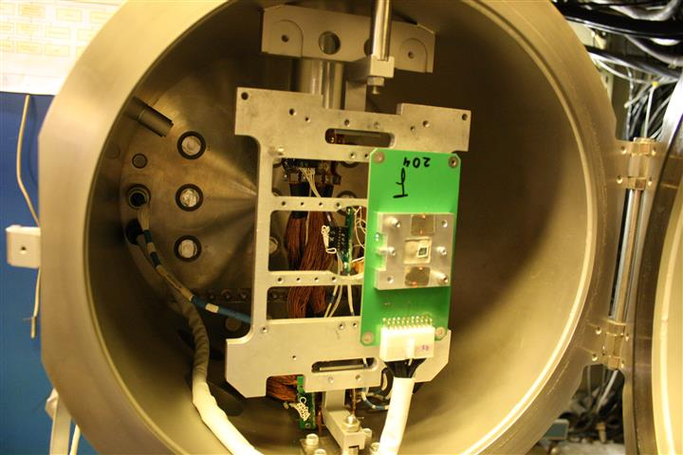
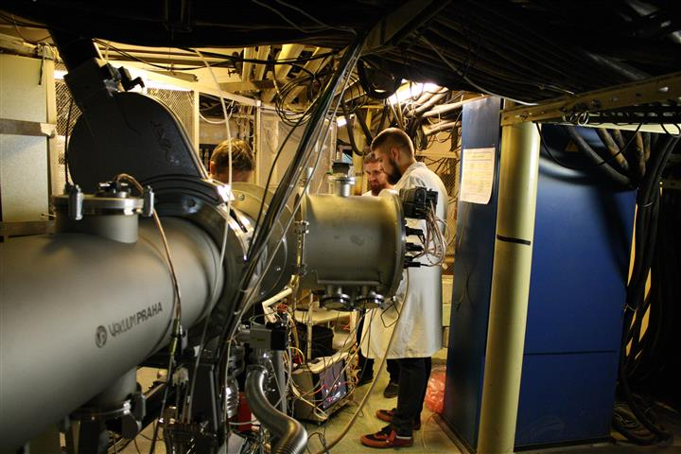
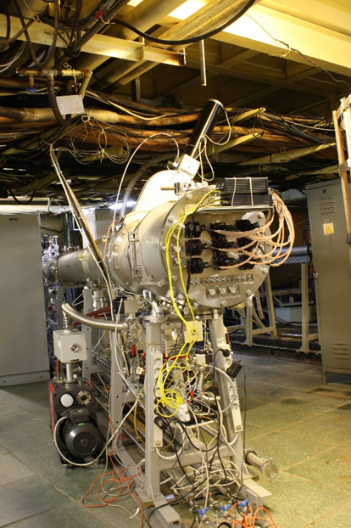
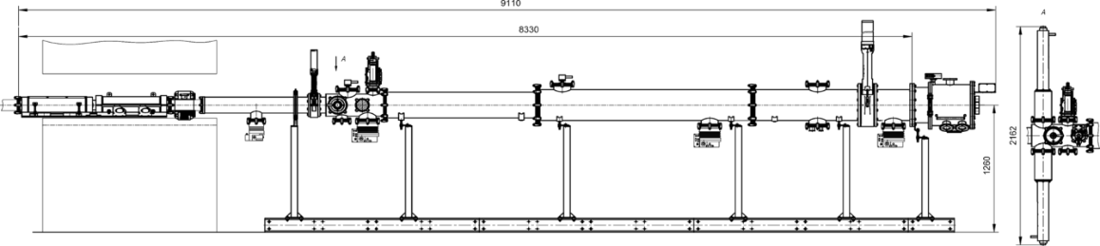
The low energy ion bean line based on U400
Main features of this facility are:
200 mm x 155 mm irradiation area
Beam uniformity over irradiation area better then 20%
Ne, Ar, Fe, Kr, Xe, Bi ions with 3-9 MeV/nucleon
LET range of 4.5-100 MeV/(mg/cm2).
Fluent energy variation in the U400R will allows changing the ion energy without degraders.
International Workshop on Biophysics and Materials at NICA , December 12, 2016. JINR.

Slide 12
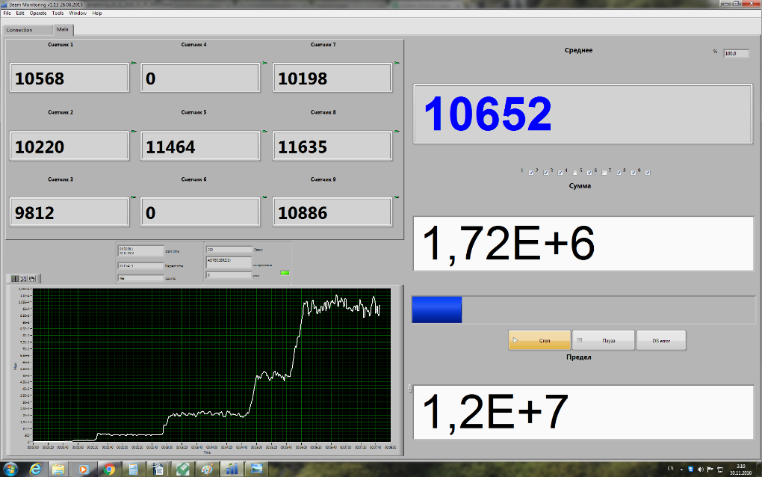
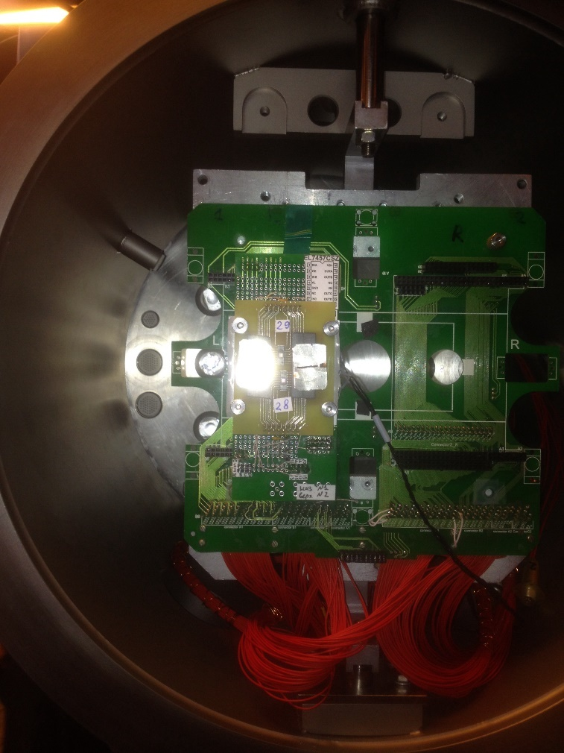
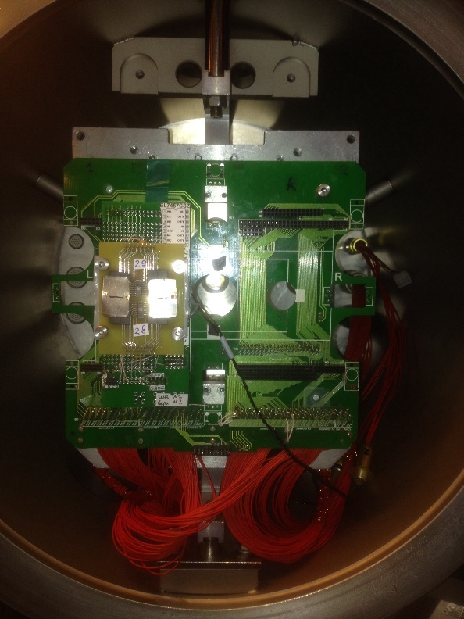
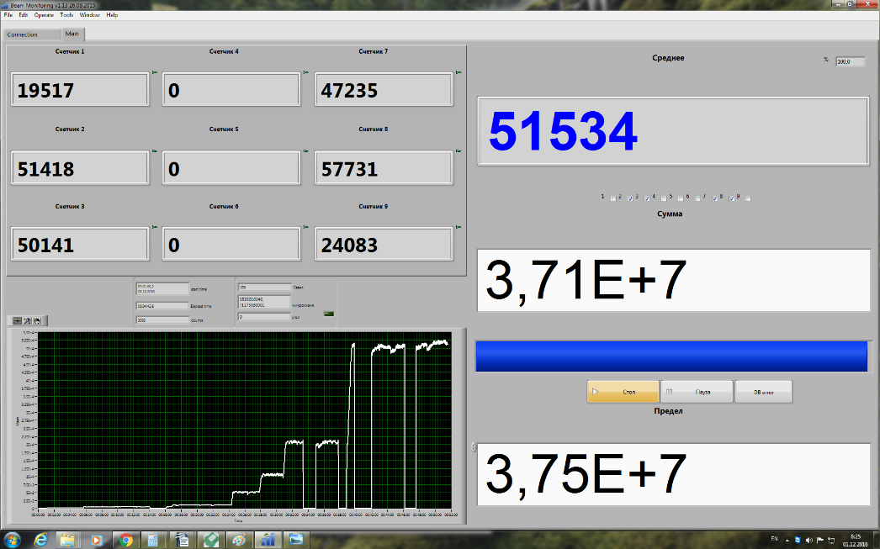
Beam fluence and flux control system
International Workshop on Biophysics and Materials at NICA , December 12, 2016. JINR.

Slide 13
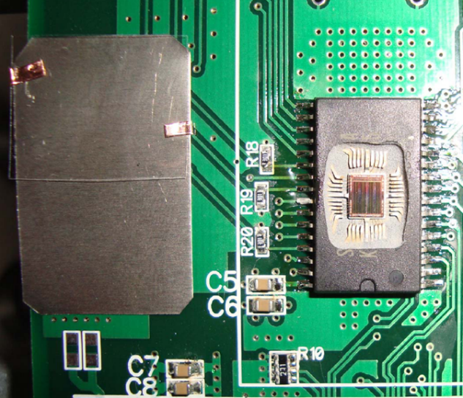
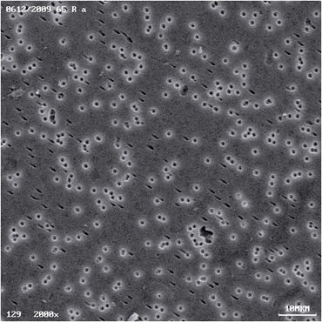
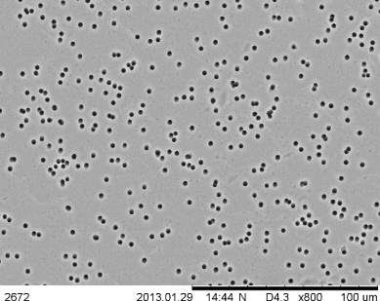
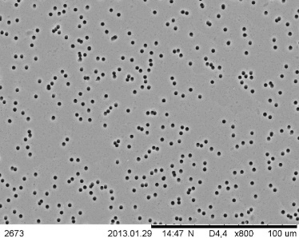
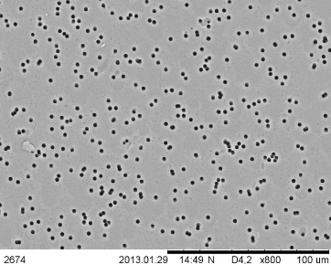
The reference point for the beam fluence value
is the “old-school” method – track membrane
Ion fluence is controlled by using polycarbonate or polyethylene terephthalate track detectors placed in close vicinity of any testing device in all irradiation runs.
Polymer track
detector
Device
Under
Test
SEM micrograph
of polymer track
detector
The result usually available for user in ONE hour after irradiation test.
Ar (35.5 MeV/n, ion fluence 10⁶ cm⁻²) + polycarbonate
E =33.5 MeV/n
LET= 5.37 MeV/(mg×cm²)
E =23.5 MeV
LET =6.8 MeV/(mg×cm²)
E =9 MeV/n
LET= 13 MeV/(mg×cm²)
Track etching efficiency is constant over a wide range of ion energy
International Workshop on Biophysics and Materials at NICA , December 12, 2016. JINR.

Slide 14
Beam control systems :
  Beam uniformity – beam profile over irradiation area
  Beam flux in the range of 10²÷10⁵ ions per second per cm²
  In-situ energy measurement
Detector’ Zoo ?
International Workshop on Biophysics and Materials at NICA , December 12, 2016. JINR.

Slide 15
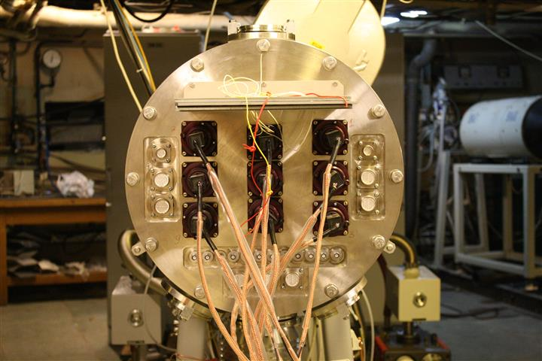
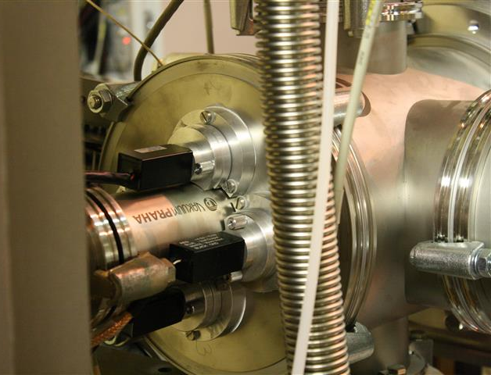
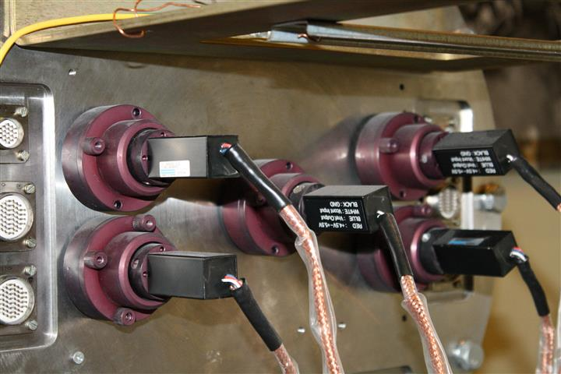
Scintillators based detectors:
To determine the beam spatial distribution and flux value.
Good stability, easy to use, almost “immortal” detectors – up to 1 month at 10⁵ ions per sec.
International Workshop on Biophysics and Materials at NICA , December 12, 2016. JINR.

Slide 16

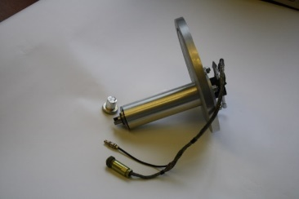
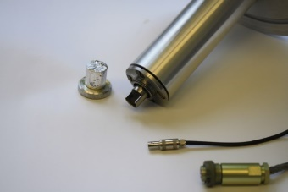
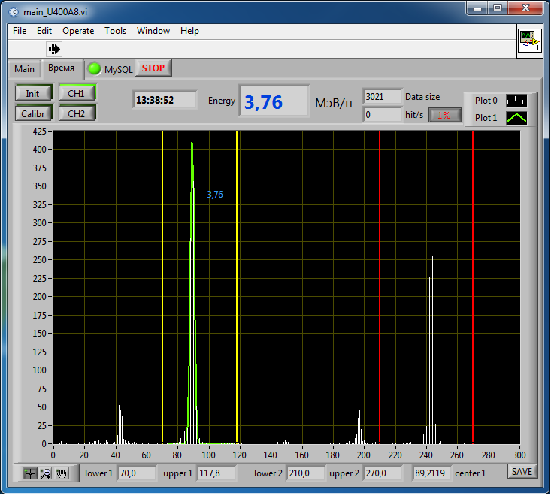
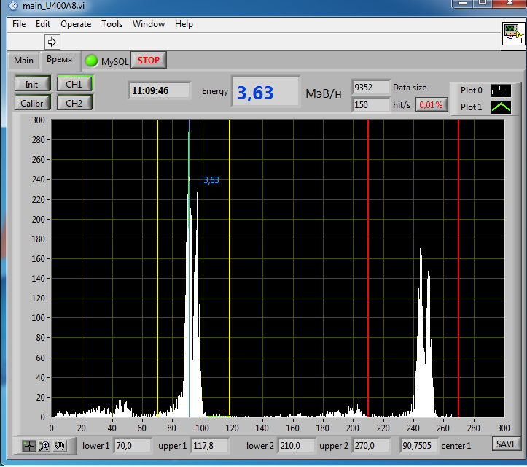
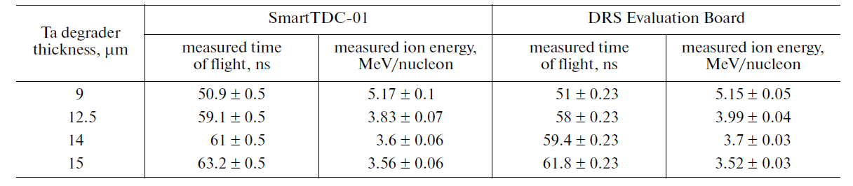
Scintillators based detectors:
online measurement of heavy ion energy - the low energy line at U400M as example.
*The second generation of the detectors and data acquisition system are presented
TOF energy measurement sensors base is L=1.602 m.
Beam purity
Use of degrading foils additionally allows us to determine the content of impurities in the ion beam. A clean from impurities ion beam corresponds to one peak on the recorded spectrum. An ion beam with impurities results in split peaks on the spectrum after passing the degrader.
Intensity ratio of the peaks occurred after splitting corresponds to the proportion of impurities. We could determine energy (LET) of the impurity by the offset of the peak on the spectrum.
PMT
light guide
Scintillator covered by Al foil
International Workshop on Biophysics and Materials at NICA , December 12, 2016. JINR.

Slide 17
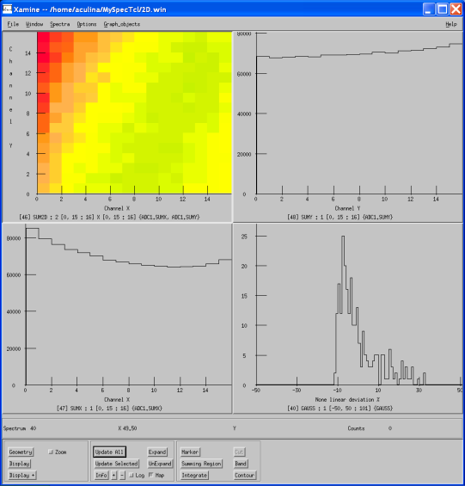
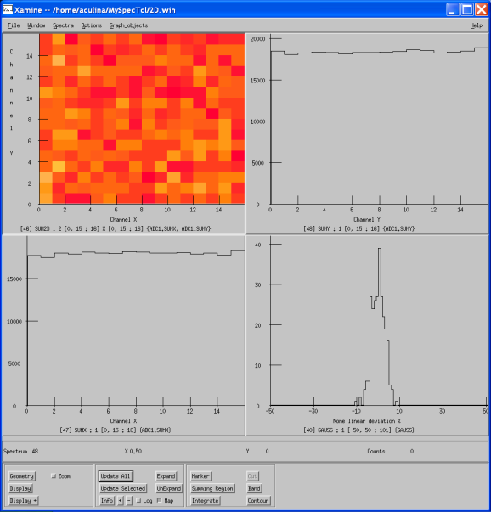
Double side Si strip detector
Fully cover the beam spot
Beam profile 64 x 64 mm² , strip width = up to 1 mm.
Dual axes (X – Y) orthogonal detection
A bit more beam intensity , a bit more human factor … and 6000 Euro goes to garbage
Long time of using = Si detector degrades due to the radiation effects inside.
Fluence more than 10⁸ is crutial
Amplitude decrease
Pulse to be wider
Collecting time rising
Impossible to use for the energy measurement due to the charge recombination.
International Workshop on Biophysics and Materials at NICA , December 12, 2016. JINR.

Slide 18
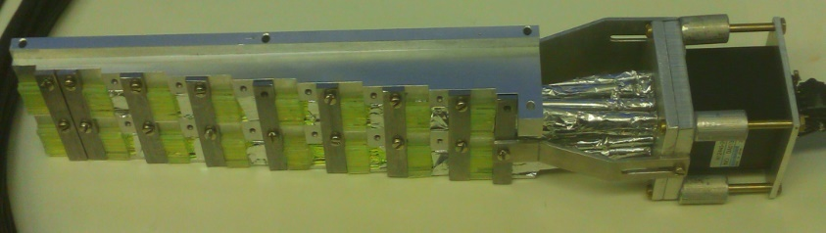
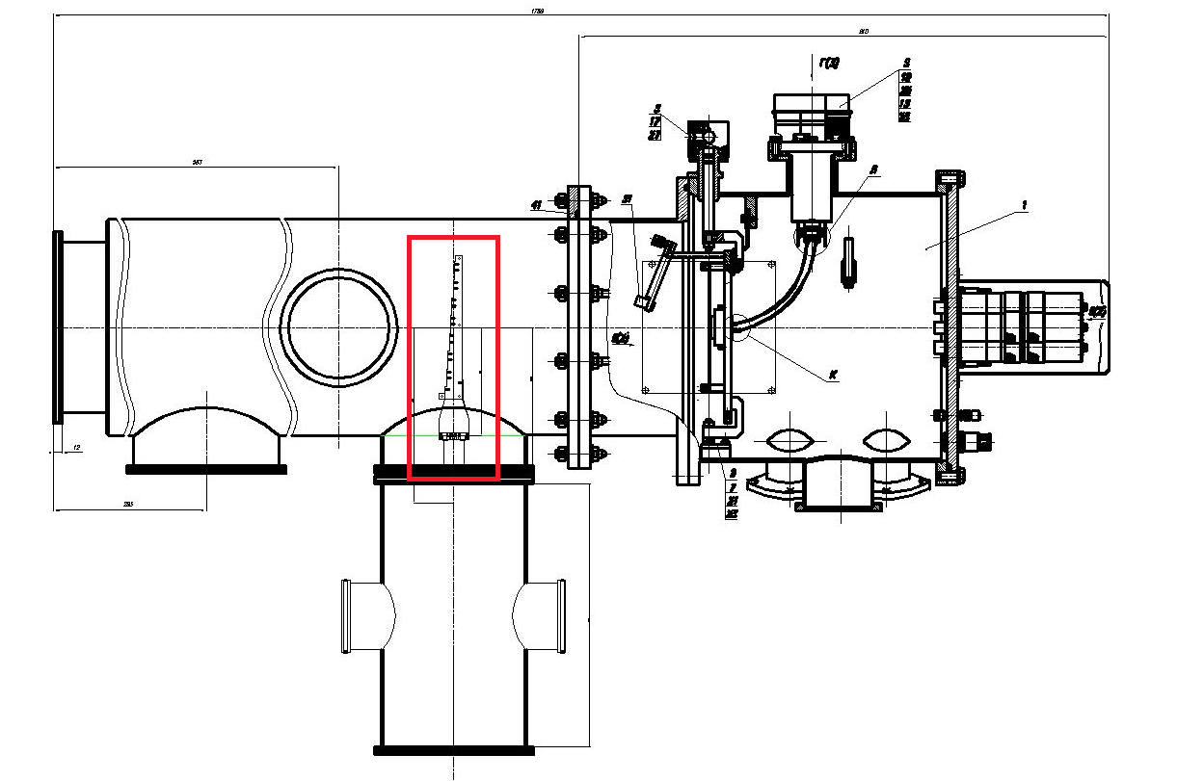

Further steps: R&D, upgrade and modernization.
Due to the huge irradiation areas we need to improve the beam profile control:
64 - matrix of 1 cm² scintillators
!Under construction!
International Workshop on Biophysics and Materials at NICA , December 12, 2016. JINR.

Slide 19
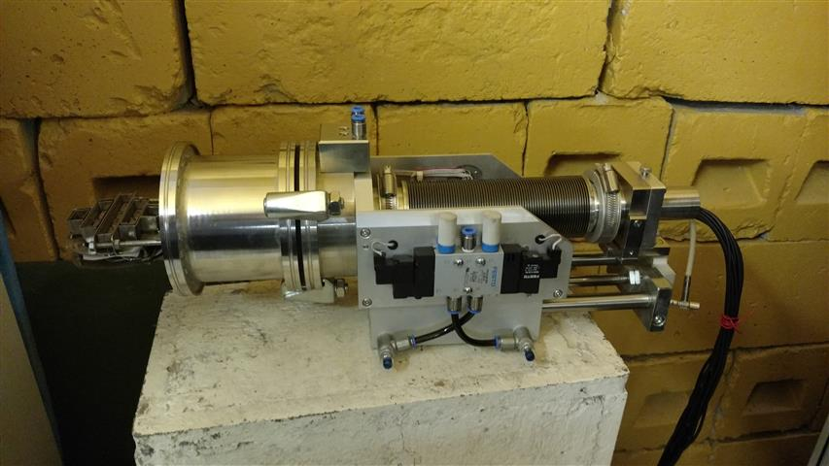
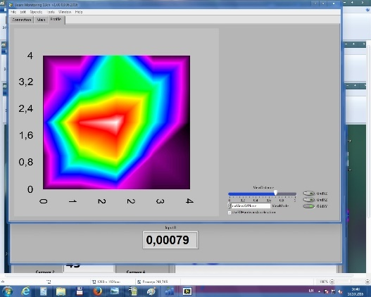
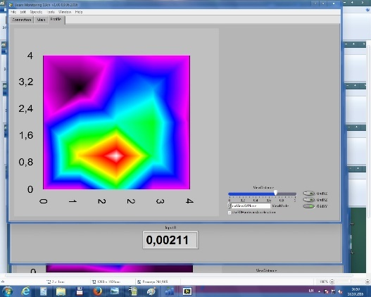
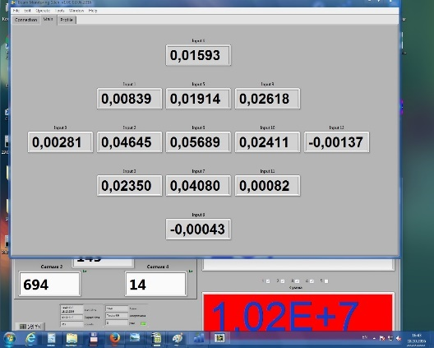
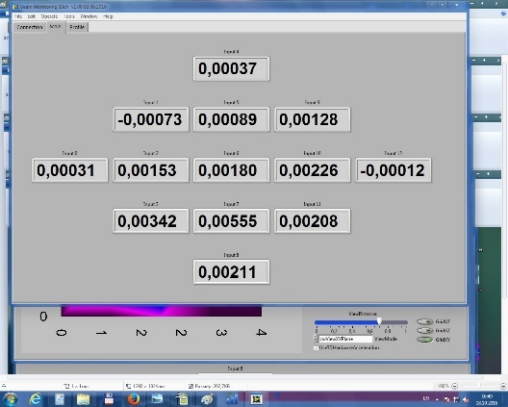
Further steps: R&D, upgrade and modernization.
To reduce the beam tuning time we developed the beam profile control station
(covers ø 60 mm) based on secondary electron emission:
!Under construction!
…At least 2 pcs will be build in 2017. 25 channels prototype is in workshop.
International Workshop on Biophysics and Materials at NICA , December 12, 2016. JINR.

Slide 20
Further steps: R&D, upgrade and modernization.
To reduce the time of the beam fluence control we need to move to CR39
instead of using polycarbonate or polyethylene terephthalate track detectors.
Fire-and-forget (CR-39 is the most sensitive track detectors that’s why it could be successfully
used to detect both heaviest and lightest accelerated ions in a wide range of energies).
Officially introduced in the state register of measuring instruments
No needs of some chemical procedures during post analyzing
It gives clear and contrast etched tracks image. Using of CR39
opens up an opportunities for the automatic software calculation of the tracks density.
!Under construction!
International Workshop on Biophysics and Materials at NICA , December 12, 2016. JINR.

Slide 21
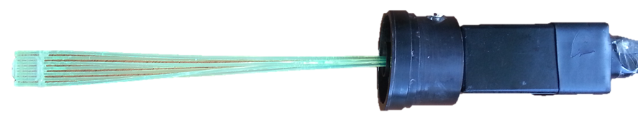
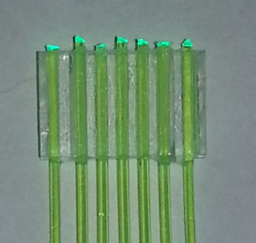
Further steps: R&D, upgrade and modernization.
To reduce the time of the beam flux and fluence control we are looking
for the calibrated movable “something” based detector.
For example: scintillator base detector
Once it will be calibrated with the CR39 – it will allow us to reduce both
the amount of the track detectors and the time of the beam fluence analyzing.
!Under construction!
International Workshop on Biophysics and Materials at NICA , December 12, 2016. JINR.

Slide 22

Milli beams: Here be dragons
Next major step at this field could be the milli-beam project with the Ø100÷1 micron beam.
It will be useful for:
Medical research
Radiobiological research
Materials Science
Semiconductor research (in the frame of the electronic components design study testing)
!Research design is under study!
International Workshop on Biophysics and Materials at NICA , December 12, 2016. JINR.

Slide 23
Conclusions
The test facility for electronic components was updated. The ions up to Bi with the energy up to 64 MeV/nucleon are available for worldwide users since 2015.
The beam monitoring systems of the facilities provide both online (beam energy, flux and uniformity) and offline (beam uniformity, absolute control of the dose) beam control. The new prototypes of the detectors were successfully tested to improve the beam control systems.
Facility allows quick change of the DUT in irradiation chambers.
Time to change the ion energy ~ 10 min.
Time to change the ion type: 8÷24 h.
Since 2010, more then 3000 devices has been tested.
The facility beam operation time are shared between medical, radiobiological and semiconductor research.
The “roadmap” of dedicated R&D steps was developed and accepted - the next step of evolution are waiting for our efforts.
International Workshop on Biophysics and Materials at NICA , December 12, 2016. JINR.

Slide 24
Thank you for your attention !!!
In few days we will overcome yet another year.
With every oncoming year, greater obstacles come in our life.
So let us be brave and I wish us to overcome all the struggles that life will present us with.
Flerov Laboratory of Nuclear Reactions
Testing of electronic components
at accelerator complex of the FLNR JINR
S. Mitrofanov, B. Gikal, G. Gulbekyan, I. Kalagin, N. Osipov, S. Paschenko, V. Skuratov, Y. Teterev (FLNR JINR, Dubna)
V. Anashin (JSC URSC ISDE)
International Workshop on Biophysics and Materials at NICA , December 12, 2016. JINR.

