Slide 1




International Workshop on Biophysics and materials at NICA
BIOMAT
Dubna, Russia, December 12-13, 2016 ____________________________________________
Radiofrequency radiation effects in biomedical applications
I. Zavestovskaya, A. Kabashin,
A. Kanavin, V. Timoshenko
International Laboratory “Bionanophotonics”
National Research Nuclear University “MEPhI”, Russia
P.N. Lebedev Physical Institute of RAS, Russia
Aix Marseille University, Marseille, France
Moscow State University, Russia

Slide 2
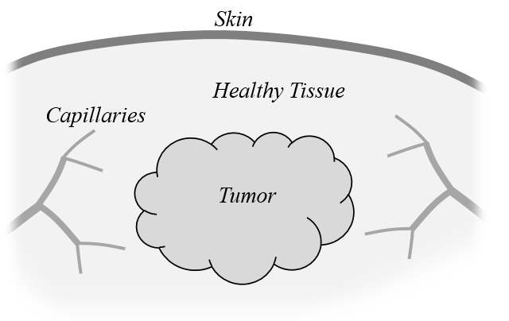
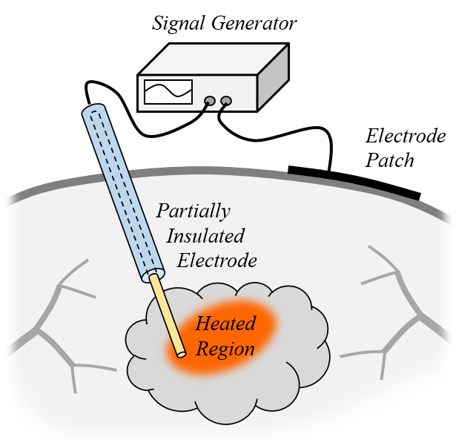
RF Ablation for medical application
Radiofrequency (RF) ablation is a treatment modality that kills unwanted tissue by heat.
The ability to target this heat to specific localized tissue areas is a key advantage of the radiofrequency tissue ablation technique.
In one of many medical applications, a cancerous tumor is a localized target.
A tumor within healthy tissue. Capillaries perfuse blood through the tissue and tumor.
Starting with cardiac arrhythmia treatment more than 30 years ago,
RF ablation has found clinical application in a number of diseases:
for certain types of cardiac arrhythmia, and cancers.
RF with 1…100 MHz:
penetration depth - 10 m … 10 cm!
A monopolar radiofrequency applicator and a patch electrode on the skin’s surface.

Slide 3
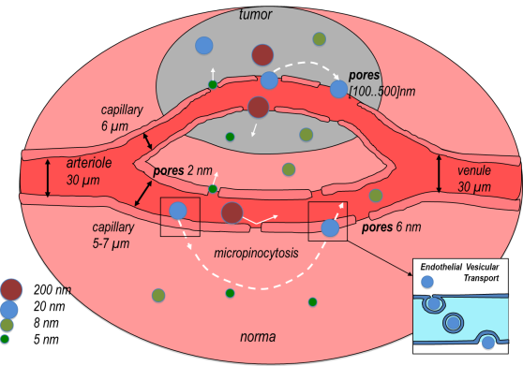
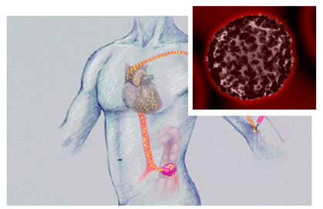
Nanoparticles in biomedical applications
In vivo
Bioimaging
Therapeutics
Nanoparticles can selectively accumulate in tumors through passive or active targeting
Nanoparticles can be used as sensitizers to initiate various cancer therapies:
Photodynamic therapy based on singlet oxygen release under photoexcitation. Singlet oxygen is deadly for cancer cells.
Radiation (photon, RF, US)-induced hyperthermia (local increase of temperature leading to a local destruction of tumors)
Drug carriers for chemotherapy
When properly functionalized, nanoparticles can be used as contrast agents to detect tumors
Early cancer detection, control of drug delivery and surgery course
Non-toxic , biocompatible and biodegradable
Synthesis of theranostic agents, capable of simultaneously providing therapeutic and diagnostic tools
Mild, non-invasive cancer treatment
Theranostics = Therapy + Diagnostics
Theranostic nanoparticles: nanoparticles, which can combine therapeutic and bioimaging functionalities

Slide 4
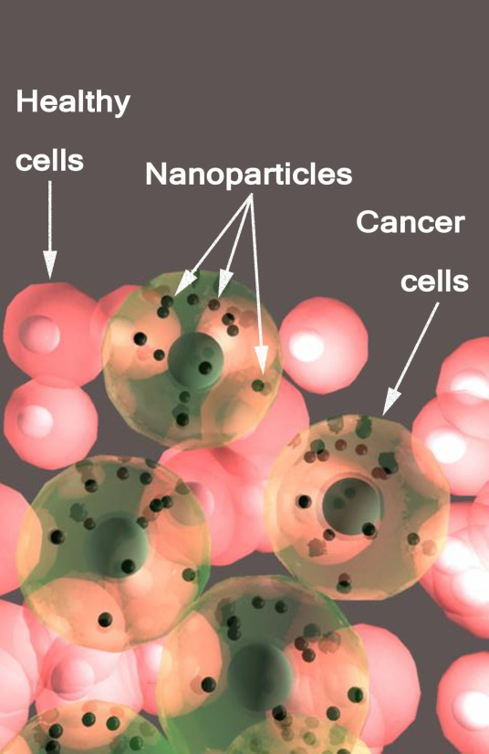
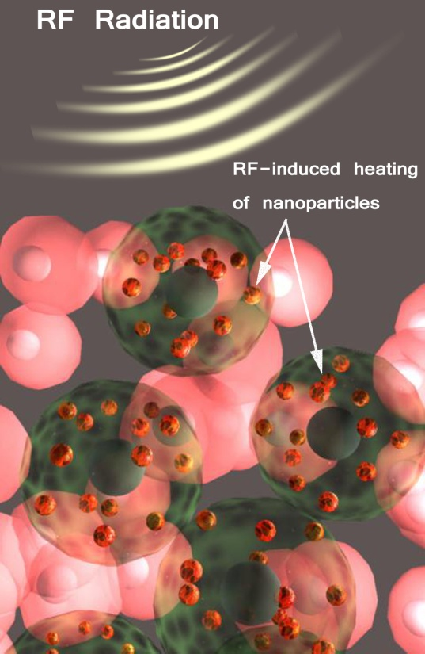
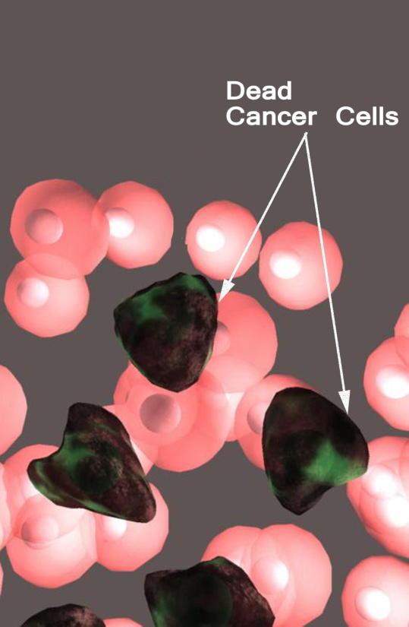
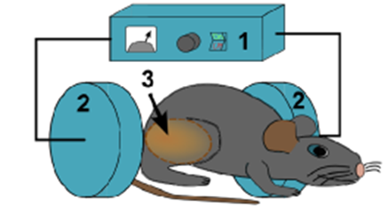
RF radiation-induced hyperthermia using biodegradable Si-based nanosensitizers for mild cancer therapy
RF irradiation can cause hyperthermia of cancer cells and their death, but in the absence of sensitizers it may be dangerous
It is known that conductive nanoparticles (Carbon nanotubes, Au nanoparticles) can absorb RF radiation, but these nanomaterials are not biodegradable
Mild therapeutic modality
Deep penetration to tissues
Our idea for the improvement of RF therapy:
Use of Si nanoparticles as nanosensitizers
ADVANTAGE:
Laser-ablated Si nanoparticles are biocompatible and biodegradable as in biological environment they dissolve and are excreted with the urine:
no toxicity effects
Scientific Reports, 4, 7034 (2014).

Slide 5
Mission:
Affect the RF heating with presence of Nanoparticles
Research:
MATERIALS:
Synthesis of Si NPs and characterization of their properties
METHODS:
Modeling and Study of interactions of NPs with biological systems
+
BIOMEDICAL APPLICATIONS:
Development of novel imaging and therapy modalities based on highly biocompatible and biodegradable Si and their compounds
NPs can act as sensitizers of the RF

Slide 6
Formation of Si NPs
Laser ablation/fragmentation of solid c-Si targets
Fragmentation of porous Si layers/wires/particles prepared by chemical/electrochemical methods
CVD, RF or laser decomposition of SiH₄, …

Slide 7
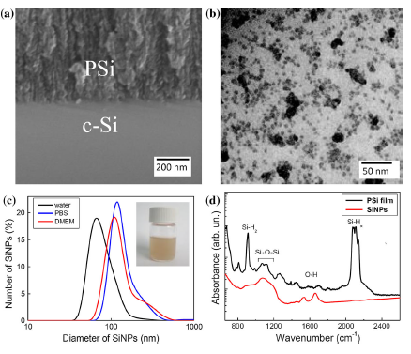
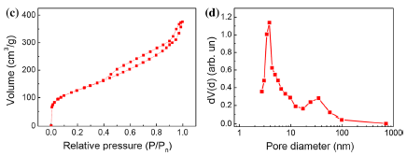
Porous Si NPs from Porous Silicon (PSi)
PSi is a nanocomposite material, which consists of Si nanocrystals and pores.
TEM: Aqueous suspensions of PSi
NPs - 5-10 g/l, 5-50 nm
The nanocrystalline structure of SiNPs is confirmed by electron diffraction patterns.
SEM:Films of PSi on crystalline c-Si
Diameter distribution of SiNPs in suspension
PBS (phosphate buffered solution)
nutrient solution DMEM
Absorption spectra: internal surface of as-prepared PSi films is predominantly covered by hydrogen
Pore size distributions for Si NPs
The mean pore diameters:
10 and 4 nm
Notes:
Films of PSi are formed by using the electrochemical etching of crystalline silicon (c-Si) wafers in hydrofluoric acid solutions.
Mesoporous (mPSi) and microporous (µPSi) films are formed from boron-doped c-Si substrates with specific resistivity of 1–50 mΩ•cm and 1-20 Ω•cm, respectively.
The prepared PSi films are lifted off by a short increase of the current up to 500–600 mA/cm².
The dried free-standing films were ground in distilled water (wet grinding) or without any dispersant (dry grinding) in a planetary-type mill.
After the grinding, the PSi suspension is centrifuged to remove larger aggregates and the supernatant is used. For as-prepared suspensions the concentration of NPs is about 5-10 g/l. For further experiments, suspensions are diluted to obtain the concentrations below 1 g/l (physiological toxicity level).
Figure (left-hand) shows a cross-sectional SEM image of the interface between PSi film and c-Si substrate. PSi is known to be a nanocomposite material, which consists of Si nanocrystals and pores. The employed grinding procedure allowed us to obtain SiNPs with sizes 5–50 nm as it is shown in TEM ( up image in center) . The nanocrystalline structure of SiNPs is confirmed by electron diffraction patterns.
According to the DLS data, the hydrodynamic size (diameter) distribution of SiNPs in suspension is characterized by a maximum at 70 nm for de-ionized
water, 120 nm for PBS (phosphate buffered solution), and 110 nm for the media of the cellular studies, containing nutrient solution DMEM (lef-hand Figure in the second row). The larger sizes of SiNPs, detected by DLS in comparison with TEM data, can be explained by agglomeration of smaller NPs. The NP agglomerates
also revealed from both TEM and SEM images. Note, that additional agglomeration of SiNPs could take place, when aqueous suspension of SiNP was diluted by PBS or by DMEM. FTIR spectra shown in Figure in the center demonstrate that the internal surface of as-prepared PSi films is predominantly covered by hydrogen, as it is evidenced by the absorption peaks at 2082–2190 and 906 cm-1 both related to the Si–H surface bonds. The oxidation of PSi surface is markedly expressed by the absorption peaks of Si–O–Si vibrations at 1070 cm-1. Upon the mechanical grinding a strong increase of the Si–O–Si absorption peak took place because of the oxidation of SiNPs surface in water. The mostly oxidized silicon surface bonds of SiNPs ensure thehydrophilic properties of the latter that determines the possibility to form the stable aqueous suspension.
Figures (right-hand) shows two examples of nitrogen adsorption desorption isotherms and pore size distributions for SiNPs. According to the BET data the specific surface area is estimated to be about 300 and 450 m2/g for the PSi film and SiNPs respectively. The observed increase of specific surface area can be explained by mechanical distraction of interconnections between silicon nanocrystals under the employed high-energy milling of PSi films. The mean pore diameters are 10 and 4 nm for PSi and SiNPs, respectively (see for detail L.A.Osminkina et al., J. Nanopart. Res. 16:240 (2016)).

Slide 8
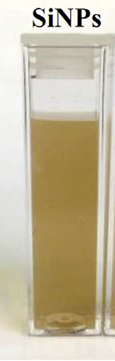
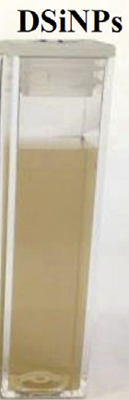
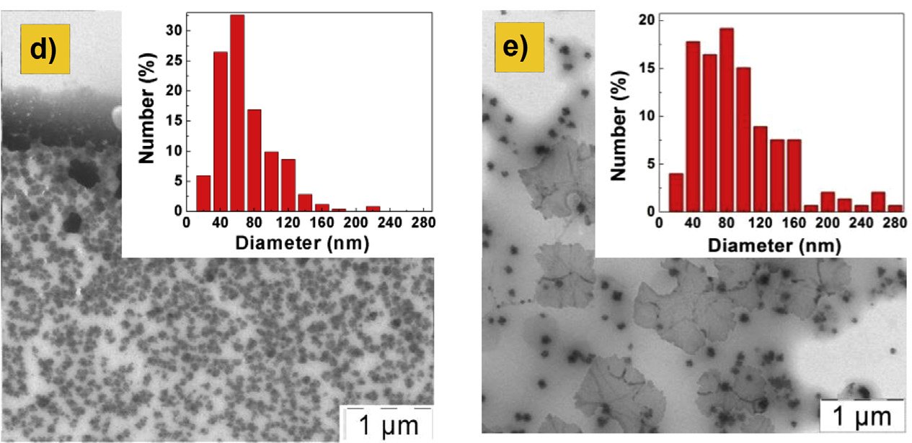
Dextran-coated Si NPs from meso-Psi
SiNPs and DSiNPs aqueous suspensions with concentration of 1 mg/mL
To prevent a rapid degradation of SiNPs after the intravenous injection and to increase their blood half-life, nanoparticles could be coated with a polysaccharide (dextran) .
DSi NPs were prepared according to the same procedure as PSiNPs followed by coating with dextran.
Notes:
Aqueous suspensions of SiNPs were fabricated by the mechanical grinding of PSi films formed by the electrochemical etching of low boron-doped (specific resistivity of 10 Ω•cm) (100)-oriented c-Si wafers in a solution of HF(50%):C₂H₅OH = 1:1 at a current density of 60 mA/cm² and etching time of 30–60 min. Prior the grinding process, the films were detached from c-Si substrates by applying a short pulse of the etching current with a density of 600 mA/cm². The grinding was performed by hand-milling of the films in an agate pounder to produce a powder of SiNPs and further high-energy milling in de-ionized water for 30 min under the rotation speed of 1000 rpm using a FRITSCH “Pulverisette 7 premium line” ball milling machine. Freshly prepared aqueous suspensions were centrifuged at 2000 rpm for 2 minutes, and then the obtained supernatant was diluted with water down to a concentration of SiNPs in 1 mg/mL. To prepare dextran-coated SiNPs (DSiNPs), a 1 mL aliquot of the aqueous suspension of SiNPs was mixed with a 1 mL aliquot of dextran solution (30000–40000 mol wt, 10% dextran, 0.9% NaCl), after which the mixture was sonicated for 1 h in a 30 kHz ultrasonic bath and settled for 24 h before the experiments.
Figures show photos of the SiNPs (left) and DSiNPs (right) aqueous suspensions with the concentration of 1 mg/mL.
A TEM image of SiNPs fabricated by grinding of the PSi powder in water is presented in Figure at the left-hand. The inset depicts the size distribution of particles plotted on the basis of the TEM image using a free software ImageJ, which shows that the employed grinding procedure allowed us to obtain suspensions of SiNPs with a mean diameter near 60 nm. To prevent a rapid degradation of SiNPs after the intravenous injection and to increase their blood half-life, nanoparticles could be coated with a polysaccharide (dextran) .
A TEM image of DSiNPs is presented in Figure at the right-hand. The inset depicts the particle size distribution plotted on the basis of the TEM image. As one can see, coating the surface of SiNPs with dextran, which is described above, leads to the increase of nanoparticles’ mean size to the value of nearly 80 nm (see for detail L.A.Osminkina et al., Micropor.&Mesopor. Mat. 210, 169-175 (2015)).

Slide 9
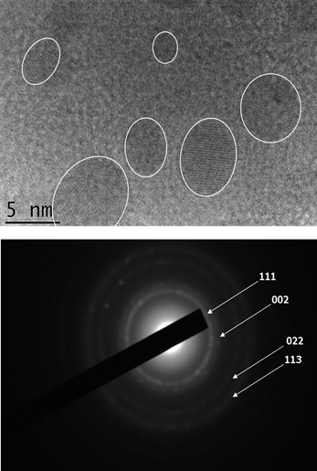
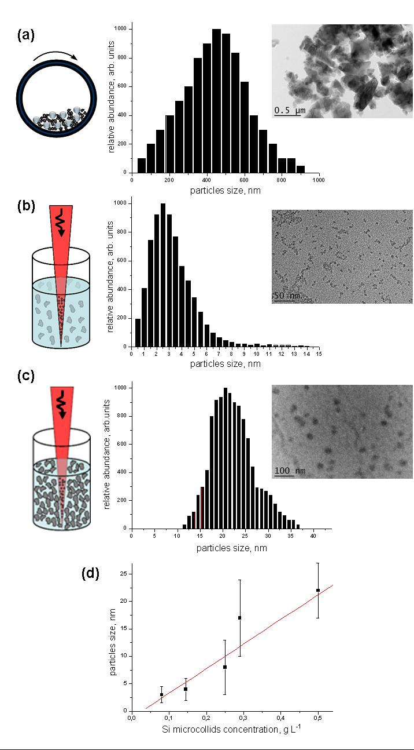
Si NPs Synthesis by FS Laser Ablation/ Fragmentation in Water
Fragmentation Advantages:
Fast synthesis of concentrated solutions
Mean size can be controlled by changing initial concentration of microparticles
PL efficiency can be improved through the optimization of laser fragmentation process
High Resolutin TEM: High crystallinity of SiNPs
Having much superior purity compared to chemically synthesized counterparts and exhibiting photoluminescence response, the nanoparticles present a unique object for biological in vivo applications such as drug vectoring, imaging, and therapeutics!
STEP 1: Milling of a Si wafer (a)
STEP 2: fs fragmentation of microcolloids (b,c)
Linearly dependence of NP mean size on the
initial concentration was increased (d)
J. Mater. Chem. B, 1, 2489 (2013)
Notes:
A laser-assisted method for fast production of concentrated aqueous solutions of ultrapure Si-based colloidal nanoparticles was reported. The method profits from 3D geometry of femtosecond laser ablation water-dispersed microscale colloids, prepared preliminarily by mechanical milling of a Si wafer, in order to avoid strong concentration gradients of ablated material and provide similar conditions of nanocluster growth within a relatively large laser caustics volume. We demonstrate the possibility for fast synthesis of non-aggregated, low size dispersed, crystalline Si-based nanoparticles, whose size and surface oxidation can be controlled by changing the initial microcolloid concentration and the amount of dissolved oxygen in water. Having much superior purity compared to chemically synthesized counterparts and exhibiting photoluminescence response, the nanoparticles present a unique object for biological in vivo applications such as drug vectoring, imaging, and therapeutics.
The whole procedure consists of two steps. The first "mechanical milling" step serves to prepare concentrated solutions of water-dispersed Si microparticles. In the simplest case, it can be done through a hammer-based milling of a Si wafer and a further wet milling of crashed particles in a planetary ball mill. Crystalline Si wafers (p-type boron doped with specific resistivity of about 1−10 Ω*cm) were first crushed by a hummer to obtain powder with a particle size less than 1 mm. To further mill the particles, the dry powder was subjected to high energy wet milling in a Fritsch Pulverisette 7 planetary ball mill with grinding ball diameter of 5 mm. The grinding bowl and balls were made from tungsten carbide. The milling was done for the c-Si powder mixed with de-ionized water to get the initial concentration of c-Si particles of about 10 g L⁻¹. The milling time and rotation speed were 5 minutes and 1000 rpm, respectively. The milled particles are normally size-dispersed between few tens of nm and 1 µm with the mean size around 500 nm, as shown in Fig. 1a. The formed suspension was diluted in 18 MΩ de-ionized water to different concentrations from 0.08 to 1 g L⁻¹. The final microparticle solution was dark grey. Top layer of about 10 mL of the suspension was taken and used as the initial suspension for the laser-assisted treatment.
The second "laser treatment" step employs approaches of fs laser fragmentation,^{35–37} which were previously applied for re-shaping of already formed gold colloids. In our experiments, 10 mL of the newly prepared microparticle solutions with the concentration ranging from 0.08 to 1 g L⁻¹ were transferred into a glass cuvette and subjected to laser irradiation by an Yb:KGW femtosecond laser (Amplitude Systems, 1025 nm, 480 fs, 1 kHz). The laser beam with initial diameter of 2.3 mm was focused by a 75-mm lens in the center of the cuvette, while the solution was stirred by a magnet to homogenize the ablation process. The duration of the laser fragmentation step was selected to provide a stabilized "quasi-equilibrium" size distribution of nanoparticles after the fragmentation of all micro-colloids, as was determined from Transmission Electron Microscopy (TEM) images. The duration of this step dependened on the concentration of the initial solution and varied from 45 minutes for 0.08 g L⁻¹ to 5 hours for 1 g L⁻¹ solutions. The experiments were carried out both in ambient conditions when water was saturated with air under atmospheric pressure and after bubbling of the solutions by nitrogen gas in order to deoxygenate them. We used relatively low laser fluences (1 J cm⁻²) to avoid the phenomenon of laser-assisted plasma breakdown of the liquid, but the radiation intensity was high enough to ablate the suspended particles.
The laser treatment process in oxygen-saturated water led to a visible change of the solution color from deep grey to completely transparent. At relatively high initial concentration of microparticles, the solution became slightly yellow − brownish. Meanwhile, when water was deoxygenated by nitrogen pumping (before and during the experiment), the solution remained grey even after a prolonged laser fragmentation procedure. The laser-treated samples were very stable without any trace of precipitated particles on the bottom of the vial. As shown in Fig. 1b, the laser ablation process led to a complete fragmentation of suspended microparticles and the formation of small nanoparticles. The mean size of produced nanoparticles was proportional to the initial concentration of the microcolloids. As shown in Fig. 1(b, c), the use of relatively low concentrations (0.08−0.1 g L⁻¹) led to small (2−3 nm) and low size dispersed (the dispersion was lower than 2.5 nm full width at half maximum (FWHM)) nanoparticles, whereas the 6-times increase of particles concentration resulted in the nanoparticles with the mean size of 20−25 nm and the size dispersion less than 10 nm FWHM. As shown in Fig. 1d, for the range of used microcolloid concentrations, the nanoparticle mean size increased linearly as the initial concentration was increased. Additionally, we estimated the stability of nanoparticle characteristics during their post-fabrication aging in deionized water. 2-month aging in sealed glass vial did not reveal any sign of precipitation of nanoparticles on the vial bottom, whereas TEM analysis evidenced the stability of size characteristics and the absence of agglomeration effects.
High-resolution TEM (HRTEM) studies revealed a high crystallinity of Si-based nanoparticles prepared by laser fragmentation. As shown in Fig. 2a, crystalline planes could be easily seen on HRTEM images. Diffraction mode images confirmed the polycrystalline cubic structure of Si nanoparticles.
X-ray Photoelectron Spectroscopy (XPS) revealed a strong influence of the content of water-dissolved molecular oxygen on the composition of laser-synthesized nanoparticles. The deconvolution by Gaussian contours of Si 2p XPS spectra solutions before and after laser fragmentation in deoxygenated water (Fig. 3a) demonstrated the presence of three bands, including a low intensity band with a maximum at ~99.0 eV, a much more intense band at approximately 101.0 eV, and another intense band at ~103.0 eV. These bands may be assigned to crystalline non-oxidized silicon Si⁰ (crystalline Si matrix), silicon mono-oxide Si²⁺ (SiO), and completely oxidized silicon Si⁴⁺ (SiO₂), respectively.
Finally, Si nanoparticles produced by the laser fragmentation in air-saturated water (red circles) exhibited remarkable photoluminescence (PL) signals with two main peaks at about 450 and 900 nm, although the PL intensity was rather weak compared to cases of electrochemically prepared porous silicon⁵ or nanostructured layers formed by laser ablation of Si in gaseous environment. On the other hand, nanoparticles prepared by laser fragmentation in deoxygenated water exhibited much weaker PL signals that is probably explained by an insufficient passivation of nonradiative surface states of the formed nanoparticles by silicon dioxide. This supposition is confirmed by a much weaker peak Si⁴⁺ peak in Si 2p XPS spectrum compared to the case of laser fragmentation in air-saturated water. We expect that PL efficiency can be further improved through the optimization of laser-ablative fragmentation process and additional chemical processing of formed nanoparticles (see for detail P.Blandin et al., J. Mat Chem B 1(19), 2489-2495 (2013)).

Slide 10
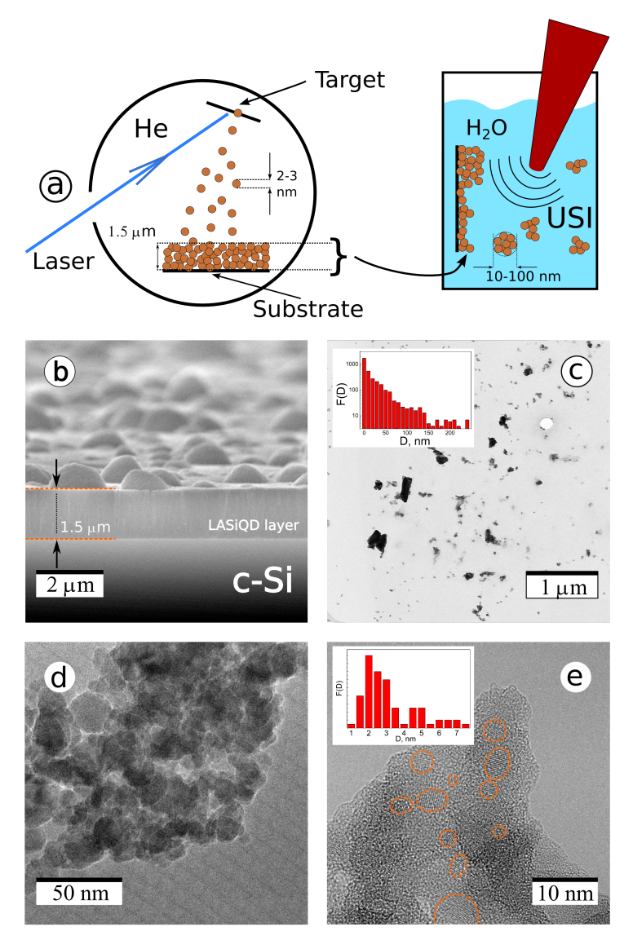
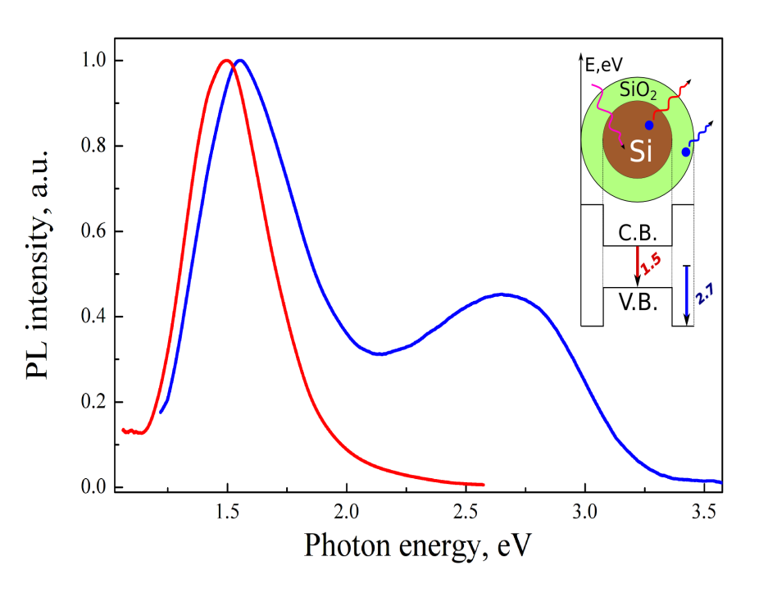
Si NPs Synthesis by Ns Laser Ablation of Si in gaseous He: Oxide-passivated bright Si quantum dots (QDs) for bioimaging
Fluorescence properties
Generation of a strong (quantum yield 3-5%) exciton-related band around 1.5-1.6 eV (780-820 nm)
Fluorescence emission remains efficient even after water-dispersion of nanocrystals
Ultrapure laser-synthesized Si QDs (water-dispersible) exhibit bright exciton PL in the window of relative tissue transparency near 800 nm
Laser-ablated films can be water-dispersed by ultrasound
Nature Scientific Reports (2015)
Notes:
Ultrapure laser-synthesized Si-based quantum dots (QDs), which are water-dispersible and exhibit bright exciton PL in the window of relative tissue transparency near 800 nm, were prepared by nanosecond laser ablation of crystalline Si targets in gaseous helium, followed by ultrasound-assisted dispersion of the deposited films in physiological saline. The proposed method avoids any toxic by-products during the synthesis. Efficient contrast of the Si QDs in living cells by following the exciton PL was demonstrated. Te prepared QDs do not provoke any cytoxicity effects while penetrating into the cells and efficiently accumulating near the cell membrane and in the cytoplasm. Combined with the possibility of enabling parallel therapeutic channels, ultrapure laser-synthesized Si nanostructures present unique object for cancer theranostic applications.
The laser-ablative synthesis consists of two steps. As the first step, a technique of pulsed laser ablation of a solid c-Si target in gaseous ambience to deposit a thin nanostructured Si-based film on a substrate was used. Briefly, a c-Si wafer is irradiated by UV radiation of a KrF excimer laser in residual He gas. The laser irradiation leads to ablation of material in the form of atoms and smallest nanoclusters, which move perpendicularly to the target surface, as shown schematically in Figure. He gas under the pressure of 1-5 Torr is used to finely control the growth and crystallization of nanoclusters: collisions of the nanoclusters with He atoms lead to their cooling, condensation and crystallization in the vapor phase. The nanocrystals are then deposited on optically polished substrates of c-Si wafers, which are placed 2-3 cm from the target, to form a nanostructured film with the thickness of 1-5 µm. As shown in Figure, such films are highly porous with the estimated porosity of 65-75%. The films also contain hemispherical µm-size droplets due to the ejection of large target fragments, but these droplets do not affect the integrity and optical quality of the films. As the second stage, an ultrasound-assisted breakage (sonification) of the laser-deposited films in deionized water or physiological saline was used. The nanostructured porous films were detached from the substrate as a result of this sonification and dispersed in the solution forming a colloidal Si nanocrystal-based suspension.
Fine structure of typical LA-Si NPs can be seen in high resolution TEM image (e). It is visible that these LA-Si NPs are composed of randomly distributed crystalline grains (denoted by orange circles) incorporated into the porous matrix. Such a matrix is mostly composed of amorphous SiO_{x}.
According to NPs size distribution shown in the inset of Fig. 1e, the mean crystal size is 2.5 ±0.5 nm, while QDs with sizes of 5-8 nm are also present. It should be noted that such small nanocrystal sizes are consistent with the manifestation of the quantum confinement effect in semiconductor nanostructure.
The laser-ablated films exhibit strong PL signals just after their exposition to ambient air. As shown in Fig. 2a, the recorded PL band is spectrally centered at 1.5 eV (810 nm). While the band position is commonly explained by the quantum confinement of charge carriers in Si QDs, the PL origin can be attributed to the radiative recombination of excitons either in the whole volume of QDs^{13,39} or on Si-O bonds at the SiO₂/Si interface⁴⁰. Note, that the band position (1.5 eV) perfectly corresponds to the average nanocrystal size 2.5 ±0.5 nm, what is in accordance with results observed for the excitonic PL of Si QDs in SiO₂ matrix. It is important that the exciton PL band does not disappear after the sonification of the LA-Si films and their subsequent dispersion in pure water or physiological saline (Fig. 2a). The storage of NPs in aqueous media leads to a slight blue-shift of the exciton PL band to 1.6 eV, which is probably explained by a partial oxidation of LA-Si NPs, and consequently, to a decrease of the size of pure Si core. The storage of LA-Si NPs in aqueous environment also leads to the appearance of the second PL band located at 2.7 eV, which is usually attributed to the electronic states of point defects in the SiO_{x} phase. The most relevant candidates for the origin of blue band are neutral oxygen vacancy (≡Si-Si≡), which are molecular-like centers in silicon-rich or oxygen-deficient silicon oxides. It is also important that the observed PL bands have quite different time decay dependences. Whereas the time decay of the defect-related band is very fast (tens of nanosecond for the 10-fold decrease of the PL intensity), the relevant parameter for the exciton band is much slower (tens of µs), which is in agreement with previous studies of the exciton emission in porous silicon and nanostructured Si-based films. The external QY of the spectrally integrated PL was found to be about 5% and 3% for the films and aqueous suspensions of LA-Si NPs, respectively. It should be noted that such QY values are orders of magnitude higher than in the case of Si NPs prepared by laser ablation in deionized water
To assess the potential of the prepared LA-Si NPs for biological imaging tasks, we carried out a series of tests on the incubation of nanoparticles in a cellular model. Fig. 3 shows confocal fluorescent microscopy images of cancer cells with added LA-Si NPs under different magnifications. Cell nuclei are colored blue and the cytoplasm is colored green. Fig. 3a shows the cells in different proliferation states, including mitotic cells in the metaphase. The last ones can be distinguished by metaphase plates, which look as blue rods substituting normal nuclei. These data evidence normal cell proliferation in the medium containing LA-Si NPs (red or red-blue spots) that confirms excellent biocompatibility of the prepared Si QDs. Figs. 3b and 3c represent detailed views of cells before and after washing out of the nutrient solution with dispersed LA-Si NPs, correspondingly, and Fig. 3d represents a control group without NPs. It is visible that most LA-Si NPs emit both red and blue PL bands, which are in good agreement with their PL spectra in water (see Fig.2b). In the images of Fig.3 one can distinguish several groups of luminescent NPs: (i) free-floating NPs outside the cells; (ii) NPs stuck on the cell membrane; (iii) NPs penetrated into the cell cytoplasm; (iv) NPs concentrated near the cell nuclei. The observed variety of NPs locations evidences a non-selective mechanism of their penetration into the cells, i.e. endocytosis. Note that LA-Si NPs located near the nucleus membrane are hardly able to penetrate inside the nuclei, because the size of NPs is larger than the pore size of the nucleus membrane.
Thus, the incubation of Si QDs into living cells does not provoke any toxicity effects, while the NPs easily penetrate into the cells and concentrate in different cell regions except the nuclei. The presence of the NPs can be efficiently tracked by the red and blue emission of the PL bands of Si QDs (see for deatal M/B/Gongalsky et al., Sci Rep. 6:24732 (2016)).

Slide 11
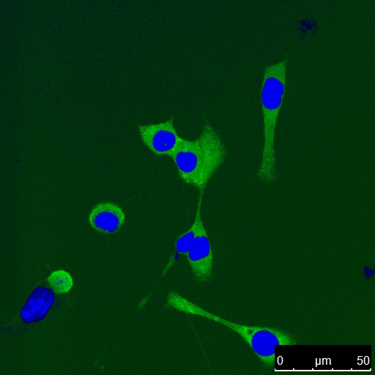
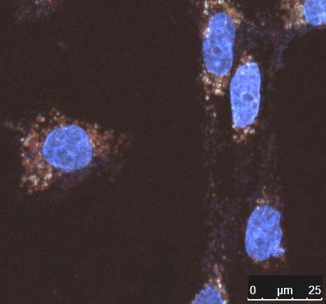
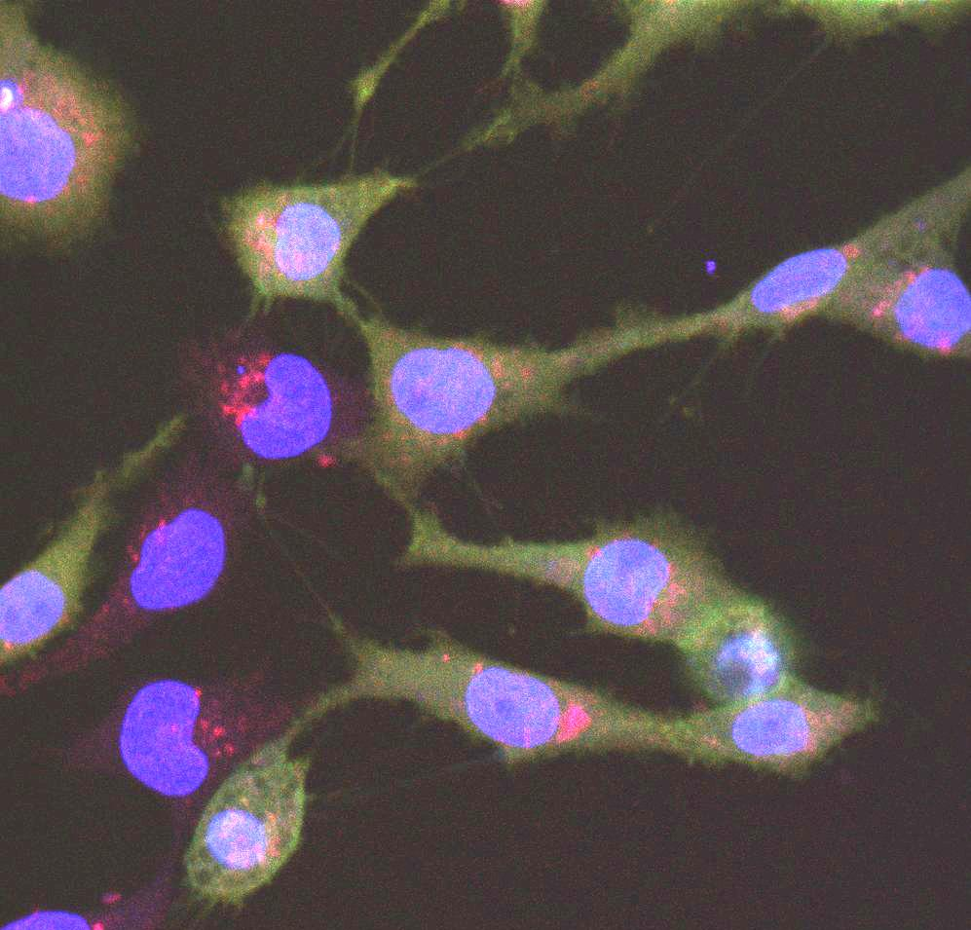
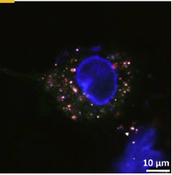
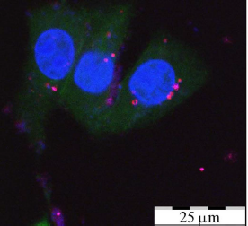
PL Bioimaging with Si nanoparticles
Reference
microporous Si NPs
Si NPs from SiNWs
J.Nanoel.&Optoel..7, 602-606 (2012)
J.Biophot.5 (7), 529-535 (2012)
Photoluminescent images of CF2Th (dog thymus) cells.
Green, blue, and red colors correspond to the PL of cell membrane, cell nuclei, and Si NPs, respectively.
Dextran-coated Si NPs
ablated Si NPs
Penetration depth < 1 mm
Micropor.Mesopor.Mat.(2015)
Sci. Rep., 6:24732 (2016)
Notes:
11

Slide 12
Sensitized Therapy Modalities with Si NPs:
Phototherapy
photodynamic (photochemical)
photothermal (hyperthermia)
Sonodynamic (Ultrasonic)
RF hyperthermia

Slide 13
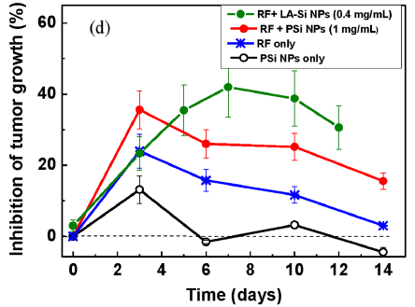
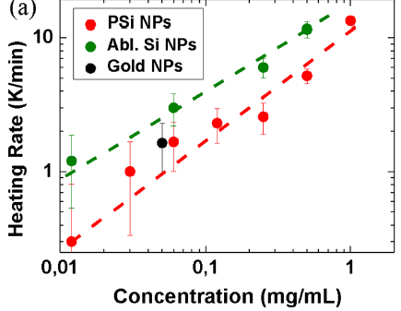

Si NPs sensitized RF-induced hyperthermia:
treatment of Lewis lung carcinoma in vivo
Schematics of the RF radiation-based therapy setup
(i) Just RF therapy procedure shows a partial inhibition of tumor
(ii) Laser-synthesized NPs provide much stronger tumor inhibition effect
Intratumoral injection of Si NPs (0.2-0.5 mL per mice)
RF at 27 MHz, and intensity of 5 W/cm²,
2 min
15 min delay between the Si NPs injection and RF treatment.
The very first successful application of laser-synthesized nanomaterials in vivo
1-dose RF treatment using Si nanoparticles as sensitizers
K. Tamarov et al, Scientific Reports, 4, (2014).
Notes:
RF heating of aqueous suspensions of Si NPs was investigated. The temperature increase relative to the pure water was found to be non-monotonic versus RF frequency. While the RF heating in the frequency range frpm 20 to 150 MHz is well explained by a model of the Joule heat relies in homogeneous electrolyte, the low frequency RF heating below 10 MHz requeires another explanation, e.g. by modeling the electrical currents nearby nanoparticles.

Slide 14
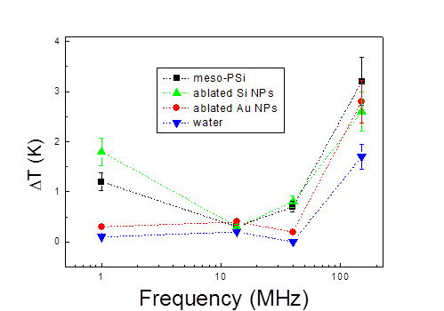
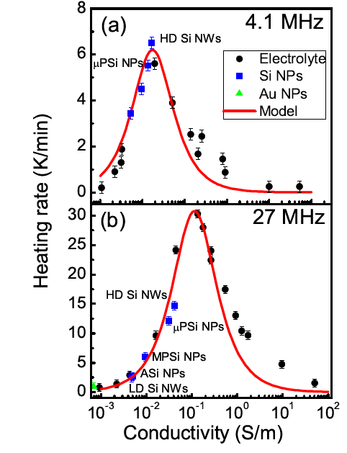
Si NP sensitized RF-heating
(experimental results)
RF heating of aqueous suspensions of Si NPs was investigated.
The temperature increase was found to be non-monotonic versus RF frequency.
RF heating in the frequency range from 20 to 150 MHz is well explained by a model of the Joule heat relies in homogeneous electrolyte
The low frequency RF heating below 10 MHz need another explanation, e.g. by modeling the electrical currents nearby nanoparticles.
Electric field of RF radiation:
Eo=1-10 V/cm, RF power < 10 W/cm2
Notes:
RF heating of aqueous suspensions of Si NPs was investigated. The temperature increase relative to the pure water was found to be non-monotonic versus RF frequency. While the RF heating in the frequency range frpm 20 to 150 MHz is well explained by a model of the Joule heat relies in homogeneous electrolyte, the low frequency RF heating below 10 MHz requeires another explanation, e.g. by modeling the electrical currents nearby nanoparticles.

Slide 15
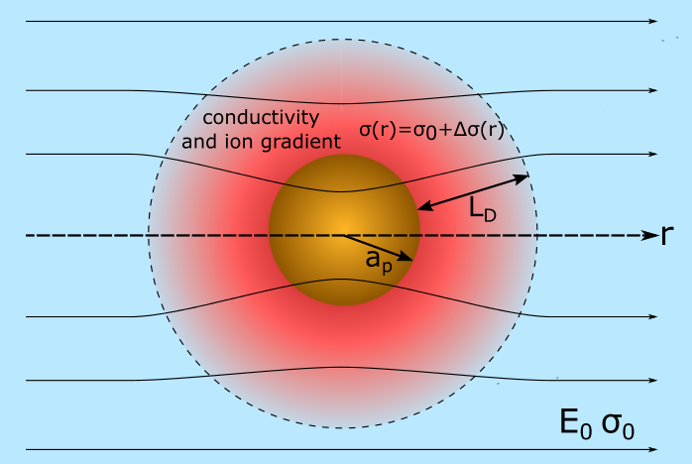
Modeling of RF-Sensitizing Properties of Solid Nanoparticles in Aqueous Medium
Electric field of RF radiation:
Polarization of medium:
Complex dielectric function of electrolyte:
Electrical conductivity of electrolyte:
Inside NP:
Outside NP:
A schematic view of a nanoparticle immersed in the electrolyte.
The nanoparticle has surface zeta potential and changes the local conductivity and dielectric permittivity around itself.
a_{p} is particle radius, λ_{D} is Debye screening length

Slide 16
The dependency of the released heat from conductivity of the electrolyte for various frequencies.
Total Heating:
RF-heating in the NP region:
The heating of the HCl electrolyte without a nanoparticle and
Heat of a Si NP for particle with a_{p} = 50 nm and ζ = -50 mV.
The peak, where maximum heating occurs, moves linearly to higher values of electrolyte conductivities with the increase of the RF radiation frequency.
Notes:
The peak, where maximum heating occurs, moves linearly to higher values of electrolyte conductivities with the increase of the RF radiation frequency. The introduction of a particle in the electrolyte changes the heating profile. The heating at lower values of electrolyte conductivities increases significantly; the peak value is weakly pronounced at lower frequencies and the relationship between the conductivity, where the peak is located, and RF radiation frequency is not linear any more. Au NP influences the heating curves in the similar way as Si NP. The NP material conductivities were set as 4.1·10⁷ and 4.3·10-⁴ Sm/m for Au and Si, respectively.

Slide 17
Conductivity/Frequency Dependences of RF Induced Heating nearby Solid NPs in Electrolyte
Comparison the heating rates of the Au and Si NP of 100 nm size in the electrolyte at 100 MHz for -100 mV zeta potentials.
There are several parameters in the model, which can be varied: RF radiation frequency, particle material conductivity, zeta potential and particle size.
It is interesting to see, how the change of these parameters influences the heat, released in the system.
Notes:
Figure 4 compares the heating rates of the Au and Si NP of 100 nm size in the electrolyte at 100 MHz for various zeta potentials. It can be seen, that at lower electrolyte conductivities, Si NP produces more heat, while after the peak value, more heat is generated in case of Au NP. The difference between Si and Au is higher when the surface potential is closer to zero and decreases at lower zeta potential values. Additionally, with the decrease of zeta potential, the heating increases in the peak value and at low values of the electrolyte conductivity. To estimate the variation between the heating induced by the presence of Au or Si NP, the relative difference was calculated according the equation: (q_{Si} – q_{Au})/q_{Si}. Figure 5 demonstrates that at RF frequencies below 10 MHz and low electrolyte conductivities there is no difference in the heating between Au and Si. Then the relative difference start to decrease at high electrolyte conductivities, however it is not important and happens due to calculation errors since the absolute heating values are very small. The highest contrast is observed at 500 MHz for all zeta potential values.

Slide 18
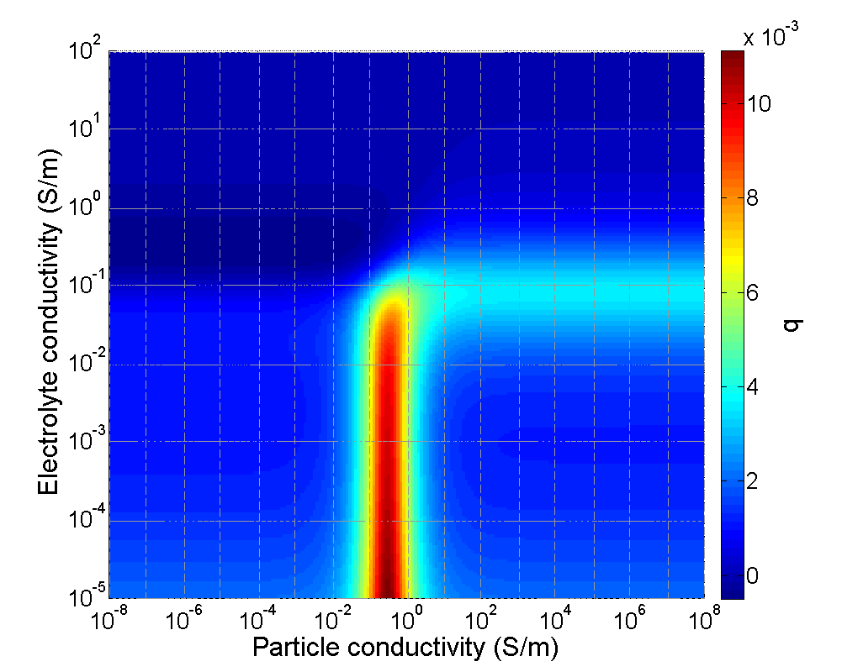
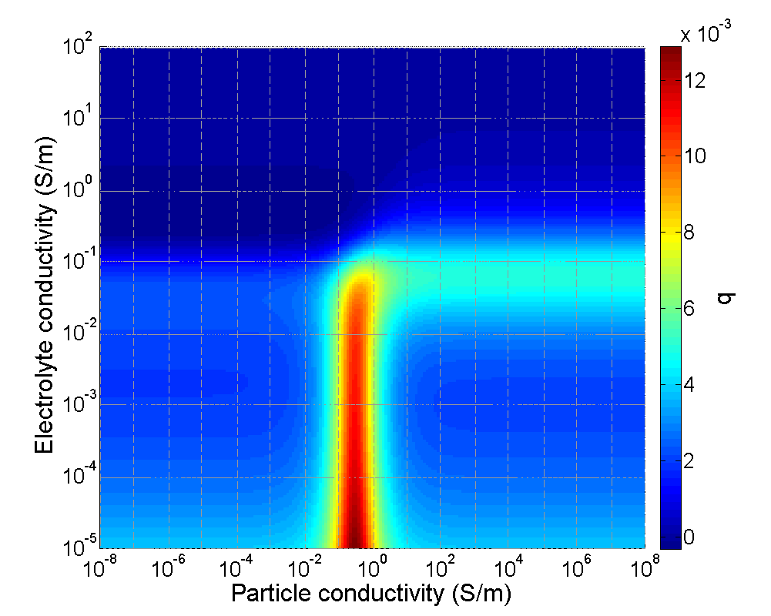
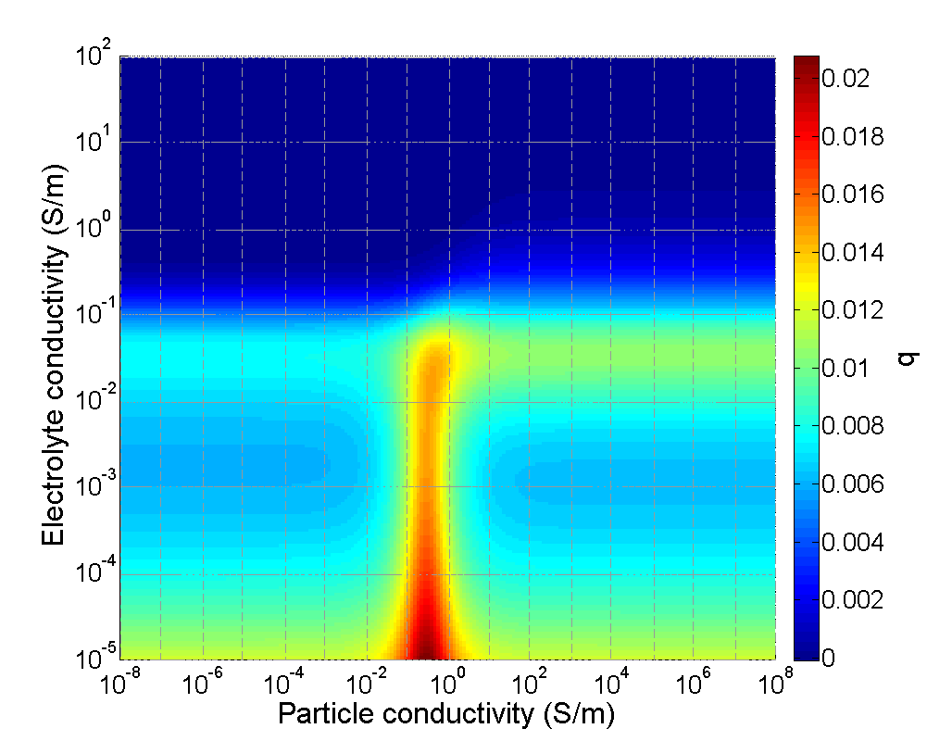
Dependences of produced Heat from NPs and Electrolyte conductivity for different zeta-potential
(b)
20 mV
(a)
0 mV
(c)
50 mV
(d)
(d) shows the dependency of the maximum heating rate from particle conductivity: at small zeta potential values and electrolyte conductivities, the value of particle conductivity, where the maximum heating occur, is around 0.25
The particle radius in 50 nm and the RF radiation frequency is 30 MHz.
Notes:
Figures 6a shows, how the produced heat changes from the particle material and the electrolyte conductivity at various zeta potentials. At small zeta potential values and electrolyte conductivities, the value of particle conductivity, where the maximum heating occurs, is around 0.25 (Figure 6f). When the zeta potential decreases, this peak diminishes along with the peak around σ₀ = 0.1 Sm/m. Further we selected σ_{p} = σ_{Si} and ζ = -20 mV to analyze the heating dependency from frequency and particle size.

Slide 19
Dependences of produced Heat from NPs size
(a) 1 MHz | (b) 100 MHz
The particle conductivity and zeta potential are 4.1·10⁷ Sm/m and -20 mV, respectively
The smaller particle size provides more efficient heating at low frequencies,
while the heating curves of big enough particles possess the peak value.
Notes:
Figure 7 depicts the changes of heating from the particle size at two frequencies. The smaller particle size provides more efficient heating at low frequencies, while the heating curves of big enough particles possess the peak value.

Slide 20
Conclusions
The obtained results indicate that Si NPs can act as sensitizers of the RF induced hyperthermia for biomedical applications - hyperthermia of cancer.
Presence of NPs can significantly affect the RF heating, especially at low electrolyte conductivities.
Optimum particle conductivity for maximum heating is located in range 0.1-1 Sm/m at 30 MHz and -50 mV zeta-potential, while the NP size shows quite insignificant impact on the heating.
Simulations show a strong dependence of the heating rate on electrical conductivity of the electrolyte rather than on that of NPs properties.
Si nanoparticles - example of novel classes of semiconductor nanomaterials, which can offer a better biological compatibility and other functionalities: biodegradable, no biotoxicity, etc
Infrared radiation–induced and ultrasound-induced Si Ns hyperthermia can be applied in parallel to the RF hyperthermia approach!
Notes:
20

Slide 21
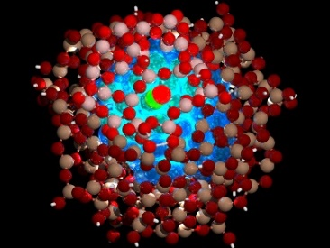

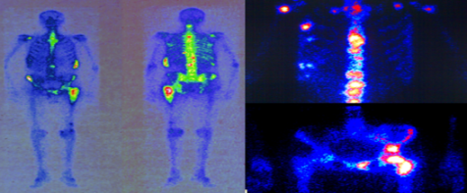
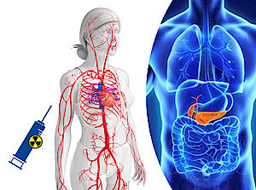
nano-theranostics for nuclear medicine
NANOTECHNOLOGY
+
NUCLEAR MEDICINE
BIODEGRADABLE NANOPARTICLES
RADIONUCLIDES
Vector and transport vehicles for functional radionuclides
(passive or active targeting)
Imaging modality
e.g., F-18, Ga-68 for PET imaging
Therapeutic modality
e.g., Re-188
Ultrasensitive PET technique with improved spatial resolution.
Targeted radiopharmaceutical drug delivery using nanovectors and nanocarriers

Slide 22



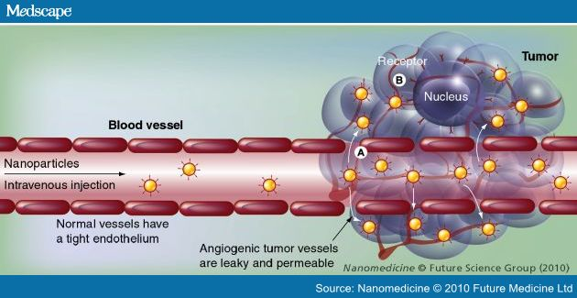
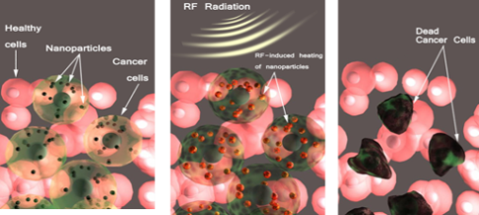
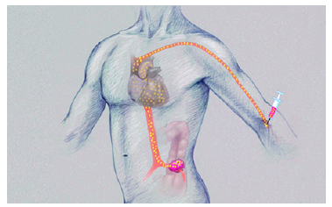
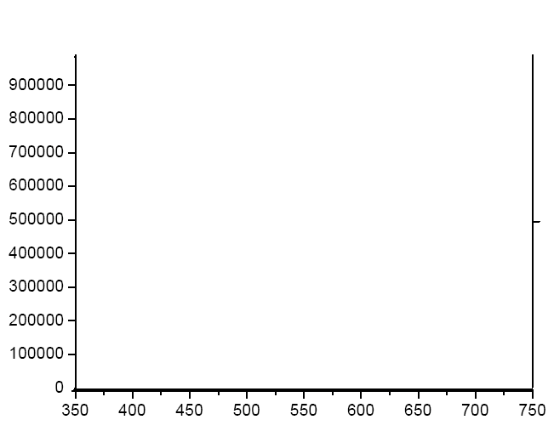
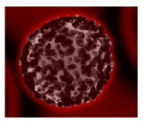

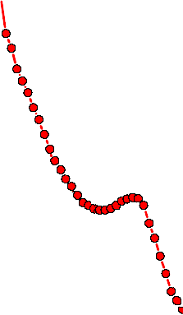
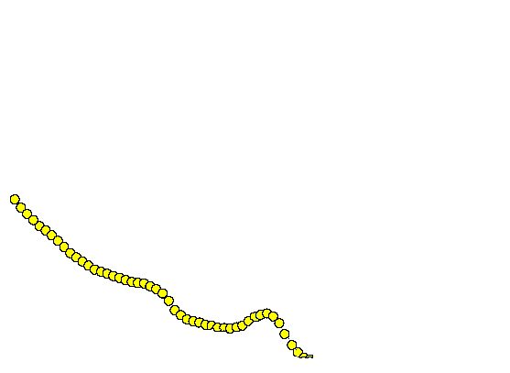



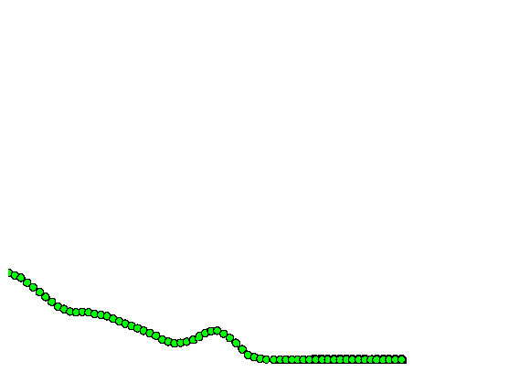
INSTITUTE OF ENGINEERING PHYSICS
FOR BIOMEDICINE (PHYSBIO)
SCIENCE
• The world recognized scientific results in fundamentals of modern technologies of Biomedicine, nano – and bio-Photonics, quantum dots, etc.
• Highly trained specialists-engineers in new devices developing and technologies for Biomedicine
BREAKTHROUGH TECHNOLOGIES
Combination of new methods of nuclear and radiation medicine and new nanomaterials and emerging nanotechnologies in biomedicine
for early detection and targeted treatment of dangerous diseases
EDUCATION
• Integration of engineering physics and medical education
• The availability of basic educational programs required to prepare interdisciplinary specialists in Biomedicine
RESEARCH
Bionanotechnologies: synthesis and functionalization of biocompatible and biodegradable nanomaterials for diagnosis and treatment.
Therapy:
nanoparticles can be used as targeted sensitizers and modifiers of cell sensitivity for various physiotherapeutic treatments
Diagnosis:
in vitro: photoluminescent properties of quantum dots can be used to enhance sensitivity of detecting disease markers in patients’ analyses (e.g. blood tests).
in vivo: being accumulated in a sick organ, nanoparticles can be detected by their unique, optical, magnetic, radioactive properties, thus visualizing the affected area (contrast nanomaterials).
Nanoparticles can serve as nanoprobes to direct highly contrast agents into the affected area.
PhysBio Institute
Center of Translational Medicine

Slide 23

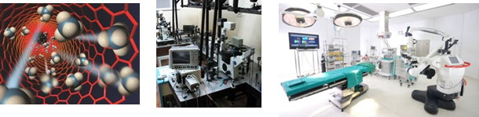


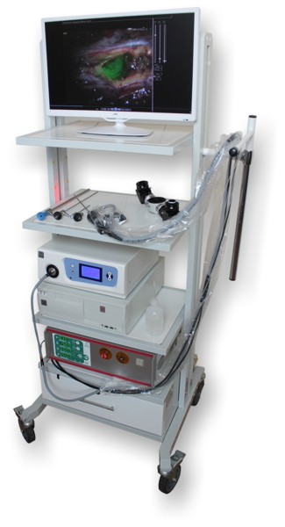

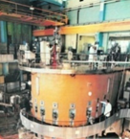
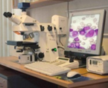


structure
SUBDIVISIONS
Medical Faculty;
Department of Medical Physics;
Department of Computer Medical Systems;
Department of Nuclear Medicine;
Department of Laser Micro- and Nanotechnologies;
Department of Pharmaceutical and Radiopharmaceutical Chemistry;
Department of Radionuclide Medicine
Department of Biology
INTERNATIONAL LABORATORIES
  Nanobioengineering
  Bionanophotonics
  Technology and equipment for theranostics
  Nuclear medicine
  Bioinformatics
TECHNICAL POTENTIAL
Nanoparticle production laser system for biomedicine
Laboratory and clinical equipment for biomedical photonics
High-tech oncological diagnostic systems, a complex of specialized clean room
Research nuclear reactor IRT MEPhI
PERSONNEL

