Slide 1
Area of applied technologies and scientific infrastructure at the accelerator complex NICA
S.Tyutyunnikov
LHEP JINR
12-13 December 2016

Slide 2
Content :
Modern Research Center for Radiation (FEARA, BIMAX, KEK)
The main directions of applied research with beams of relativistic particles in the world
Accelerator complex NICA (JINR). The main parameters of the beams
Creating a basic carbon therapy complex prototype units
Studies at Nuclotron in the field of nuclear relativistic technology
Research of structural changes in condensed matter on heavy ions
Creating a solid nanostructured systems on beams of relativistic nuclei
The scientific infrastructure for radiation effects research

Slide 3
Various Applications of the KEK AIA
Warm Dense Matter Science
Nanostructure Fabrication (Ion Track, Nanowire)
Ion-tuning to Make Intelligent Material & Surface Improvement
Hybrid Cancer Therapy with H, C and Fe
Mutation Breeding
Micro-beam for Biological Science
SEU Experiments for Microprocessor, Semiconductor & Power Transistor

Slide 4
High-Energy Irradiation Facility for High-Energy Irradiation Facility for
Biophysics and Material Research -
BIOMAT
Researrch program: Space radiation efffects
  heavy ion induced modifications of soliids under extremely high pressure
  analysis of material modifications induced by relativisttic heavy ions
  Radiation hardness of materials
Equipments:
- Magnetic scanner system
- Flexible irradiation set-ups
- Instrrumentation for in-situ diagnosttics off irradiated samples

Slide 5
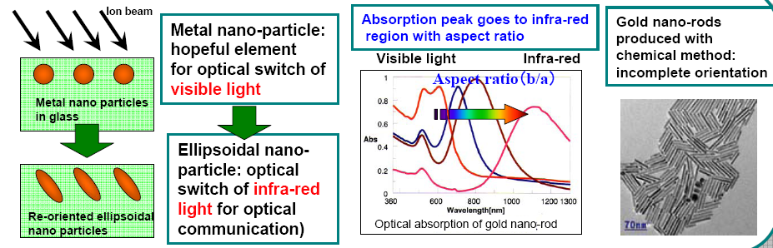
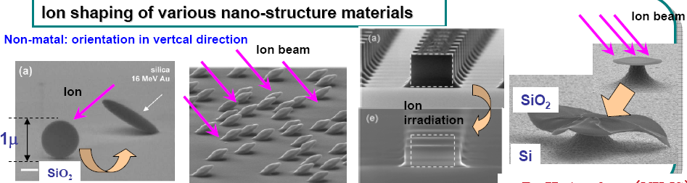
Intelligent Material Creation by Heavy Ions with GeV Energy (2)
1. Reorientation of nano-material by ion, ion shaping and nano-rod formation
2. Ion shaping of various nano-structure materials

Slide 6
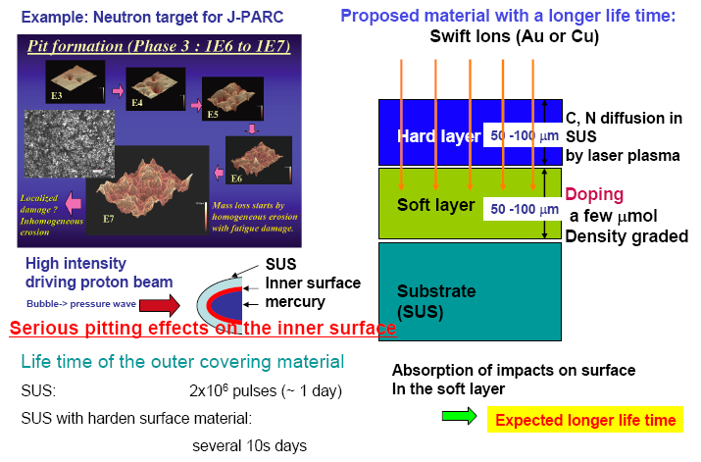
Multilayer Formation by Ion Doping

Slide 7

Output for innovative projects
R&D programmes
(the creation of new systems)
Technology development
(accelerator, detector)
Nuclotron-М
NICA/MPD
Facilities
(unique beams)
New knowledge
New technologies should be
competitive
determined the conditions for access to the JINR Member States and industrial partners

Slide 8
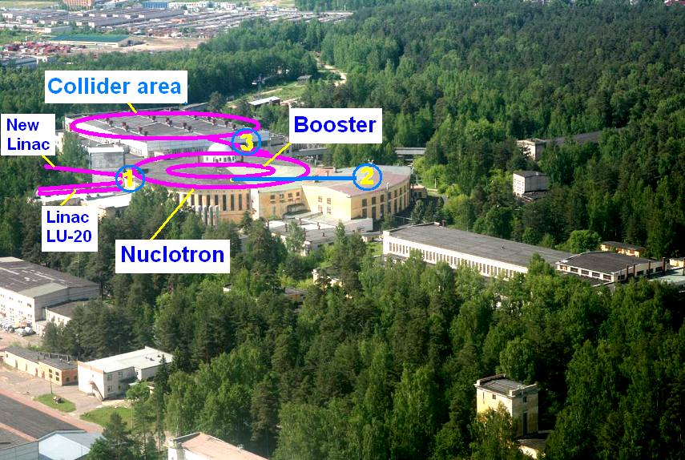

Slide 9
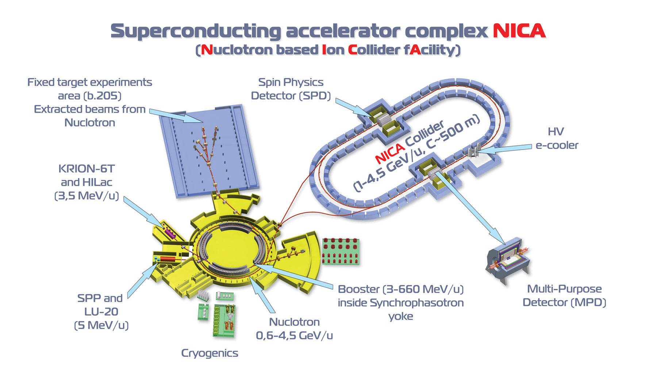

Slide 10
NICA scheme
area-1
beams of low-energy
Injector: 2×10⁹ ions/pulse of ²³⁸U³⁰⁺ at energy 5 MeV/u
Booster (30 Tm)
5 single-turn injections,
storage of 8×10⁹
at electron cooling bunching & acceleration
up to 590 MeV/u
Collider (37 ⇒ 45 Tm)
Storage of
20 bunches × 2.5⋅10⁹ ions per ring
at 3.5 GeV/u max.,
electron and/or stochastic cooling
Stripping (eff. 40%) ²³⁸U^{32+ ⇒ 238}U⁹²⁺
area-2
medium-energy beams
Nuclotron (45) Tm)
injection of one bunch
of 3×10⁹ ions,
acceleration up to
3.5 GeV/u max.
IP-1
Two collider rings
IP-2
2x20 injection cycles
area-3
beams of high-energy

Slide 11
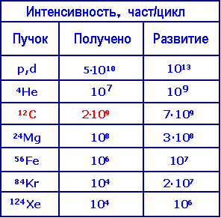
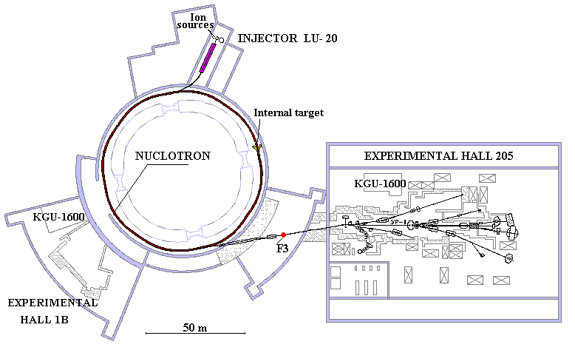
The existing accelerator complex VBLHEP
Intensity nucl/cycl
beam
recd
future

Slide 12
Using beams of the NICA

Slide 13
Development of the prototype units Complex of Carbon Radiotherapy

Slide 14
The main directions of scientific-methodical and innovative work on the beams of relativistic nuclei
Radiocarbon Therapy: A prototype of the complex for radiocarbon therapy
Creation of complex equipment for radiobiological studies to simulating galactic radiation
Radiation Materials science :
  Radiation damage of micro electronics
  Technology for creating electronic structures in the tracks of relativistic ions

Slide 15
Block diagram of the experimental setup of the prototype on a carbon nuclei beam of the Nuclotron-M
The results obtained by measuring the stability, intensity and size of the ion beam from the Nuclotron and fully comply with the requirements of radiocarbon therapy.
Currently, the main components of the prototype experimental setup for ion beam Nuclotron-M are developing.

Slide 16
Basic block diagram of a prototype installation on Nuclotron for radiobiological research
Wire chambers with feelings. reg. 200x200mm
Pads camera senses. reg. 200x200mm
Tumor
The last layer E_{min}
The first layer E_{max}

Slide 17
Beam of a prototype installation
Absorbers
Collimators
Phantom for calibration of the Bragg peak depth
Wire Camera
Video chamber, fixed on a movable table in front of the patient
Moving table with the patient

Slide 18
A set of detectors and electronics for complex of Carbon therapy is shown below.

Slide 19
Developed by two subtypes chambers with 90 (for beam division) and 96 (for the medical channel) signal wires.
It made a number of cameras. The appearance of both types of cameras with a beam at F-3 is shown in the photo below. As shown below, the camera allows you to have gas increased to 10⁴. Each channel readout electronics MIT32 has a conversion factor of 10 v / μA. Thus the range of the maximum measured currents for each channel, with the gas gain, from 40 pA to 0.4 μA, when the signal / noise ratio of ~ 1000.

Slide 20
It is assumed constant scanning beam, providing maximum illumination area 190x190 mm. Interrupting the beam and including it in the right time, we can get a flare within the planned path. Wire cameras should provide control of the beam position in the need for times and pads camera - exposure dose distribution in the plane perpendicular to the beam.
Some of the general requirements for health
beam:
Controlled intensity and scanning
The relatively rapid changes in the properties of the beam
A wide range of changes in the intensity of the beam
Sample ions: p, He, C, O.
The penetration depth in water 20 - 300 mm.
The ion energy of 50 - 430 MeV / nucleon
Time extracted 1 -10 seconds.
The beam diameter 4 - 10 mm
The intensity of the beam 10 ** 6 - 10 ** 10 ions / reset
The time between discharges - about 1
The maximum scan speed of 100 mm / msec.
Rapid on-off beam - less than 1 ms
The radiation of the tumor layer by layer within the highlighted area in each of them

Slide 21
Within the framework of the implementation of the above concept in 2011 created a system of wire chamber pads cameras and electronics to read them. Elements of the system and its layout shown in the figure below. Only the main unit.

Slide 22
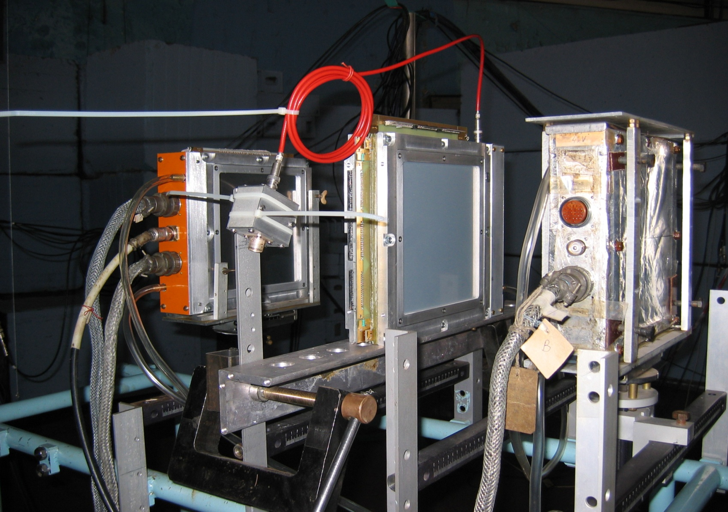
Two types of cameras on the Nuclotron beam
90
signal wires
96
signal wires

Slide 23
Examples of the radiation dose distribution in the plane of the pad camera on the results of the beam reset at different stages of the session

Slide 25
Comparison of beam monitoring
Progress irradiation // Quinta 1 GeV and 4 GeV

Slide 26
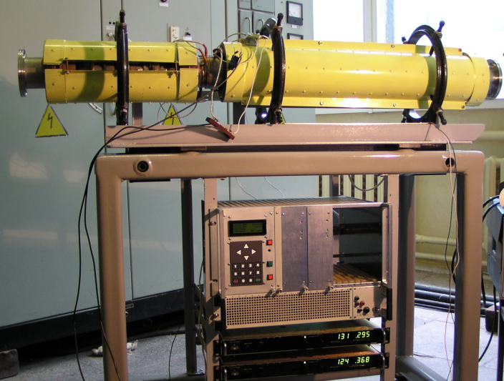
The main parameters
Ion
Carbon range in substance
Irradiation area
Interval of dozes
Time of an irradiation
Carbon
20....300mm H₂O
200х200mm²
Healthy substance: 0.5...2.0 Gye
Irradiation volume: 0.75...4.0 Gye
< 5min/step
Example of LPP beam scanning system
for ions in the range (5-10) MeV/nucl
Requirements to the magnetic scanning system
Horizontal
Vertical
Angle of a deviation
The minimal radius
Irradiation area
Speed of the scanning
Magnetic field
Max current
Rise/fall current pulse time
1.45°
21.0 m
20.0 cm
2.0 cm/msec
0.38 Т
409.5 А
10.0 msec
3.30°
21.0 m
20.0 cm
1.0 cm/msec
0.38 Т
401.6 А
39.0 msec
Parameters of the ion accelerator
Beam scanning system
Range of energies
Step on energy
Time of a cycle
Accuracy on energy
Time of a output
Range of intensity
The size of a beam (FWHM)
Stability of beam (FWHM)
85...430 MeV/nucl.
255 steps
5 s
0,5%
2 s
1х10⁶...1х10⁸ particle/pulse
4…10 mm
<20%

Slide 27
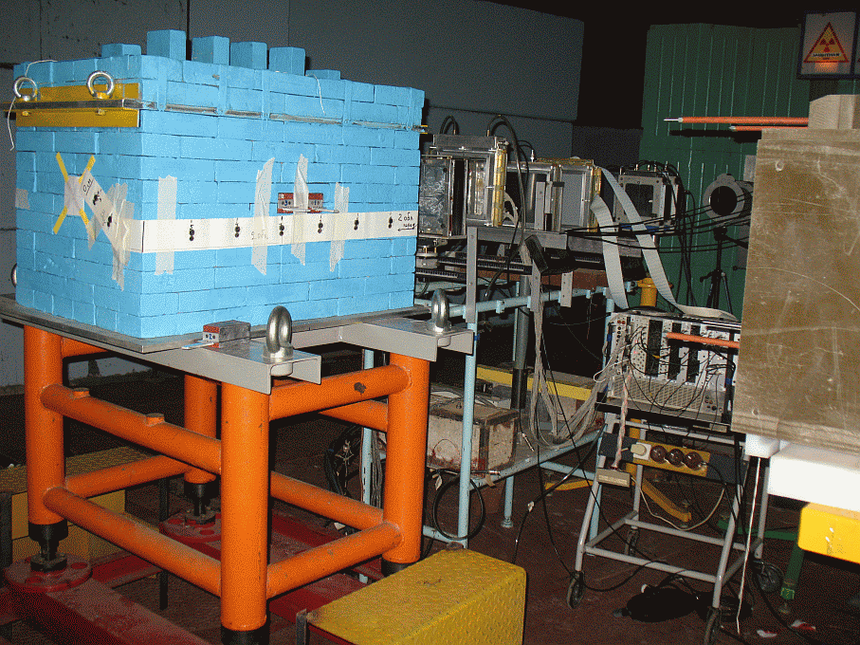
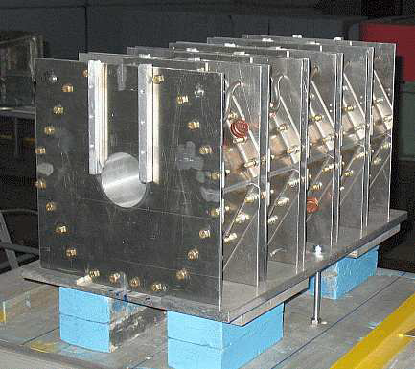
QUINTA assembly in the lead shield
The Quinta is surrounded by lead bricks 100 mm thick on all six sides of total weight 1780 kg. Shield work as a neutron reflector and as a biological shielding for γ-rays. In the front is a square window 150x150 mm.
The setup "Quinta" on the irradiation position (December 2011 - March 2013)

Slide 28
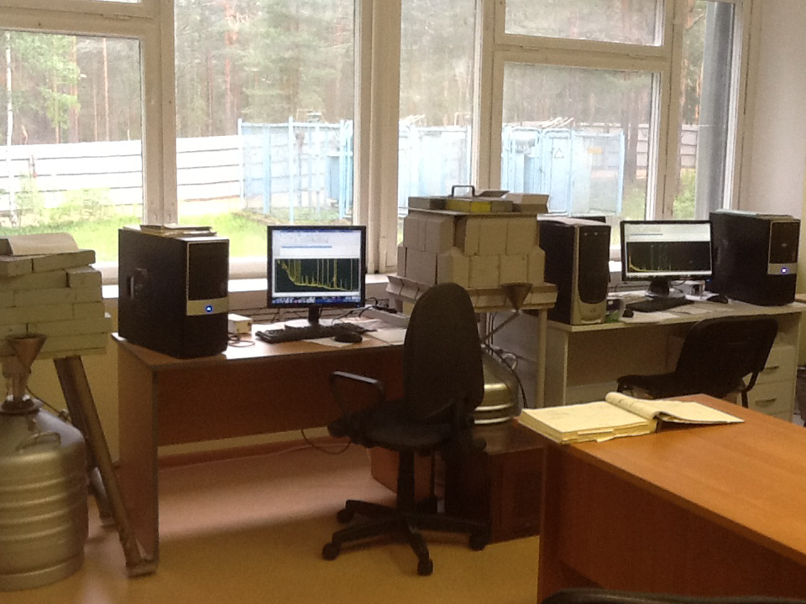
Spectral and analytical complex of LHEP for measuring the induced activity

Slide 29
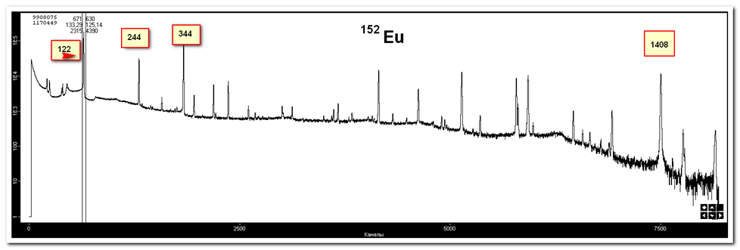
The spectrum of activity of the ¹⁵²Eu isotope, measured by GeHP detector

Slide 30
Data from gamma spectrometer, analysis and correction.
Sample 2 as an example of experimental data.
Spectra analysis with Czech program DEIMOS. Peak areas as a result.
Correction for time, irradiation time, weight and so on by calibration formula

Slide 31
Average neutron flux densities per deuteron for the three energy deuteron beams in QUINTA experiments.
For radial distance R=8cm
The curves of the neutron flux density per deuteron and its energy (for R=8cm) overlap in the energy ranges 20.8-32.7 MeV and nearly overlap in the other energy range. It is expected that for the deuteron beam energies higher than 0.5 GeV the average neutron flux densities per deuteron and per one GeV beam energy, should be equal.

Slide 32
Radiation hardness of silicon detectors
A. The detector leakage current increases linearly with hadrons fluence:
ΔΙ=α_{I}⋅I ⋅ Φ ⋅ V
Φ − fluence, V − the detector bulk,
α_{I} =(5±1) · 10 ⁻¹⁷ А⋅см⁻¹
for fast neutrons at T = +20⁰C (no self-annealing)
Possible solution:
  • work at low temperature - (30-50)°C, detector leakage current doubles it’s value every 8 degrees;
  •Detectors module design required very good thermo contact between Si-sensor and cooling plate for the excluding of the heating and thermo break down ^{/3/}

Slide 33
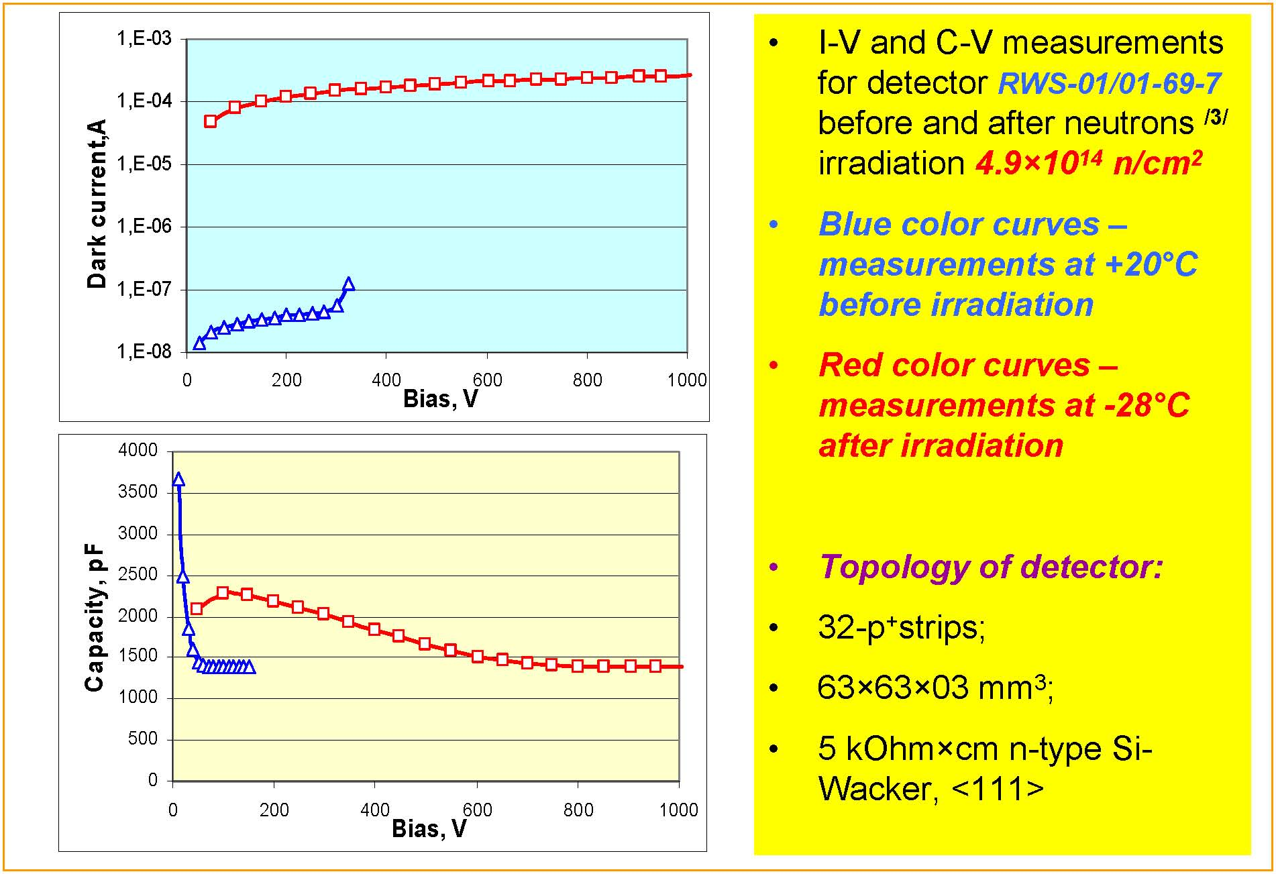

Slide 34
Neutron fluxes (in the 1 deuteron) on the "Quinta" surface in various Ed
The front surface of the "Quinta"
The back surface of the "Quinta"
The side surface of the "Quinta"

Slide 35
Device structures tracks of heavy ions, filled with nanoparticles

Slide 36
Electrodeposition of nanoparticles
The method provides high selectivity (locality) deposition.
Using low (room) temperature in the electrochemical deposition of multilayer semiconductor structures can reduce the likelihood of mutual diffusion of various components of a semiconductor heterojunction.
The method suggests a combination of electrochemical and chemical steps.
Electrochemical method provides a complex chemical composition of substances - solid solutions chalcogenides, alloys of several metals (not only the equilibrium, but also the composition of the non-equilibrium), complex oxides, the metal chalcogenide systems and others.
A new direction in the field of nanotechnology is dedicated to the creation of nanostructures within a track, which is created by the heavy ion in the silicon wafer, and can be implemented in the composite structure - ferromagnetic, paramagnetic.

Slide 37
The degree of filling with Ni nanoparticles pores is controlled by the deposition time
On the basis of silicon created a structure with magnetic Ni nanoclusters.

Slide 38
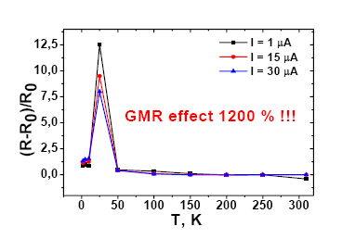
Giant magnetic resistance n-Si / SiO₂ / Ni nanostructures
Fedotov A., Ivanou D., Ivanova Yu., Mazanik A., Svito I., Streltsov E.,
¹ Belarusian State University, Independence av. 4, 220030 Minsk, Belarus
Tyutyunnikov S.
² Joint Institute for Nuclear Research, Dubna, Russia
R – resistance at field 8 T
R₀ – resistance at B = 0
For the first time in these composite structures are obtained the material properties with a giant magnetic resistance (a prototype spintronic structure).
The dependence of giant magnetic resistance on temperature

Slide 39
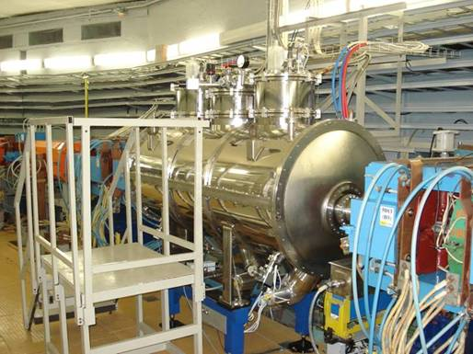
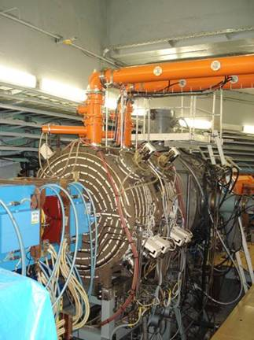
Kurchatov synchrotron radiation source

Slide 40
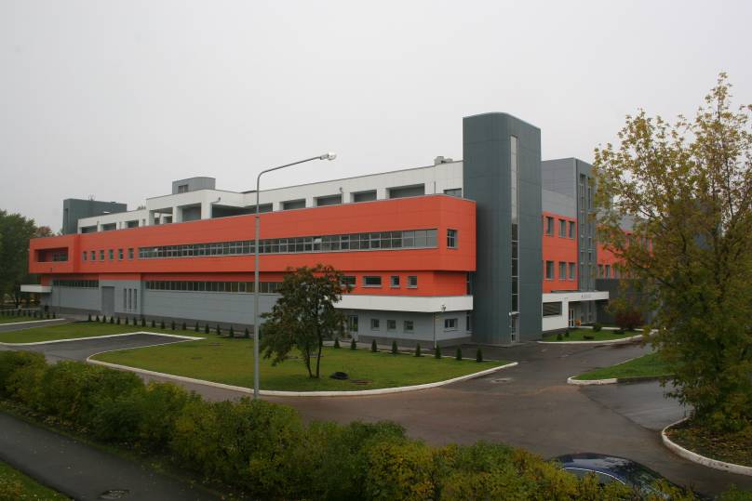
Kurchatov Center for Synchrotron Radiation

Slide 41
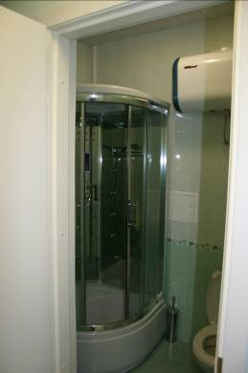
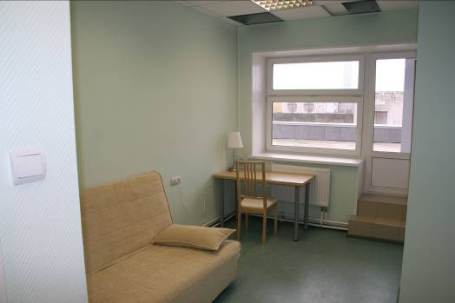
Infrastructure to accommodate users

Slide 42
The main directions of structure investigations by using EXAFS - spectroscopy

Slide 43
Experimental (—) and fitted (o) Fourier transforms of the Co K-edge EXAFS
χ(k)k³ signals for the unirradiated La_{0.7}Sr_{0.3}CoO₃ and La_{0.5}Sr_{0.5}CoO₃ powders and ten-pulse (10 k) electron-irradiated La_{0.7}Sr_{0.3}CoO₃ sample

Slide 44
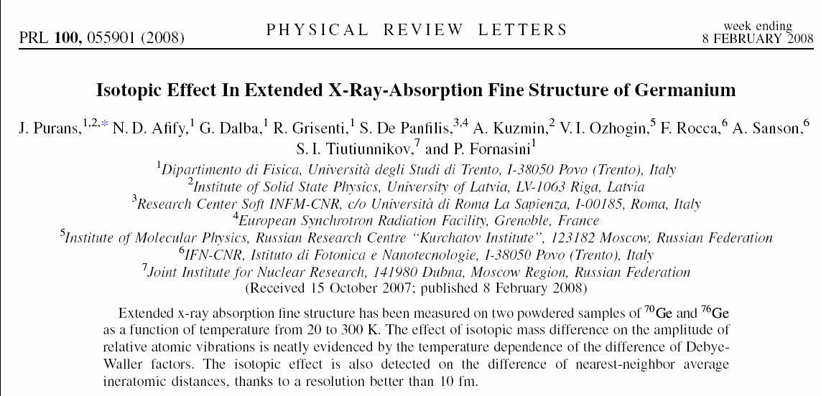
EXAFS with Femtometer Accuracy
2004-2008 => 5-10 fm(10-4 A)

Slide 45
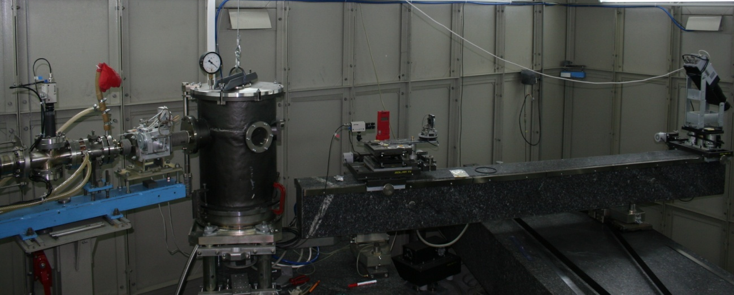
The basic units of the station "Energy dispersive EXAFS spectrometer"
General view of the spectrometer inside the hutch.
Notes:
45
45

Slide 46
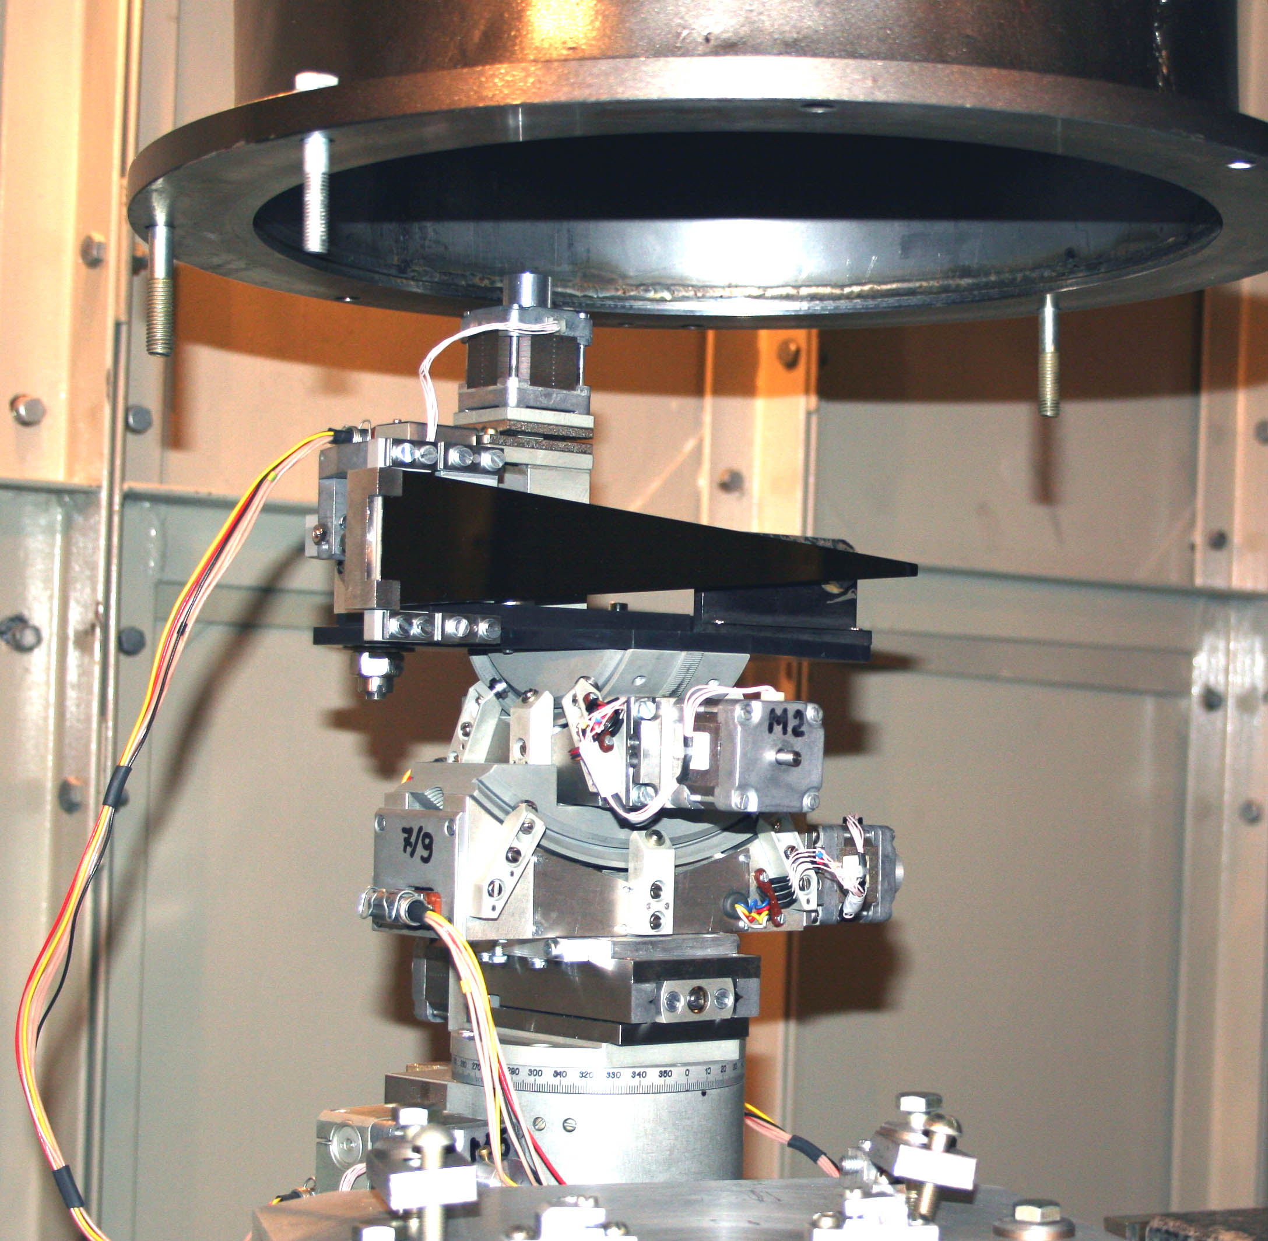
The triangular crystal monochromator on a goniometer

Slide 47
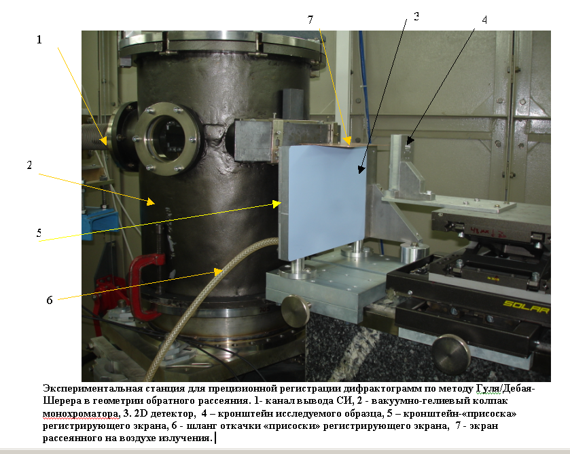
Diffraction in the opposite hemisphere based on equipment of EXAFS – D spectrometer

Slide 48
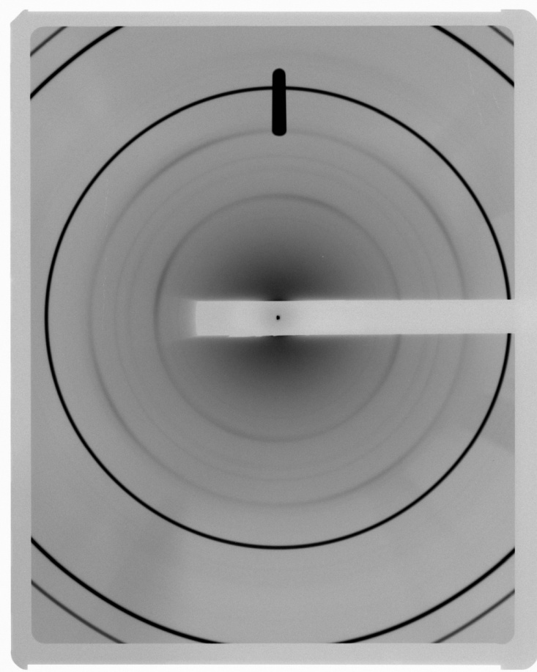
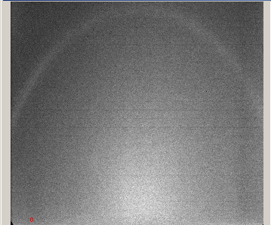
Debye-Scherrer diffraction in the forward hemisphere. Corundum. (Reference Model)
Experiment.
Debye-Scherrer diffraction in the backward hemisphere. Steel body of Balakovo NPP. Experiment.

Slide 49
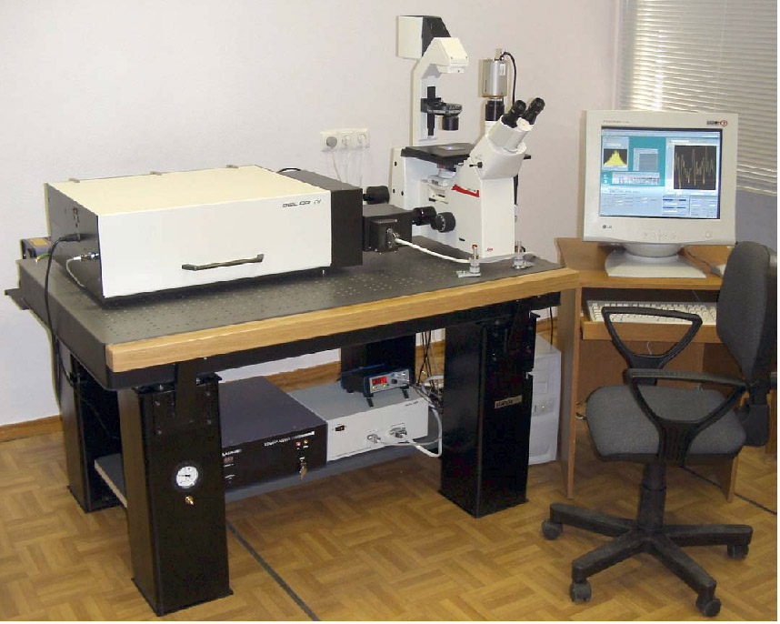
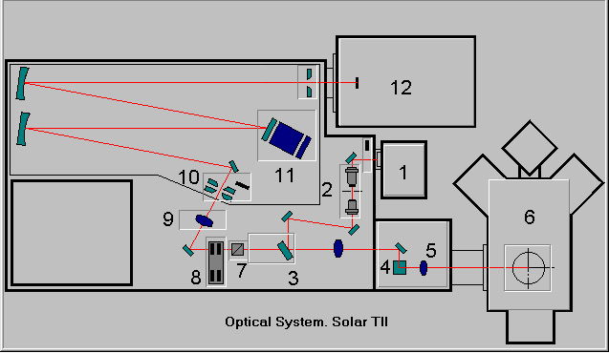
Main view of
SOLAR-TII setup
Basic scheme of
SOLAR-TII setup

Slide 50
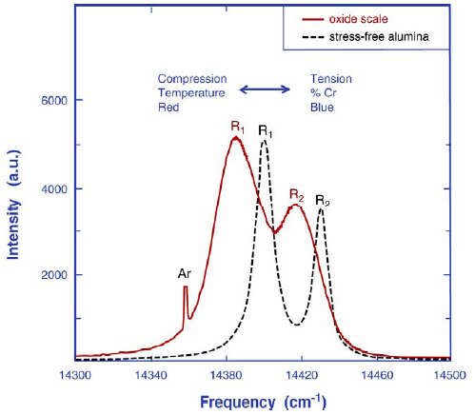
Basis of the piezospectroscopic effect
the applied stress strains the lattice and alters the energy of transitions between electronic states
R-lines shift :
Δν = Π_{ij}×σ_{ij}
Π_{ij} – piezospectroscopic coefficients
For hydrostatic stresses:
σ_{h} (GPa) ≈ Δν₂(cm⁻¹) / 7.61
For nonhydrostatic stresses:
σ11 = (Δν₂ - 2,16σ₃₃) / 5,46
σ22 = σ33 = (Δν₂ - 0,83Δν₁) / 0,88
D. Clarke et. al. Non-Contact Methods of Measuring Stresses in High Temperature Materials

Slide 51
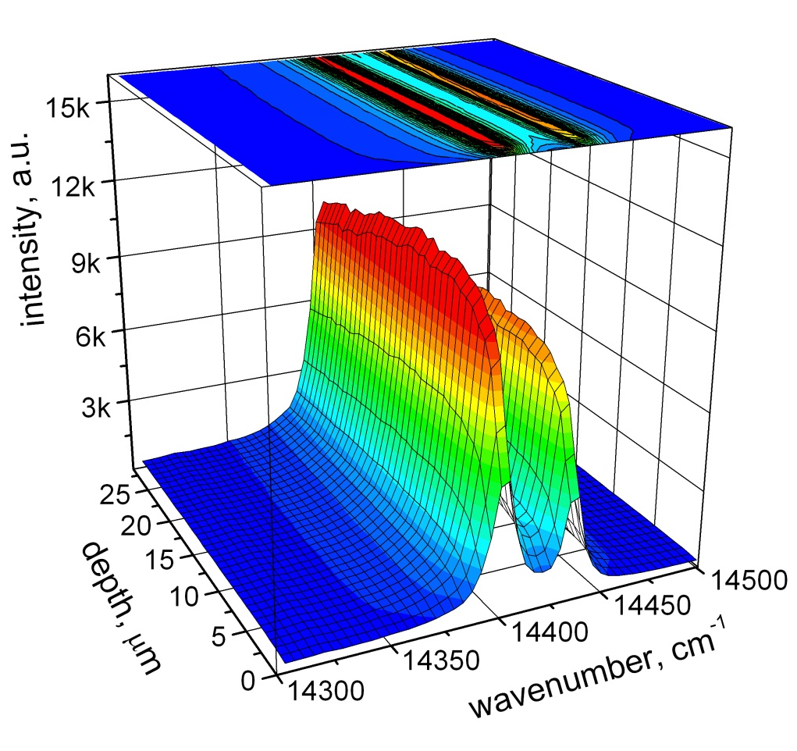
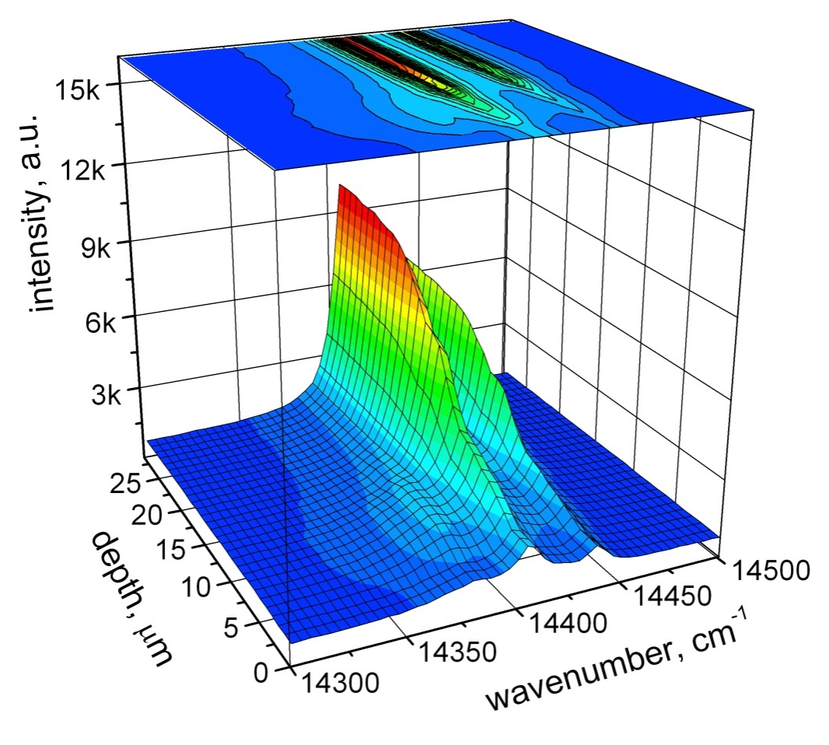
Depth-resolved R-lines spectra on Al₂O₃Cr virgin and irradiated by 250 MeV Kr ions.
Ion flux Φ=1×10¹⁴ cm⁻²
R_{p}=12.2 μm

Slide 52
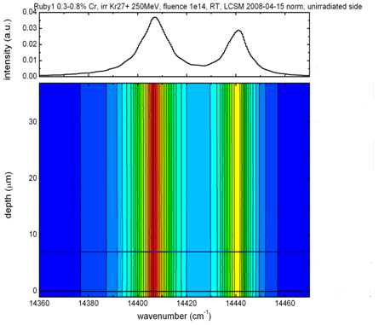
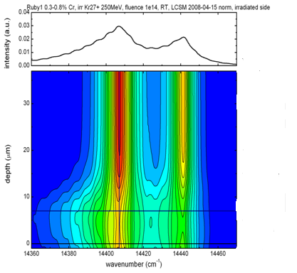
Depth-resolved R-lines spectra on Al₂O₃Cr virgin and irradiated by 250 MeV Kr ions.
Ion flux Φ=1×10¹⁴ cm⁻²
R_{p}=12.2 μm

Slide 53

Depth-resolved R-lines spectra on Al₂O₃Cr irradiated by 250 MeV Kr ions. Ion flux Φ=1×10¹⁴ cm⁻²
R_{p}=12.2 μm

Slide 54
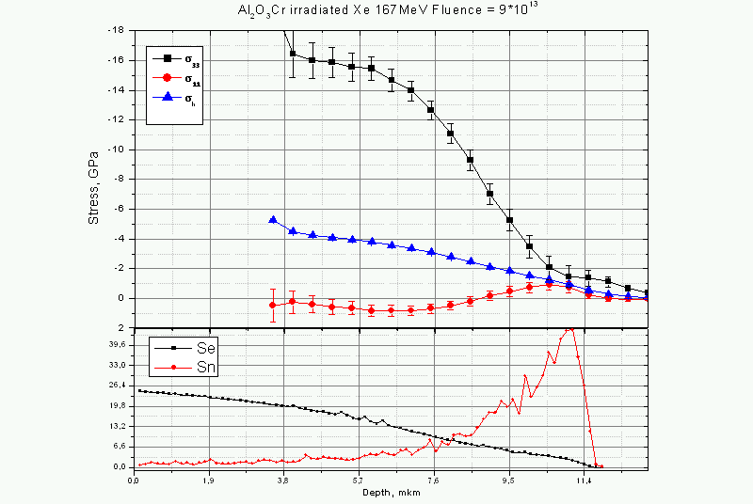
Residual stress depth profiles calculated from R-lines shift

Slide 55
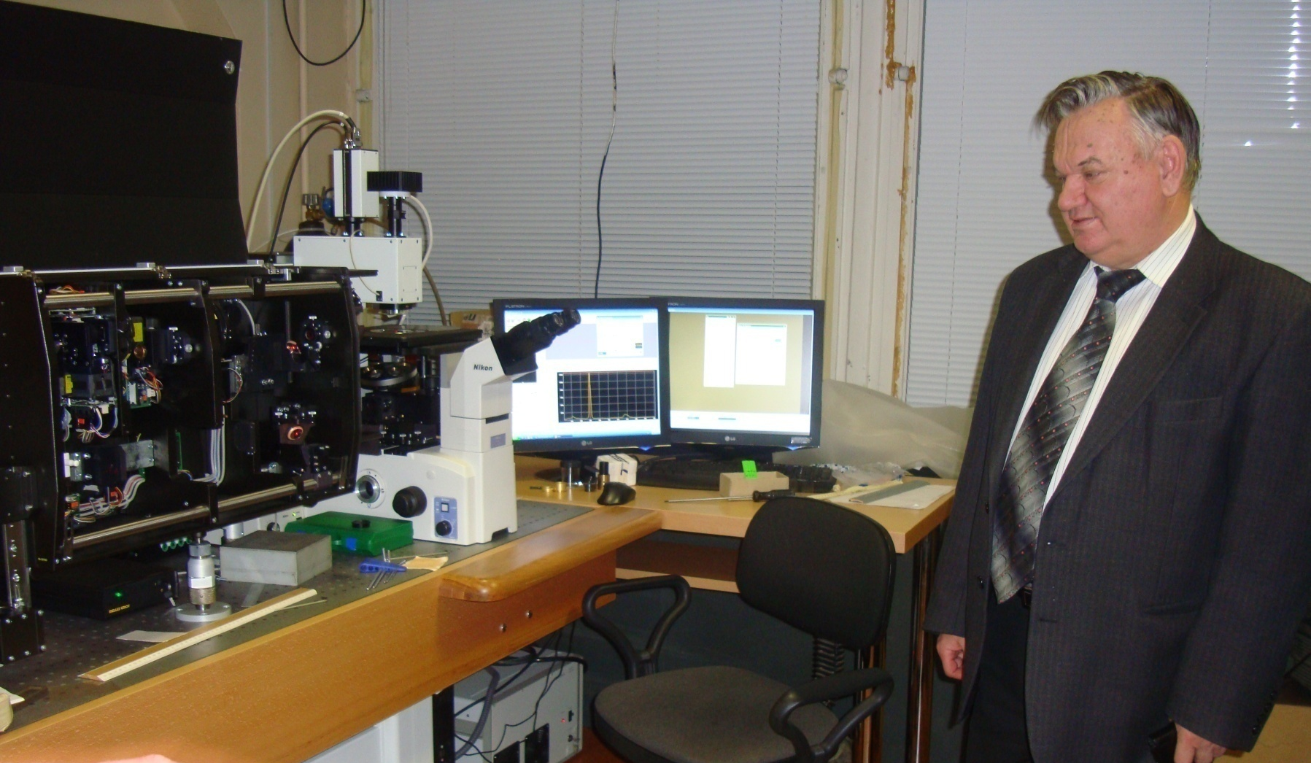
Tests of nonlinear laser microscope (CARS) in Minsk before being sent to the JINR, December 2009

Slide 56
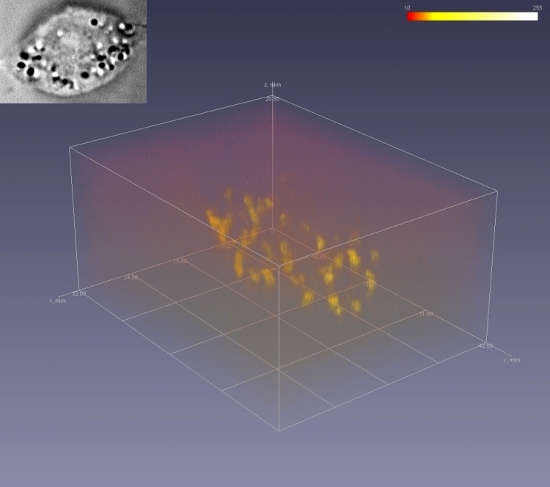
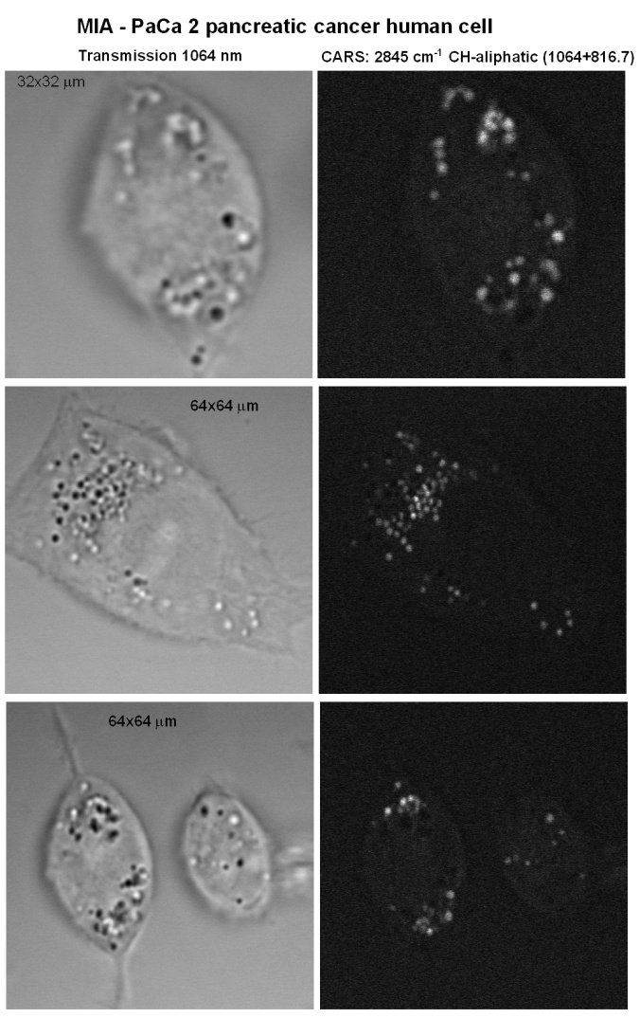
Selective imaging MIA-PaCa pancreatitis human cancer cell to the resonance 2845 cm⁻¹ C-H connection (C-H aliphatic stretch).
Selective visualization of lipids.
The right image corresponds to the 3D image of the cell.
JINR and the University of Buffalo are working together on the development of early diagnosis of cancer using CARS microscopy.

Slide 57
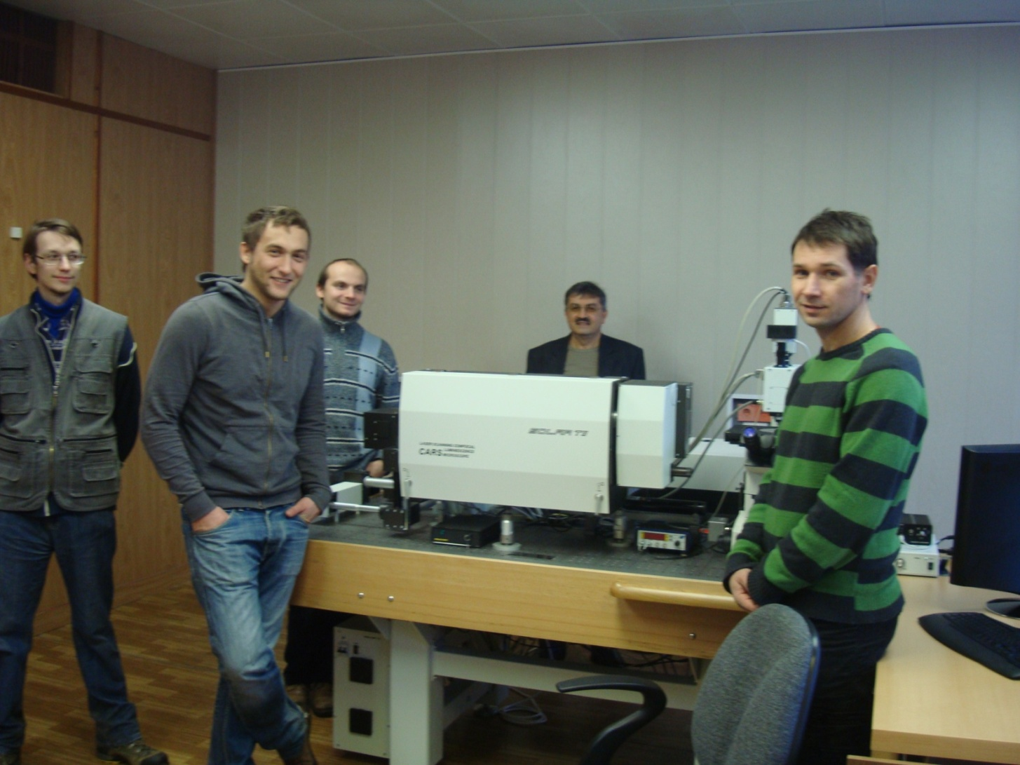
Experiment: the ability to study cellular structures.
CARS microscope launched in December 2010

Slide 58
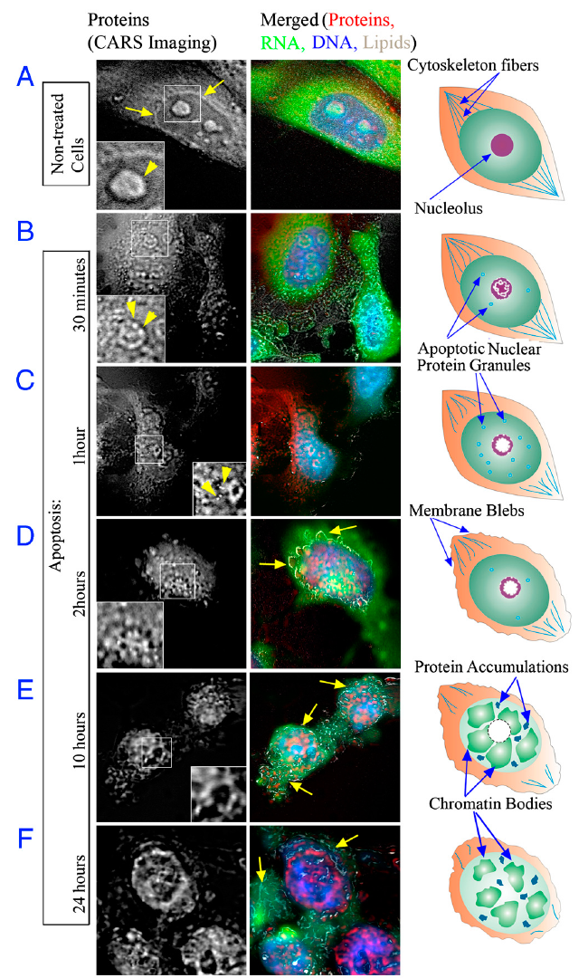
Study of apoptosis in cells with CARS microscope
The distribution of proteins, lipids, DNA, and RNA in dividing and apoptotic HeLa cells visualized by multimodal CARS/TPEF imaging. During the imaging live cells were maintained at the physiological conditions.
Proteins and lipids were observed in the CARS mode at their characteristic vibrations of 2930 cm−1 and 2840 cm−1, respectively. Nucleic acids, stained by acridine orange, were acquired in the red (RNA) and green (DNA) fluorescence channels in TPEF mode. In the right panels, schematics of the macromolecular organization of cells are represented. The CARS signal from proteins is represented in the left panels. The panels in the middle represent merger signals of the proteins (red), RNA (green), DNA (blue), and lipids (gray). The white-outlined areas in the protein channel are enlarged below. (A) Nontreated cells. The signal from proteins is accumulated in the nucleolus (Inset, arrowhead) and the nuclear lamina (arrows). In the
rest of the nuclear volume, the intensity of the protein signal is nearly uni-
form. (B–F) Representative cells at the subsequent stages of the apoptotic
development. (B) 30 minutes following the initiation of apoptosis, the
distribution of proteins is altered in the nucleolus (Inset, arrowheads) and
the novel structure, apoptotic nuclear protein granules (ANPG), emerged
in the nucleoplasm. In the cytoplasm, cytoskeleton fibers begin to lose their
structural polarization. (C) The pattern of proteins becomes increasingly ir-
regular, and ANPG become prominent (Inset, arrowheads). (D) The nucleolar
proteins are forming a complex meshwork (Inset). The apoptotic membrane
blebs are seen (D and E merged panels, arrows), ANPG disintegrate. (E and F)
Proteins abandon the nucleolus and demonstrate a highly irregular distribution in the nucleoplasm; the genomic DNA is condensing to chromatin bodies and partially segregates from the proteins.

Slide 59
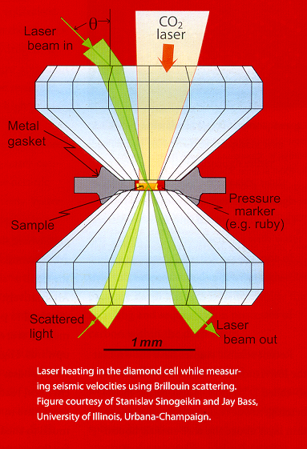
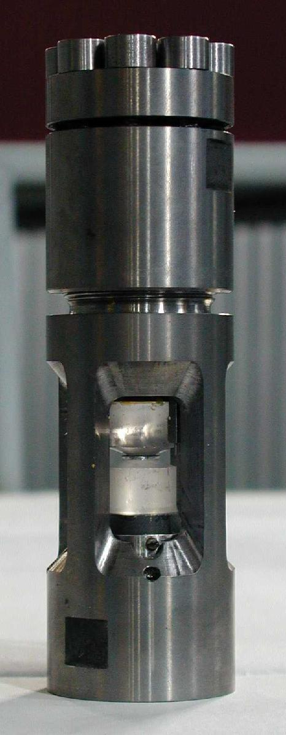


Slide 60
Thanks for your attention

