Slide 1
Conical feature of damage in near surface region of TiO₂ and Al₂O₃ irradiated with swift heavy ions
Maxim Saifulin⁽¹⁾, Jacques O’Connell⁽²⁾, Vladimir Skuratov⁽¹⁾, Arno Janse van Vuuren⁽²⁾
⁽¹⁾ FLNR JINR, Dubna, Russia
⁽²⁾ CHRTEM NMMU, Port Elizabeth, South Africa
Dubna, 2016
1

Slide 2
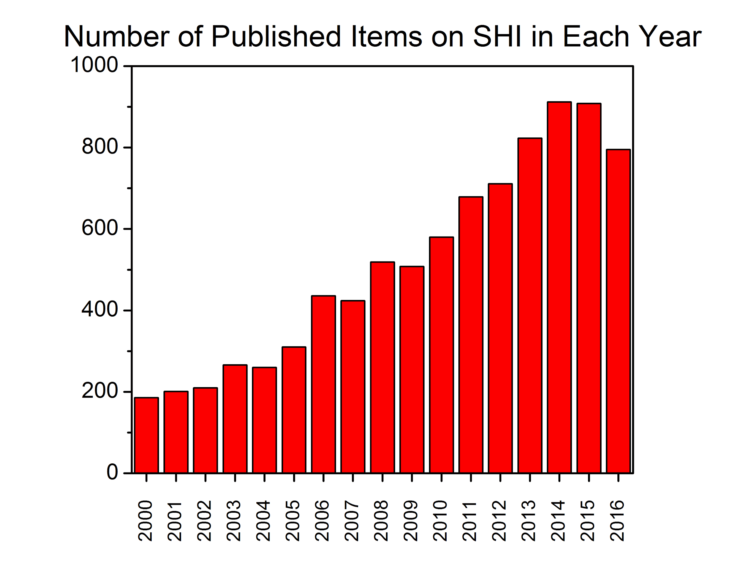
Motivation
Swift heavy ions (SHI): E ≳ 1 MeV/u, A ≳ Li, S_{e} ≫ S_{n}
Nano-patterning of surfaces;
Modification of material properties;
Simulation of radiation effects in materials at extreme states (nuclear power plants, space etc.)
According to Scopus database
2
Notes:
Investigations of the effects induced by swift heavy ions in matter are of great interest nowadays. According to the various databases like Scopus one may see that a number of published items on swift heavy ion induced damage in various solids is growing intensively since the beginning of the 21st century. For the past 16 years the number of papers has increased for about 4 times. Such a great attention probably is paid due to the special way of interaction of these ions with matter. Swift heavy ions represent charged particles with the energy of 1 MeV per nucleon or higher, and mass number starting from lithium ion and higher. Projectiles of such mass and energy lose their energy generally by ionization of surrounding matter, which means that electronic stopping power is much higher than nuclear stopping power. Such property of radiation can be used for various applications, for example nano-patterning of material surfaces, modification of material properties, or simulation of radiation effects in materials at extreme states, such as materials in core of working nuclear power plant or materials and electronics of spacecrafts.

Slide 3
Motivation
What are the processes and mechanisms that convert electronic excitations into structural disorder of the irradiated material?
There is no unified description
of phenomena triggered by SHI
Need to choose a proper method to accurately measure latent track parameters:
Rutherford backscattering/channeling spectroscopy
Small angle x-ray scattering
Transmission electron microscopy
3
Notes:
High values of ionization finally may result in structural changes around the ion path, which are called latent tracks. Additionally to various applications, swift heavy ions raise a fundamental question on “what are the processes and mechanisms that convert electronic excitations into structural disorder of the irradiated material?”. Great number of studies have been done for different metals, semiconductors, and insulators, which allow us to see some patterns to answer that question, but still, there is no unified description of phenomena triggered by swift heavy ions. One needs to choose a proper methods to accurately measure latent track parameters to solve this problem. Among huge variety of methods the most oftenly used are Rutherford backscattering/channeling spectroscopy, small angle x-ray scattering and transmission electron microscopy. Here I would like to emphasize that transmission electron microscopy is the only one method, which allow direct observation of damaged structure. So the privilege should be given to this method, while current situation is such that the most part of the data was collected by indirect methods.

Slide 4
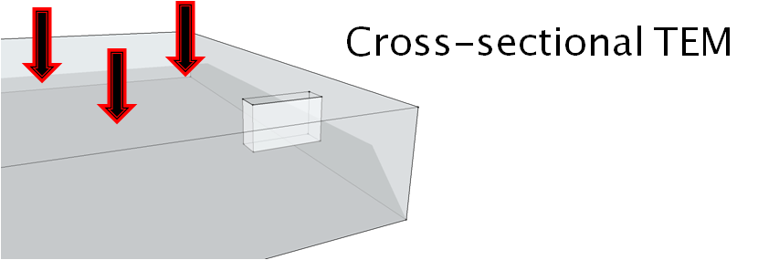
Sample preparation/irradiation
167 MeV Xe ions at IC-100 cyclotron
1 and 2.4 GeV Bi ions at MC-400 cyclotron
700 MeV Bi ions at U-400 cyclotron
Room temperature
Low ion fluence (individual tracks)
JEOL JEM 2100 TEM operated at 200 kV
Focused Ion beam for sample preparation
4
Notes:
In this work we performed transmission electron microscopy studies to investigate the morphology of latent tracks induced by 167 MeV Xe, 700 MeV, 1GeV and 2.4 GeV Bi ions in titanium oxide and aluminum oxide. Since TEM sample should be electron transparent, its thickness should be around 100 nm. Therefore two different types of samples were prepared for this study. The 1st group of samples was thinned to electron transparency by ion milling technique prior to ion irradiation, and the 2nd group of samples was thinned after irradiation. All irradiations were performed at FLNR cyclotron facilities at room temperature and ion fluences around 1E10 - 1E11 ion/cm2 to obtain individual latent tracks. TEM observations were made by JEOL JEM 2100 TEM at 200 kV operating voltage in CHRTEM in South Africa. To observe latent tracks in both cross-sectional and plain view geometries, focused ion beam technique was used for sample preparation.

Slide 5
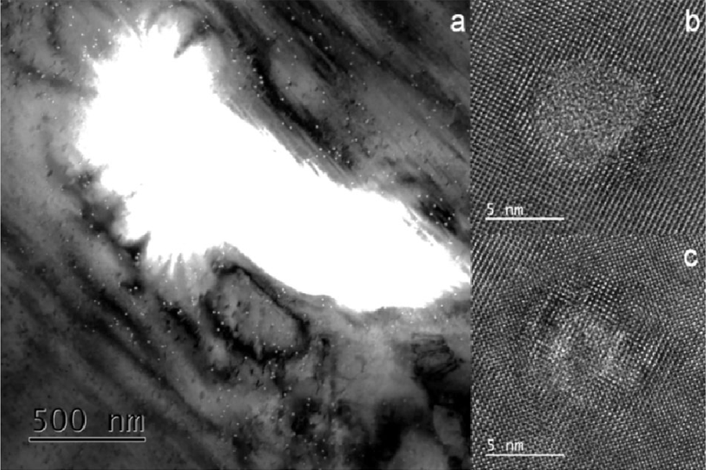
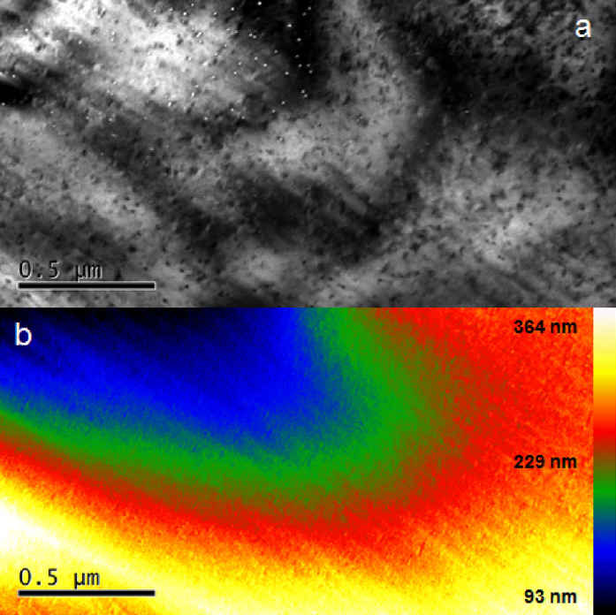
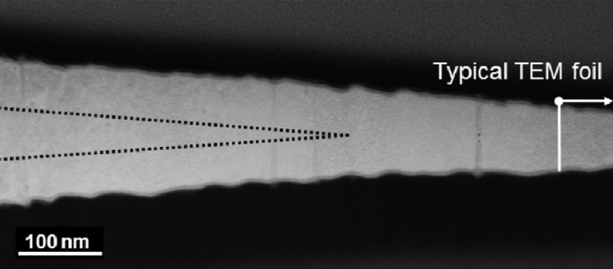
TEM study of TiO₂ (pre-thinned samples, 167 MeV Xe)
a
b
d
c
e
f
~70-80 nm
~100 nm
5
Notes:
The results of bright field TEM study of pre-thinned 167 MeV Xe irradiated TiO2 sample is presented on this slide. On figure (a) plain view image of the irradiated sample is shown. Big white area at the centre is the hole, produced during ion milling. Small white and black dots correspond to latent tracks, where white contrast in bright field image corresponds to amorphous phase, and black contrast corresponds to crystalline phase. It is clearly seen that white dots are concentrated closer to the edge of the hole, where the thickness of the sample is lower, if compared to those regions, where tracks are seen as black dots. On figures b, c high resolution images of white and black spots are presented, showing amorphous track corresponding to white spot, but for the black spot considerable crystallinity remains in the track core in projection through the sample. Figure (a) clearly demonstrates us that there must be some kind of transition from amorphous to crystalline tracks depending on the sample thickness. But it should be noted that for both cases the diameter of the track core is about the same. To detect this transition zone we built a thickness map for a part of the area on figure (a) using the energy filtered TEM on figures (d) and (e). According to this map, the thickness at which transition from amorphous to crystalline track occur is about 150-170 nm inside the green area of the thickness map. On figure (f) the cross-sectional TEM image near the transition zone is presented. From this image one can see that for the small thickness about 100 nm which is typical TEM sample thickness tracks are amorphous and continuous. Increasing the thickness of the sample track becomes discontinuous with conical amorphous parts near the ion enter and exit surfaces, with crystalline region in the middle. It was interesting to discover that conical amorphous part of the track penetrates inside the sample until a specific depth about 70-80 nm below the surfaces.

Slide 6
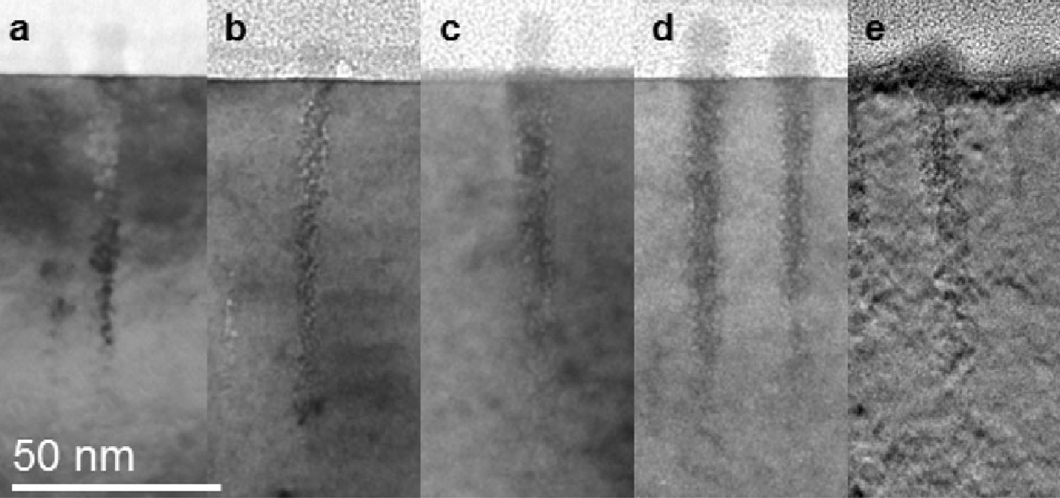
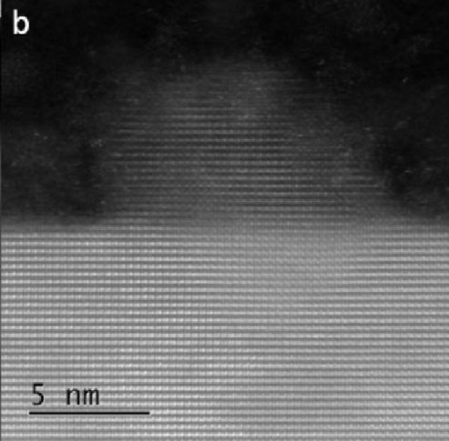
TEM study of TiO₂ (thick samples)
700 MeV Bi, 45°
~70-80 nm
40.1 keV/nm 39.2 keV/nm 34.7 keV/nm 29.9 keV/nm 24.3 keV/nm
1 GeV Bi input
700 MeV Bi
input
700 MeV Bi
output, 10 um
700 MeV Bi
output, 14 um
167 MeV Xe
input
6
Notes:
For the bulk irradiated samples we have found similar behaviour as near the enter and exit surfaces. These conical features also subtend a surface hillock and extend into the bulk of the crystal to a depth of 70–80 nm. On the right side figure (a) illustrates near surface cross-sectional bright field TEM micrograph of a TiO2 crystal irradiated at 45 degree by 700 MeV Bi ions. The conical structures are visible in the near surface region but in this case they are consistently longer than for normally incident irradiation. However, the projected depth below the crystal surface is again 70–80 nm which suggests that the formation of these structures is related to the presence of the nearby free surface. The image (b) shows the hillock to be directed along the ion path supporting the idea that they are produced by material ejected from the conical region which then results in the observed reduced density in these regions. Image (b) allows to see that hillocks are crystalline and epitaxial to original surface. If we turn back to this group of images of cones near enter and exit surfaces, I forgot to mention that for electronic stopping powers from 24.3 to 40.1 keV/nm the depth at which cones stop to form seems independent of stopping power. Also since cones are seen for both enter and exit surfaces and their shape is about the same, it seems that changes of charge state of the projectile from some initial to equilibrium value inside the target material, which may occur near the enter surface is negligible.

Slide 7
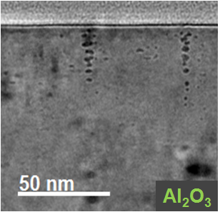
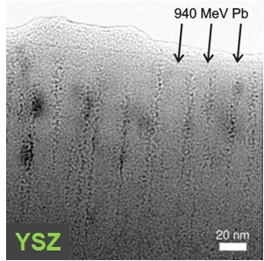
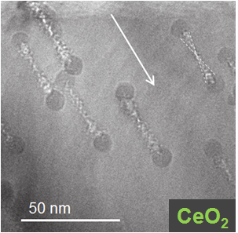
Conical tracks in Al₂O₃ and other oxides
700 MeV Bi
200 MeV Au
7
Notes:
The images on this slide are to demonstrate that titanium oxide seems not the only one material, for which conically shaped damage is observed. We have seen similar, but smaller cones near the surface of aluminum oxide, with smaller hardly observable surface hillocks. Review of the literature showed some evidences of conical features in pre-thinned cerium oxide irradiated with 200 MeV gold ions, where one can see double conical tracks in TEM image of tilted sample. And yttria-stabilized zirconia in the work by Moll and others also exhibits cones near the surface. But to our knowledge we were the first who have paid attention to this feature of damage near the surface.

Slide 8
Why conical tracks? (internal pressure)
pressure
depth
Notes:
The question on why do we see conical features of the tracks near the surface must obviously occur. We suggest that two possible scenarios are responsible for this. The first one is the following.
1) After the ion has passed through the target, a thermal spike occurs around the ion trajectory.
2) Due to the heating of material, it starts to increase its volume encountering the internal pressure from the side of cold bulk material. This pressure must be high at depth and sufficiently lower near the free surface, since it is more free to expand.
3) Deep inside the material the high pressure prevents the material expansion and significant reordering of the atoms therefore the structure in this region is not significantly modified producing highly strained crystalline lattice. But the closer the free surface the lower this internal pressure, because free surface is more free to expand. Hence material phase change is more probable in this region. Part of the material comes out to the surface producing the surface hillock and the rest material is quenched in amorphous tracks with lower density.

Slide 9
Why conical tracks? (additional energy)
Coulomb energy
-
-
-
-
+
+
-
+
+
-
+
+
-
-
-
+
+
-
+
+
-
+
+
-
+
+
-
+
-
+
+
-
+
-
depth
+
+
-
-
+
+
-
-
-
+
+
+
-
Notes:
The second possible reason why do we see conical tracks near the free surface is the presence of some additional source of heat near the surface.
1) As we know after the ion has passed through the target, before the thermal spike has occurred, ionization induced by swift heavy ion produces positively charged track core and electrons surrounding this core.
2) These electrons neutralize the track core in a very short time after the ionization, however near the free surface, a part of electrons may escape from the material surface increasing the charge neutralization time. This may lead to so called Coulomb explosion, when the Coulomb repulsion energy transforms into kinetic energy of target ions. The probability of this mechanism goes down increasing the depth.
3) So after all this processes the energy distribution inside the thermal spike must be higher and broader near the surface, resulting in conical shape of damage near the free surface.

Slide 10
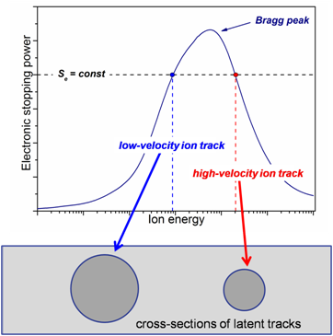
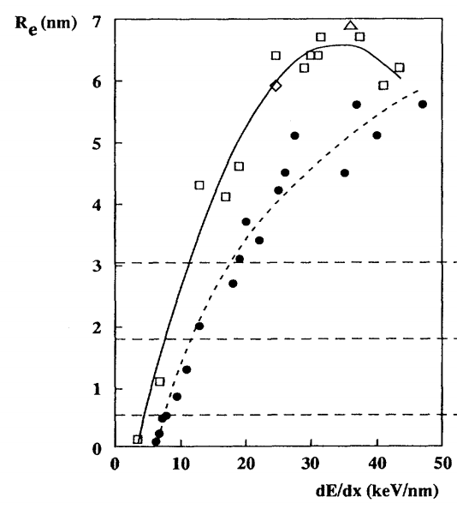
Discussions (velocity effect)
Track evolution curve in YIG
low-velocity
high-velocity
Meftah et al. Phys.Rev.B, 48, (1993), 920
10
Notes:
Since the conical shape of swift heavy ion damage near the surface has never been taken into account before, we came up with the question, what if this feature of near surface damage has some influence on effects previously observed for various materials. Nowadays much attention is paid to so called velocity effect. The first and the most cited paper on this effect is by Meftah and others, where velocity effect has been observed for the first time in yttrium iron garnet. According to this work the size of the latent track at fixed value of electronic stopping power is higher if it is produced by low energy ion and lower if it is induced by high energy ions. The current explanation for this is that the energy distribution of electrons for low energy ions is broader, compared to high energy ions.

Slide 11
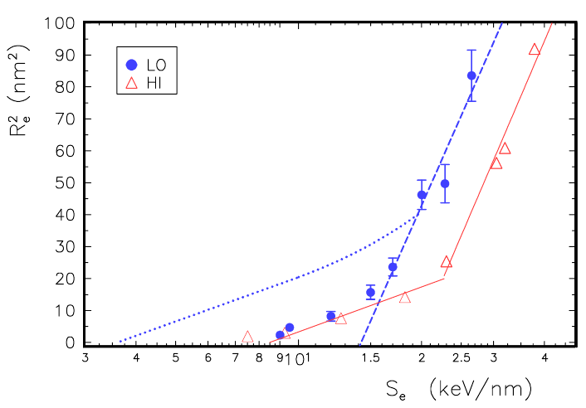
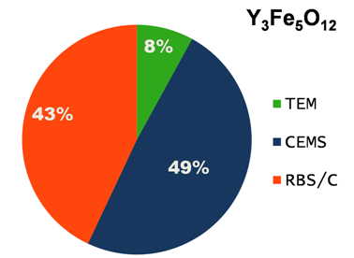
Discussions (velocity effect)
Szenes, Pecz, NIMB, 389-390, (2016), 17
Meftah et al. Phys.Rev.B, 48, (1993), 920
GeS
Zeng et al. NIMB, 330, (2014), 18
VE in HOPG and no VE in graphene
The most part of the data for YIG was collected by indirect methods, assuming cylindrical shape of track!!!
11
Notes:
But some facts may lead us to have some doubts in the validity of velocity effect. If one will take a closer view on the methods, used to measure track sizes in YIG, the most part of the data was collected by indirect methods, which assume that tracks have cylindrical shape. We believe that the presence of conical features in near surface region of YIG could tangle the results. Another work is by Zeng and others, where Raman spectroscopy was used to estimate the value of damage by high and low energy ions, revealing the presence of velocity effect in highly oriented pyrolytic graphite, but no such effect in monolayer graphene. And the recent results by Szenes showed anomalous behaviour for low and high energy track evolution curves obtained by TEM for GeS. VE can be seen only at high values of electronic stopping powers, and disappears for Se values lower than 17 keV/nm. Authors of this work also mention the possible contribution of Coulomb explosion mechanism for observed effect at Se more than 17 keV/nm. Since that it would be interesting for us to study the near surface damage shape dependence on electronic stopping power with more details and to try to find some relations between VE and conicity of latent tracks.

Slide 12
Conclusions
TEM studies have revealed that subsurface region of TiO₂, Al₂O₃, and some other materials is more sensitive to influence of SHI compared to bulk
Conical feature of latent track must be due to presence of free surface
In the most cases indirect methods (such as RBS/c) are used to evaluate track size near the irradiated surface, assuming cylindrical shape of track
Raises question about conical tracks in more complex oxides
MC simulations are planned to reveal the influence of conical tracks on correct evaluation of track sizes measured using RBS/c
12
Notes:
To summarize all this talk I would like to say the following:
1) out TEM studies have revealed that near surface region of TiO2 and Al2O3 is more sensitive to influence of SHI compared to bulk.
2) conical feature of near surface damage must be due to presence of free surface and can be the common feature for some other materials.
3) review of literature shows that indirect methods such as RBS/c are generally used to measure track parameters, so it rises a question on validity of this data.
4) as plans for the future we would like to make some MC simulations in order to reveal the influence of conical tracks on correct evaluation of track sizes.
5) and of cause we are going to continue detailed studies of near surface damage in various materials with their possible influence on velocity effect.

Slide 13
Thank you for attention!

